Slide 1
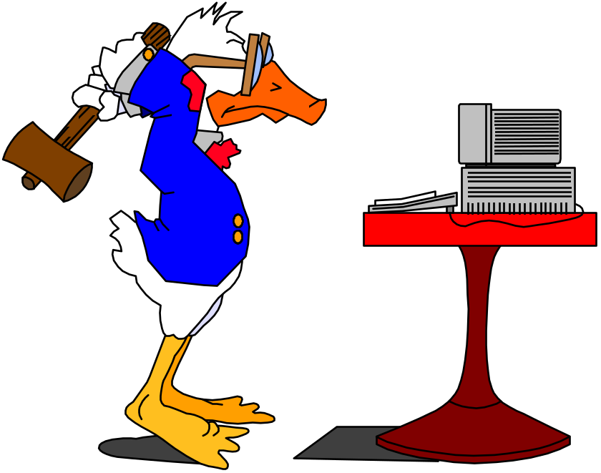
Transaction Management Overview
R & G Chapter 16
There are three side effects of acid. Enhanced long term memory, decreased short term memory, and I forget the third.
- Timothy Leary
Notes:
The slides for this text are organized into several modules. Each lecture contains about enough material for a 1.25 hour class period. (The time estimate is very approximate--it will vary with the instructor, and lectures also differ in length; so use this as a rough guideline.) This covers Lecture 1A in Module (6); it is a 1-lecture overview of the material, and is an alternative to Lectures 1 through 4 in this module, which provide more detailed coverage. Note that the text contains enough material for an even more detailed treatment than Lectures 1 through 4, e.g., view serializability, B-tree CC, non-locking approaches.)
Module (1): Introduction (DBMS, Relational Model)
Module (2): Storage and File Organizations (Disks, Buffering, Indexes)
Module (3): Database Concepts (Relational Queries, DDL/ICs, Views and Security)
Module (4): Relational Implementation (Query Evaluation, Optimization)
Module (5): Database Design (ER Model, Normalization, Physical Design, Tuning)
Module (6): Transaction Processing (Concurrency Control, Recovery)
Module (7): Advanced Topics

Slide 2
Concurrency Control & Recovery
Concurrency Control
  Provide correct and highly available data access in the presence of concurrent access by many users
Recovery
  Ensures database is fault tolerant, and not corrupted by software, system or media failure
  24x7 access to mission critical data
A boon to application authors!
  Existence of CC&R allows applications be be written without explicit concern for concurrency and fault tolerance
Notes:
Allows DMBS to have concurrent execution and recovery from system failure, esp involving mission critical data.
Users to write applications without having to worry about concurrent control and recovery. Increased programmer productivity and allows new applications to be added more easily and safely to existing system.

Slide 3
Roadmap
Overview (Today)
Concurrency Control (1-2 lectures)
Recovery (1-2 lectures)

Slide 4
Structure of a DBMS
Query Optimization
and Execution
Relational Operators
Files and Access Methods
These layers must consider concurrency
control and recovery
(Transaction, Lock, Recovery Managers)
Buffer Management
Disk Space Management
DB

Slide 5
Transactions and Concurrent Execution
Transaction (“xact”)- DBMS’s abstract view of a user program (or activity):
  A sequence of reads and writes of database objects.
  Unit of work that must commit or abort as an atomic unit
Transaction Manager controls the execution of transactions.
User’s program logic is invisible to DBMS!
  Arbitrary computation possible on data fetched from the DB
  The DBMS only sees data read/written from/to the DB.
Challenge: provide atomic transactions to concurrent users!
  Given only the read/write interface.
Notes:
While one transaction is waiting for a page to be read in from disk, CPU can process another transaction. Overlapping I/O and CPU activity reduces the amount of time disk and processors are idle and increases system throughput (useful work completed per unit time)
In serial execution, a short transaction can get stuck behind a long transaction. Interleaving the execution of a short transaction with a long transaction allows the short transaction to complete quickly.
Transaction is defined as any one execution of a user program in a DBMS and differs from an execution outside the DBMS.

Slide 6
Concurrency: Why bother?
The latency argument
The throughput argument
Both are critical!

Slide 7
ACID properties of Transaction Executions
A tomicity: All actions in the Xact happen, or none happen.
C onsistency: If each Xact is consistent, and the DB starts consistent, it ends up consistent.
I solation: Execution of one Xact is isolated from that of other Xacts.
D urability: If a Xact commits, its effects persist.
Notes:
Transaction executions are said to respect the following 4 properties.

Slide 8
Atomicity and Durability
A.C.I.D.
A transaction ends in one of two ways:
  commit after completing all its actions
    “commit” is a contract with the caller of the DB
  abort (or be aborted by the DBMS) after executing some actions.
    Or system crash while the xact is in progress; treat as abort.
Two important properties for a transaction:
  Atomicity : Either execute all its actions, or none of them
  Durability : The effects of a committed xact must survive failures.
DBMS ensures the above by logging all actions:
  Undo the actions of aborted/failed transactions.
  Redo actions of committed transactions not yet propagated to disk when system crashes.
Notes:
1) Users should not have to worry about the effect of incomplete transactions (say when a system crash occurs)

Slide 9
Transaction Consistency
A.C.I.D.
Transactions preserve DB consistency
  Given a consistent DB state, produce another consistent DB state
DB Consistency expressed as a set of declarative Integrity Constraints
  CREATE TABLE/ASSERTION statements
    E.g. Each CS186 student can only register in one project group. Each group must have 2 students.
  Application-level
    E.g. Bank account total of each customer must stay the same during a “transfer” from savings to checking account
Transactions that violate ICs are aborted
  That’s all the DBMS can automatically check!
Notes:
Bank transfer example.

Slide 10
Isolation (Concurrency)
A.C.I.D.
DBMS interleaves actions of many xacts concurrently
  Actions = reads/writes of DB objects
DBMS ensures xacts do not “step onto” one another.
Each xact executes as if it were running by itself.
  Concurrent accesses have no effect on a Transaction’s behavior
  Net effect must be identical to executing all transactions for some serial order.
  Users & programmers think about transactions in isolation
    Without considering effects of other concurrent transactions!
Notes:
Sees only the state of a database that could occur if the transaction were the only one running against the database and produce only the results that it could produce if it were running alone.

Slide 11
Example
Consider two transactions (Xacts):
T1: BEGIN A=A+100, B=B-100 END
T2: BEGIN A=1.06*A, B=1.06*B END
1st xact transfers $100 from B’s account to A’s
2nd credits both accounts with 6% interest.
Assume at first A and B each have $1000. What are the legal outcomes of running T1 and T2?
  T1 ; T2 (A=1166,B=954)
  T2 ; T1 (A=1160,B=960)
  In either case, A+B = $2000 *1.06 = $2120
  There is no guarantee that T1 will execute before T2 or vice-versa, if both are submitted together.
Notes:
Sum of balance of A and B should be the same regardless of whether T1/T2 commits/aborts.

Slide 12
Example (Contd.)
Consider a possible interleaved schedule:
T1: A=A+100, B=B-100
T2: A=1.06*A, B=1.06*B
This is OK (same as T1;T2). But what about:
T1: A=A+100, B=B-100
T2: A=1.06*A, B=1.06*B
Result: A=1166, B=960; A+B = 2126, bank loses $6 !
The DBMS’s view of the second schedule:
T1: R(A), W(A), R(B), W(B)
T2: R(A), W(A), R(B), W(B)
Notes:
T1 followed by T2 …
T2 followed by T1 are both ok. In both cases, A+B is 2120

Slide 13
Scheduling Transactions: Definitions
Serial schedule: no concurrency
  Does not interleave the actions of different transactions.
Equivalent schedules: same result on any DB state
  For any database state, the effect (on the set of objects in the database) of executing the first schedule is identical to the effect of executing the second schedule.
Serializable schedule: equivalent to a serial schedule
  A schedule that is equivalent to some serial execution of the transactions.
(Note: If each transaction preserves consistency, every serializable schedule preserves consistency. )
Notes:
Executing transactions serially in different orders may produce different results, but all are presumed to be acceptable.

Slide 14
Anomalies with Interleaved Execution
Reading Uncommitted Data (WR Conflicts, “dirty reads”):
Unrepeatable Reads (RW Conflicts):
T1: R(A), W(A), R(B), W(B), Abort
T2: R(A), W(A), C
T1: R(A), R(A), W(A), C
T2: R(A), W(A), C

Slide 15
Anomalies (Continued)
Overwriting Uncommitted Data (WW Conflicts):
T1: W(A), W(B), C
T2: W(A), W(B), C

Slide 16
Lock-Based Concurrency Control
A simple mechanism to allow concurrency but avoid the anomalies just described…
Two-phase Locking (2PL) Protocol:
  Always obtain a S (shared) lock on object before reading
  Always obtain an X (exclusive) lock on object before writing.
  If an Xact holds an X lock on an object, no other Xact can get a lock (S or X) on that object.
  DBMS internally enforces the above locking protocol
  Two phases: acquiring locks, and releasing them
    No lock is ever acquired after one has been released
    “Growing phase” followed by “shrinking phase”.
Lock Manager tracks lock requests, grants locks on database objects when they become available.

Slide 17
Strict 2PL
2PL allows only serializable schedules but is subjected to cascading aborts.
Example: rollback of T1 requires rollback of T2!
To avoid Cascading aborts, use Strict 2PL
Strict Two-phase Locking (Strict 2PL) Protocol:
  Same as 2PL, except:
  A transaction releases no locks until it completes
T1: R(A), W(A), Abort
T2: R(A), W(A), R(B), W(B)

Slide 18
Introduction to Crash Recovery
Recovery Manager
  Upon recovery from crash:
    Must bring DB to a consistent transactional state
  Ensures transaction Atomicity and Durability
  Undoes actions of transactions that do not commit
  Redoes lost actions of committed transactions
    lost during system failures or media failures
Recovery Manager maintains log information during normal execution of transactions for use during crash recovery

Slide 19
The Log
Log consists of “records” that are written sequentially.
  Stored on a separate disk from the DB
  Typically chained together by Xact id
  Log is often duplexed and archived on stable storage.
Log stores modifications to the database
  if Ti writes an object, write a log record with:
    If UNDO required need “before image”
    IF REDO required need “after image”.
  Ti commits/aborts: a log record indicating this action.
Need for UNDO/REDO depend on Buffer Mgr (!!)
  UNDO required if uncommitted data can overwrite stable version of committed data (STEAL buffer management).
  REDO required if xact can commit before all its updates are on disk (NO FORCE buffer management).
Notes:
Duplexed: Store at two different disks perhaps at different locations.
Xact id: Log sequence number (LSN). Monotonically increasing number.

Slide 20
Logging Continued
Write Ahead Logging (WAL) protocol
  Log record must go to disk before the changed page!
    implemented via a handshake between log manager and the buffer manager.
  All log records for a transaction (including its commit record) must be written to disk before the transaction is considered “Committed”.
All log related activities are handled transparently by the DBMS.
  As was true of CC-related activities such as lock/unlock, dealing with deadlocks, etc.

Slide 21
ARIES Recovery
There are 3 phases in ARIES recovery protocol:
  Analysis: Scan the log forward (from the most recent checkpoint) to identify all Xacts that were active, and all dirty pages in the buffer pool at the time of the crash.
  Redo: Redoes all updates to dirty pages in the buffer pool, as needed, to ensure that all logged updates are in fact carried out and written to disk.
  Undo: The writes of all Xacts that were active at the crash are undone (by restoring the before value of the update, as found in the log), working backwards in the log.
At the end --- all committed updates and only those updates are reflected in the database.
Some care must be taken to handle the case of a crash occurring during the recovery process!

Slide 22
Summary
Concurrency control and recovery are among the most important functions provided by a DBMS.
Concurrency control (Isolation) is automatic.
  DBMS issues proper Two-Phase Locking (2PL) requests
  Enforces lock discipline (S & X)
  End result promised to be “serializable”: equivalent to some serial schedule
Atomicity and Durability ensured by Write-Ahead Logging (WAL) and recovery protocol
  used to undo the actions of aborted transactions (no subatomic stuff visible after recovery!)
  used to redo the lost actions of committed transactions

