Slide 1

Entity-Relationship Diagrams and the Relational Model
CS 186, Fall 2007, Lecture 2
R & G, Chaps. 2&3
A relationship, I think, is like a shark, you know? It has to constantly move forward or it dies. And I think what we got on our hands is a dead shark.
Woody Allen (from Annie Hall, 1979)

Slide 2
Review
Why use a DBMS? OS provides RAM and disk

Slide 3
Review
Why use a DBMS? OS provides RAM and disk
  Concurrency
  Recovery
  Abstraction, Data Independence
  Query Languages
  Efficiency (for most tasks)
  Security
  Data Integrity

Slide 4
Describing Data: Data Models
Data model : collection of concepts for describing data.
Schema: description of a particular collection of data, using a given data model.
Relational model of data
  Main concept: relation (table), rows and columns
  Every relation has a schema
    describes the columns
    column names and domains
Notes:
5

Slide 5
Some Synonyms
Formal | Not-so-formal 1 | Not-so-formal 2
Relation | Table
Tuple | Row | Record
Attribute | Column | Field
Domain | Type

Slide 6
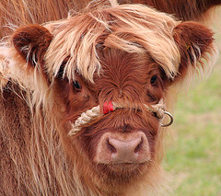


Levels of Abstraction
Users
Views describe how users see the data.
Conceptual schema defines logical structure
Physical schema describes the files and indexes used.
View 1
View 2
View 3
Conceptual Schema
Physical Schema
DB
Notes:
6

Slide 7
Example: University Database
Conceptual schema:
  Students(sid text, name text,
  login text, age integer,
  gpa float)
  Courses(cid text, cname text,
  credits integer)
  Enrolled(sid text, cid text,
  grade text)
Physical schema:
  Relations stored as unordered files.
  Index on first column of Students.
External Schema (View):
  Course_info(cid text,
  enrollment integer)
Notes:
7

Slide 8
Data Independence
Applications insulated from how data is structured and stored.
Logical data independence:
  Protection from changes in logical structure
Physical data independence:
  Protection from changes in physical structure
Q: Why is this particularly important for DBMS?
Because databases and their associated applications persist.

Slide 9
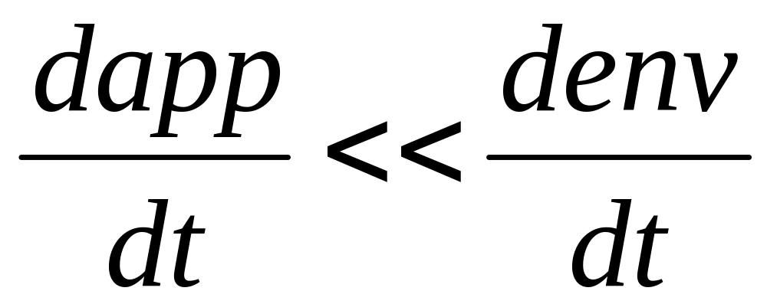
Hellerstein’s Inequality

Slide 10


Data Models
DBMS models real world
Data Model links user’s view of the world and bits stored in computer
Many models exist
We will ground ourselves in the Relational model
  clean and common
But use the Entity-Relationship model as a middle ground for design
Student (sid: string, name: string, login: string, age: integer, gpa:real)
1010111101

Slide 11
Why Study the Relational Model?
Most widely used model.
Other models exist (and co-exist)
  “Legacy systems” in older models
    e.g., IBM’s IMS
  Object-Relational mergers
    Object-Oriented features provided by DBMS
      Not too popular
    Object-Relational Mapping (ORM) outside the DBMS
      A la Rails (Ruby), Django (Python), Hibernate (Java)
XML features in most relational systems
  Can export XML interfaces
  Can provide XML storage/retrieval

Slide 12


An Aside: Ruby on Rails
Ruby
  An object-oriented scripting (?) language
Rails
  An open source web framework
  Active Record
    An Object-Relational Mapping (ORM)
    Very similar to Entity-Relationship modeling
  Migrations
    A methodology for database evolution
  A Model-View-Controller (MVC) design pattern for websites
  Convention over Configuration

Slide 13
Steps in Database Design
Requirements Analysis
  user needs; what must database do?
Conceptual Design
  high level description (often done w/ER model)
  Rails encourages you to program here
Logical Design
  translate ER into DBMS data model
  Rails requires you to help here too
Schema Refinement
  consistency, normalization
Physical Design - indexes, disk layout
Security Design - who accesses what, and how

Slide 14
Conceptual Design
What are the entities and relationships?
What info about E’s & R’s should be in DB?
What integrity constraints (business rules) hold?
ER diagram is the `schema’
Can map an ER diagram into a relational schema.
Conceptual design is where the SW/data engineering begins
  Rails “models”
Notes:
2

Slide 15
ER Model Basics
name
ssn
lot
Employees
Entity:
  A real-world object described by a set of attribute values.
Entity Set: A collection of similar entities.
  E.g., all employees.
  All entities in an entity set have the same attributes.
  Each entity set has a key (underlined)
  Each attribute has a domain
Notes:
3
The slides for this text are organized into several modules. Each lecture contains about enough material for a 1.25 hour class period. (The time estimate is very approximate--it will vary with the instructor, and lectures also differ in length; so use this as a rough guideline.) This covers Lectures 1 and 2 (of 6) in Module (5).
Module (1): Introduction (DBMS, Relational Model)
Module (2): Storage and File Organizations (Disks, Buffering, Indexes)
Module (3): Database Concepts (Relational Queries, DDL/ICs, Views and Security)
Module (4): Relational Implementation (Query Evaluation, Optimization)
Module (5): Database Design (ER Model, Normalization, Physical Design, Tuning)
Module (6): Transaction Processing (Concurrency Control, Recovery)
Module (7): Advanced Topics

Slide 16
ER Model Basics (Contd.)
since
name
dname
ssn
lot
did
budget
Employees
Works_In
Departments
Relationship: Association among two or more entities.
  E.g., Attishoo works in Pharmacy department.
  relationships can have their own attributes.
Relationship Set: Collection of similar relationships.
  An n-ary relationship set R relates n entity sets E₁ ... E_{n} ; each relationship in R involves entities e₁ ∈ E₁, ..., e_{n} ∈ E_{n}
Notes:
4

Slide 17
ER Model Basics (Cont.)
name
ssn
lot
Employees
since
dname
super-visor
subor-dinate
did
budget
Reports_To
Departments
Works_In
    Same entity set can participate in different relationship sets, or in different “roles” in the same relationship set.
Notes:
4

Slide 18
Key Constraints
name
since
dname
ssn
lot
did
budget
Employees
Manages
Departments
An employee can work in many departments; a dept can have many employees.
Works_In
since
In contrast, each dept has at most one manager, according to the key constraint on Manages.
Many-to-Many
1-to-Many
Many-to-1
1-to-1
Notes:
6

Slide 19
Participation Constraints
Does every employee work in a department?
If so: a participation constraint
  participation of Employees in Works_In is total (vs. partial)
  What if every department has an employee working in it?
Basically means “at least one”
since
since
name
name
dname
dname
ssn
did
did
budget
lot
budget
Employees
Manages
Departments
Works_In
since
Notes:
8

Slide 20
Weak Entities
A weak entity can be identified uniquely only by considering the primary key of another (owner) entity.
  Owner entity set and weak entity set must participate in a one-to-many relationship set (one owner, many weak entities).
  Weak entity set must have total participation in this identifying relationship set.
name
ssn
lot
cost
pname
age
Employees
Policy
Dependents
Weak entities have only a “partial key” (dashed underline)
Notes:
10

Slide 21


Slide 22
Binary vs. Ternary Relationships
name
ssn
lot
pname
age
Employees
Covers
Dependents
If each policy is owned by just 1 employee:
Policies
Key constraint on Policies would mean policy can only cover 1 dependent!
policyid
cost
name
pname
age
ssn
lot
Dependents
Employees
Think through all the constraints in the 2nd diagram!
Purchaser
Beneficiary
Better design
Policies
policyid
cost
Notes:
7

Slide 23
Binary vs. Ternary Relationships (Contd.)
Previous example:
  2 binary relationships better than 1 ternary relationship.
An example in the other direction:
  ternary relationship set Contracts relates entity sets Parts, Departments and Suppliers
  relationship set has descriptive attribute qty.
  no combo of binary relationships is a substitute!
    See next slide…
Notes:
9

Slide 24
Binary vs. Ternary Relationships (Contd.)
qty
Parts
Contract
Departments
VS.
Suppliers
Parts
needs
Departments
can-supply
Suppliers
deals-with
  S “can-supply” P, D “needs” P, and D “deals-with” S does not imply that D has agreed to buy P from S.
  How do we record qty?
Notes:
9

Slide 25
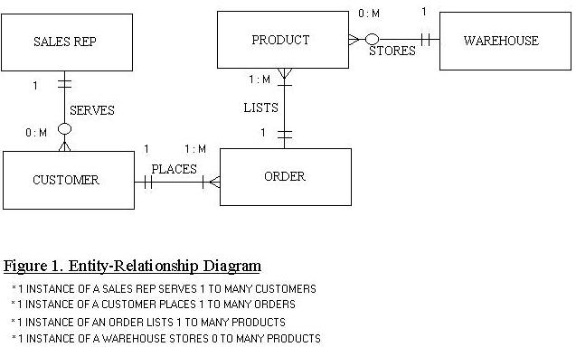
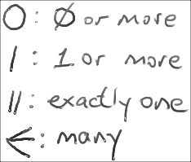
Alternative: Crow’s Foot Notation

Slide 26
Summary so far
Entities and Entity Set (boxes)
Relationships and Relationship sets (diamonds)
  binary
  n-ary
Key constraints (1-1,1-N, M-N, arrows)
Participation constraints (bold for Total)
Weak entities - require strong entity for key

Slide 27
Online Resources
Website
  http://www.cs186berkeley.net/ or
  http://inst.eecs.berkeley.edu/~cs186
Class blog
Class bulletin board
  http://tech.groups.yahoo.com/group/cs186-09/

Slide 28
Administrivia, cont.
Office Hours and Sections on the website
  One more section will be added soon
  Discussion Sections meet next Monday
Syllabus & HW calendar coming on-line
  Schedule and due dates may change (check frequently)
  Lecture notes are/will be posted
Acct forms!
Other textbooks
  Korth/Silberschatz/Sudarshan
  O’Neil and O’Neil
  Garcia-Molina/Ullman/Widom

Slide 29
Relational Database: Definitions
Relational database: a set of relations.
Relation: made up of 2 parts:
  Schema : specifies name of relation, plus name and type of each column.
    E.g. Students(sid: string, name: string, login: string, age: integer, gpa: real)
  Instance : a table, with rows and columns.
    #rows = cardinality
    #fields = arity (or degree)
Can think of a relation as a set of rows or tuples.
  i.e., all rows are distinct

Slide 30
Ex: Instance of Students Relation
sid
name
login
age
gpa
536
6
6
Jones
jones
@c
s
18
3.4
536
8
8
Smith
smith@e
e
cs
18
3.2
536
5
0
Smith
smith
@m
ath
19
3.8
Cardinality = 3, arity = 5 , all rows distinct
Do all values in each column of a relation instance
have to be distinct?

Slide 31
SQL - A language for Relational DBs
SQL (a.k.a. “Sequel”), standard language
Data Definition Language (DDL)
  create, modify, delete relations
  specify constraints
  administer users, security, etc.
Data Manipulation Language (DML)
  Specify queries to find tuples that satisfy criteria
  add, modify, remove tuples

Slide 32
SQL Overview
CREATE TABLE <name> ( <field> <domain>, … )
INSERT INTO <name> (<field names>)
VALUES (<field values>)
DELETE FROM <name>
WHERE <condition>
UPDATE <name>
SET <field name> = <value>
WHERE <condition>
SELECT <fields>
FROM <name>
WHERE <condition>

Slide 33
Creating Relations in SQL
Creates the Students relation.
  Note: the type (domain) of each field is specified, and enforced by the DBMS whenever tuples are added or modified.
CREATE TABLE Students
(sid CHAR(20),
name CHAR(20),
login CHAR(10),
age INTEGER,
gpa FLOAT)

Slide 34
Table Creation (continued)
Another example: the Enrolled table holds information about courses students take.
CREATE TABLE Enrolled
(sid CHAR(20),
cid CHAR(20),
grade CHAR(2))

Slide 35
Adding and Deleting Tuples
Can insert a single tuple using:
INSERT INTO Students (sid, name, login, age, gpa)
VALUES ('53688', 'Smith', 'smith@ee', 18, 3.2)
Can delete all tuples satisfying some condition (e.g., name = Smith):
DELETE
FROM Students S
WHERE S.name = 'Smith'
Powerful variants of these commands are available;
more later!

Slide 36
Keys
Keys are a way to associate tuples in different relations
Keys are one form of integrity constraint (IC)
Enrolled
Students
sid
cid
grade
53666
Carnatic101
C
sid
name
login
age
gpa
53666
Reggae203
B
53666
Jones
jones@cs
18
3.4
53650
Topology112
A
53688
Smith
smith@eecs
18
3.2
53666
History105
B
53650
Smith
smith@math
19
3.8
FOREIGN Key
PRIMARY Key

Slide 37
Primary Keys
A set of fields is a superkey if:
  No two distinct tuples can have same values in all key fields
A set of fields is a key for a relation if :
  It is a superkey
  No subset of the fields is a superkey
what if >1 key for a relation?
  One of the keys is chosen (by DBA) to be the primary key. Other keys are called candidate keys.
E.g.
  sid is a key for Students.
  What about name?
  The set {sid, gpa} is a superkey.

Slide 38
Primary and Candidate Keys in SQL
Possibly many candidate keys (specified using UNIQUE), one of which is chosen as the primary key.
Keys must be used carefully!
“For a given student and course, there is a single grade.”
CREATE TABLE Enrolled
(sid CHAR(20)
cid CHAR(20),
grade CHAR(2),
PRIMARY KEY (sid,cid))
CREATE TABLE Enrolled
(sid CHAR(20),
cid CHAR(20),
grade CHAR(2),
PRIMARY KEY (sid),
UNIQUE (cid, grade))
vs.
“Students can take only one course, and no two students in a course receive the same grade.”

Slide 39
Foreign Keys, Referential Integrity
Foreign key: Set of fields in one relation that is used to `refer’ to a tuple in another relation.
  Must correspond to the primary key of the other relation.
  Like a `logical pointer’.
If all foreign key constraints are enforced, referential integrity is achieved (i.e., no dangling references.)

Slide 40
Foreign Keys in SQL
E.g. Only students listed in the Students relation should be allowed to enroll for courses.
  sid is a foreign key referring to Students:
CREATE TABLE Enrolled
(sid CHAR(20),cid CHAR(20),grade CHAR(2),
PRIMARY KEY (sid,cid),
FOREIGN KEY (sid) REFERENCES Students )
Enrolled
Students
sid
cid
grade
sid
name
login
age
gpa
53666
Carnatic101
C
53666
Jones
jones@cs
18
3.4
53666
Reggae203
B
53650
Topology112
A
53688
Smith
smith@eecs
18
3.2
53666
History105
B
53650
Smith
smith@math
19
3.8
11111 English102 A

Slide 41
Enforcing Referential Integrity
sid in Enrolled: foreign key referencing Students.
Scenarios:
  Insert Enrolled tuple with non-existent student id?
  Delete a Students tuple?
    Also delete Enrolled tuples that refer to it? (Cascade)
    Disallow if referred to? (No Action)
    Set sid in referring Enrolled tuples to a default value? (Set Default)
    Set sid in referring Enrolled tuples to null, denoting `unknown’ or `inapplicable’. (Set NULL)
Similar issues arise if primary key of Students tuple is updated.

Slide 42
Integrity Constraints (ICs)
IC: condition that must be true for any instance of the database
  e.g., domain constraints.
  ICs are specified when schema is defined.
  ICs are checked when relations are modified.
A legal instance of a relation is one that satisfies all specified ICs.
  DBMS should not allow illegal instances.
If the DBMS checks ICs, stored data is more faithful to real-world meaning.
  Avoids data entry errors, too!

Slide 43
Where do ICs Come From?
Semantics of the real world!
Note:
  We can check IC violation in a DB instance
  We can NEVER infer that an IC is true by looking at an instance.
    An IC is a statement about all possible instances!
  From example, we know name is not a key, but the assertion that sid is a key is given to us.
Key and foreign key ICs are the most common
More general ICs supported too.

Slide 44
Relational Query Languages
Feature: Simple, powerful ad hoc querying
Declarative languages
  Queries precisely specify what to return
  DBMS is responsible for efficient evaluation (how).
  Allows the optimizer to extensively re-order operations, and still ensure that the answer does not change.
    Key to data independence!

Slide 45
The SQL Query Language
The most widely used relational query language.
  Current std is SQL:2008; SQL92 is a basic subset
To find all 18 year old students, we can write:
SELECT *
FROM Students S
WHERE S.age=18
sid
name
login
age
gpa
53666
Jones
jones@cs
18
3.4
53688
Smith
smith@ee
18
3.2
53650
Smith
smith@math
19
3.8
To find just names and logins, replace the first line:
SELECT S.name, S.login

Slide 46
Querying Multiple Relations
What does the following query compute?
SELECT S.name, E.cid
FROM Students S, Enrolled E
WHERE S.sid=E.sid AND E.grade='A'
Given the following instance of Enrolled
sid
cid
grade
53831
Carnatic101
C
53831
Reggae203
B
53650
Topology112
A
53666
History105
B
we get:
S.name
E.cid
Smith
Topology112

Slide 47
Semantics of a Query
A conceptual evaluation method for the previous query:
  1. do FROM clause: compute cross-product of Students and Enrolled
  2. do WHERE clause: Check conditions, discard tuples that fail
  3. do SELECT clause: Delete unwanted fields
Remember, this is conceptual. Actual evaluation will be much more efficient, but must produce the same answers.

Slide 48
Cross-product of Students and Enrolled Instances
S.sid
S.name
S.login
S.age
S.gpa
E.sid
E.cid
E.grade
53666
Jones
jones@cs
18
3.4
53831
Carnatic101
C
53666
Jones
jones@cs
18
3.4
53832
Reggae203
B
53666
Jones
jones@cs
18
3.4
53650
Topology112
A
53666
Jones
jones@cs
18
3.4
53666
History105
B
53688
Sm
ith
smith@ee
18
3.2
53831
Carnatic101
C
53688
Smith
smith@ee
18
3.2
53831
Reggae203
B
53688
Smith
smith@ee
18
3.2
53650
Topology112
A
53688
Smith
smith@ee
18
3.2
53666
History105
B
53650
Smith
smith@math
19
3.8
53831
Carnatic101
C
53650
Smith
smith@ma
th
19
3.8
53831
Reggae203
B
53650
Smith
smith@math
19
3.8
53650
Topology112
A
53650
Smith
smith@math
19
3.8
53666
History105
B

Slide 49
Relational Model: Summary
A tabular representation of data.
Simple and intuitive, currently the most widely used
  Object-relational features in most products
  XML support added in SQL:2003, most systems
Integrity constraints can be specified by the DBA, based on application semantics. DBMS checks for violations.
  Two important ICs: primary and foreign keys
  In addition, we always have domain constraints.
Powerful query languages exist.
  SQL is the standard commercial one
    DDL - Data Definition Language
    DML - Data Manipulation Language

