Slide 1
Elementary IR: Scalable Boolean Text Search
(Compare with R & G 27.1-3)

Slide 2
Information Retrieval: History
A research field traditionally separate from Databases
  Hans P. Luhn, IBM, 1959: “Keyword in Context (KWIC)”
  G. Salton at Cornell in the 60’s/70’s: SMART
    Around the same time as relational DB revolution
  Tons of research since then
    Especially in the web era
Products traditionally separate
  Originally, document management systems
    Libraries, government, law, etc.
  Renaissance due to web search and advertising
    Still a small market in “Enterprise search”

Slide 3
Today: Simple (naïve!) IR
Boolean Search on keywords
Goal: course checkpoint
  You’re ready to build something useful!
Postponing:
  Intelligent result ranking (hopefully later!)
  Parallelism
    Critical for modern relational DBs too
We’ll skip:
  Text-oriented index compression
  Various bells and whistles (lots of little ones!)
    Engineering the specifics of (written) human language
      E.g. dealing with tense and plurals
      E.g. identifying synonyms and related words
      E.g. disambiguating multiple meanings of a word
      E.g. clustering output

Slide 4
IR vs. DBMS
Seem like very different beasts
Under the hood, not as different as they might seem
  In practice, no product does both well (yet)
IR engines more “custom” than most DBMSs
IR | DBMS
Imprecise Semantics | Precise Semantics
Keyword search | SQL
Unstructured data format | Structured data
Read-Mostly. Add docs occasionally | Expect reasonable number of updates
Page through top k results | Generate full answer

Slide 5
IR’s “Bag of Words” Model
Typical IR data model:
  Each document is just a bag of words (“terms”)
Detail 1: “Stop Words”
  Certain words are not helpful, so not placed in the bag
  e.g. real words like “the”
  e.g. HTML tags like <H1>
Detail 2: “Stemming”
  Using language-specific rules, convert words to basic form
  e.g. “surfing”, “surfed” --> “surf”
  Unfortunately have to do this for each language
    Yuck!
  Lots of open source libraries for this

Slide 6
Boolean Text Search
Find all docs matching a Boolean expression:
  “Windows”
  AND (“Glass” OR “Door”)
  AND NOT “Microsoft”
Note: query terms are stemmed/stopped
When web search engines say “10,000,000 documents found”, that’s the Boolean search result size
  More or less ;-)

Slide 7
Text “Indexes”
When IR folks say “text index”…
  usually mean more than what DB people mean
In our terms, both “tables” and indexes
  Really a logical schema (i.e. tables)
  With a physical schema (i.e. indexes)
  Usually not stored in a DBMS
    Tables implemented as files in a file system

Slide 8
A Simple Relational Text Index
Given: a corpus of text files
  Files(docID string, content string)
Create and populate a “bag of words” table
  InvertedFile(term string, docID string)
Build a B+-tree index on InvertedFile.term
  Something like “Alternative 3” critical here!!
    Keep lists of dup keys sorted by docID
      Will provide “interesting orders” later on!
    Fancy list compression on the docIDs is important, too
    Typically called a postings list by IR people
  Note: URL instead of RID, the web is your “heap file”!
    Can also cache pages and use RIDs
This is often called an “inverted file” or “inverted index”
  Maps from words -> docs, rather than docs -> words
Given this, you can now do single-word text search queries!

Slide 9
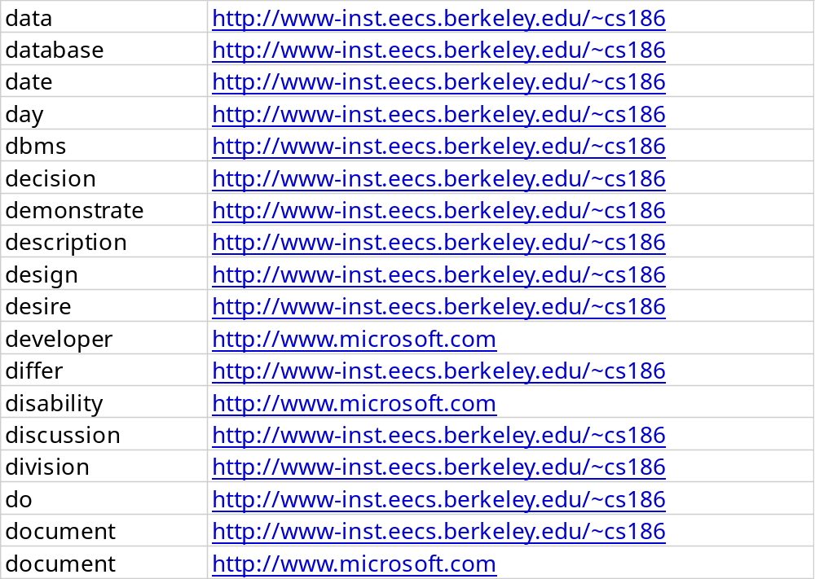
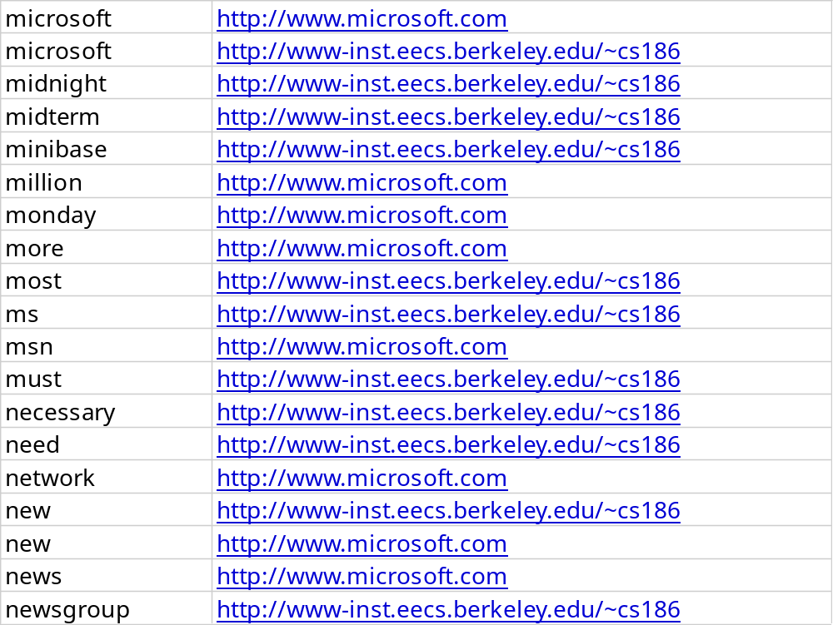
An Inverted File
Term | docID
Snippets from:
  Old class web page
  Old microsoft.com home page
Search for
  databases
  microsoft

Slide 10
Handling Boolean Logic
“term1” OR “term2”:
  Union of two postings lists (docID sets)!
“term1” AND “term2”:
  Intersection of two postings lists!
    Can be done via merge of postings lists
    Remember: postings list per key sorted by docID in index
“term1” AND NOT “term2”:
  Set subtraction
    Also easy because sorted (basically merge logic again)
“term1” OR NOT “term2”:
  Union of “term1” with “NOT term2”.
    “Not term2” = all docs not containing term2. Yuck!
  Usually not allowed!
Optimizations: What order to handle terms if you have many ANDs? Can you do better than merge? How does this interact with postings list compression?

Slide 11
Boolean Search in SQL
“Windows” AND (“Glass” OR “Door”)
AND NOT “Microsoft”
(SELECT docID FROM InvertedFile
WHERE word = “window”
INTERSECT
SELECT docID FROM InvertedFile
WHERE word = “glass” OR word = “door”)
EXCEPT
SELECT docID FROM InvertedFile
WHERE word=“Microsoft”
ORDER BY magic_rank()
There’s only one SQL query (template) in Boolean Search
  Single-table selects, UNION, INTERSECT, EXCEPT
  Customize everything for this!
    What tricks have you seen already?
magic_rank() is the “secret sauce” in the search engines
  We’ll study this later in the semester
  Combos of statistics, linguistics, and graph theory tricks!

Slide 12
A bit fancier: Phrases and “Near”
Suppose you want a phrase
  E.g. “Happy Days”
Augment the schema:
  InvertedFile (term string, docID string, position int)
  Index on term, Alternative 3 style
  Postings lists sorted by (docID, position)
Post-process the results
  Find “Happy” AND “Days”
  Keep results where positions are 1 off
    Can be done during the merging of the 2 lists during AND!
Can do a similar thing for “term1” NEAR “term2”
  Position < k off
  Think about the refinement to merge…

Slide 13
Getting the document content?
  InvertedFile (term string, position int, docID int)
    IDs smaller, compress better than URLS
  Files(docID int, URL string, snippet string, …)
  Btree on InvertedFile.term
  Btree on Files.docID
  Requires a final “join” step between typical query result and Files.docID
    Do this lazily: one results page at a time!

Slide 14
Updates and Text Search
Text search engines are designed to be query-mostly
  Deletes and modifications are rare
  Can postpone updates (nobody notices, no transactions!)
    Can work off a union of indexes
    Merge them in batch (typically re-bulk-load a new index)
  Can’t afford to go offline for an update?
    Create a 2nd index on a separate machine
    Replace the 1st index with the 2nd!
  So no concurrency control problems
  Can compress to search-friendly, update-unfriendly format
  Can keep postings lists sorted
See why text search engines and DBMSs are separate?
  Also, text-search engines tune that one SQL query to death!
  The benefits of a special-case workload.

Slide 15
Lots more tricks in IR
How to “rank” the output?
  Simple text tricks works well (we’ll learn the main one: TFxIDF)
  Hyperlink graph helps on the web (we’ll learn PageRank)
Other ways to help users paw through the output?
  Document “clustering” (e.g. Clusty.com)
  Document visualization
How to use compression for better I/O performance?
  E.g. making postings lists smaller
  Try to make things fit in RAM
    Or in processor caches
How to deal with synonyms, misspelling, abbreviations?
How to write a good web crawler?
We’ll return to some of these later
  Introduction to Information Retrieval (Manning/Raghavan/Schutze)
  Managing Gigabytes (Witten/Moffat/Bell)

Slide 16
Recall From the First Lecture
Query Optimization
and Execution
Search String Modifier
Ranking Algorithm
Relational Operators
“The Query”
}
{
Simple
DBMS
Files and Access Methods
The Access Method
OS
Buffer Management
Buffer Management
Disk Space Management
Disk Space Management
Concurrency
and
Recovery
Needed
DB
DB
DBMS
Search Engine

Slide 17
You Know The Basics!
“Inverted files” are the workhorses of all text search engines
  Just B+-tree or Hash indexes on bag-of-words
Intersect, Union and Set Difference (Except)
  Usually implemented via pre-sorting and merge
  Or can be done with hash or index joins
Most of the other stuff is not “systems” work
  A lot of it is cleverness in dealing with language
  Both linguistics and statistics (more the latter!)

Slide 18
Revisiting Our IR/DBMS Distinctions
Semantic Guarantees on Storage
  DBMS guarantees transactional semantics
    If an inserting transaction commits, a subsequent query will see the update
    Handles multiple concurrent updates correctly
  IR systems do not do this; nobody notices!
    Postpone insertions until convenient
    No model of correct concurrency.
    Can even return incorrect answers for various reasons!
Data Modeling & Query Complexity
  DBMS supports any schema & queries
    But requires you to define schema (?)
    And SQL is hard to figure out for the average citizen
  IR supports only one schema & query
    No schema design required (unstructured text)
    Trivial (natural?) query language for simple tasks
    No data correlation or analysis capabilities -- “search” only

Slide 19
Revisiting Distinctions, Cont.
Performance goals
  DBMS supports general SELECT
    plus mix of INSERT, UPDATE, DELETE
    general purpose engine must always perform “well”
  IR systems expect only one stylized SELECT
    plus delayed INSERT, unusual DELETE, no UPDATE.
    special purpose, must run super-fast on “The Query”
    users rarely look at the full answer in Boolean Search
      Postpone any work you can to subsequent index joins
      But make sure you can rank!

Slide 20
Summary
IR & Relational systems share basic building blocks for scalability
  IR internal representation is relational!
  Equality indexes (B-trees)
  Dataflow (iterators) and parallel dataflow
  “Join” algorithms, esp. merge-join
  “Join” ordering and selectivity estimation
IR constrains queries, schema, promises on semantics
  Affects storage format, indexing and concurrency control
  Affects join algorithms & selectivity estimation
IR has different performance goals
  Ranking and best answers fast
Many challenges in IR related to “text engineering”
  But don’t tend to change the scalability infrastructure

Slide 21
IR Buzzwords to Know (so far!)
Learning this in the context of relational foundations is fine, but you need to know the IR lingo!
  Corpus: a collection of documents
  Term: an isolated string (searchable unit)
  Index: a mechanism mapping terms to documents
  Inverted File (= Postings File): a file containing terms and associated postings lists
  Postings List: a list of pointers (“postings”) to documents

Slide 22
Exercise for the Curious!
Implement Boolean search as described in Postgres
  Using the schemas and indexes here.
    Write a simple script to load files.
    You can do stemming and stop-words with a package from the net
  Run the SQL versions of Boolean queries
    Measure how slow search is
  Identify contributing factors in performance
    E.g. how much disk space does this version use (including indexes) vs. the raw documents vs. the documents gzip’ed
    E.g. is PG identifying the “interesting orders” in the postings lists? (use EXPLAIN) If not, can you force it to do so?
Compare to Postgres’ tsearch2 facility
  Two indexes choices, GIN and GiST. GIN is an inverted index.
  Use the cost models for IndexScan and MergeJoin to calculate the expected number of IOs. Distinguish sequential and random IO’s.
  Why is the naïve solution slow? Storage overhead? Optimizer smarts?

