Slide 1




Slide 2

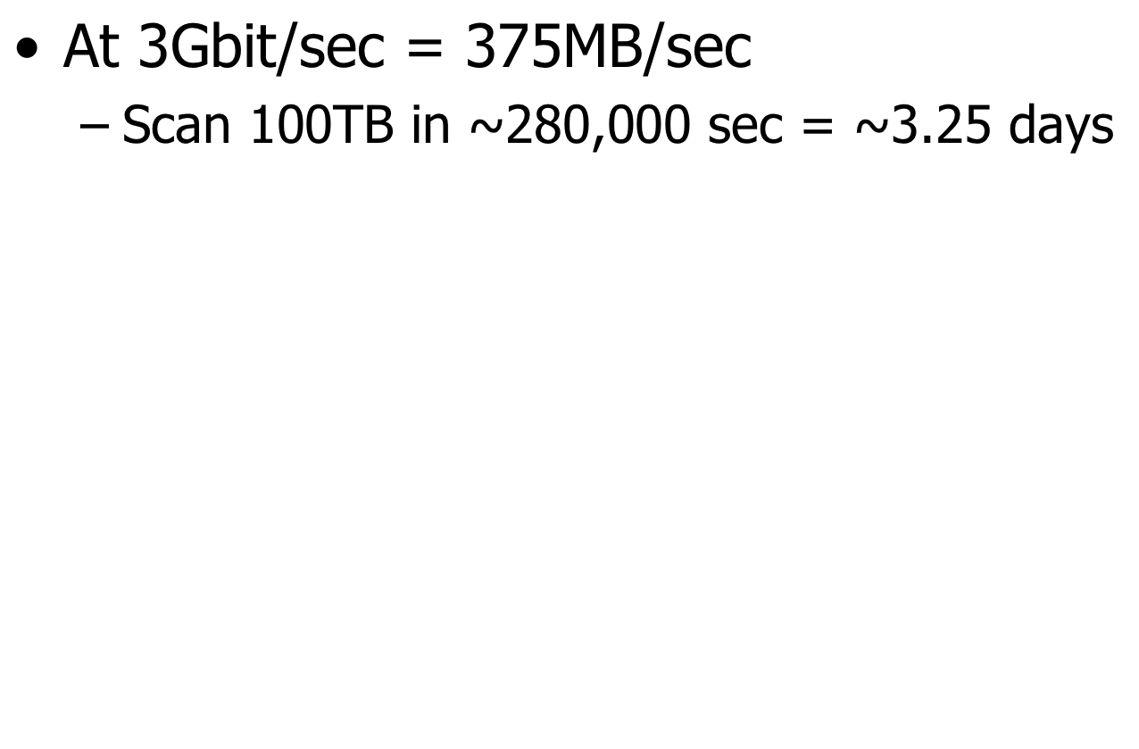

Slide 3
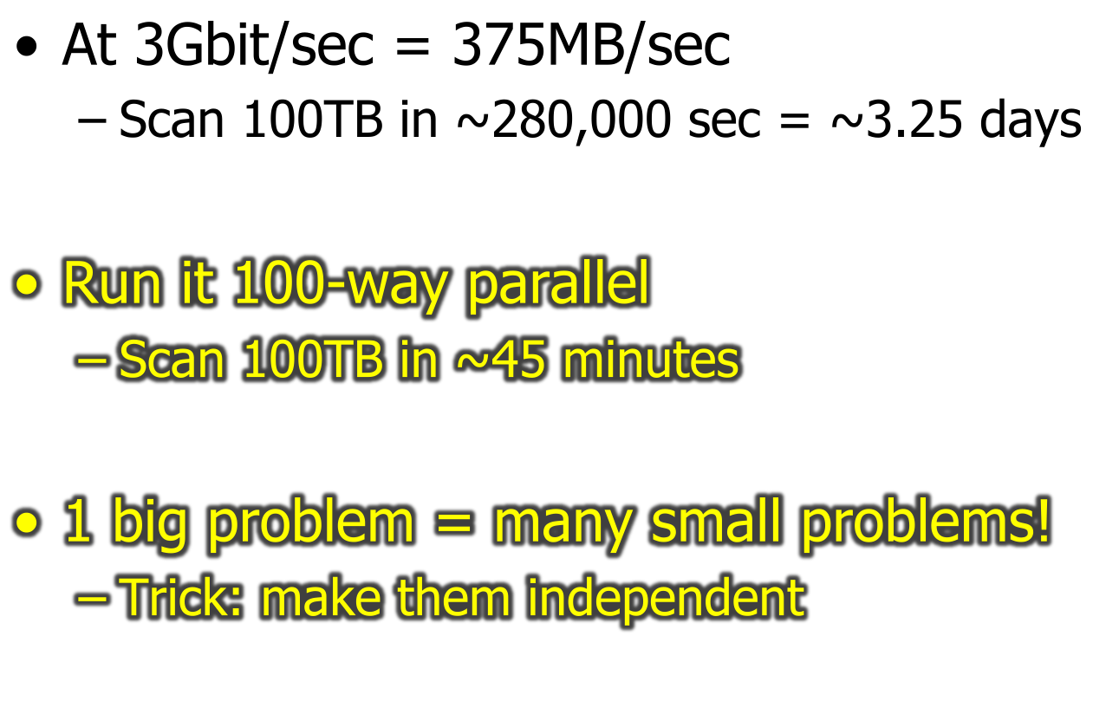

Slide 4
A little history
Relational revolution
  declarative set-oriented primitives
  1970’s
Parallel relational database systems
  on commodity hardware
  1980’s
Renaissance: MapReduce etc.
  now

Slide 5
Two Kinds of Parallelism
: any sequential program
Pipeline
Partition

Slide 6
Two Kinds of Benefit
Speed-up
  Increase HW
  Fix workload
Scale-up
  Increase HW
  Increase workload
ideal
throughput
parallelism
throughput
ideal
data size + parallelism

Slide 7
“Big Data” is GREAT for Parallelism!
Why?
  Set-oriented languages
  Batch operations
  Pre-existing divide-and-conquer algorithms
  Natural pipelining

Slide 8
Parallel Architectures
Shared Memory
Shared Disk
Shared Nothing
(cluster)

Slide 9
Some Early Systems
Research
  XPRS (Berkeley, shared-memory)
  Gamma (Wisconsin, shared-nothing)
  Volcano (Colorado, shared-nothing)
  Bubba (MCC, shared-nothing)
Industry
  Teradata (shared-nothing)
  Tandem Non-Stop SQL (shared-nothing)

Slide 10
Uses of Parallelism
Inter-query
  Esp. for Transaction Processing
    Wait for discussion of Concurrency Control
Intra-query
  Inter-operator
    Tree
    Pipeline
  Intra-operator
    Divide & Conquer
    Focus here – best bang for the buck

Slide 11
Data Partitioning
Partitioning a table:
Range Hash Round Robin
A...E
F...J
K...N
O...S
T...Z
A...E
F...J
K...N
O...S
T...Z
A...E
F...J
K...N
O...S
T...Z
Good for equijoins,
range queries
group-by
Good for equijoins,
group-by
Good for spreading load
Shared nothing benefits from "good" partitioning
Remind you of something?
Notes:
77

Slide 12
Parallel Scans
Scan in parallel, merge (concat) output
Selection: may skip sites in some cases
  range or hash partitioning
Indexes can be built at each partition
Question: How do indexes differ in the different schemes?
  Think about both lookups and inserts
  What about unique indexes (keys)?

Slide 13
Lookup by key
data partitioned on function of key?
  great!
otherwise
  umm…
…
partitioned data

Slide 14
Sort
problems with this approach?
…
…
merge sorted runs
a-c
w-z
…
sort local data
…

Slide 15
Sort, improved
a key issue: avoiding skew
  sample to estimate data distribution
  choose ranges to get uniformity
…
receive & sort
…
a-c
w-z
…
partition
…

Slide 16
Sorting Records!
Sorting has become a blood sport!
  Parallel sorting is the name of the game ...
Minute Sort: how many 100-byte records can you sort in a minute?
  Current World record: 264 GB
    400 x (dual-3.2GHz processors, 6 disks, 8GB RAM) (2007)
Penny Sort: how many can you sort for a penny?
  Current world record: 190 GB
    2408 seconds on a $393 Linux/AMD system (2008)
    $393 spread over 3 years worth of seconds
    = 2408 seconds/penny
Joule Sort: how many can you sort with a Joule?
See http://www.hpl.hp.com/hosted/sortbenchmark/

Slide 17
Parallel Hashing
Well … think about single-site hashing
  Phase 1: partition input
  Phase 2: build in-memory hashtable
Where do you put the communication?
  And how do you split data across sites?

Slide 18
Grouping
again, skew is an issue
approaches:
  avoid (choose partition function carefully)
  react (migrate groups to balance load)
…
…
sort or hash
0
99
…
partition
…

Slide 19
Parallel Aggregates/GroupBy
For each aggregate function, need a
local/global decomposition:
  sum(S) = Σ Σ (s)
  count = Σ count (s)
  avg(S) = (Σ Σ (s))
  / Σ count (s)
  etc...
Group by:
  Do a local aggregate for each group
    3 machines (M¹..M³), k “dno” sums each
  Ship each local agg to an appointed “collector” to compute global agg
    Hash function maps “dno” to one of 3 collector “buckets” (B₁..B₃)
    Sum up each group at exactly 1 collector
SELECT dno, SUM(sales)
FROM all_sales
GROUP BY dno
B₁
B₂
B₃
Σ₁^{1 …} Σ_{κ}¹
Σ₁^{2 …} Σ_{κ}²
Σ₁^{3 …} Σ_{κ}³
M¹
M²
M³
Advanced topic: can you think of a summary statistic this doesn’t work for?
Notes:
88

Slide 20
Parallel Joins
Nested loop:
  Compare each outer tuple with each inner tuple that might join.
  Easy for range/hash partitioning and equijoin
    Hard otherwise!
Sort-Merge (or plain Merge-Join):
  Sorting gives range-partitioning.
    But what about handling 2 skews?
  Merging partitioned tables is local.
Hash-join
  Hash-partition both inputs
  build/probe phase is local

Slide 21
Joins: Bigger picture
alternatives:
  symmetric repartitioning
    what we did so far
  asymmetric repartitioning
  fragment and replicate
  generalized f-and-r

Slide 22
join: symmetric repartitioning
…
equality-based join
partition
…
…
partition
…
…
input A
input B

Slide 23
join: asymmetric repartitioning
…
equality-based join
…
…
partition
input A
…
(already suitably partitioned)
input B

Slide 24
join: fragment and replicate
input A
…
…
input B

Slide 25
join: generalized f-and-r
input A
input B

Slide 26
Complex Parallel Query Plans
Complex Queries: Inter-Operator parallelism
  Pipelining between operators:
    note that sort and phase 1 of hash-join block the pipeline!!
  Bushy Trees
Sites 1-8
Sites 1-4
Sites 5-8
A
B
R
S

Slide 27
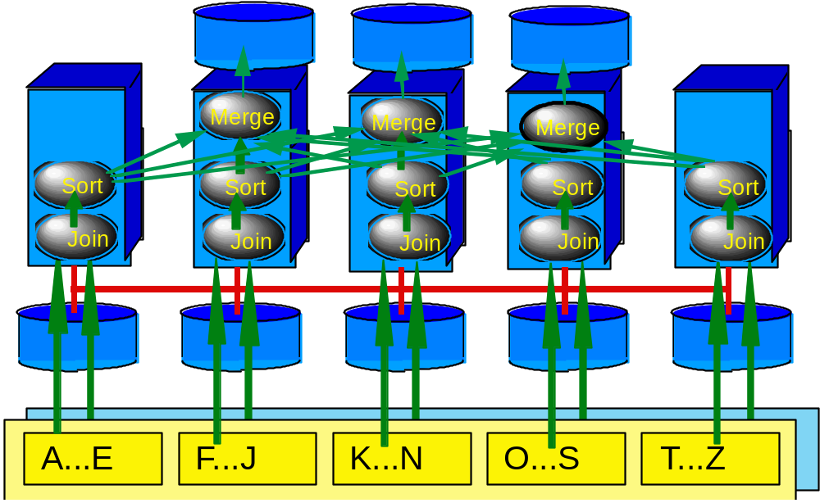
The Whole Enchilada
N inputs, M outputs, no bottlenecks.
Partitioned Data
Partitioned and Pipelined Data Flows
Notes:
84

Slide 28
MapReduce @ Google
Shared-disk (shared filesystem)
Goals
  Familiar programming (Java) over files
    More on this in a few weeks
  Auto-parallelization
  Simple load-balancing and “fault tolerance” on LOTS of machines
    Why is this important as you increase the value of LOTS
Main trick: no pipelining
  Always store iterator outputs to disk
    A “master” node can keep track of iterator partitions that fail and restart them on the relevant inputs
  Worth it? Hmm….

Slide 29
Parallel DBMS Summary
parallelism natural to query processing:
  Both pipeline and partition
Shared-Nothing vs. Shared-Mem vs. Shared Disk
  Shared-mem easiest SW, costliest HW.
    Doesn’t scale.
  Shared-nothing cheap, scales well, harder to implement.
  Shared disk a middle ground
    Introduces icky stuff related to concurrency control
Intra-op, Inter-op, & Inter-query parallelism all possible.

Slide 30
Parallel DBMS Summary, cont.
Data layout choices important!
Most DB operations can be done partition-parallel
  Sort.
  Sort-merge join, hash-join.
Complex plans.
  Allow for pipeline-parallelism, but sorts, hashes block the pipeline.
  Partition parallelism achieved via bushy trees.

Slide 31
Parallel DBMS Summary, cont.
Hardest part of the equation: query optimization.
  Wait for it!
We haven’t said anything about Xacts, logging.
  Familiar in shared-memory architecture.
  Takes some care in shared-nothing.
  Yet more tricky in shared-disk

