Slide 1
ER & Relational: Digging Deeper
R &G - Chapters 2 & 3
Agile Web Development with Rails 3rd edition
Chapters 18-19.3
Notes:
1

Slide 2
Databases Model the Real World
Data Model: “language” of concepts to translate real world into data
Many models: Relational, E-R, O-O, Network, Hierarchical, etc.
Relational
  Rows & Columns
  Keys & Foreign Keys to link Relations
Enrolled
Students
sid
cid
grade
53666
Carnatic101
C
sid
name
login
age
gpa
53666
Reggae203
B
53666
Jones
jones@cs
18
3.4
53650
Topology112
A
53688
Smith
smith@eecs
18
3.2
53666
History105
B
53650
Smith
smith@math
19
3.8

Slide 3
Aggregation
name
ssn
lot
Employees
Monitors
until
started_on
since
dname
pid
pbudget
did
budget
Projects
Sponsors
Departments
Allows relationships with relationship sets.
Notes:
2

Slide 4
Aggregation vs. Ternary
name
ssn
lot
Employees
Monitors
until
name
ssn
lot
started_on
since
dname
Employees
pid
pbudget
did
budget
Projects
Sponsors
Departments
Monitors
Sponsors
until
since
started_on
dname
pid
budget
Projects
Departments
pbudget
did

Slide 5
Conceptual Design Using the ER Model
ER modeling can get tricky!
Design choices:
  Entity or attribute?
  Entity or relationship?
  Relationships: Binary or ternary? Aggregation?
ER Model goals and limitations:
  Lots of semantics can (and should) be captured.
  Some constraints cannot be captured in ER.
    We’ll refine things in our logical (relational) design
Notes:
3

Slide 6

Entity vs. Attribute
“Address”:
  attribute of Employees?
  Entity of its own?
It depends! Semantics and usage.
  Several addresses per employee?
    must be an entity
    atomic attribute types (no set-valued attributes!)
  Care about structure? (city, street, etc.)
    must be an entity!
    atomic attribute types (no tuple-valued attributes!)

Slide 7
Entity vs. Attribute (Cont.)
from
to
name
dname
Works_In2: employee cannot work in a department for >1 period.
Like multiple addresses per employee!
ssn
lot
did
budget
Employees
Works_In2
Departments
name
dname
ssn
lot
did
budget
Employees
Works_In3
Departments
from
Duration
to
Notes:
5

Slide 8
Entity vs. Relationship
Separate discretionary budget (dbudget) for each dept.
What if manager’s dbudget covers all managed depts
  Could repeat value
  But redundancy = problems
Better design:
since
dbudget
name
dname
ssn
lot
did
budget
Employees
Manages2
Departments
name
ssn
lot
dname
Employees
did
budget
Departments
is_manager
managed_by
since
apptnum
Mgr_Appts
dbudget
Notes:
6

Slide 9
Now you try it
Try this at home - Courses database:
Courses, Students, Teachers
Courses have ids, titles, credits, …
Courses have multiple sections that have time/rm and exactly one teacher
Must track students’ course schedules and transcripts including grades, semester taken, etc.
Must track which classes a professor has taught
Database should work over multiple semesters

Slide 10
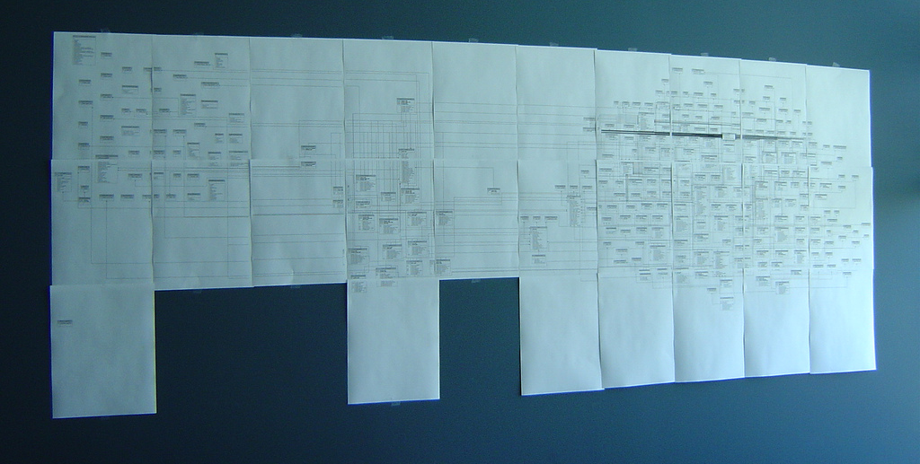
E-R Diagram as Wallpaper
Very common for them to be wall-sized

Slide 11
Converting ER to Relational
Fairly analogous structure
But many simple concepts in ER are subtle to specify in relations

Slide 12
Logical DB Design: ER to Relational
Entity sets to tables.
ssn
name
lot
123-22-3666
Attishoo
48
name
231-31-5368
Smiley
22
ssn
lot
131-24-3650
Smethurst
35
Employees
CREATE TABLE Employees
(ssn CHAR(11),
name CHAR(20),
lot INTEGER,
PRIMARY KEY (ssn))
Notes:
3
The slides for this text are organized into several modules. Each lecture contains about enough material for a 1.25 hour class period. (The time estimate is very approximate--it will vary with the instructor, and lectures also differ in length; so use this as a rough guideline.) This covers Lectures 1 and 2 (of 6) in Module (5).
Module (1): Introduction (DBMS, Relational Model)
Module (2): Storage and File Organizations (Disks, Buffering, Indexes)
Module (3): Database Concepts (Relational Queries, DDL/ICs, Views and Security)
Module (4): Relational Implementation (Query Evaluation, Optimization)
Module (5): Database Design (ER Model, Normalization, Physical Design, Tuning)
Module (6): Transaction Processing (Concurrency Control, Recovery)
Module (7): Advanced Topics

Slide 13
Relationship Sets to Tables
CREATE TABLE Works_In(
ssn CHAR(1),
did INTEGER,
since DATE,
PRIMARY KEY (ssn, did),
FOREIGN KEY (ssn)
REFERENCES Employees,
FOREIGN KEY (did)
REFERENCES Departments)
In translating a many-to-many relationship set to a relation, attributes of the relation must include:
  1) Keys for each participating entity set (as foreign keys). This set of attributes forms a superkey for the relation.
  2) All descriptive attributes.
ssn
did
since
123-22-3666
51
1/1/91
123-22-3666
56
3/3/93
231-31-5368
51
2/2/92
Notes:
5

Slide 14
Review: Key Constraints
Each dept has at most one manager, according to the key constraint on Manages.
since
name
dname
ssn
lot
did
budget
Employees
Manages
Departments
Translation to
relational model?
1-to-1
1-to Many
Many-to-1
Many-to-Many
Notes:
6

Slide 15
Translating ER with Key Constraints
since
Since each department has a unique manager, we could instead combine Manages and Departments.
name
dname
ssn
lot
did
budget
Employees
Manages
Departments
CREATE TABLE Manages(
ssn CHAR(11),
did INTEGER,
since DATE,
PRIMARY KEY (did),
FOREIGN KEY (ssn) REFERENCES Employees,
FOREIGN KEY (did) REFERENCES Departments)
CREATE TABLE Dept_Mgr(
did INTEGER,
dname CHAR(20),
budget REAL,
ssn CHAR(11),
since DATE,
PRIMARY KEY (did),
FOREIGN KEY (ssn)
REFERENCES Employees)
Vs.
Notes:
7

Slide 16
Review: Participation Constraints
Does every department have a manager?
  If so, this is a participation constraint: the participation of Departments in Manages is said to be total (vs. partial).
    Every did value in Departments table must appear in a row of the Manages table (with a non-null ssn value!)
since
since
name
name
dname
dname
ssn
did
did
budget
lot
budget
Employees
Manages
Departments
Works_In
since
Notes:
8

Slide 17
Participation Constraints in SQL
We can capture participation constraints involving one entity set in a binary relationship, but little else (without resorting to CHECK constraints which we’ll learn later).
CREATE TABLE Dept_Mgr(
did INTEGER,
dname CHAR(20),
budget REAL,
ssn CHAR(11) NOT NULL,
since DATE,
PRIMARY KEY (did),
FOREIGN KEY (ssn) REFERENCES Employees,
ON DELETE NO ACTION)
Notes:
9

Slide 18
Review: Weak Entities
A weak entity can be identified uniquely only by considering the primary key of another (owner) entity.
  Owner entity set and weak entity set must participate in a one-to-many relationship set (1 owner, many weak entities).
  Weak entity set must have total participation in this identifying relationship set.
name
ssn
lot
cost
pname
age
Employees
Policy
Dependents
Notes:
10

Slide 19
Translating Weak Entity Sets
Weak entity set and identifying relationship set are translated into a single table.
  When the owner entity is deleted, all owned weak entities must also be deleted.
CREATE TABLE Dep_Policy (
pname CHAR(20),
age INTEGER,
cost REAL,
ssn CHAR(11) NOT NULL,
PRIMARY KEY (pname, ssn),
FOREIGN KEY (ssn) REFERENCES Employees,
ON DELETE CASCADE)
Notes:
11

Slide 20
Administrivia
Homework #1
Class website
  Trac & svn
  Calendar
  Syllabus
  Roadmap
  Screencasts
  Grading

Slide 21
Databases for Programmers
Programmers think about objects (structs)
  Nested and interleaved
Often want to “persist” these things
Options
  encode opaquely and store
  translate to a structured form
    relational DB, XML file
  pros and cons?

Slide 22
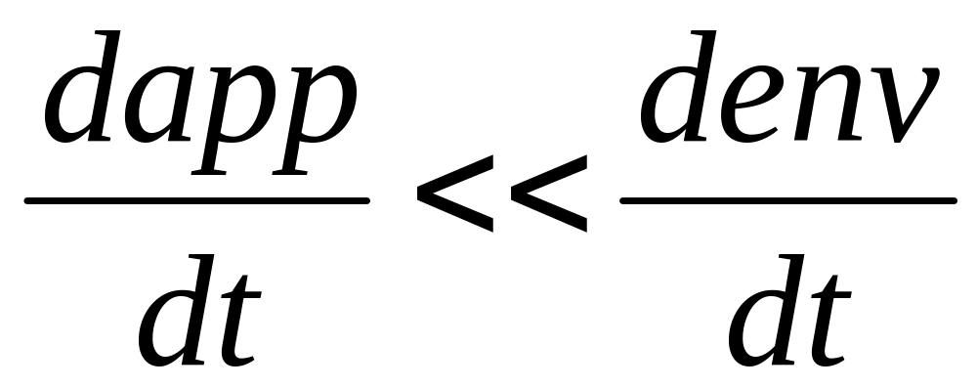
Remember the Inequality!
If storing indefinitely…use a flexible representation

Slide 23
But YUCK!!
How do I “relationalize” my objects?
Have to write a converter for each class?
Think about when to save things into the DB?
Good news:
  Can all be automated
  With varying amounts of trouble

Slide 24
Object-Relational Mappings
Roughly:
  Class ~ Entity Set
  Instance ~ Entity
  Data member ~ Attribute
  Reference ~ Foreign Key

Slide 25
Details, details
We have to map this down to tables
Which table holds which class of object?
What about relationships?
Solution #1: Declarative Configuration
  Write a description file (often in XML)
    E.g. Enterprise Java Beans (EJBs)
Solution #2: Convention
  Agree to use some conventions
    E.g. Rails

Slide 26
Ruby on Rails
Ruby: an OO scripting language
  and a pretty nice one, too
Rails: a framework for web apps
  “convention over configuration”
    great for standard web-app stuff!
  allows overriding as needed
Rails “Models”
  Represent the data and business rules in an application
  Very ER-like

Slide 27
Rails and ER
Models
  Employees
  Departments
  Works_In?
    Depends on constraints
since
name
dname
ssn
lot
did
budget
Employees
Works_In
Departments

Slide 28
Rails “Models” and “Associations”
app/models/department.rb
class Department < ActiveRecord::Base
has_many :employees # 1-to-n
end
app/models/employee.rb
class Employee < ActiveRecord::Base
belongs_to :department # n-to-1
end

Slide 29
Rails “Models” and “Associations”
app/models/engine.rb
class Engine < ActiveRecord::Base
belongs_to :vehicle # 1-to-0 or 1-to-1
end
app/models/vehicle.rb
Class Vehicle < ActiveRecord::Base
has_one :engine, # 1-to-1
:conditions => "id is not null”
end

Slide 30
Rails “Models” and “Associations”
app/models/parent.rb
Class Parent < ActiveRecord::Base
# many-to-many
has_and_belongs_to_many :children
end
app/models/child.rb
Class Child < ActiveRecord::Base
# many-to-many, full participation
has_and_belongs_to_many :parents,
:conditions => "id is not null"
end

Slide 31
A more complex example
Models
  Employees
  Departments
  Works_In?
    Remove the key constraint
    Where does “since” live?? Needs a model!
since
name
dname
ssn
lot
did
budget
Employees
Works_In
Departments
since
name
dname
ssn
lot
did
budget
Employees
Hirings
Departments

Slide 32
Rails “Through Associations”
app/models/hiring.rb
Class Hiring < ActiveRecord::Base
belongs_to :employee, # one-to-many
:conditions => "id is not null"
belongs_to :department, # one-to-many
:conditions => "id is not null"
end
app/models/employee.rb
Class Employee < ActiveRecord::Base
has_many :hirings
has_many :departments,
:through => hirings
end

Slide 33
Further Reading
Chapter 18/19 (through 19.3) in Agile Web Development with Rails (3rd edition)

Slide 34
Summary of Conceptual Design
Conceptual design follows requirements analysis,
  Yields a high-level description of data to be stored
ER model popular for conceptual design
  Constructs are expressive, close to the way people think about their applications.
  Note: There are many variations on ER model
    Both graphically and conceptually
Basic constructs: entities, relationships, and attributes (of entities and relationships).
Some additional constructs: weak entities, ISA hierarchies (see text if you’re curious), and aggregation.
Notes:
11

Slide 35
Summary of ER (Cont.)
Several kinds of integrity constraints:
  key constraints
  participation constraints
Some foreign key constraints are also implicit in the definition of a relationship set.
Many other constraints (notably, functional dependencies) cannot be expressed.
Constraints play an important role in determining the best database design for an enterprise.
Notes:
12

Slide 36
Summary of ER (Cont.)
ER design is subjective. There are often many ways to model a given scenario!
Analyzing alternatives can be tricky, especially for a large enterprise. Common choices include:
  Entity vs. attribute, entity vs. relationship, binary or n-ary relationship, whether or not to use ISA hierarchies, aggregation.
Ensuring good database design: resulting relational schema should be analyzed and refined further.
  Functional Dependency information and normalization techniques are especially useful.
Notes:
13

