Slide 1
SQL: The Query Language
Part 1
R &G - Chapter 5
The important thing is not to
stop questioning.
Albert Einstein
Notes:
The slides for this text are organized into several modules. Each lecture contains about enough material for a 1.25 hour class period. (The time estimate is very approximate--it will vary with the instructor, and lectures also differ in length; so use this as a rough guideline.) This covers Lectures 3 and 4 (of 6) in Module (3).
Module (1): Introduction (DBMS, Relational Model)
Module (2): Storage and File Organizations (Disks, Buffering, Indexes)
Module (3): Database Concepts (Relational Queries, DDL/ICs, Views and Security)
Module (4): Relational Implementation (Query Evaluation, Optimization)
Module (5): Database Design (ER Model, Normalization, Physical Design, Tuning)
Module (6): Transaction Processing (Concurrency Control, Recovery)
Module (7): Advanced Topics

Slide 2
Review
Relational Algebra (Operational Semantics)
  Given a query, how to mix and match the relational algebra operators to answer it
  Used for query optimization
Relational Calculus (Declarative Semantics)
  Given a query, what do I want my answer set to include?
Algebra and safe calculus are simple and powerful models for query languages for relational model
  Have same expressive power
SQL can express every query that is expressible in relational algebra/calculus. (and more)

Slide 3


Relational Query Languages
Rel. Algebra Query 1
Rel. Algebra Query 2
SQL Query
.
.
.
Rel. Algebra Query n
Pick the cheapest one

Slide 4
Relational Query Languages
Two sublanguages:
  DDL – Data Definition Language
    Define and modify schema (at all 3 levels)
  DML – Data Manipulation Language
    Queries can be written intuitively.
DBMS is responsible for efficient evaluation.
  The key: precise semantics for relational queries.
  Optimizer can re-order operations
    Won’t affect query answer.
  Choices driven by “cost model”

Slide 5
The SQL Query Language
The most widely used relational query language.
Standardized
  (although most systems add their own “special sauce” -- including PostgreSQL)
We will study SQL92 -- a basic subset

Slide 6
Example Database
Sailors
Boats
sid | sname | rating | age
1 | Fred | 7 | 22
2 | Jim | 2 | 39
3 | Nancy | 8 | 27
bid | bname | color
101 | Nina | red
102 | Pinta | blue
103 | Santa Maria | red
Reserves
sid | bid | day
1 | 102 | 9/12
2 | 102 | 9/13

Slide 7
The SQL DDL
sid | sname | rating | age
1 | Fred | 7 | 22
2 | Jim | 2 | 39
3 | Nancy | 8 | 27
CREATE TABLE Sailors (
sid INTEGER,
sname CHAR(20),
rating INTEGER,
age REAL,
PRIMARY KEY sid);
CREATE TABLE Boats (
bid INTEGER,
bname CHAR (20),
color CHAR(10)
PRIMARY KEY bid);
CREATE TABLE Reserves (
sid INTEGER,
bid INTEGER,
day DATE,
PRIMARY KEY (sid, bid, date),
FOREIGN KEY sid REFERENCES Sailors,
FOREIGN KEY bid REFERENCES Boats);
bid | bname | color
101 | Nina | red
102 | Pinta | blue
103 | Santa Maria | red
sid | bid | day
1 | 102 | 9/12
2 | 102 | 9/13

Slide 8
The SQL DML
Sailors
sid | sname | rating | age
1 | Fred | 7 | 22
2 | Jim | 2 | 39
3 | Nancy | 8 | 27
Find all 18-year-old sailors:
SELECT *
FROM Sailors S
WHERE S.age=18
To find just names and ratings, replace the first line:
SELECT S.sname, S.rating

Slide 9
Querying Multiple Relations
SELECT S.sname
FROM Sailors S, Reserves R
WHERE S.sid=R.sid AND R.bid=102
Sailors
Reserves
sid | sname | rating | age
1 | Fred | 7 | 22
2 | Jim | 2 | 39
3 | Nancy | 8 | 27
sid | bid | day
1 | 102 | 9/12
2 | 102 | 9/13

Slide 10
Basic SQL Query
DISTINCT: optional. Answer should not contain duplicates.
  SQL default: duplicates are not eliminated! (Result a “multiset”)
target-list : List of expressions over attributes of tables in relation-list
SELECT [DISTINCT] target-list
FROM relation-list
WHERE qualification
qualification : Comparisons combined using AND, OR and NOT. Comparisons are Attr op const or Attr1 op Attr2, where op is one of =,<,>,≠, etc.
relation-list : List of relation names, possibly with a range-variable after each name

Slide 11
Query Semantics
SELECT [DISTINCT] target-list
FROM relation-list
WHERE qualification
  1. FROM : compute cross product of tables.
  2. WHERE : Check conditions, discard tuples that fail.
  3. SELECT : Delete unwanted fields.
  4. DISTINCT (optional) : eliminate duplicate rows.
Note: Probably the least efficient way to compute a query!
  Query optimizer will find more efficient ways to get the same answer.

Slide 12
Find sailors who’ve reserved at least one boat
SELECT
FROM
WHERE
S.sid
Sailors S, Reserves R
S.sid=R.sid
Would DISTINCT make a difference here?
What is the effect of replacing S.sid by S.sname in the SELECT clause?
  Would DISTINCT make a diff to this variant of the query?

Slide 13
About Range Variables
Needed when ambiguity could arise.
  e.g., same table used multiple times in FROM (“self-join”)
SELECT x.sname, x.age, y.sname, y.age
FROM Sailors x, Sailors y
WHERE x.age > y.age
Sailors
sid | sname | rating | age
1 | Fred | 7 | 22
2 | Jim | 2 | 39
3 | Nancy | 8 | 27

Slide 14
Arithmetic Expressions
SELECT S.age, S.age-5 AS age1, 2*S.age AS age2
FROM Sailors S
WHERE S.sname = ‘dustin’
SELECT S1.sname AS name1, S2.sname AS name2
FROM Sailors S1, Sailors S2
WHERE 2*S1.rating = S2.rating - 1

Slide 15
String Comparisons
  `_’ stands for any one character and `%’ stands for 0 or more arbitrary characters.
SELECT S.sname
FROM Sailors S
WHERE S.sname LIKE ‘B_%B’

Slide 16
Find sid’s of sailors who’ve reserved a red or a green boat
SELECT R.sid
FROM Boats B, Reserves R
WHERE R.bid=B.bid AND
(B.color=‘red’ OR
B.color=‘green’)
... or:
SELECT R.sid
FROM Boats B, Reserves R
WHERE R.bid=B.bid AND
B.color=‘red’
UNION
SELECT R.sid
FROM Boats B, Reserves R
WHERE R.bid=B.bid AND B.color=‘green’

Slide 17
Find sid’s of sailors who’ve reserved a red and a green boat
SELECT R.sid
FROM Boats B,Reserves R
WHERE R.bid=B.bid AND
(B.color=‘red’ AND B.color=‘green’)

Slide 18
Find sid’s of sailors who’ve reserved a red and a green boat
SELECT S.sid
FROM Sailors S, Boats B, Reserves R
WHERE S.sid=R.sid
AND R.bid=B.bid
AND B.color=‘red’
INTERSECT
SELECT S.sid
FROM Sailors S, Boats B, Reserves R
WHERE S.sid=R.sid
AND R.bid=B.bid
AND B.color=‘green’

Slide 19
Find sid’s of sailors who’ve reserved a red and a green boat
Could use a self-join:
SELECT R1.sid
FROM Boats B1, Reserves R1,
Boats B2, Reserves R2
WHERE R1.sid=R2.sid
AND R1.bid=B1.bid
AND R2.bid=B2.bid
AND (B1.color=‘red’ AND B2.color=‘green’)

Slide 20
Find sid’s of sailors who have not reserved a boat
SELECT S.sid
FROM Sailors S
EXCEPT
SELECT S.sid
FROM Sailors S, Reserves R
WHERE S.sid=R.sid

Slide 21
Nested Queries: IN
Names of sailors who’ve reserved boat #103:
SELECT S.sname
FROM Sailors S
WHERE S.sid IN
(SELECT R.sid
FROM Reserves R
WHERE R.bid=103)

Slide 22
Nested Queries: NOT IN
Names of sailors who’ve not reserved boat #103:
SELECT S.sname
FROM Sailors S
WHERE S.sid NOT IN
(SELECT R.sid
FROM Reserves R
WHERE R.bid=103)

Slide 23
Nested Queries with Correlation
Names of sailors who’ve reserved boat #103:
SELECT S.sname
FROM Sailors S
WHERE EXISTS
(SELECT *
FROM Reserves R
WHERE R.bid=103 AND S.sid=R.sid)
Subquery must be recomputed for each Sailors tuple.
  Think of subquery as a function call that runs a query
Also: NOT EXISTS.

Slide 24
More on Set-Comparison Operators
we’ve seen: IN, EXISTS
can also have: NOT IN, NOT EXISTS
other forms: op ANY, op ALL
Find sailors whose rating is greater than that of some sailor called Horatio:
SELECT *
FROM Sailors S
WHERE S.rating > ANY
(SELECT S2.rating
FROM Sailors S2
WHERE S2.sname=‘Horatio’)

Slide 25
A Tough One
Find sailors who’ve reserved all boats.
SELECT S.sname
FROM Sailors S
WHERE NOT EXISTS ( SELECT B.bid
FROM Boats B
WHERE NOT EXISTS ( SELECT R.bid
FROM Reserves R
WHERE R.bid=B.bid
AND R.sid=S.sid ))
Sailors S such that ...
there is no boat B without ...
a Reserves tuple showing S reserved B

Slide 26
Conceptual SQL Evaluation
SELECT [DISTINCT] target-list
FROM relation-list
WHERE qualification
GROUP BY grouping-list
HAVING group-qualification
Project away columns
(just keep those used in SELECT, GBY, HAVING)
SELECT
[DISTINCT]
Eliminate duplicates
Apply selections
(eliminate rows)
WHERE
HAVING
Eliminate groups
Relation cross-product
FROM
GROUP BY
Form groups & aggregate

Slide 27
Sorting the Results of a Query
ORDER BY column [ ASC | DESC] [, ...]
Can order by any column in SELECT list, including expressions or aggs:
SELECT S.rating, S.sname, S.age
FROM Sailors S, Boats B, Reserves R
WHERE S.sid=R.sid
AND R.bid=B.bid AND B.color=‘red’
ORDER BY S.rating, S.sname;
SELECT S.sid, COUNT (*) AS redrescnt
FROM Sailors S, Boats B, Reserves R
WHERE S.sid=R.sid
AND R.bid=B.bid AND B.color=‘red’
GROUP BY S.sid
ORDER BY redrescnt DESC;

Slide 28
Null Values
Field values are sometimes unknown (e.g., a rating has not been assigned) or inapplicable (e.g., no spouse’s name).
  SQL provides a special value null for such situations.
The presence of null complicates many issues. E.g.:
  Special operators needed to check if value is/is not null.
  Is rating>8 true or false when rating is equal to null? What about AND, OR and NOT connectives?
  We need a 3-valued logic (true, false and unknown).
  Meaning of constructs must be defined carefully. (e.g., WHERE clause eliminates rows that don’t evaluate to true.)
  New operators (in particular, outer joins) possible/needed.

Slide 29
Joins
SELECT (column_list)
FROM table_name
[INNER | {LEFT |RIGHT | FULL } OUTER] JOIN table_name
ON qualification_list
WHERE …
Explicit join semantics needed unless it is an INNER join
(INNER is default)

Slide 30
Inner Join
Only rows that match the qualification are returned.
SELECT s.sid, s.name, r.bid
FROM Sailors s INNER JOIN Reserves r
ON s.sid = r.sid
Returns only those sailors who have reserved boats.
SQL-92 also allows:
SELECT s.sid, s.name, r.bid
FROM Sailors s NATURAL JOIN Reserves r
“NATURAL” means equi-join for each pair of attributes with the same name

Slide 31
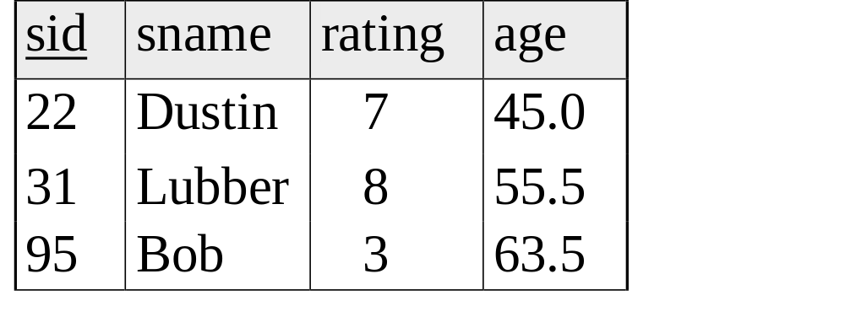
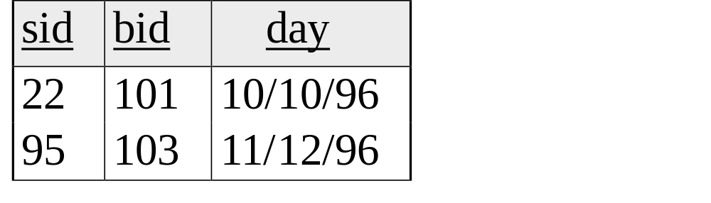
SELECT s.sid, s.name, r.bid
FROM Sailors s INNER JOIN Reserves r
ON s.sid = r.sid

Slide 32
Left Outer Join
Returns all matched rows, plus all unmatched rows from the table on the left of the join clause
(use nulls in fields of non-matching tuples)
SELECT s.sid, s.name, r.bid
FROM Sailors s LEFT OUTER JOIN Reserves r
ON s.sid = r.sid
Returns all sailors & information on whether they have reserved boats

Slide 33
SELECT s.sid, s.name, r.bid
FROM Sailors s LEFT OUTER JOIN Reserves r
ON s.sid = r.sid

Slide 34
Right Outer Join
Right Outer Join returns all matched rows, plus all unmatched rows from the table on the right of the join clause
SELECT r.sid, b.bid, b.name
FROM Reserves r RIGHT OUTER JOIN Boats b
ON r.bid = b.bid
Returns all boats & information on which ones are reserved.

Slide 35
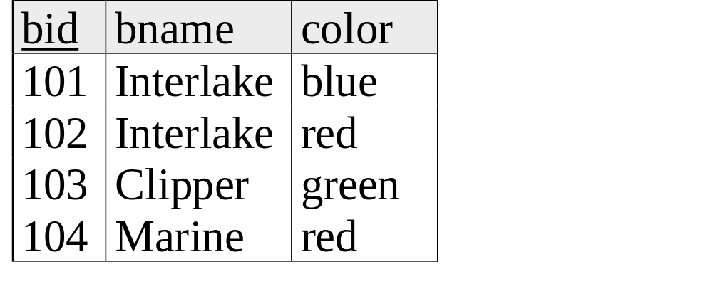
SELECT r.sid, b.bid, b.name
FROM Reserves r RIGHT OUTER JOIN Boats b
ON r.bid = b.bid

Slide 36
Full Outer Join
Full Outer Join returns all (matched or unmatched) rows from the tables on both sides of the join clause
SELECT r.sid, b.bid, b.name
FROM Reserves r FULL OUTER JOIN Boats b
ON r.bid = b.bid
Returns all boats & all information on reservations

Slide 37
SELECT r.sid, b.bid, b.name
FROM Reserves r FULL OUTER JOIN Boats b
ON r.bid = b.bid
Note: in this case it is the same as the ROJ!
bid is a foreign key in reserves, so all reservations must
have a corresponding tuple in boats.

Slide 38
Views: Defining External DB Schemas
CREATE VIEW view_name
AS select_statement
Makes development simpler
Often used for security
Not “materialized”
CREATE VIEW Reds
AS SELECT B.bid, COUNT (*) AS scount
FROM Boats B, Reserves R
WHERE R.bid=B.bid AND B.color=‘red’
GROUP BY B.bid

Slide 39
Views Instead of Relations in Queries
CREATE VIEW Reds
AS SELECT B.bid, COUNT (*) AS scount
FROM Boats B, Reserves R
WHERE R.bid=B.bid AND B.color=‘red’
GROUP BY B.bid
Reds
SELECT bname, scount
FROM Reds R, Boats B
WHERE R.bid=B.bid
AND scount < 10

Slide 40
Discretionary Access Control
GRANT privileges ON object TO users [WITH GRANT OPTION]
Object can be a Table or a View
Privileges can be:
  Select
  Insert
  Delete
  References (cols) – allow to create a foreign key that references the specified column(s)
  All
Can later be REVOKEd
Users can be single users or groups
See Chapter 17 for more details.

Slide 41
Two more important topics
Constraints
SQL embedded in other languages

Slide 42
Integrity Constraints (Review)
An IC describes conditions that every legal instance of a relation must satisfy.
  Inserts/deletes/updates that violate IC’s are disallowed.
  Can ensure application semantics (e.g., sid is a key), or prevent inconsistencies (e.g., sname has to be a string, age must be < 200)
Types of IC’s: Domain constraints, primary key constraints, foreign key constraints, general constraints.
  Domain constraints: Field values must be of right type. Always enforced.
  Primary key and foreign key constraints: you know them.
Notes:
5

Slide 43
General Constraints
CREATE TABLE Sailors
( sid INTEGER,
sname CHAR(10),
rating INTEGER,
age REAL,
PRIMARY KEY (sid),
CHECK ( rating >= 1
AND rating <= 10 ))
Useful when more general ICs than keys are involved.
Can use queries to express constraint.
Checked on insert or update.
Constraints can be named.
CREATE TABLE Reserves
( sname CHAR(10),
bid INTEGER,
day DATE,
PRIMARY KEY (bid,day),
CONSTRAINT noInterlakeRes
CHECK (`Interlake’ <>
( SELECT B.bname
FROM Boats B
WHERE B.bid=bid)))
Notes:
8

Slide 44
Constraints Over Multiple Relations
CREATE TABLE Sailors
( sid INTEGER,
sname CHAR(10),
rating INTEGER,
age REAL,
PRIMARY KEY (sid),
CHECK
( (SELECT COUNT (S.sid) FROM Sailors S)
+ (SELECT COUNT (B.bid) FROM
Boats B) < 100 )
Awkward and wrong!
Only checks sailors!
Only required to hold if the associated table is non-empty.
ASSERTION is the right solution; not associated with either table.
Unfortunately, not supported in many DBMS.
Triggers are another solution.
Number of boats
plus number of
sailors is < 100
CREATE ASSERTION smallClub
CHECK
( (SELECT COUNT (S.sid) FROM Sailors S)
+ (SELECT COUNT (B.bid)
FROM Boats B) < 100 )
Notes:
9

Slide 45
Writing Applications with SQL
SQL is not a general purpose programming language.
  + Tailored for data retrieval and manipulation
  + Relatively easy to optimize and parallelize
  Can’t write entire apps in SQL alone
Options:
  Make the query language “Turing complete”
    Avoids the “impedance mismatch”
    but, loses advantages of relational language simplicity
  Allow SQL to be embedded in regular programming languages.
  Q: What needs to be solved to make the latter approach work?

Slide 46
Embedded SQL
DBMS vendors traditionally provided “host language bindings”
  E.g. for C or COBOL
  Allow SQL statements to be called from within a program
  Typically you preprocess your programs
  Preprocessor generates calls to a proprietary DB connectivity library
General pattern
  One call to connect to the right database (login, etc.)
  SQL statements can refer to host variables from the language
Typically vendor-specific
  We won’t look at any in detail, we’ll look at standard stuff
Problem
  SQL relations are (multi-)sets, no a priori bound on the number of records. No such data structure in C.
  SQL supports a mechanism called a cursor to handle this.
Notes:
16

Slide 47
Just to give you a flavor
EXEC SQL SELECT S.sname, S.age
INTO :c_sname,:c_age
FROM Sailors S
WHERE S.sid = :c_sid

Slide 48
Cursors
Can declare a cursor on a relation or query
Can open a cursor
Can repeatedly fetch a tuple (moving the cursor)
Special return value when all tuples have been retrieved.
ORDER BY allows control over the order tuples are returned.
    Fields in ORDER BY clause must also appear in SELECT clause.
LIMIT controls the number of rows returned (good fit w/ORDER BY)
Can also modify/delete tuple pointed to by a cursor
  A “non-relational” way to get a handle to a particular tuple
There’s an Embedded SQL syntax for cursors
  DECLARE <cursorname> CURSOR FOR <select stmt>
  FETCH FROM <cursorname> INTO <variable names>
  But we’ll peek at JDBC instead
Notes:
16

Slide 49
Database APIs: Alternative to embedding
Rather than modify compiler, add a library with database calls (API)
  special objects/methods
  passes SQL strings from language, presents result sets in a language-friendly way
  ODBC a C/C++ standard started on Windows
  JDBC a Java equivalent
  Most scripting languages have similar things
    E.g. For Perl there is DBI, “oraPerl”, other packages
Mostly DBMS-neutral
  at least try to hide distinctions across different DBMSs

Slide 50
Architecture
Application
ODBC driver
Data Source
    A lookup service maps “data source names” (“DSNs”) to drivers
      Typically handled by OS
    Based on the DSN used, a “driver” is linked into the app at runtime
    The driver traps calls, translates them into DBMS-specific code
    Database can be across a network
    ODBC is standard, so the same program can be used (in principle) to access multiple database systems
    Data source may not even be an SQL database!

Slide 51
ODBC/JDBC
Various vendors provide drivers
  MS bundles a bunch into Windows
  Vendors like DataDirect and OpenLink sell drivers for multiple OSes
Drivers for various data sources
  Relational DBMSs (Oracle, DB2, SQL Server, etc.)
  “Desktop” DBMSs (Access, Dbase, Paradox, FoxPro, etc.)
  Spreadsheets (MS Excel, Lotus 1-2-3, etc.)
  Delimited text files (.CSV, .TXT, etc.)
You can use JDBC/ODBC clients over many data sources
  E.g. MS Query comes with many versions of MS Office (msqry32.exe)
Can write your own Java or C++ programs against xDBC

Slide 52
JDBC
Part of Java, easy to use
Java comes with a JDBC-to-ODBC bridge
  So JDBC code can talk to any ODBC data source
  E.g. look in your Windows Control Panel or MacOS Utilities folder for JDBC/ODBC drivers!
JDBC tutorial online
  http://developer.java.sun.com/developer/Books/JDBCTutorial/

Slide 53
Ruby on Rails
Rails’ find method gives a simple rowset interface
  Just an array of records
  Unfortunately slurps entire result set into memory.
Rails’ ORM (Object Relational Mapping) goes beyond queries and cursors
  Data modeling and implicit query construction
  The ActiveRecord.find method sometimes generates key/foreign-key joins, for example
Can also do:
  find_by_sql
  ActiveRecord::Base.connection.execute(

Slide 54
API Summary
  APIs are needed to interface DBMSs to programming languages
Embedded SQL uses “native drivers” and is usually faster but less standard
ODBC (used to be Microsoft-specific) for C/C++
JDBC the standard for Java
Scripting languages (PHP, Perl, JSP) are becoming the preferred technique for web-based systems

Slide 55
Summary
Relational model has well-defined query semantics
SQL provides functionality close to basic relational model
  (some differences in duplicate handling, null values, set operators, …)
Typically, many ways to write a query
  DBMS figures out a fast way to execute a query, regardless of how it is written.

