Slide 1
Embedded Methods: Interface Poisson and Fracture
Jeffrey Lee Hellrung, Jr. (UCLA)
jeffrey.hellrung@gmail.com
Presented for:
Sandia National Laboratories
Albuquerque, NM
November 8th, 2011

Slide 2
Outline
Personal background
Lagrangian mesh cutting
  Virtual surgery
  XFEM fracture simulation
  Volumetric fracturing
Embedded domain/interface Poisson
  Embedded Neumann
  Embedded Dirichlet
  Embedded interface
  Numerical results

Slide 3
Personal Background
~10 years in South Ogden, UT
~10 years in Los Angeles, CA
  B.S. in Mathematics from Harvey Mudd College, Claremont, CA
  M.A. in Mathematics from UCLA, Los Angeles, CA
  Ph.D. in Mathematics from UCLA, Los Angeles, CA (expected 2011 June)

Slide 4
Interface Poisson - Introduction

Slide 5

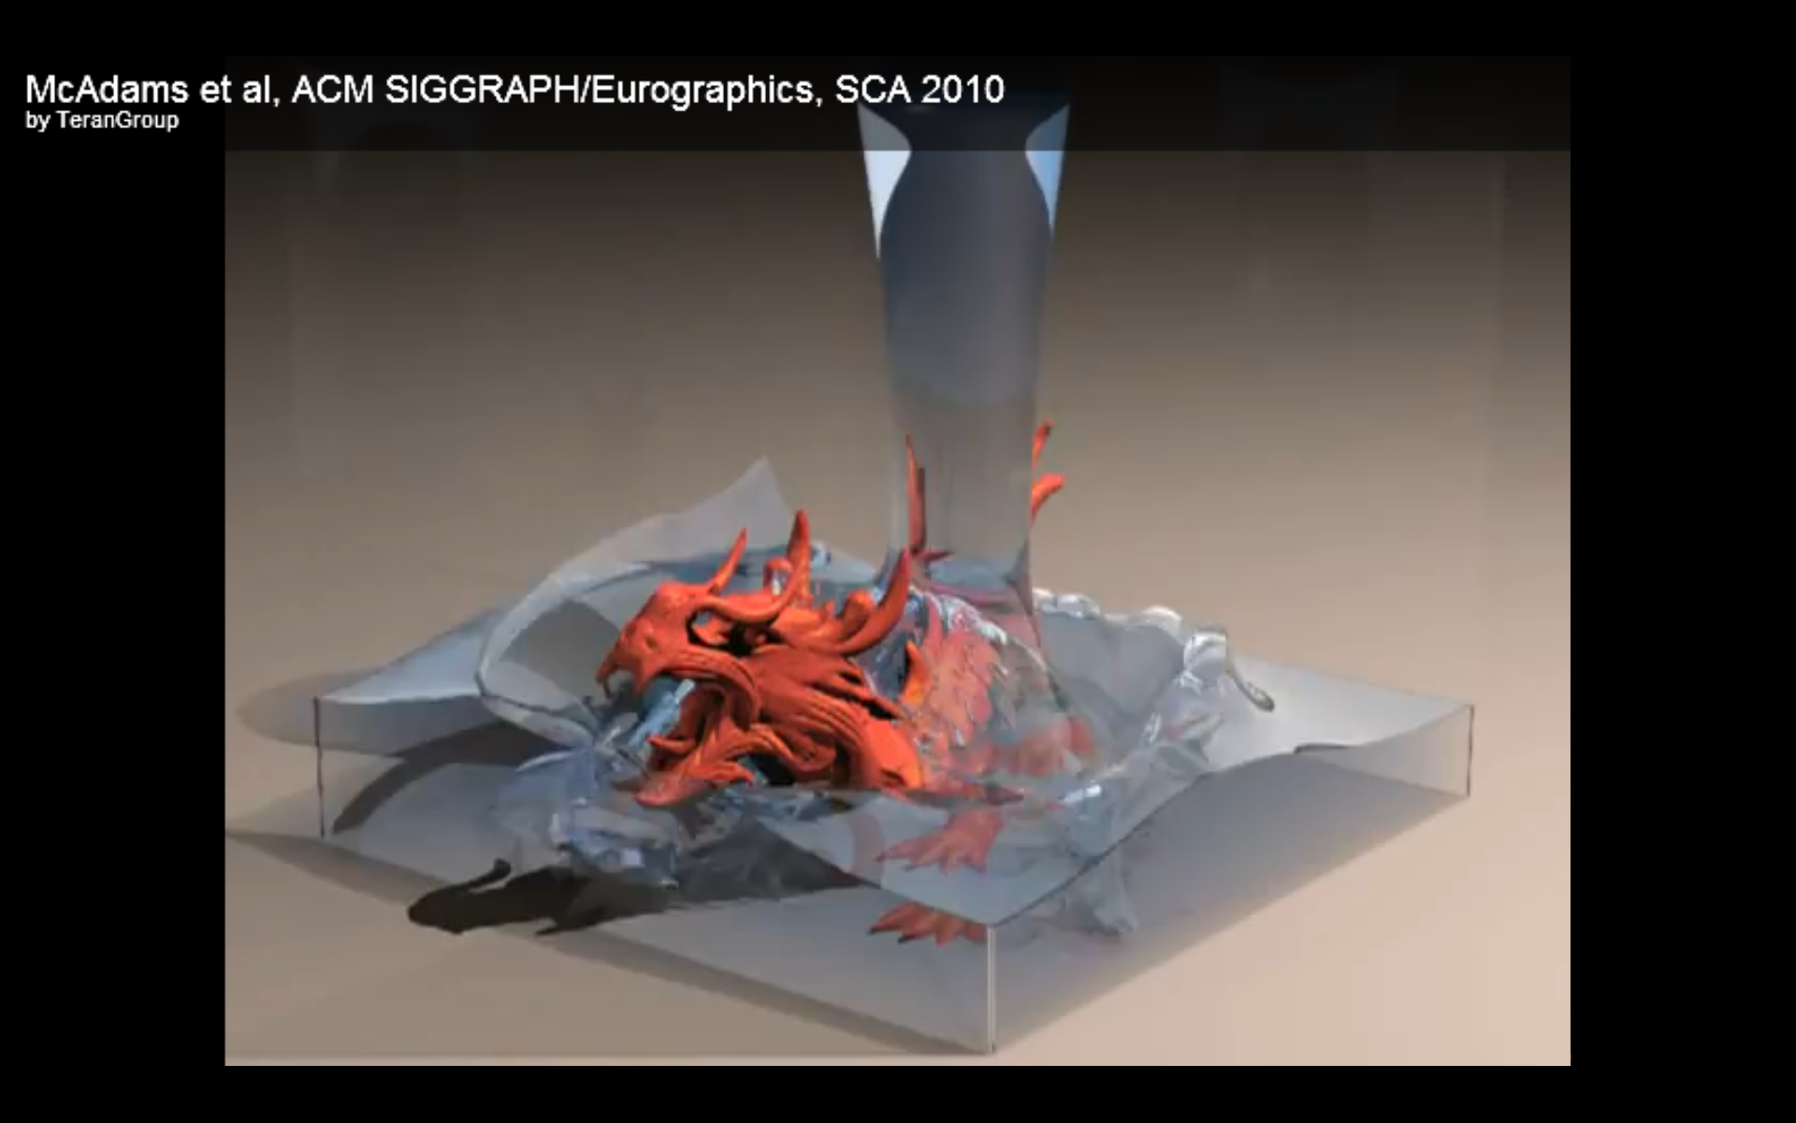
Interface Poisson - Applications
Two dissimilar materials interacting across a thin interface
  Immiscible, incompressible fluids in contact
  Phase change problems

Slide 6
Embedded Poisson – Previous Work
Finite difference methods
  Immersed Boundary (IB) method, Immersed Interface Method (IIM) (LeVeque, Li)
  Ghost Fluid Method (GFM) (Liu et al.)
  Coupling Interface Method (CIM) (Chern, Shu)
  Matched Interface and Boundary (MIB) method (Zhou et al.)

Slide 7
Embedded Poisson – Previous Work
Finite element methods
  Unstructured, conforming meshes
  Fictitious domain methods (e.g., Glowinski et al., Almgren et al.)
  Discontinuous Galerkin (DG) method (Lew, Buscaglia)
  Extended Finite Element Method (XFEM) (e.g., Dolbow et al., Vaughn et al.)
Finite volume methods (Johansen, Colella)

Slide 8
Neumann Boundary Conditions
Base discretization on energy minimization

Slide 9
Domain Embedding
material degree of freedom
boundary grid cell (partitioned into material region and virtual region)
virtual degree of freedom

Slide 10
Discretization
standard multilinear nodal basis functions
Discretize energy cell-wise:
different energy discretizations for interior cells and boundary cells

Slide 11
Energy Discretization – Interior Cells
Based on finite difference approximation

Slide 12
Energy Discretization – Boundary Cells
Based on multilinear representation

Slide 13
Linear System from Energy Minimization
Discrete minimization problem:
Linear system for solution obtained by differentiating energy:

Slide 14
Stencil Visualization
0
NZ
0
e^{c13,13}
e^{c14,13}
NZ
NZ
NZ
e^{c13,12}
e^{c14,12}
NZ
NZ
ẽ^{c3,8}
0
NZ
0
NZ
NZ
NZ
NZ
NZ
NZ
ẽ^{c2,7}
ẽ^{c3,7}
ẽ^{c12,5}
ẽ^{c13,5}
NZ
NZ
NZ
NZ
NZ
NZ
e^{c12,4}
ẽ^{c13,4}
0
NZ
NZ

Slide 15
Dirichlet Boundary Conditions
Variational form: constrained minimization

Slide 16
Discretization
Energy discretized exactly as for Neumann problem (excepting the “q” term):
Constraints discretized by choosing finite-dimensional discrete Lagrange multiplier space:

Slide 17
Single-Cell Constraints
Choose Λ^{h} = Λ1^{h}, the set of piecewise-constant functions over each Cartesian grid cell intersecting the boundary:

Slide 18
Geometric Interpretation of Single-Cell Constraints
Choosing Λ^{h} = Λ1^{h} gives the equivalent set of constraints:
Compiling all above constraints into a matrix yields a sparse underdetermined linear system:

Slide 19
Visualization of Single-Cell Constraints
=

Slide 20
Constrained Minimization
Discretization:
Equivalent saddle-point system with Lagrange multiplier:

Slide 21
Fundamental Basis
Use null-basis Z to reduce to SPD system: For any matrix Z whose columns span the null-space of B,
Symmetric Positive Definite
Easy!
Define Z via fundamental basis:

Slide 22
Fundamental Basis
Unfortunately, using the discrete Lagrange multiplier space Λ1^{h} (single-cell constraints) makes it difficult to define a well-conditioned and easily invertible Bm.
Solution: Choose a different discrete Lagrange multiplier space!
  Goal: Obtain a diagonal Bm!
  Construct alternate multiplier space based on single-cell constraints.

Slide 23
Constraint Aggregation Overview
Select an independent set of dofs wrt the single-cell constraints.
Sum all single-cell constraints containing a given independent dof to form an aggregate constraint.
Incorporate remaining single-cell constraints into a nearby aggregate constraint.
Essentially, we just sum together rows of the constraint matrix B to arrange for a leading diagonal Bm block.

Slide 24
Adjacency Graph Induced by Single-Cell Constraints
Recall: A single-cell constraint couples together all 4 (2D) / 8 (3D) of its contained dofs.
Thus, dofs are adjacent wrt the single-cell constraint system iff they are contained within a common boundary grid cell.

Slide 25
Selecting Independent DOFs
E.g., greedily and one-by-one.
Not required to be maximal.

Slide 26
Partial Aggregation of Single-Cell Constraints
Aggregate together all boundary grid cells containing a given independent dof

Slide 27
Full Aggregation of Single-Cell Constraints
Associate remaining boundary grid cells to some nearby independent dof

Slide 28
Summing Rows in Single-Cell Constraint System
Each row of the aggregate constraint system is a sum of rows of the single-cell constraint system.

Slide 29
Leading Diagonal Bm Block
Each independent dof participates in precisely one aggregate constraint, by construction.
Thus, ordering the independent dofs first yields a leading diagonal block in the aggregate constraint matrix.

Slide 30
Recap: Constraint Aggregation
Aggregating single-cell constraints and reordering dofs yields an aggregate constraint matrix Bª with a leading diagonal block Bªm.
Thus, null-basis Z is easy to form.
Thus, saddle-point system easily reduces to SPD system.

Slide 31
Interfacial Jump Conditions

Slide 32
Interface Embedding

