Slide 1
A Robust and Accelerated Cutting Algorithm with Applications to Fracture and Interface Problems
Jeffrey Lee Hellrung, Jr.
Wednesday, April 8, 2009

Slide 2
Outline
Cutting Algorithm Introduction and Examples
Motivation for More Precision
Adaptive Use of Exact Arithmetic
Cutting Algorithm Redesign
Applications
  Fracture Dynamics for Visual Effects
  Virtual Surgery
  Crack Propagation in 2D and 3D
  Interface Problems in CFD

Slide 3
Outline
Cutting Algorithm Introduction and Examples
Motivation for More Precision
Adaptive Use of Exact Arithmetic
Cutting Algorithm Redesign
Applications
  Fracture Dynamics for Visual Effects
  Virtual Surgery
  Crack Propagation in 2D and 3D
  Interface Problems in CFD

Slide 4
Introduction
“Arbitrary Cutting of Deformable Tetrahedralized Objects” by E. Sifakis, K. Der, R. Fedkiw (2005).
Describes an algorithm to cut a tetrahedralized volume by an arbitrarily complex triangulated surface.
Additionally, the tetrahedralized volume may be deformed and recut any number of times.

Slide 5
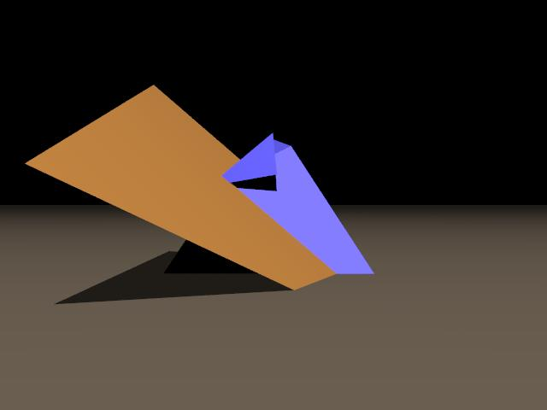
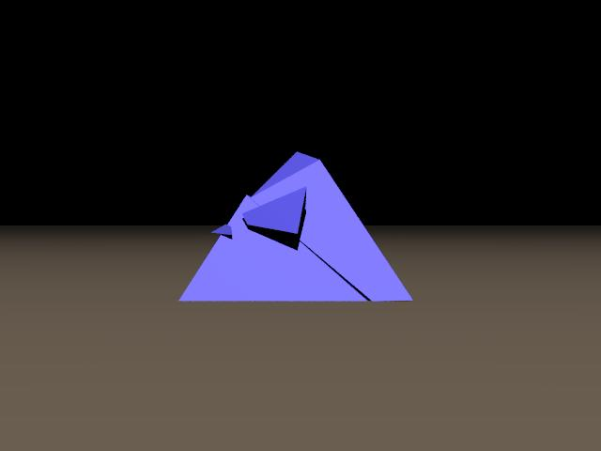
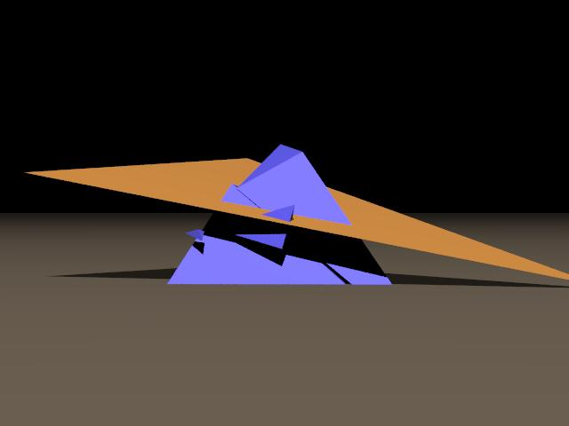
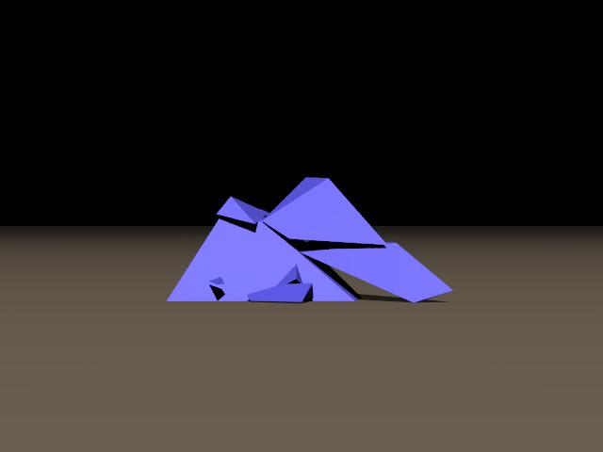
Examples
One tetrahedron, multiple cutting planes.

Slide 6
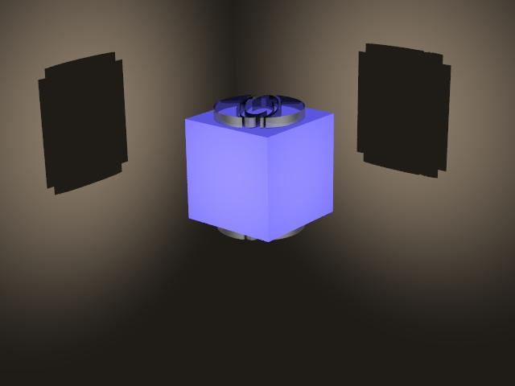
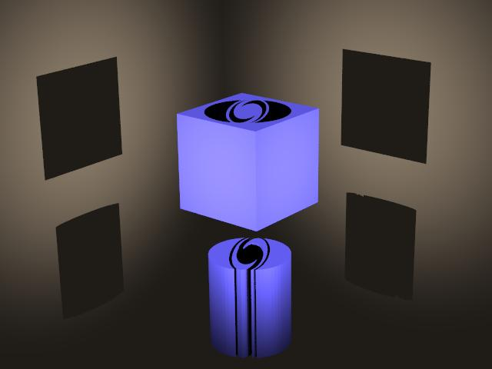
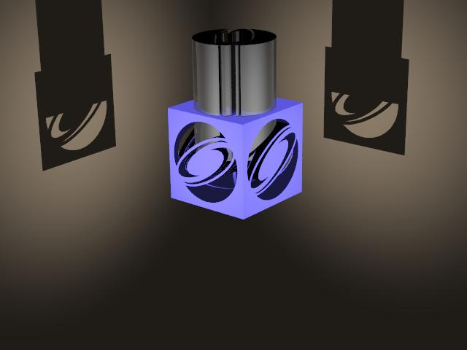
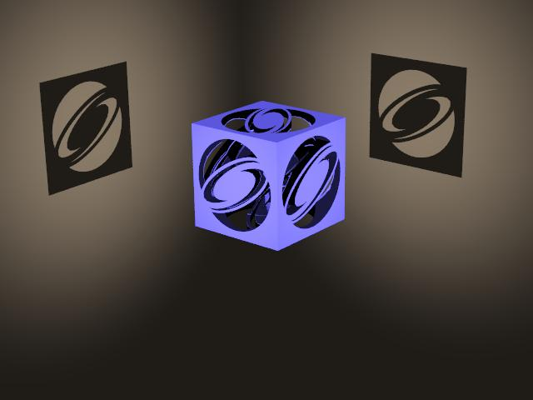
Examples
625-element tetrahedral mesh out of which the the SIGGRAPH logo is cut.

Slide 7
General Idea
Tetrahedral elements can be partially empty; a tetrahedral element “knows” what material it contains.
Tetrahedral elements can thus be duplicated, dividing the material in the original element among the duplicates.

Slide 8
Note on Geometric Degeneracies
The cutting algorithm does not attempt to resolve (legitimate) geometric degeneracies.
A geometric degeneracy occurs when the combinatorial structure of intersections among geometric objects is sensitive to perturbations. For example, if a triangle's edge coincides with the face of a tetrahedron, the intersection is degenerate.

Slide 9
Dealing with Degeneracies
In our applications, degenerate inputs almost never arise in practice.
In the rare instances when a degeneracy exists, nearly any perturbation of the input, however small, is sufficient to “break” the degeneracy.

Slide 10
Stages of the Cutting Algorithm
Stage 1: Determine tri-tet intersections.
Stage 2: Update old and determine new intersection points.
Stage 3: Split existing and add new segments and polygons.
Stage 4: Split material regions (polyhedra) within a tetrahedral element.
Stage 5: Join material regions in adjacent tetrahedral elements based on material connectivity.

Slide 11
Outline
Cutting Algorithm Introduction and Examples
Motivation for More Precision
Adaptive Use of Exact Arithmetic
Cutting Algorithm Redesign
Applications
  Fracture Dynamics for Visual Effects
  Virtual Surgery
  Crack Propagation in 2D and 3D
  Interface Problems in CFD

Slide 12
Motivation for More Precision
Stages 1 through 4 require geometric computations at some point. Only stage 5 can be done purely combinatorially.
Such geometric computations are performed within a number of various coordinate systems.
If fixed-precision floating point arithmetic is naively used, round-off error could lead robustness issues.

Slide 13
Stage 1
Stage 1 determines which cutting surface triangles intersect which tetrahedral elements, and then computes the coordinates of these triangles within the barycentric space of each intersecting tetrahedron.

Slide 14
Stage 1
To visualize, consider the 2D analog:
(0,1)
(0,0)
(1,0)
“world” coordinates
barycentric coordinates

Slide 15
Why Transform to Barycentric Space?
Since a tetrahedral element can be cut and recut several times, we need to resolve the intersections between a given cut and all previous cuts.
Since the tetrahedral element can deform between cuts, we use the barycentric coordinates of the tetrahedron to resolve intersections among current and previous cuts. Tetrahedron barycentric space is “deformation invariant”.

Slide 16
Computing Barycentric Coordinates
Such barycentric coordinates are the solution to a 4x4 system of linear equations, and can be expressed as the ratio of 2 signed volumes.
Computing such coordinates with fixed precision produces round-off errors, which would make subsequent geometric computations unreliable.

Slide 17
Geometric Computations in Stages 2, 3, 4
Stage 2 determines intersection points among 3 or more triangles within a given tetrahedron, using the tetrahedron barycentric coordinates of the triangles.
Stages 3 and 4 operate on these intersection points within the barycentric space of a triangle.
These intersection points are, again, expressible as solutions to a system of linear equations, and hence are subject to round-off error if using fixed-precision arithmetic.

Slide 18
What Could Go Wrong?
Most geometric queries boil down to orientation tests, which return -1, 0, or +1.
If one queries the orientation of a set of points whose coordinates are not exactly known due to round-off, then one may get a result inconsistent with previous or future results.
If the segments' coordinates are not known exactly, an intersection test may classify either or both of these cases incorrectly.

Slide 19
Isn't Fixed Precision “Good Enough”?
A legitimate question to ask: “Shouldn't doubles be 'good enough'?”
The answer: “Usually. Almost always.”
To obtain a maximally robust, rock solid algorithm, however, doubles aren't enough.
We've found that near-degeneracies happen with enough frequency, especially for really large problems, that we desire something more than double precision.

Slide 20
Outline
Cutting Algorithm Introduction and Examples
Motivation for More Precision
Adaptive Use of Exact Arithmetic
Cutting Algorithm Redesign
Applications
  Fracture Dynamics for Visual Effects
  Virtual Surgery
  Crack Propagation in 2D and 3D
  Interface Problems in CFD

Slide 21
Computing Arithmetic Expressions Exactly
The general problem is to compute the sign of an arithmetic expression precisely. This includes signed areas and signed volumes.
In order to do this in all cases, the components of the expression must be known exactly.
The most straightforward way to do this is to use an exact arithmetic library (e.g., GMP, LEDA) to store all coordinates and intermediate computations.

Slide 22
Adaptivity
New problem: Exact arithmetic is slow.
Computing with hardware-based floats and doubles is orders of magnitude faster. Can such performance be retained?
Answer: Yes, by tracking errors in floating point computations.
This leads to an adaptive evaluation of arithmetic expressions:
  First evaluate to some fixed, floating point precision, propagating errors.
  If not precise enough, use exact arithmetic.

Slide 23
A Few Implementation Details for the Software Engineers in All of Us
We used:
  boost::interval to automate error propagation;
  a custom C++ implementation of J. R. Schewchuk's expansion arithmetic algorithms;
  expression templates to minimize the “abstraction penalty” associated with operator overloading to statically encode arithmetic expressions using the C++ type system;
  type erasure idiom to provide a convenient client-side object to store arithmetic expressions symbolically.

Slide 24
Outline
Cutting Algorithm Introduction and Examples
Motivation for More Precision
Adaptive Use of Exact Arithmetic
Cutting Algorithm Redesign
Applications
  Fracture Dynamics for Visual Effects
  Virtual Surgery
  Crack Propagation in 2D and 3D
  Interface Problems in CFD

Slide 25
Cutting Algorithm Redesign
The old implementation, though functional, had several problems:
  Unreliable geometric computations. Some exact arithmetic has been shoe-horned in, but not enough to cover all the computations.
  Inefficient. Each cut triggers a complete rebuild of all data structures.
  Inability to handle all cases.

Slide 26
Acceleration and Robustification
Given the problems in the old implementation, we elected to do a complete redesign, with the following goals in mind:
  Fully robust geometric computations; only fail on legitimate degeneracies.
  Rigorous and frequent testing.
  Efficiency. Small changes in the geometric configuration should cause minimal updates to data structures.
  Handle any and all cases: “The hammer that can pound any nail.”

Slide 27
Outline
Cutting Algorithm Introduction and Examples
Motivation for More Precision
Adaptive Use of Exact Arithmetic
Cutting Algorithm Redesign
Applications
  Fracture Dynamics for Visual Effects
  Virtual Surgery
  Crack Propagation in 2D and 3D
  Interface Problems in CFD

Slide 28
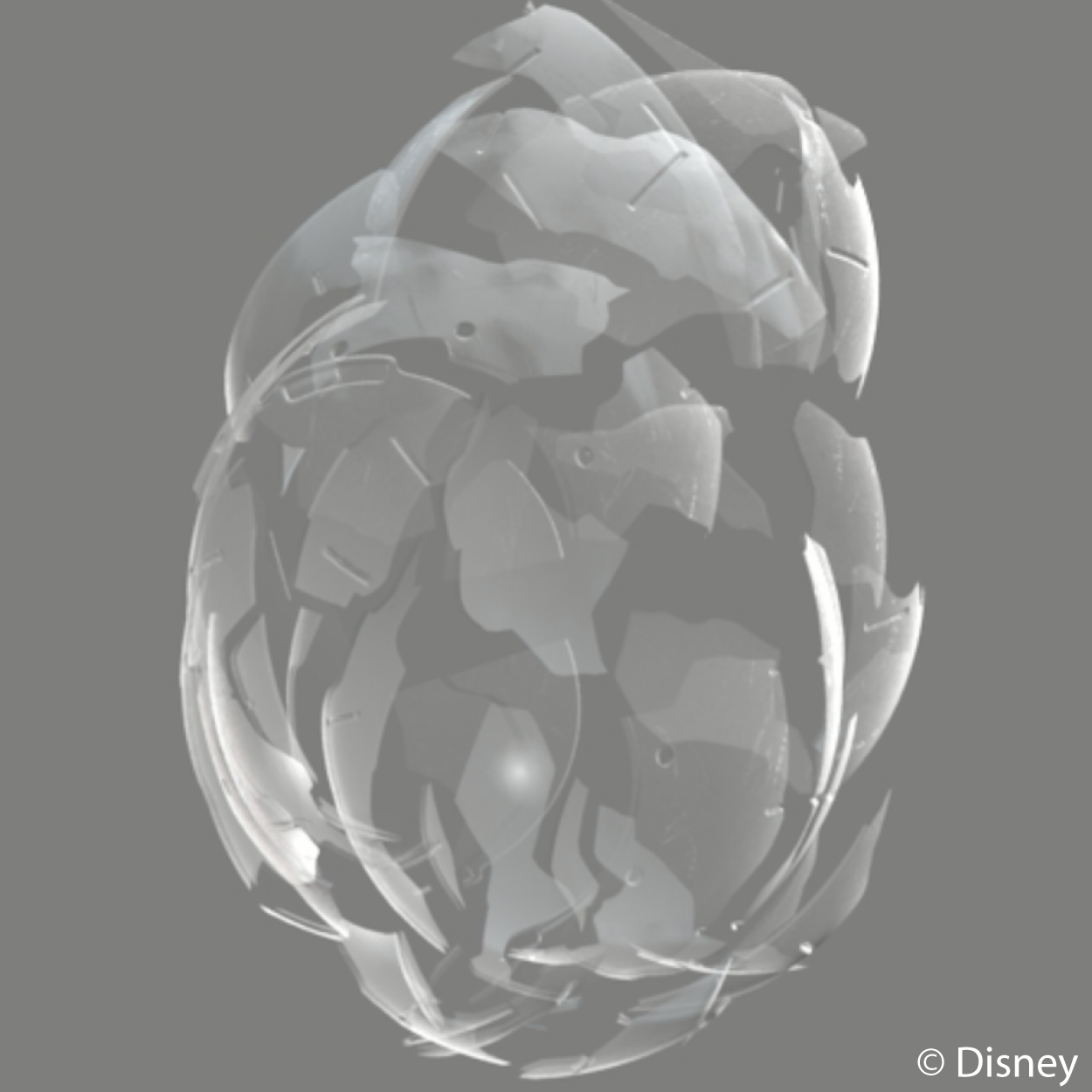
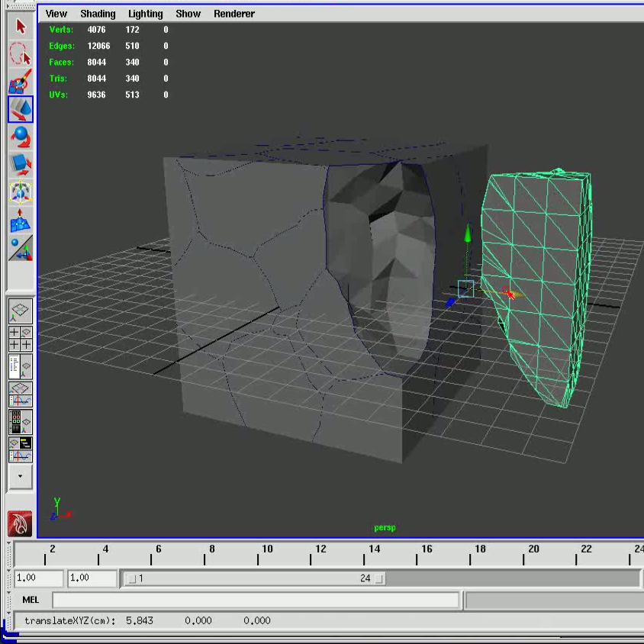


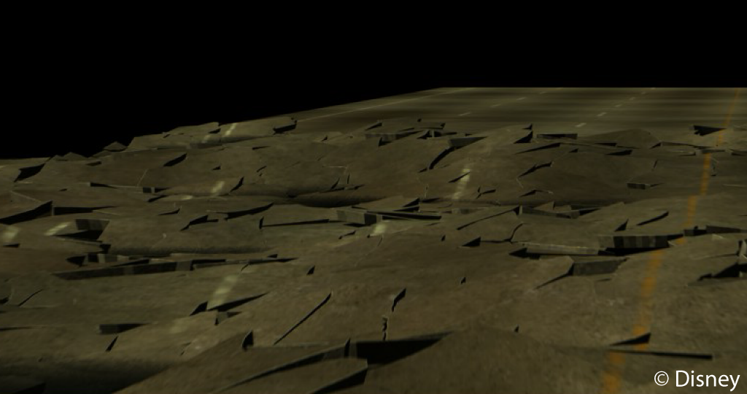
Fracture Dynamics for Visual Effects
While working at Disney, I created a Maya plugin front-end to the cutting algorithm to fracture models along randomly-generated or artist-specified grain boundaries.
[Cue movies.]

Slide 29
Outline
Cutting Algorithm Introduction and Examples
Motivation for More Precision
Adaptive Use of Exact Arithmetic
Cutting Algorithm Redesign
Applications
  Fracture Dynamics for Visual Effects
  Virtual Surgery
  Crack Propagation in 2D and 3D
  Interface Problems in CFD

Slide 30
Virtual Surgery
“Local Flaps: A Real-Time Finite Element Based Solution to the Plastic Surgery Defect Puzzle” by E. Sifakis, J. Hellrung, J. Teran, A. Oliker, C. Cutting (2009).
Cutting is integral to the topology changes necessary in virtual surgery applications.

Slide 31
Removing a Cancerous Region of the Skin

Slide 32
Elongating a Skin Scar

Slide 33
Outline
Cutting Algorithm Introduction and Examples
Motivation for More Precision
Adaptive Use of Exact Arithmetic
Cutting Algorithm Redesign
Applications
  Fracture Dynamics for Visual Effects
  Virtual Surgery
  Crack Propagation in 2D and 3D
  Interface Problems in CFD

Slide 34
Crack Propagation in 2D
“An Adaptive Hybrid Mesh Quadrature Rule for Crack Propagation” by C. Richardson, J. Heggeman, J. Hellrung, E. Sifakis, J. Teran (in preparation).
We've used the cutting algorithm in 2D together with XFEM ideas to:
  automate the increase in degrees of freedom along the crack and at the crack tip; and
  develop an accurate quadrature rule for integrating the crack tip enrichment functions.

Slide 35
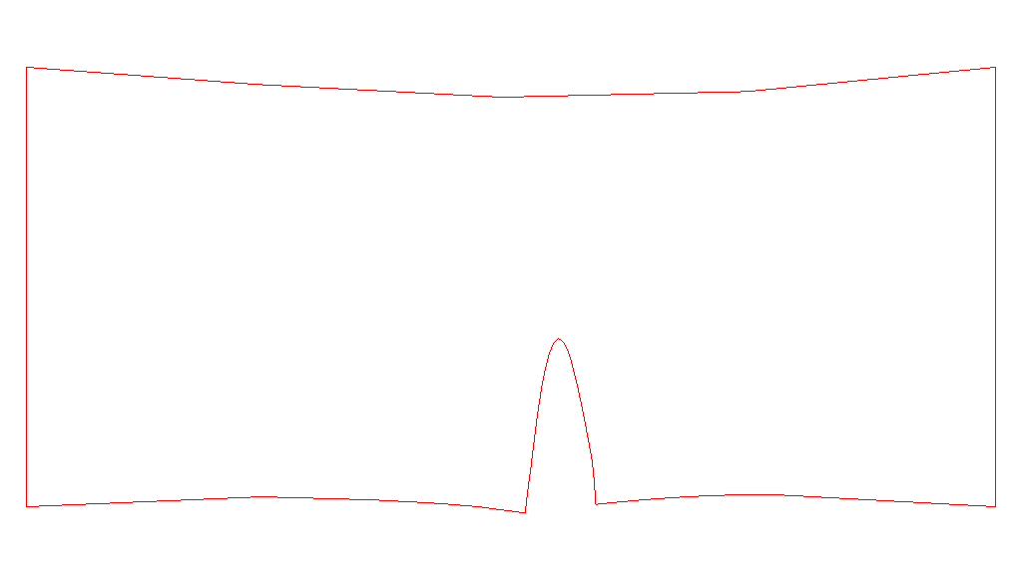
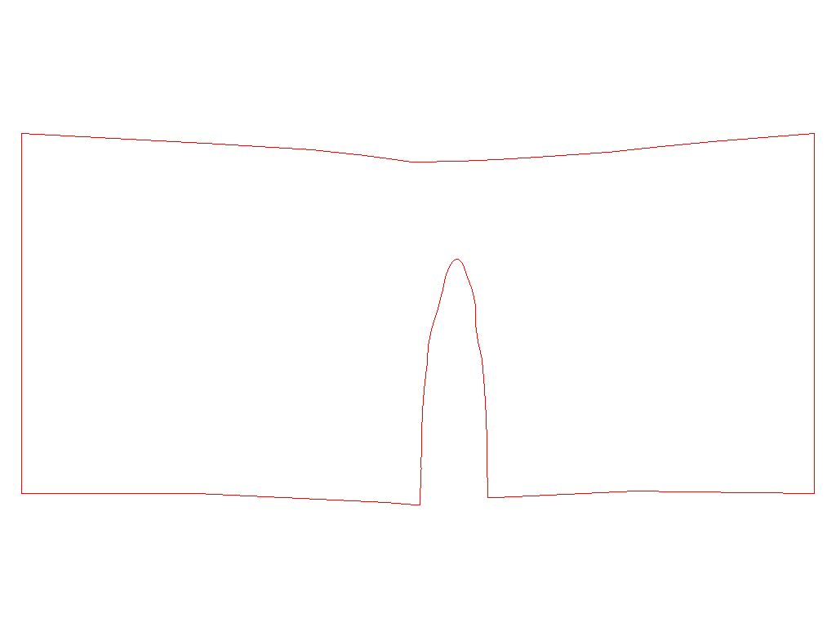
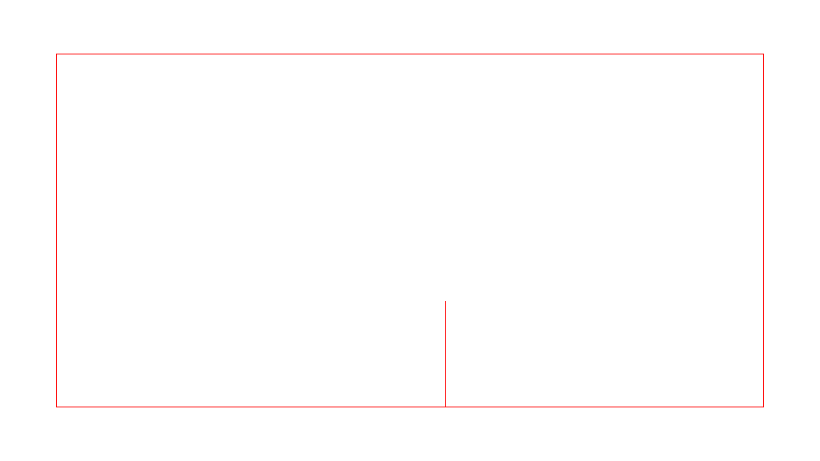
Crack Propagation in 2D
A single crack propagates upward when the edges of the rectangle are pulled apart.

Slide 36
Crack Propagation in 3D
We took a different approach in 3D than 2D, focusing on computer graphics applications.
Idea: Use a low resolution simulation volume (for faster simulation) together with a high resolution fracture surface (for visual detail).

Slide 37
Crack Propagation in 3D
Problem: Stress can only be resolved to the resolution of the simulation volume. Thus, a stress-based criteria for crack initiation and propagation would not work well with a fracture surface of a finer resolution than the simulation volume.
Solution: Locally refine the simulation volume around “active” initiation and propagation regions, increasing the degrees of freedom to better resolve the stress.

Slide 38
Local Refinement (2D Analog)
Master simulation mesh
Slave simulation mesh

Slide 39
Local Refinement Details
We locally refine the simulation mesh in neighborhoods around “active” areas of the simulation mesh, e.g., around crack tips, creating “slave” simulation meshes.
Any boundary conditions on the slave simulations (e.g., the yellow on the previous slide) come directly from the “master” simulation mesh.
Each slave simulation is relatively small and fast. Slave simulations are independent of one another, hence can be parallelized.

Slide 40
Proof of Concept
We implemented a framework within which we can apply this local refinement technique using grain boundaries. Thus, the potential fracture surface is fixed at the start of the simulation.

Slide 41
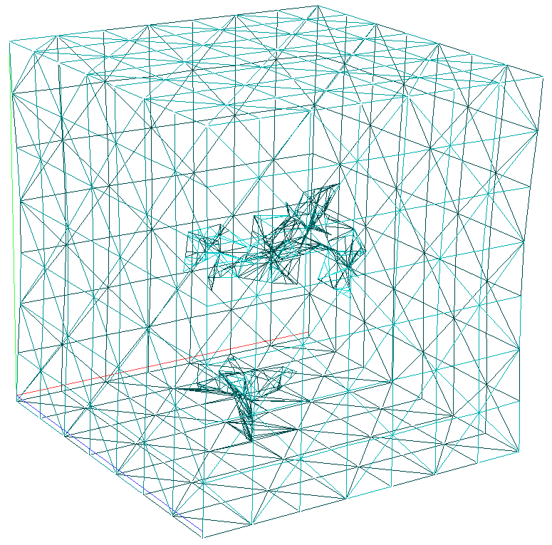
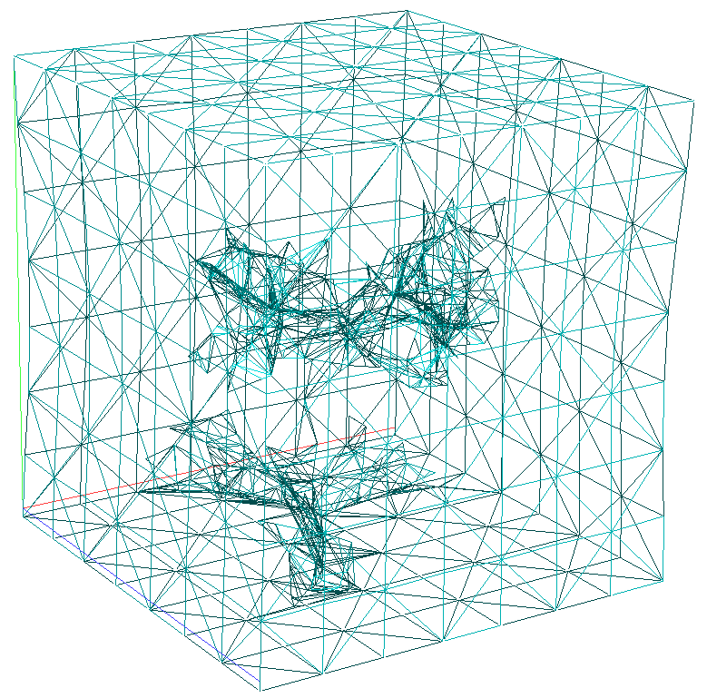
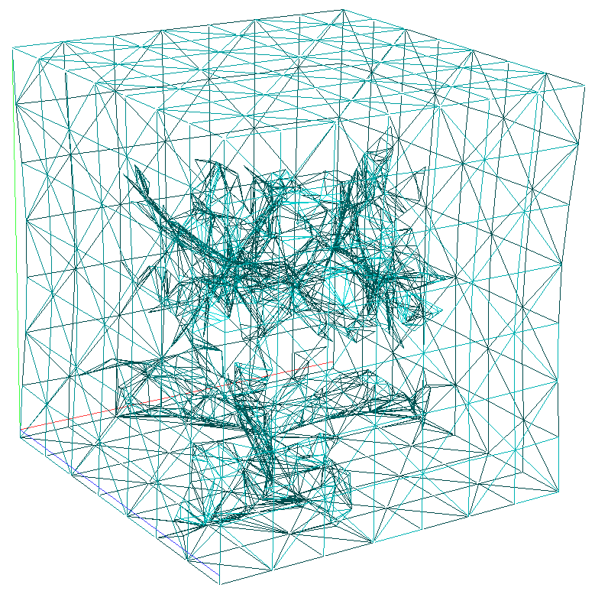
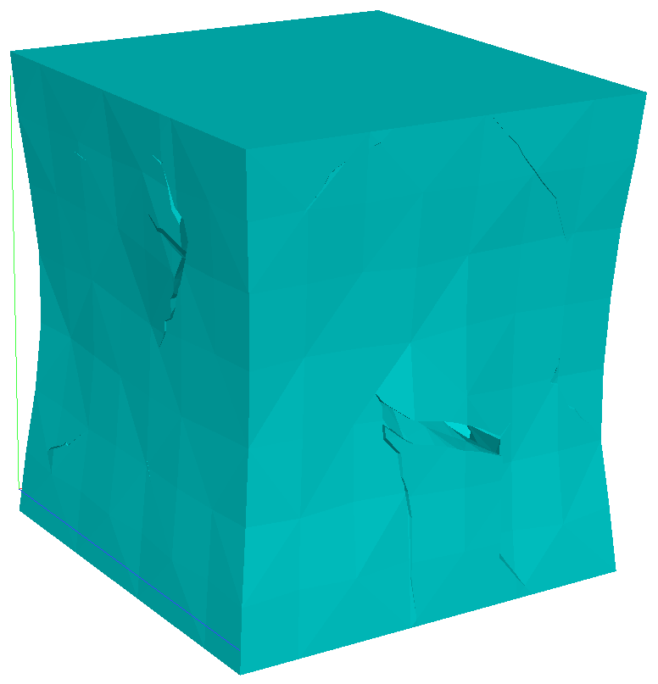
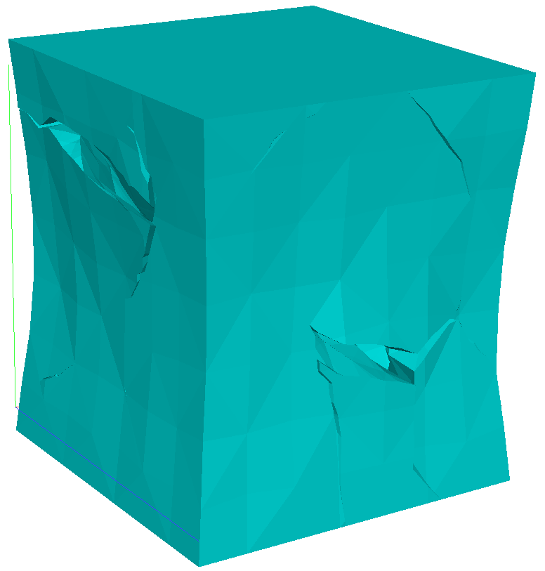

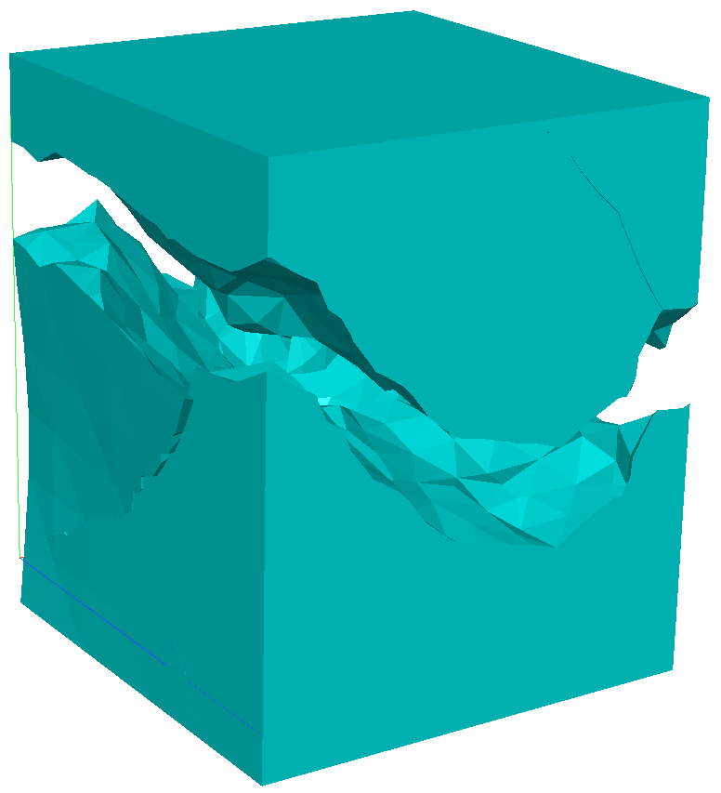
Vertically Stretching Cube
Frame 35
Frame 40
Frame 45
Frame 110
Frame 140
Frame 165
Frame 210

Slide 42
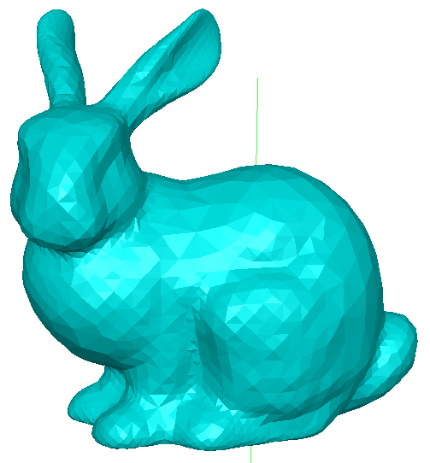
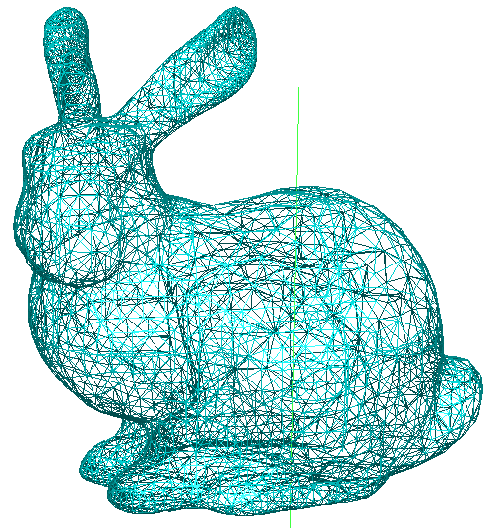
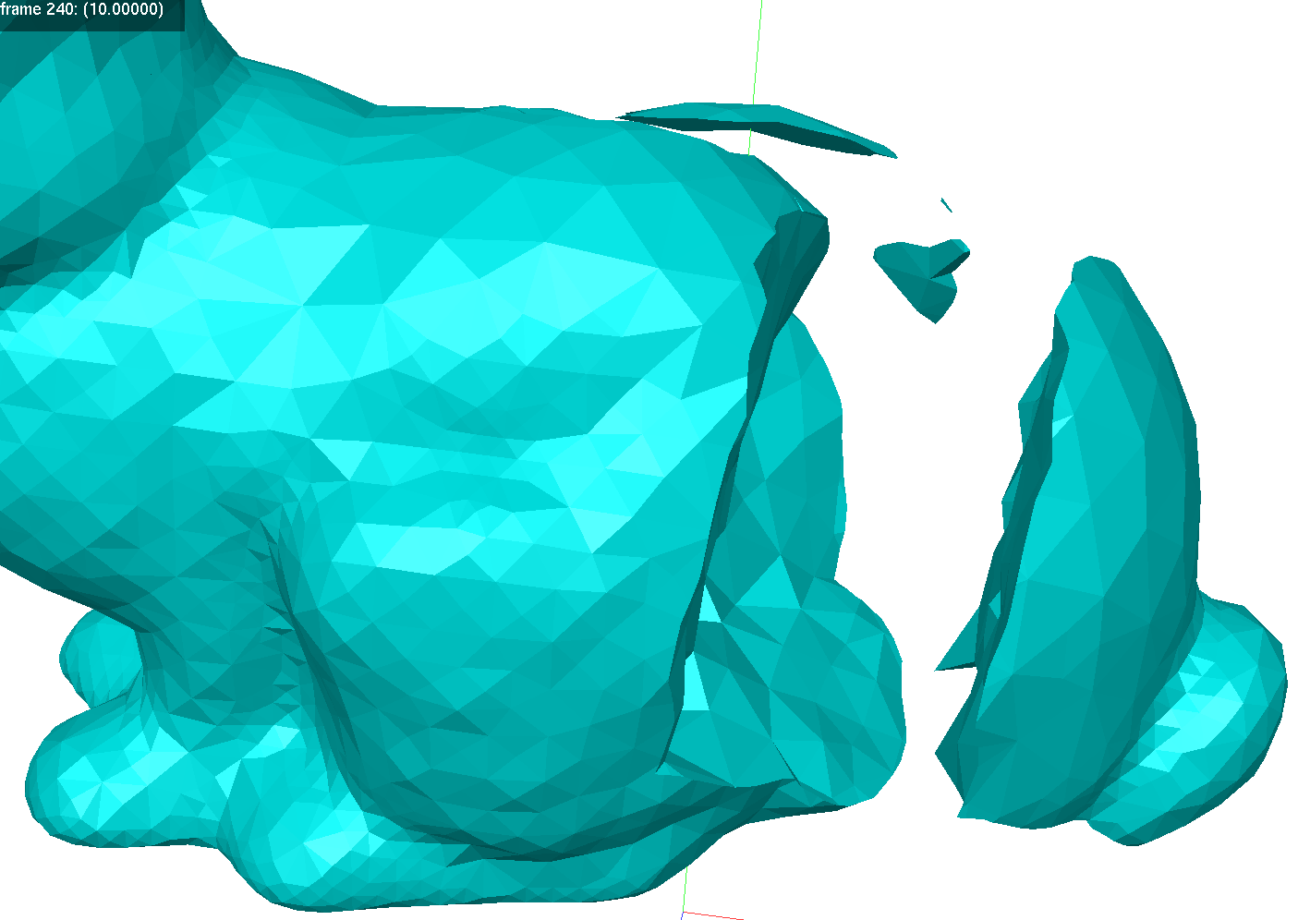
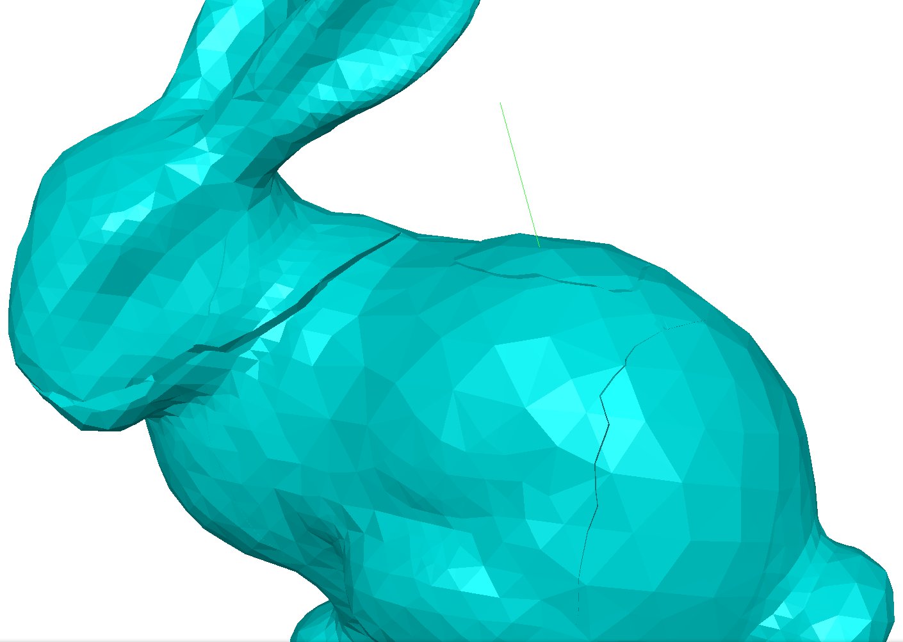

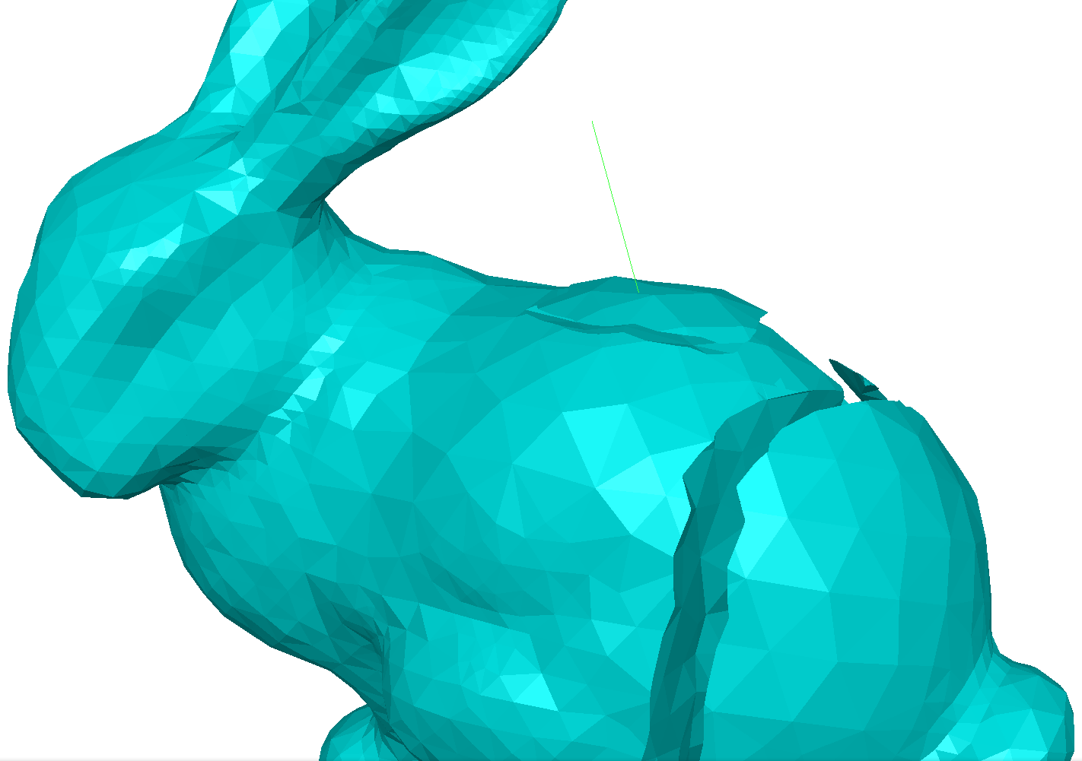
Stretching a Bunny Left-Right
Frame 210
Undeformed, pre-fractured model
Frame 55
Frame 56
Frame 57

Slide 43
Outline
Cutting Algorithm Introduction and Examples
Motivation for More Precision
Adaptive Use of Exact Arithmetic
Cutting Algorithm Redesign
Applications
  Fracture Dynamics for Visual Effects
  Virtual Surgery
  Crack Propagation in 2D and 3D
  Interface Problems in CFD

Slide 44
Poisson Interface Problem
One can use the cutting algorithm as a tool to help solve multi-phase fluid problems.
Γ
D⁻
D⁺

Slide 45
Solution Idea: Apply the Cutting Algorithm
One approach is to duplicate degrees of freedom around the interface, separating the inner and outer parts of the domain D, and account for the cells along the boundary being only partially full.

Slide 46
Questions?

