Slide 1
Geometric Fracture Modeling in Disney's BOLT
Jeffrey Hellrung*, Eftychios Sifakis*†,
Andrew Selle†, Arthur Shek†, Joseph Teran*†
August 3rd, 2009
*UCLA, †Walt Disney Animation Studios

Slide 2
Outline
Introduction
Background on Fracture Techniques
Our Approach
Crack Surface Generation
Look and Texture Transfer
Adaptive Use of Exact Arithmetic
Feature Summary

Slide 3
Motivation
Animation effects are increasingly complex.
Artists want to break apart their models!
  Destruction!
  Explosions!
  Shattering! Smashing!
  Crumbling!
Manually splitting apart animation models gets tedious quickly.
  Large numbers of fragments!
  Must transfer look and texture to fragments

Slide 4
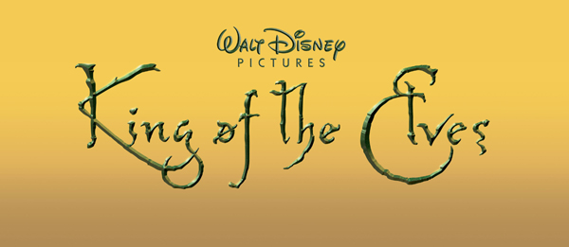
Experimental Work
Disney particularly desired an easy-to-use fracture system for future films, for example:
BOLT provided production-level testing.

Slide 5
Example
BOLT's SuperBark rupturing concrete

Slide 6
Example
Rhino's hamster ball crushing

Slide 7
Background on Fracture Techniques
Various techniques for static fracture
  Mesh boundary fracture
  Implicit surfaces
    [Museth and Clive 08]
    [Weinstein et al 08]
  Constructive solid geometry (CSG)
    [Lee and Pavlov 08]

Slide 8
Mesh Boundary Fracture
Fracture only along mesh boundaries
Can “work in” the fracture pattern to the model
If fracture pattern changes, model must be updated
Must have volumetric model to get volumetric fracture

Slide 9
Implicit Surfaces
Represent all surfaces implicitly (level sets)
Use CSG boolean operations
Fragments do not “fit together”
How to transfer look and texture?
Explicit model surface representation to implicit representation
Divide implicit model surface with implicit crack surface
Implicit fragment surface representations to explicit representations

Slide 10
Constructive Solid Geometry
All objects represented as boolean operation tree with primitive geometries as leaves
Impractical: requires model object and crack surface to be decomposed in terms of primitive geometries

Slide 11
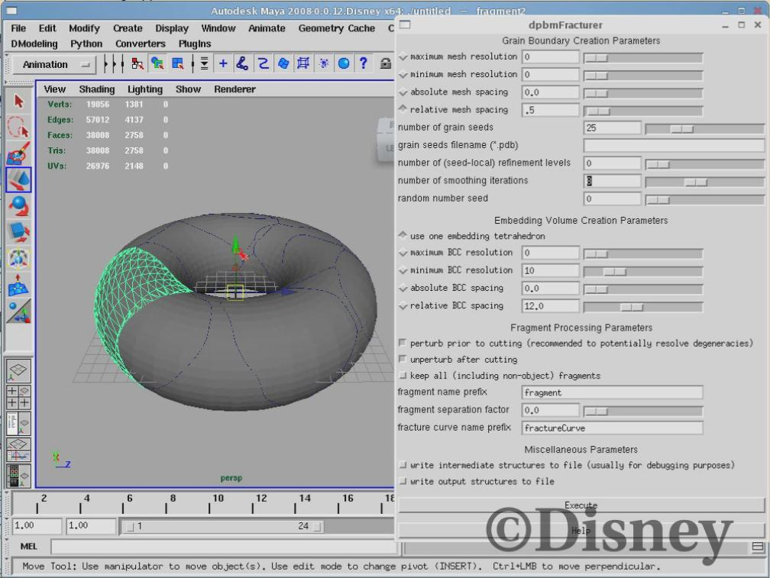
Features of Our Approach
Automatic yet art-directable
Crack surface can be any given tri surface or auto-generated
Fragments “fit together” and coincide geometrically with original model
Graphical Maya plugin interface

Slide 12
Maya Demo

Slide 13
Graphical Overview
Model surface
Fragment surfaces
Volumetric embedding (intermediate stage)
Crack surface

Slide 14
Model Surface
Model object represented as closed triangulated surface
(2D equivalent of a 3D surface)

Slide 15
Crack Surface
Crack surface represented as triangulated surface
Topology arbitrary
  Open or closed
  Non-manifold
May be self-intersecting
Artist-provided or...

Slide 16
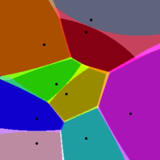
Crack Surface Generation
Artists suggested using “seed points” to specify approximate fracture pattern
Compute approximate Voronoi regions of seed points
Crack surface = union of boundaries between Voronoi regions
Increased seed point density gives finer fracture pattern
(courtesy of wikipedia)

Slide 17
Implementation
Lay down a regular background lattice
Identify lattice elements containing seed points
Flood-fill / BFS around seed elements, forming seed regions
Crack surface = union of all lattice faces bordering 2 seed regions
Subsequent smoothing optional

Slide 18
Crack Surface Generation

Slide 19
Maya Demo (Random Crack)

Slide 20
Volumetric Embedding
Cutting algorithm [Sifakis et al., 2007] resolves intersections between model and crack
Embed both surfaces into background volume
“Cookie cutter” out the volumetric fragments interior to model
Return boundary of volumetric fragments

Slide 21
Look and Texture Transfer
Look and texture properties on model surface are transferred correctly to fragments
Each fragment surface triangle coinciding with the model surface fits completely inside a unique model surface triangle, so this mapping can be done barycentrically

Slide 22
Look and Texture Transfer
Newly generated fragment surface triangles (coinciding with model interior) are specially tagged, so are procedurally texturable
Newly generated surfaces

Slide 23
Maya Demo (Look Transfer)

Slide 24
Complexity of Production Models
Production models are highly detailed
Computing solely in fixed-precision floating point is inherently unreliable, due to rounding
Cannot control interaction between model and crack surface
Rounding may cause misclassification
???

Slide 25
Adaptive Use of Exact Arithmetic
For geometric computations:
  Compute in fixed-precision floating point
    But bound and propagate rounding errors!
  If unreliable results, recompute in exact precision
    Expansion arithmetic algorithms from [Shewchuk, 1997]
Significant increase in robustness
Insignificant performance hit
  Rarely necessary to resort to exact arithmetic

Slide 26
Feature Summary
Easy-to-use graphical Maya plugin interface
Flexible crack surface specification
  Provided by artist
  Generated from seed points (artist-provided or randomly chosen)
Look and textures transferred from model to fragments
Newly-created fragment surfaces specially tagged
Robust geometric computations

Slide 27
Acknowledgements
Dale Mayeda, Disney
Rob Rosenblum, Disney
Erich Turner, Disney

