Slide 1
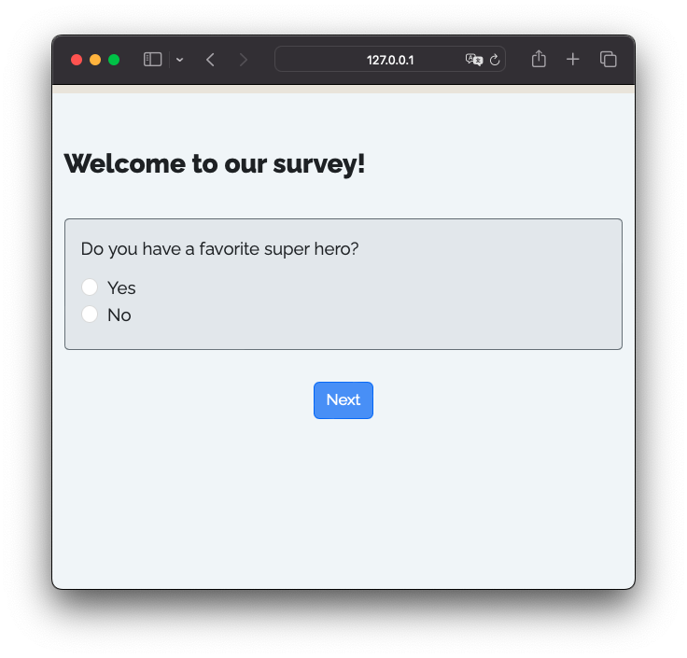


R package that renders Quarto files into surveys
+
=

Slide 2
+
=

Slide 3
Shiny App
UI
+
=

Slide 4

Shiny App
UI
+
=
Server
+

