Slide 1
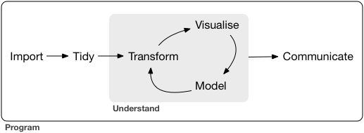

Slide 2
Collect
Data
Survey

