Slide 1
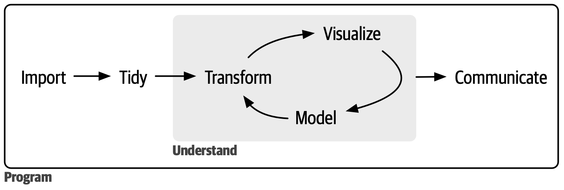

Slide 2

Reproducibility
Version Control
Open Source

Slide 3

Reproducibility
Version Control
Open Source

Slide 4
Reproducibility
Version Control
Open Source

Slide 5

Reproducibility
Version Control
Open Source

Slide 7
Collect
Data
Survey

Slide 8


Reproducibility
Version Control
Open Source
Collect
Data
Survey

Slide 9
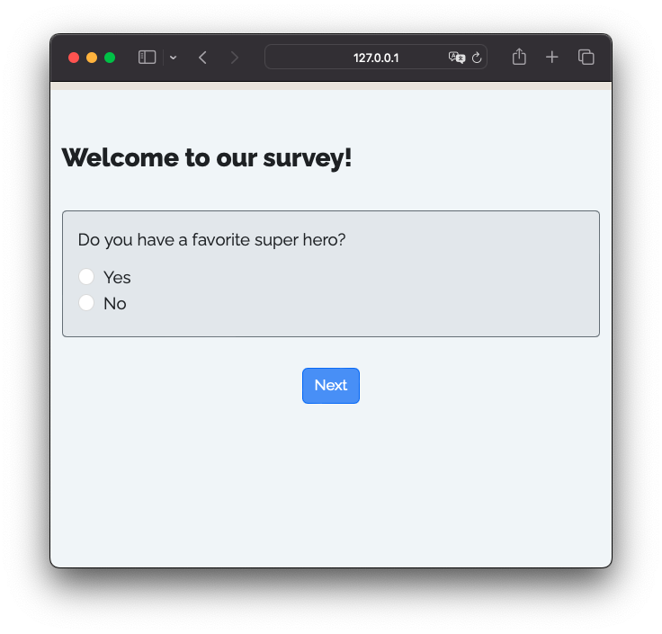

R package that renders Quarto files into surveys
+
=

Slide 10
+
=

Slide 11
Shiny App
UI
+
=

Slide 12

Shiny App
UI
+
=
Server
+

