Slide 1
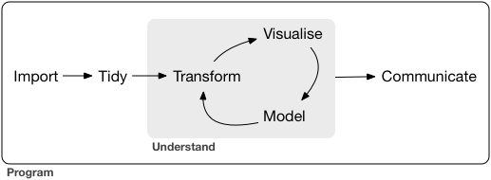

Slide 3


Slide 4


Reproducibility
Version Control

Slide 6

Reproducibility
Version Control

Slide 8
Collect
Data
Survey

Slide 9


Collect
Data
Survey
Reproducibility
Version Control

Slide 10
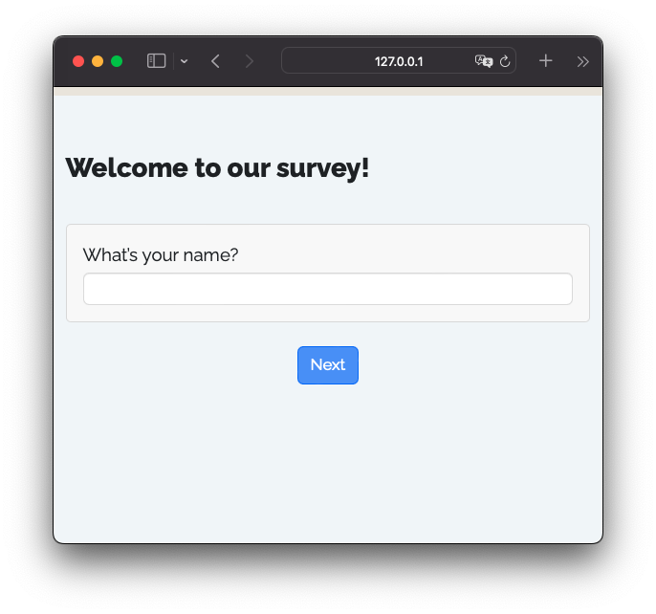

R package that renders Quarto files into surveys
+
=

Slide 11
+
=

Slide 12
Shiny App
UI
+
=

Slide 13

Shiny App
UI
+
=
Server
+

Slide 14
survey.qmd
---
format: html
echo: false
warning: false
---
```{r}
library(surveydown)
```
::: {.sd_page id=welcome}
# Welcome to our survey!
```{r}
sd_question(
type = "text",
id = "name",
label = "What's your name?"
)
sd_next()
```
:::

