Slide 1
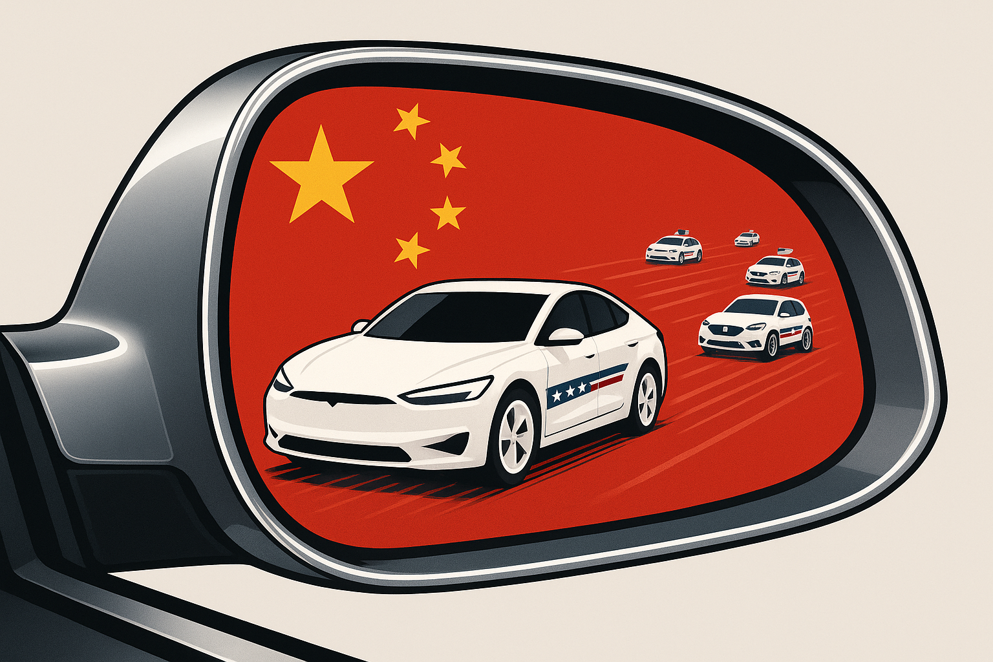
The American EV Transition:
Looking Ahead While Lagging Behind
John Paul Helveston
George Washington U.
May 08, 2025

