Slide 1
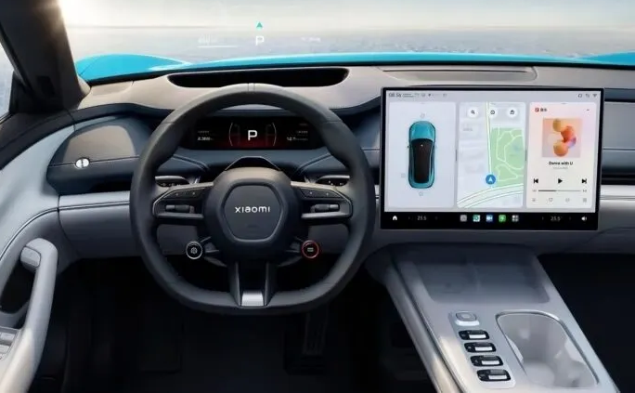
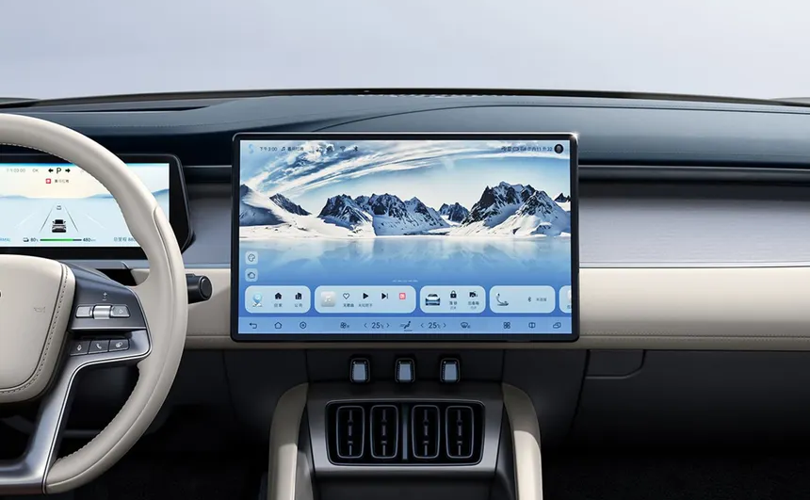
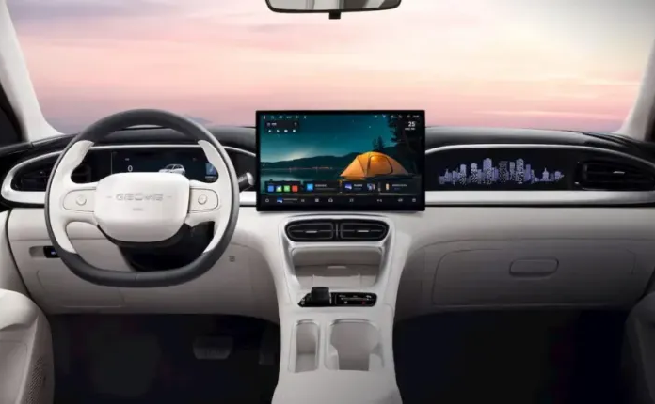
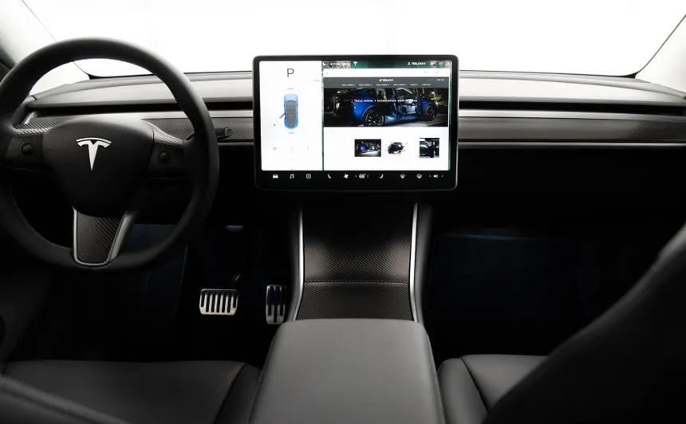
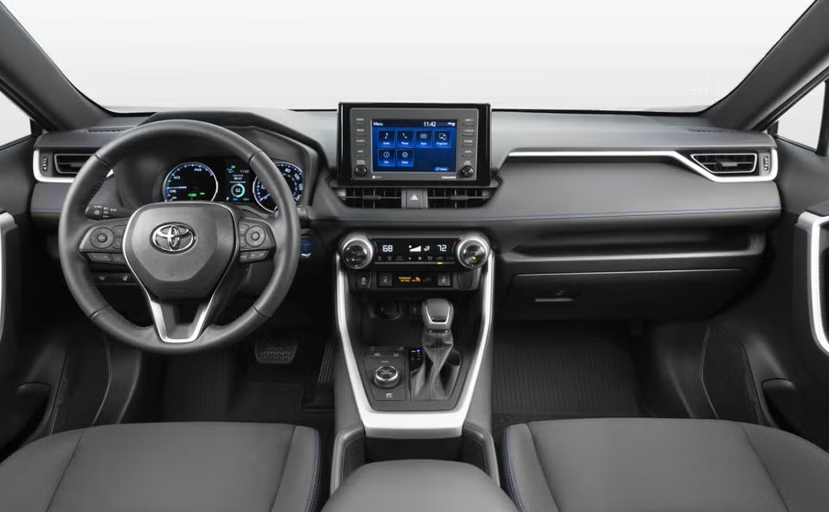
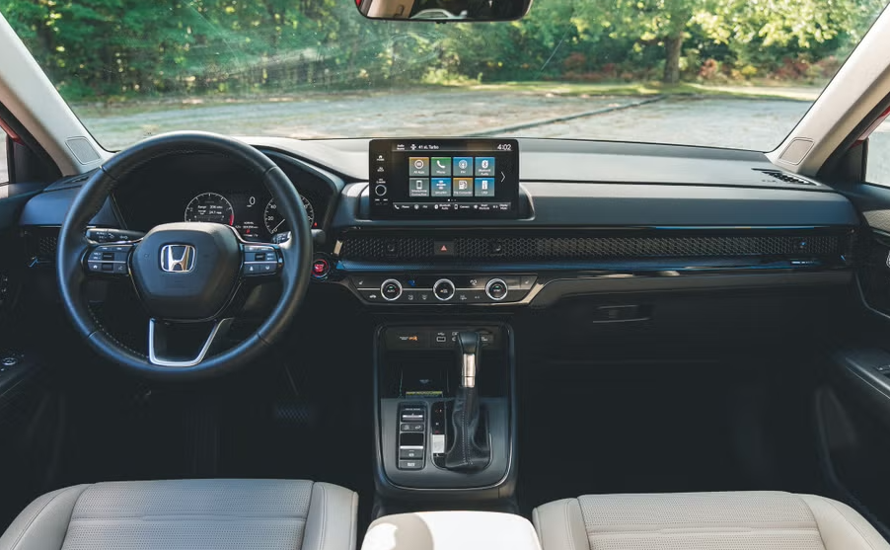
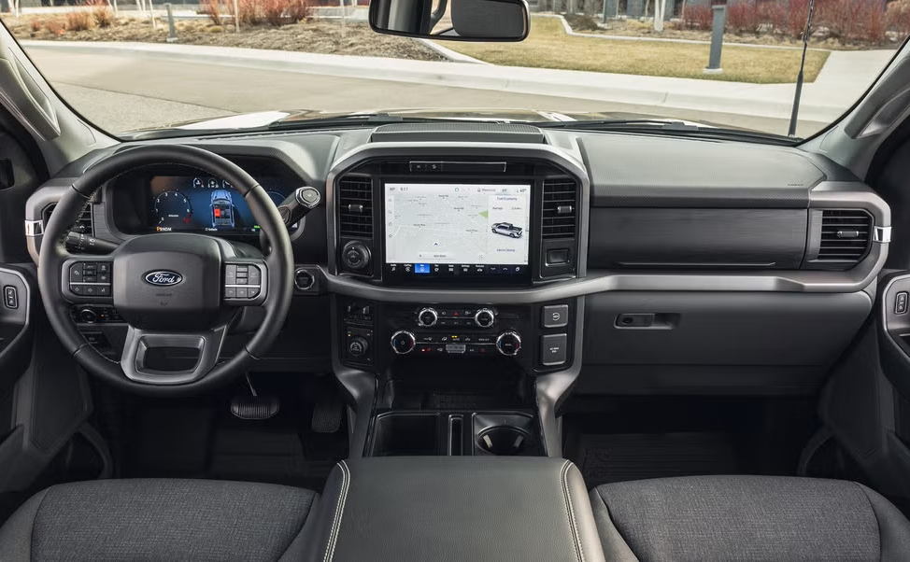
Top 4 Selling Vehicles in China
Xiaomi SU7
BYD Song
Geely Xingyuan
Tesla Model Y
Top 4 Selling Vehicles in USA
Toyota RAV4
Honda CRV
Ford F-150
Chevrolet Silverado

