Slide 1
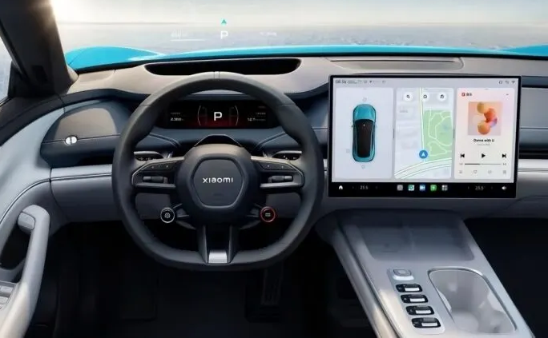
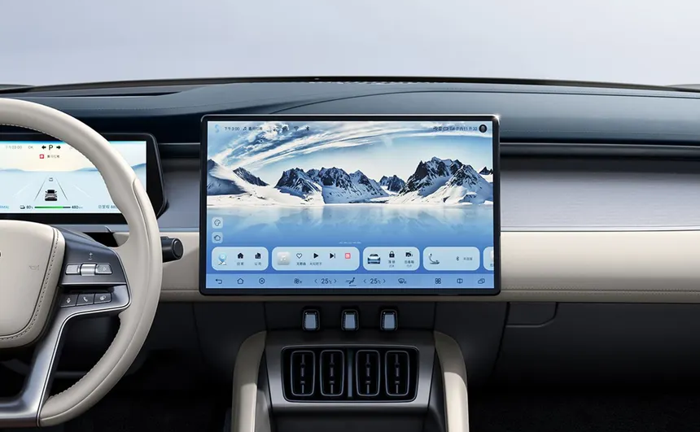

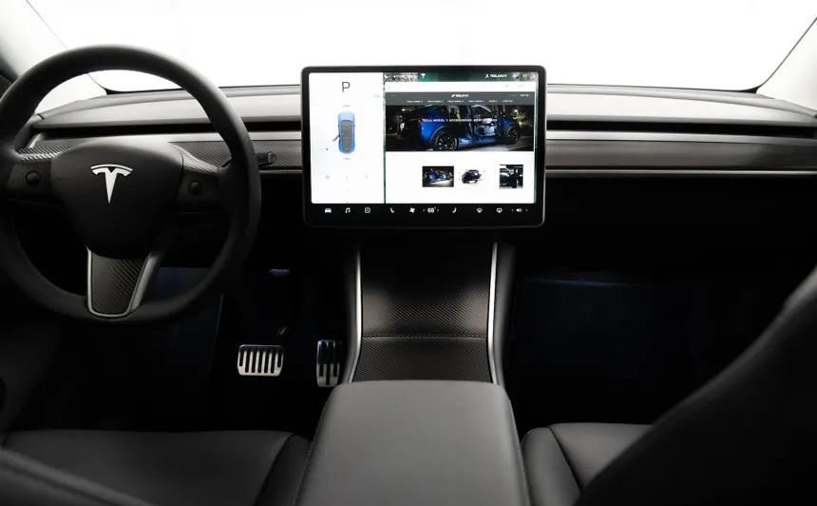
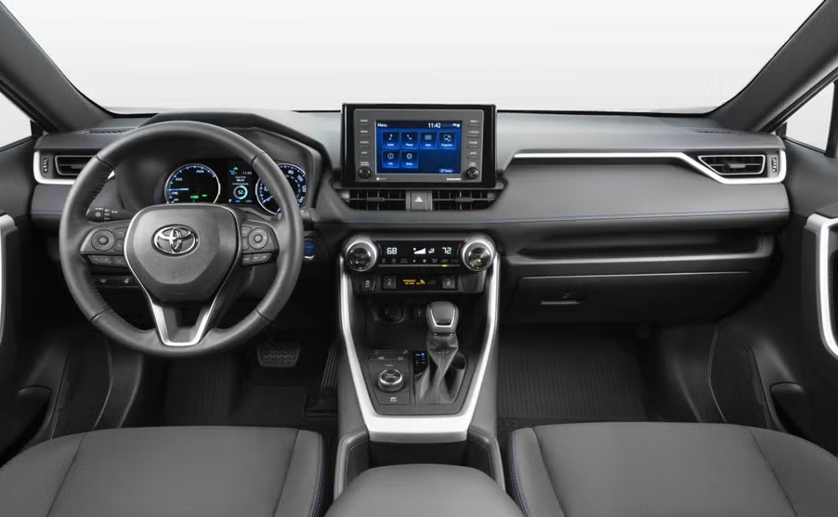
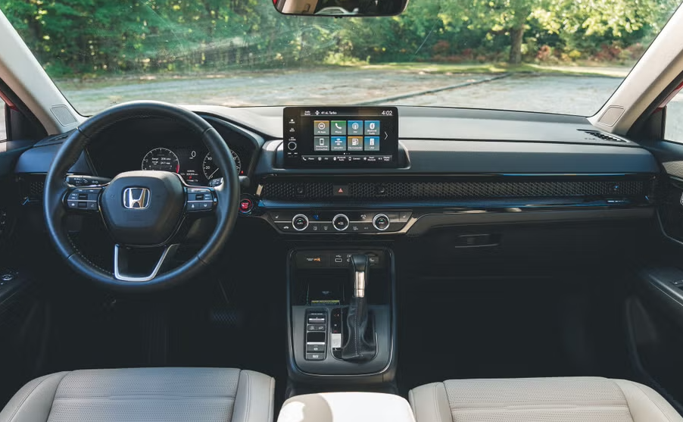
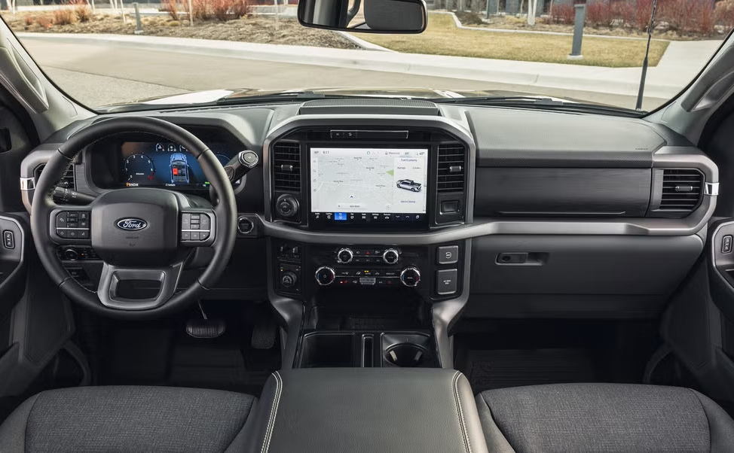
Top 4 Selling Vehicles in China
Xiaomi SU7
$30,171 - $41,909
BYD Song
$24,721 - $38,555
Geely Xingyuan
$ 9,615 - $13,667
Tesla Model Y
$36,822 - $43,809
Top 4 Selling Vehicles in USA
Toyota RAV4
$29,250 - $38,955
Honda CRV
$30,100 - $41,100
Ford F-150
$44,095 - $79,005
Chevrolet Silverado
$42,700 - $70,000

