Slide 1
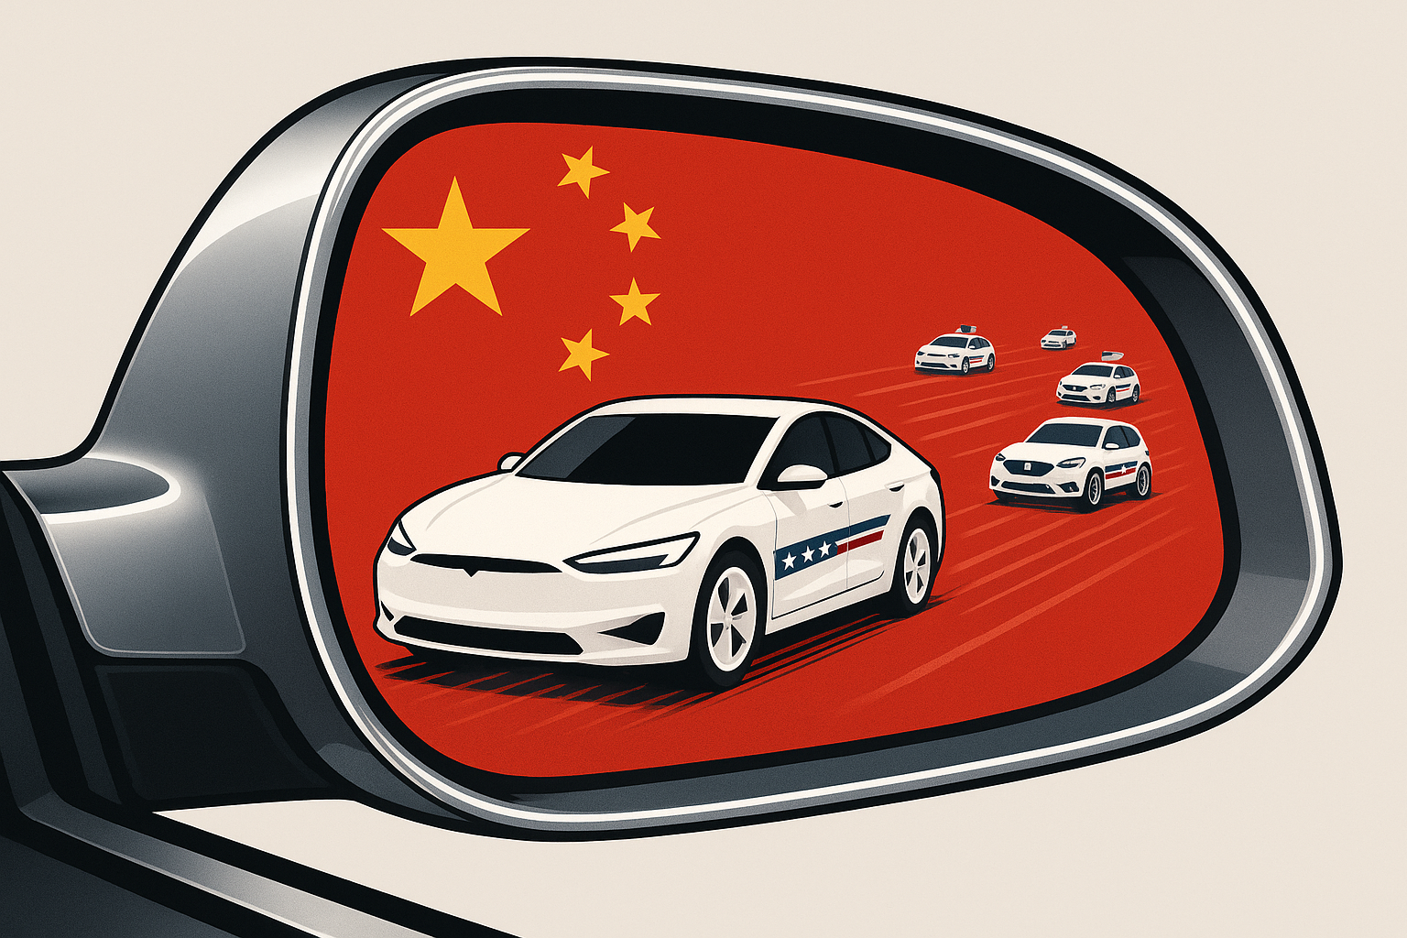
The American EV Transition:
Looking Ahead While Lagging Behind (China)
John Paul Helveston
George Washington U.
April 22, 2026

Slide 2
诸侯
经济
Local
Protectionism

Slide 3
诸侯
经济
内卷
Involution
& “996”
Local
Protectionism

Slide 4
诸侯
经济
内卷
Involution
& “996”
Local
Protectionism
R&D focus on production innovation

