Slide 1
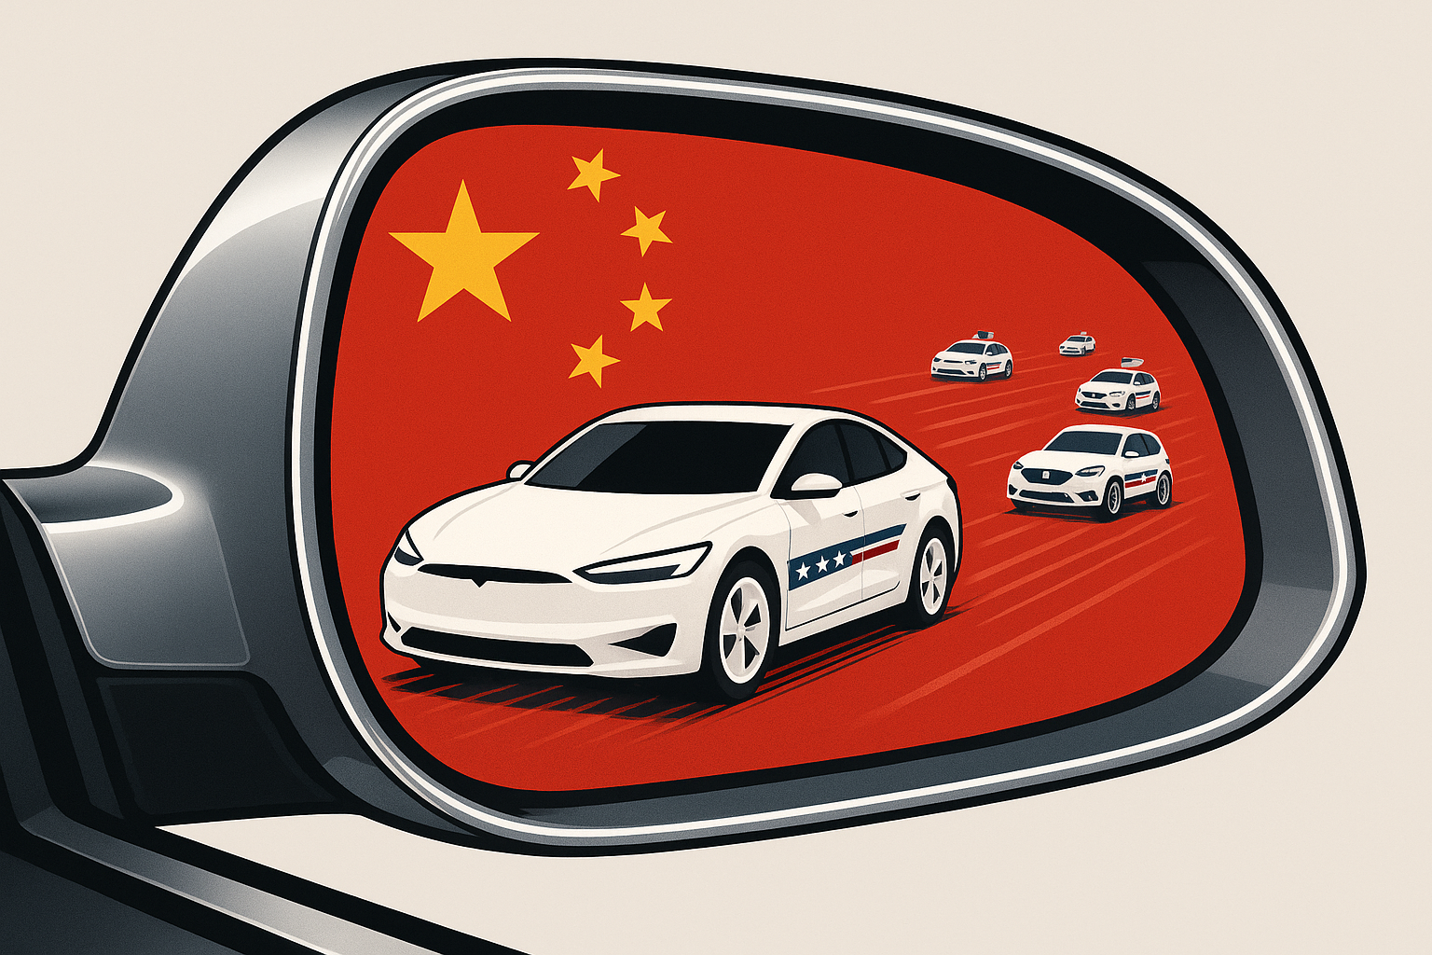
The American EV Transition:
Looking Ahead While Lagging Behind (China)
John Paul Helveston
George Washington U.
April 22, 2026

