Slide 1
The Unreasonable Effectiveness of Quarto
Based on blog post:
https://www.jhelvy.com/blog/2026-05-12-quarto-optimal-claude-output/

Slide 2
Typical Agentic Workflow
Me
Prompt
Agent
Generates
Artifact
(Probabilistic)
Data
Review artifact, then re-prompt

Slide 3
Agentic Workflow with Quarto
Me
Prompt
Agent
Generates
.qmd file
(Probabilistic)
Renders
Artifact
Data

Slide 4
Agentic Workflow with Quarto
Update .qmd file directly (skip agent)
Me
Prompt
Agent
Generates
.qmd file
(Probabilistic)
Renders
Artifact
Data
Review artifact

Slide 5
Agents with Quarto buy you 3 things:
Correctness
Efficiency
Trust

Slide 6
Correctness
Without Quarto: Agent writes probabilistic output; numbers might be wrong
With Quarto: Agent writes structure and code; data flows through code, numbers are computed.

Slide 7
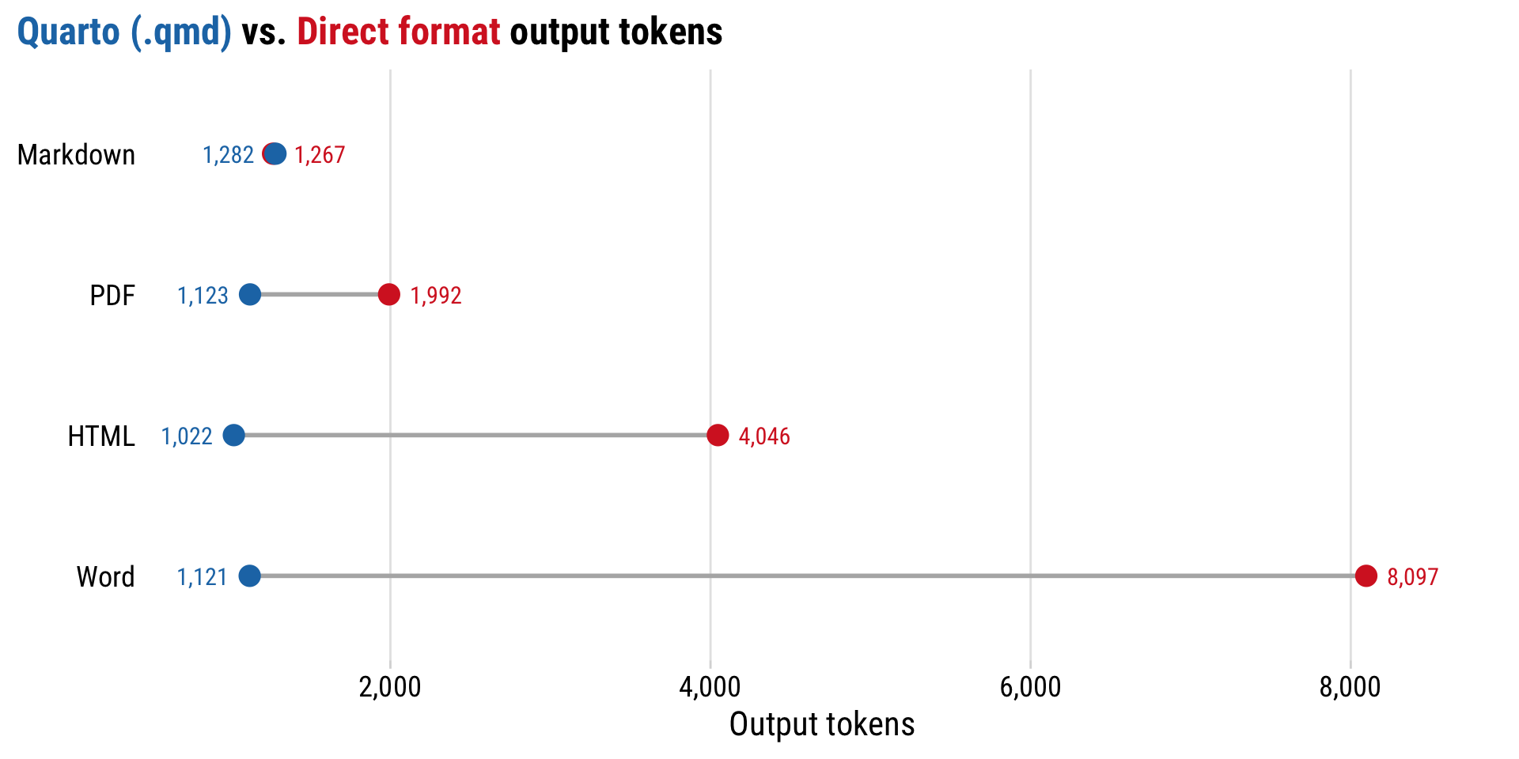
Efficiency
With Quarto, agentic generates markdown, and format is rendered

Slide 8
Trust
Checkable by machine: quarto render fails loudly; (broken references, bad yaml, etc)
Checkable by human: plain-text .qmd source means the agent's edit is a diff.

