Slide 1
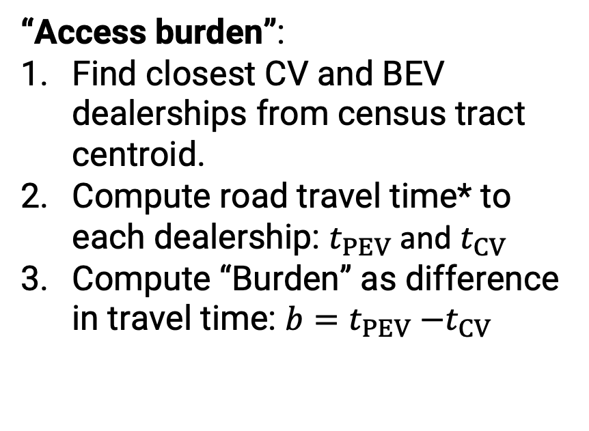


PEV “access burden”: additional travel time to see a BEV
“Access burden”:
Find closest CV and BEV dealerships from census tract centroid.
Compute road travel time* to each dealership: $t_{PEV}$ and $t_{CV}$
Compute “Burden” as difference in travel time: $b=t_{PEV}{−t}_{CV}$
Closest dealer with a PEV
Closest dealer with a CV
$$t_{PEV}$$
$$t_{CV}$$
Centroid
*Road travel times obtained using
Open Street Road Map (OSRM)
Census tract

