Slide 1
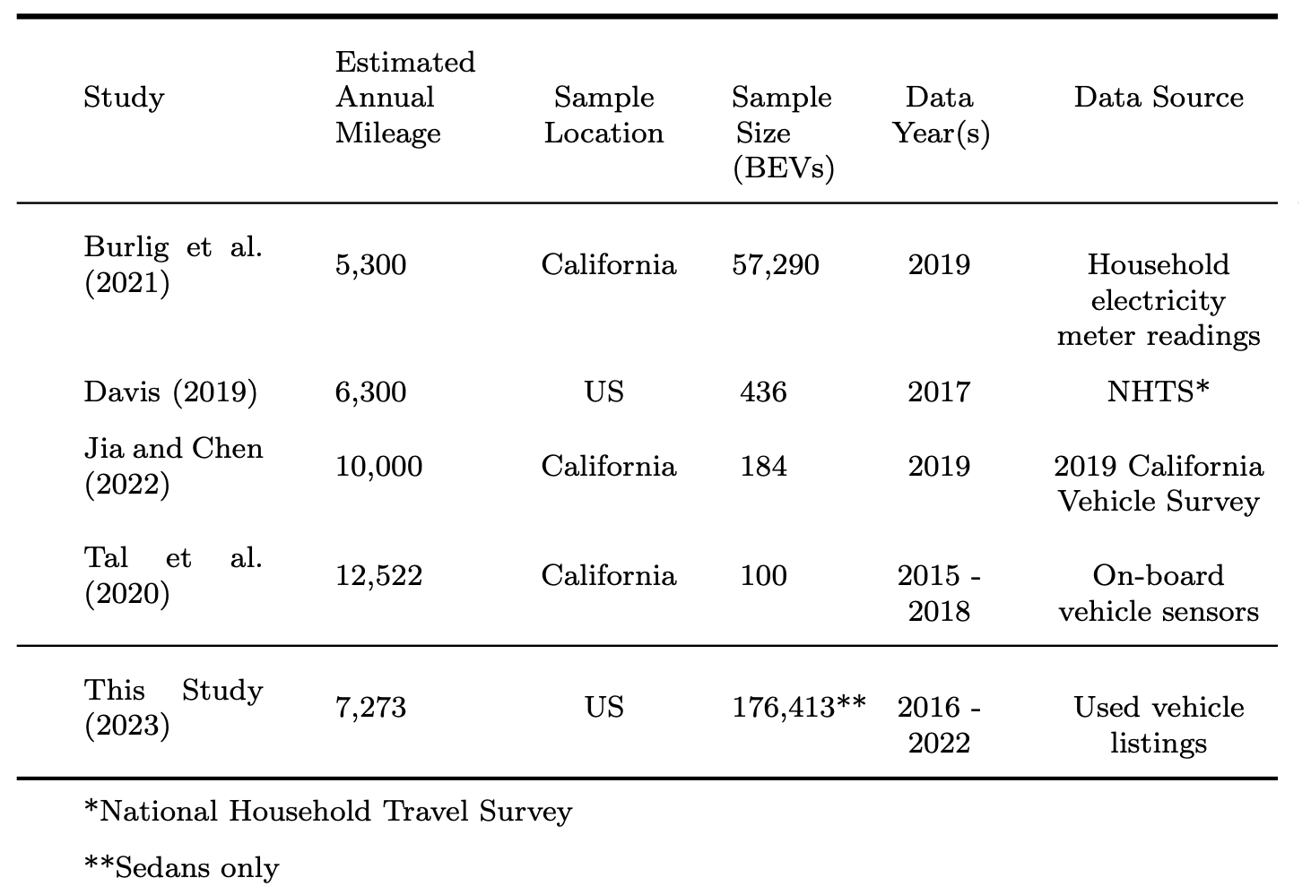

Slide 2
BEV < CV
BEV ~= CV
BEV < CV

Slide 3
Large Sample Size
Nationally
Representative
Direct VMT Measurement
X
 | X
 |  | X
 |  | X
X | X | X
BEV < CV
BEV ~= CV
BEV < CV

