Slide 1
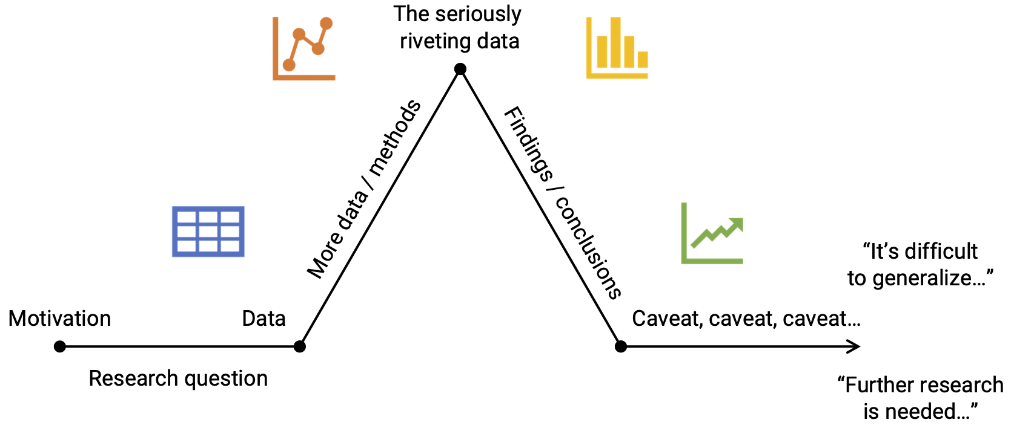
Telling a Story
Slide Design
“A single (static) visualization will rarely tell an entire story” – Clause O. Wilke (2019), Chp. 29.
Use layers or animation to build tension / provide context.
Make charts for the generals (i.e. keep it simple).
Build up towards complex figures.
Be consistent, but don't be repetitive.
Hitchcock’s rule: The size of any object on your slide should be proportional to its importance to the story at that moment.
Slide titles: A single statement about what slide means (in big font!).
Use large font sizes (>40 titles, >24 text).
Use fonts as pre-attentive attributes, e.g. san-serifs for slide text, italic serif for quotes.
Consider using a light-colored background (tan / gray)
Use high contrast between font and background color.
Don’t use silly fonts like Comic Sans, Papyrus, etc.
1 slide, 1 idea: Break up main points into multiple slides.
Slide numbers: bottom-left or bottom-right.
Remove “chart junk”: logos, etc. (exception: small footers).
Consider using handouts.
Starting a Speech
Tell a story, talk about people (“Imagine...”).
Use a shocking factoid (“40k people die in car accidents every year...”).
Ask a question that matters to the audience (“Have you ever...?”).

Slide 2
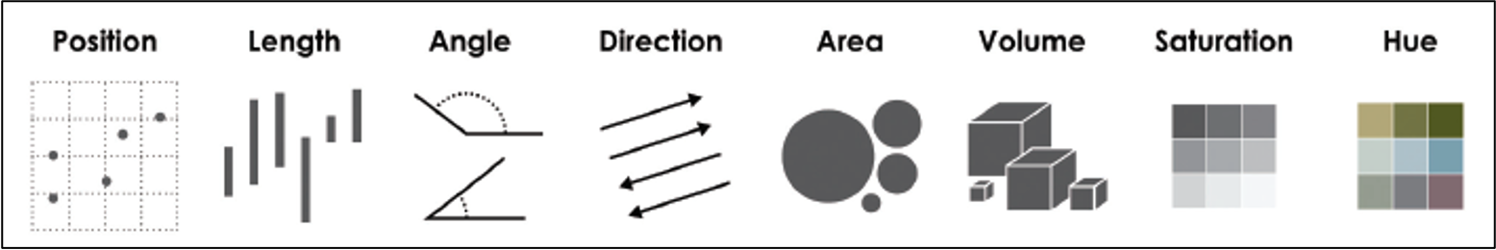
Effective Data Visualization
Two objectives of effective graphs:
Grab & direct attention (iconic memory)
Reduce processing demands (working memory)
Graph components:
Geoms: points, lines, boxes, bars, etc.
Pre-attentive attributes: position, color, shape, curvature.
Non-data ink: scales, grid lines, legend, labels, etc.
No chart junk.
Cleveland’s pattern recognition hierarchy:
Position on a common scale (best)
Position on non-aligned scales
Length
Angle
Area
Color saturation
Color hue (worst)
Data Viz Don'ts
Don't use chart junk
Don't make 3D plots
Don't use pattern fills
Don't use red & green together
Don't lie:
Start bar charts at 0
Don’t cherry pick your data
Data Viz Do’s
Annotate your charts
Eliminate legends
Show amounts with bars, dots, and lollipops
Show proportions with bars and waffles (not pies)
Show trends with lines, bars, and heatmaps

