Slide 1
IoT
PROJECT
3
SMART IoT
Environmental Monitoring
Using Robustel EG5120 Gateway and S6000U Sensor
Machine Learning Edge Intelligence | Telecommunication Engineering Program
Sisay Desalegn • Yonas Yifter • Zakariye Hassan • Meron Temesgen • Jhena Subol • Husayn Ismail • Rima Kasem
Supervisor: Prof. Vincenzo Barbuto | UNICAL | February 2026
UNICAL • 2026

Slide 2
Presentation Overview
Agenda
01
05
Project Introduction
Machine Learning
02
06
System Architecture
Web Platform & Chatbot
03
07
Hardware Components
Testing & Deployment
04
08
Software Stack
Conclusion
Smart IoT Environmental Monitoring | Giganti della Sila Park | Telecommunication Engineering Program

Slide 3
Project Introduction
Giganti della Sila Park — Calabria, Italy
Background
The Smart Park Solution
Giganti della Sila is a protected mountain park in Calabria, Italy, known for its ancient pine forests, hiking trails, and scenic viewpoints.
An IoT-driven ecosystem enabling:
🌡 Continuous environmental monitoring
No real-time environmental intelligence
🤖 AI-based trail recommendations
Limited predictive visitor guidance
📍 Safety alerts & localization
Manual park management systems
💬 Virtual assistant support
📊 Data-driven operational decisions
Smart IoT Environmental Monitoring | Giganti della Sila Park

Slide 4
System Architecture Overview
Three-Tier Architecture | Edge → Fog → Cloud
EDGE TIER
FOG TIER
CLOUD TIER
S6000U Sensor (RS485/Modbus)
Node-RED Orchestration Engine
InfluxDB Cloud (AWS)
EG5120 Industrial Gateway
InfluxDB Time-Series Database
RCMS Remote Device Management
Local ML Inference
Grafana Visualization Layer
Admin Web Platform
GPS GNSS Module
FastAPI Backend Services
RAG Chatbot (Groq API)
Smart IoT Environmental Monitoring | Giganti della Sila Park

Slide 5
Hardware: Robustel EG5120 & S6000U
Industrial IoT Gateway & Multi-Purpose Sensor
Robustel EG5120 Gateway
S6000U Multi-Purpose Sensor
Edge Computing
IP65-rated • 6 sensors in 1 • RS485 Modbus RTU
Node-RED, InfluxDB, Grafana; Python 3; TensorFlow Lite
Address
Parameter
Scaling
0x100
Temperature
Value / 100 (°C)
Industrial Reliability
0x101
Humidity
Value (0–100%)
-Dual SIM failover; IP30 housing
0x102
Light Intensity
Value (lux)
Security
0x103
Noise Level
Value (dBA)
IPsec, OpenVPN, Firewall; SSH/HTTPS
0x104–105
Pressure
IEEE 754 Float (hPa)
0x106
ToF Distance
Value (mm)
Protocol Gateway
Modbus RTU/ASCII; MQTT; HTTP/HTTPS; GPS NMEA
Smart IoT Environmental Monitoring | Giganti della Sila Park

Slide 6
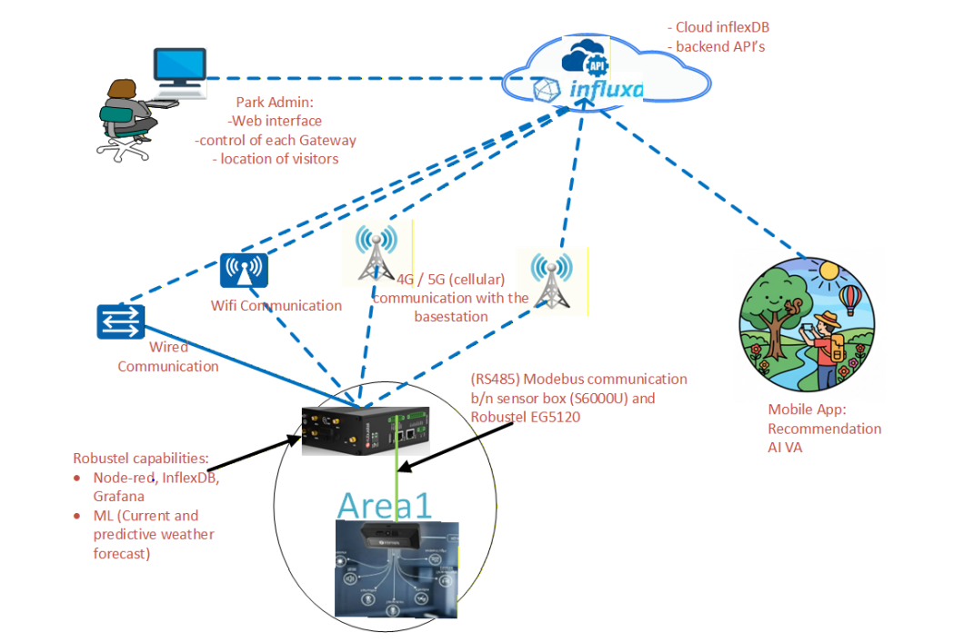

Slide 7
Node-RED Workflow Engine
From sensor data to cloud — 6-step pipeline
1
Data Acquisition
4
Local Storage
Modbus RTU polls S6000U every 30s over RS485. GPS service enabled via Node-RED TCP/NMEA stream.
Writes to local InfluxDB. Enables time-series querying for Grafana. Buffers data during outages.
2
Preprocessing
5
Cloud Sync
Decodes Modbus registers to engineering values. JSON-formats parameters. Parses GPS NMEA for lat/lon.
Forwards data to InfluxDB Cloud (AWS). Enables remote access & integration with admin platform.
3
Data Fusion
6
ML Integration
Merges sensor readings with GPS coordinates into structured JSON for spatially-aware monitoring.
exec node calls predictor.py — Random Forest inference on device. Result stored in InfluxDB & Firestore.
Smart IoT Environmental Monitoring | Giganti della Sila Park

Slide 8
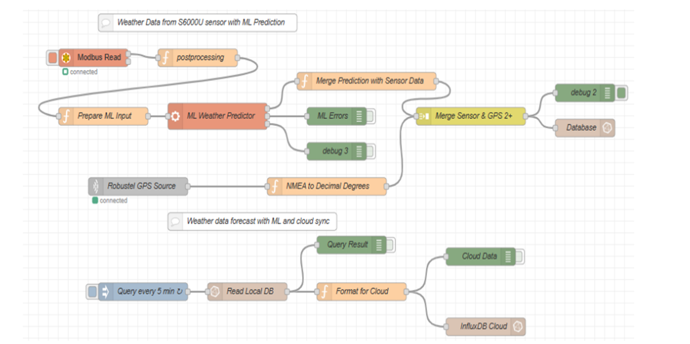

Slide 9


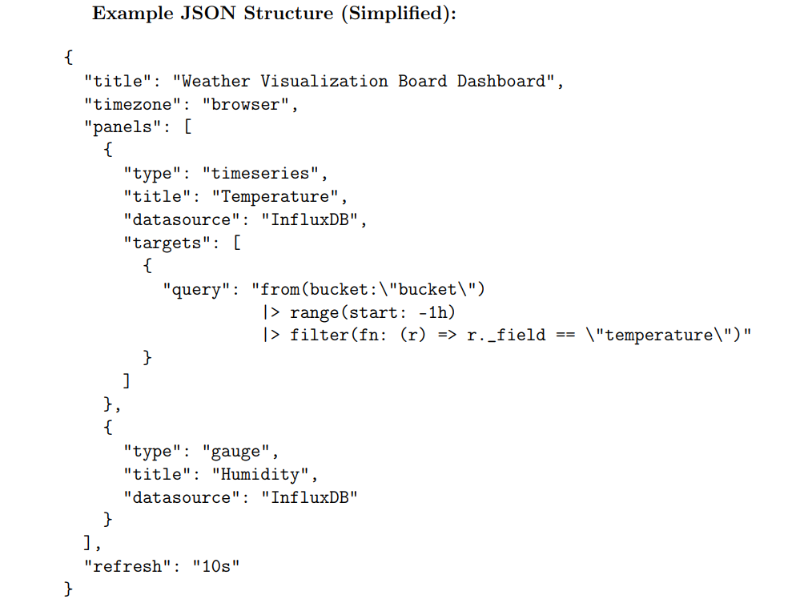
G R A F A N A
Grafana is an open-source analytics & monitoring platform installed in the EG5120 App Centre (MING stack). It connects to Influx DB as a data source and renders interactive, auto-refreshing dashboards.
Dashboard Import Process
Open Grafana Web Interface (port 3000)
Navigate to Dashboard → Import
Upload prepared JSON configuration file
Select Influx DB 2.0 as data source
Click Import — dashboard renders automatically

Slide 10
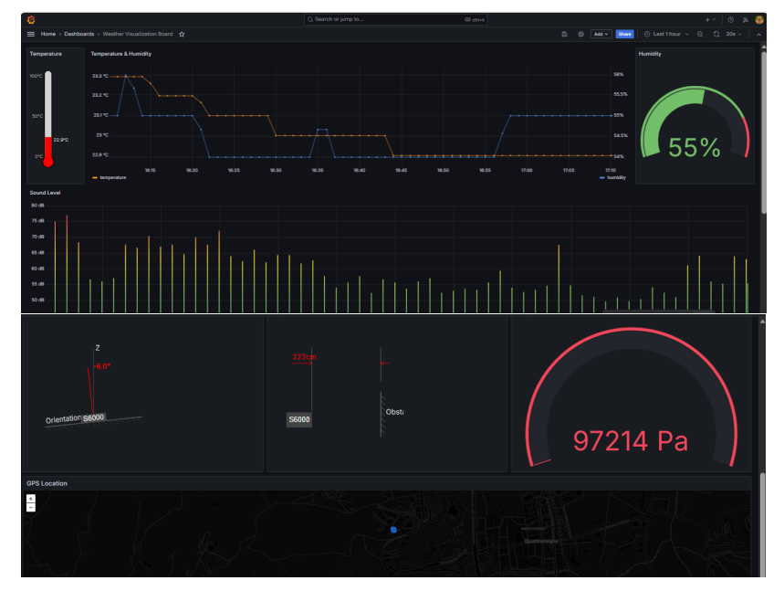

Slide 11
ML Pipeline & Trail Recommendation
From sensor data to personalized hiking suggestions
Open-Meteo
Dataset
Programmatic
Labeling
Train Random
Forest (PC)
Export
.pkl Model
Deploy to
EG5120 (SCP)
Edge
Inference
Weather Vibe Categories
Content-Based Filtering (CBF)
❄ Frosty — Below 0°C
☁ Moody — 10–20°C, Very High Humidity
1
User selects preferences: vibe, slope, width, noise tolerance
🌬 Brisk — 0–10°C, High Humidity
☀ Serene — 15–25°C, Moderate
2
System builds user preference vector from Firestore trail data
🍂 Crisp — 0–15°C, Low Humidity
🔆 Sun-Drenched — Above 25°C, Low Humidity
3
Compute intersection per category (vibe, slope, width, noise)
4
4 category scores aggregated into final match percentage
✅ Near-perfect classification — micro avg precision / recall / F1 = 1.00 across all 6 vibe categories
5
Top 5 trails ranked by match score returned to user
Smart IoT Environmental Monitoring | Giganti della Sila Park

Slide 12
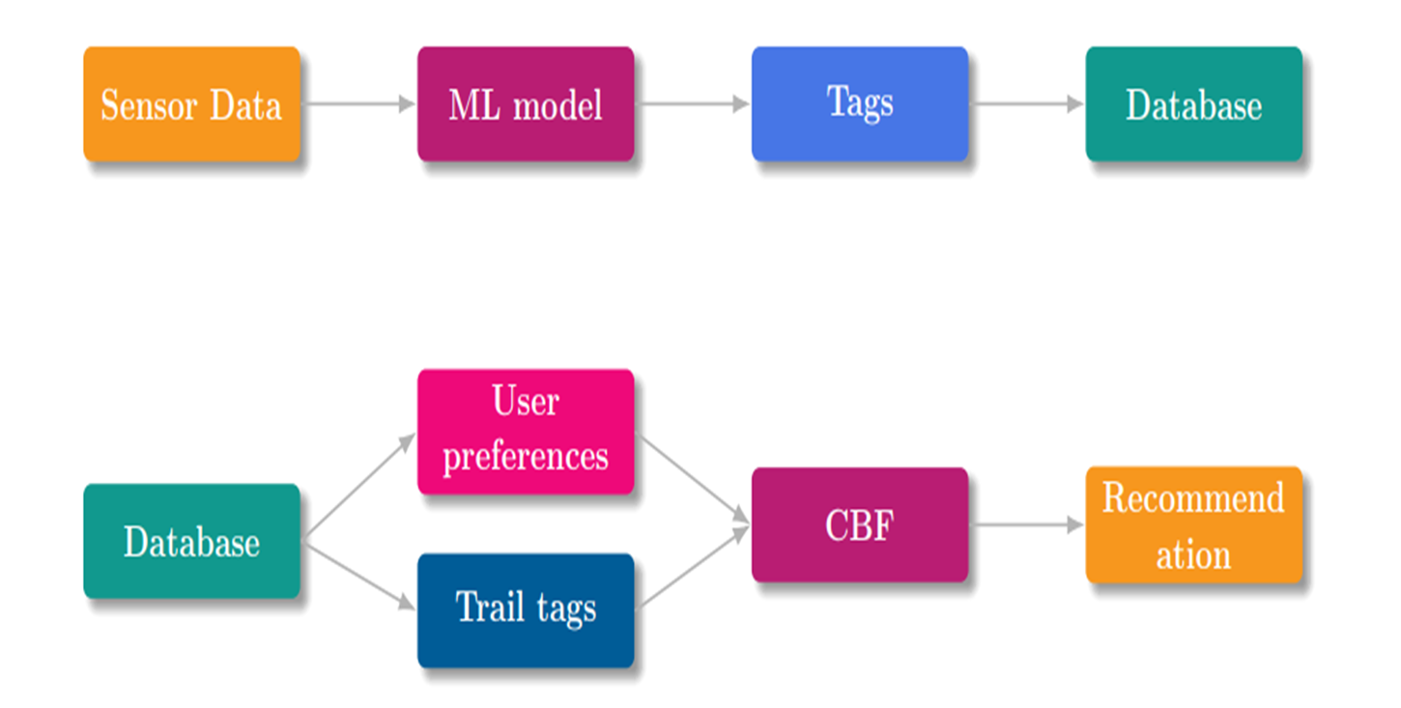

Slide 13
Web Administration Platform & RAG Chatbot
Vue.js 3 Frontend + FastAPI Backend + Groq-powered RAG
⚛️ Vue.js 3 Frontend
🔧 FastAPI Backend
real-time measurements from all deployed gateways
Data Ingestion
interactive GPS map of monitoring stations
Influx DB Integration
historical & real-time trends
RESTful API
Reactive Architecture
Pydantic Validation + Auth middleware + CORS + RBAC
🤖 RAG-Based Intelligent Chatbot (Groq API)
1
2
3
4
5
6
Admin submits query
FastAPI routes request
InfluxDB queried
Constrained prompt built
Groq API inference
Response returned
Smart IoT Environmental Monitoring | Giganti della Sila Park

Slide 14
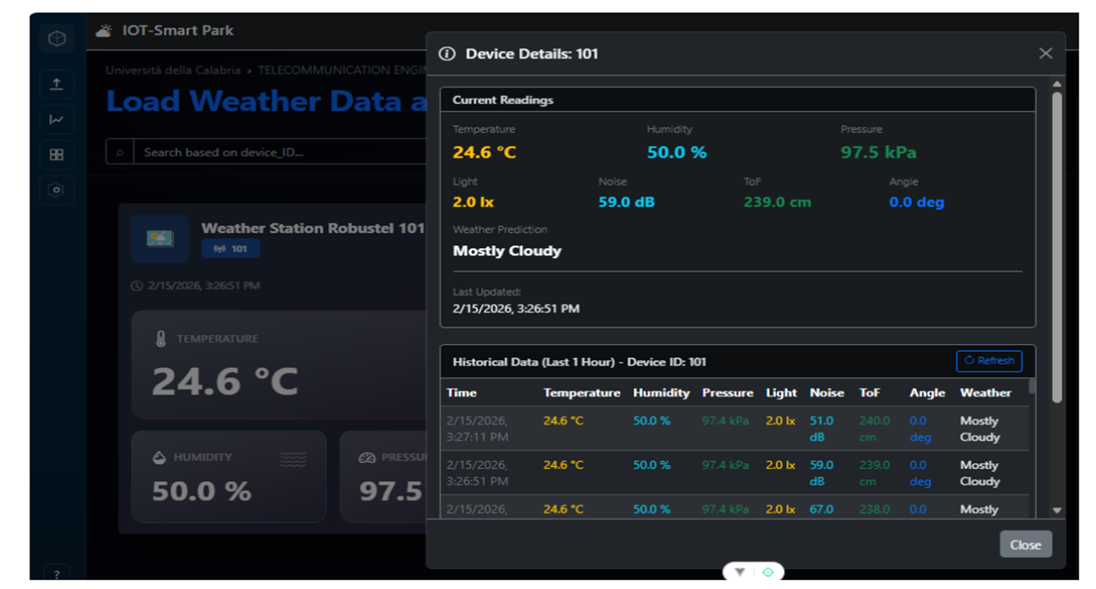

Slide 15
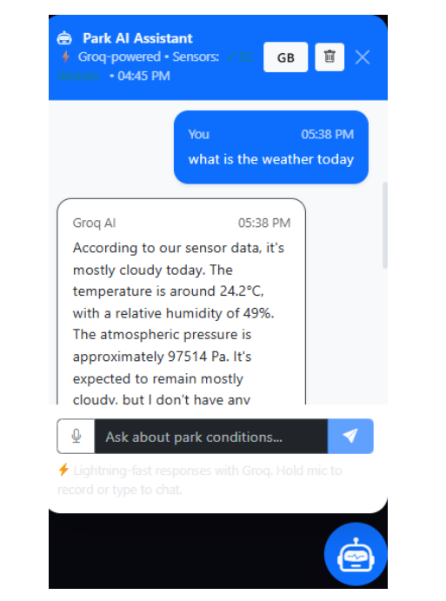

Slide 16
Deployment Procedure
Two-phase deployment: Hardware → Software
🔧 Phase 1: Hardware Deployment
💻 Phase 2: Software Deployment
1
Conduct site survey
Step 1 — Model Transfer
Random Forest exported as .pkl
predictor.py prepared → SCP upload to EG5120
2
Mount S6000U sensor at 2–3m height with unobstructed view
3
Install EG5120 gateway in IP65 weatherproof enclosure
Step 2 — Edge Integration
Model stored on gateway
Node-RED collects data → Python inference
4
Connect RS485 cable (max 1,200m run) and DC 12–24V power
5
Insert SIMs, attach 4G/5G and GPS antennas
Step 3 — Data Pipeline
Sensor → Node-RED → Random Forest → InfluxDB → Grafana
6
Power on and verify LED status indicators
✅ Validation:
Modbus → InfluxDB → Grafana → Cloud → ML → Web Platform
Smart IoT Environmental Monitoring | Giganti della Sila Park

Slide 17
Conclusion & Future Work
What We Built
🚀 Future Work
Mobile App for visitors with real-time trail recommendations And Real-time updates
This project demonstrates a scalable IoT-based environmental monitoring system using the Robustel EG5120 gateway and S6000U sensor with edge machine learning. It enables real-time data collection, intelligent processing, and cloud integration, proving the feasibility of reliable edge-based environmental analytics.
📦 github.com/yonasyifter/IoT_ProjectWeatherForcast
Smart IoT Environmental Monitoring | Giganti della Sila Park

