Slide 1
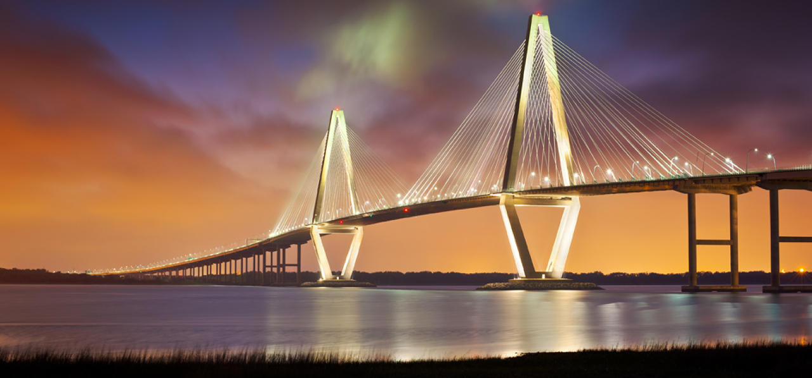
Home
JOBS
TALENT
TRAINING
SCHOOLS
CONTACT
→Index Layout--- index.erb file
Bridging the gap between talent and businesses.
JOBS
TRAINING
TALENT

Slide 2
→Index Layout--- index.erb file <%= yield %> only
Home
JOBS
TALENT
TRAINING
SCHOOLS
PARTNERS
HEADER WILL BE 960 X 30
BUTTONS WILL BE 160 X 30
Rotating Company pics from Spacewalk
JOB HEADER WILL BE 640 X 45 --60 AWAY FROM ABSOLUTE TOP
Rotating-PIC-View
CONTAINER WILL BE 960 X 1280
x1
326
COMPANY PHOTOS WILL BE 320 X 1280 ----60 AWAY FROM ABSOLUTE TOP ADJUSTED RIGHT TO CONTAINER
Job Title
Make an array of job titles
Company date faker
Location City faker
Phone numberfaker
Date Posted date faker
Job Body!
BACKGROUND IS LIGHT BLUE
Job cell button split will be 128 x 25
326
←Partial called :sidebar render_gallery.erb
Partial called :jobs render_jobs.erb →
326

