Slide 1
Interpolation to ob in SE-CAM
Where am I in a logically non-rectangular grid (or an illogically rectangular grid)?

Slide 2
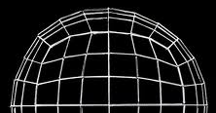
6 ‘faces’ cover the sphere
ne ‘elements’/face edge (6 here)
Each element is defined by a 4x4 grid of
quadrature nodes.
Equations of motion are solved on all the grid points
(‘nodes’) in an element at the same time.
Edge nodes are shared with adjacent elements for this solution,
but are not redundant in the initial file.
Element edges can’t always be identified as N,S,E,W
‘np’ nodes in each direction are not evenly spaced.
3 of the 4 closest nodes to an ob may be outside the
box containing the ob.
o
Nodes are arranged as a 1D array
Adjacent in array ≠ adjacent on sphere
But faces are contiguous (except for edges)

Slide 3
Strategies (based on Lauritzen’s help)
Easiest to implement: use CAM namelist to make it write out state on a lat-lon grid (high resolution?). High order interpolation is used. Fully parallel. We could use the current CAM model_mod. CAM doesn’t (?) read in lat-lon and convert to cubed sphere.
Easy implementation but slow: Use an NCL script (uses ESMF regridding) to interpolate the cubed-sphere CAM output to a (high resolution?) lat-lon grid. Not parallel. More interpolation error. Could use the current CAM model_mod. Will it convert lat-lon back into cubed sphere?
Hard implementation, but very accurate: CAM can write out data at any location. We could feed it the observation locations at each assim time and it would write out the state at the observation locations, and the state on either grid we choose. This removes both potential interpolation errors.

Slide 4
Previous Ideas (may still have relevance)
Form an irregular grid/mesh of ob locations and figure out interpolation weights (ESMF) from the cubed sphere to the obs grid.
Whatever’s used in POP and/or MPAS? Minimal grid metadata is available.
Home grown:

Slide 5
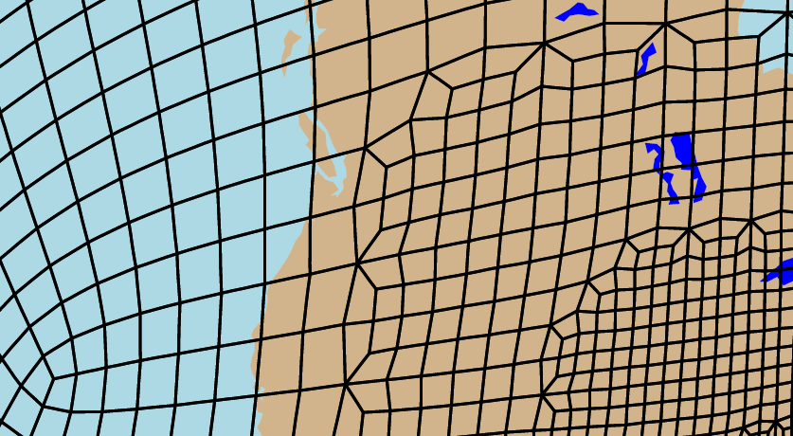
Refined mesh grid: all elements are quadrilaterals, but 3-6 elements may share a node.

Slide 6
5 elements at the boundary between coarse grid and refined grid.
Each element has nodes on its corners, edges, and interior.
The nodes form a 3x3 quilt of quadrilaterals within each element (shown earlier).
‘Neighbors’ are the closest nodes that are not diagonally across the quads.
Store the the number of neighbors,
and the list of neighbors of each node
once before any assimilation.

Slide 7
HommeMapping.nc contains neighboring node information
But it needs to be turned ‘inside out’.
It will give the names of 4 nodes around a ‘center’, aka 4 nodes defining a quad.
ncorners[0] ncenters[0] element_corners[0]=1
ncorners[1] ncenters[0] element_corners[48600]=5
ncorners[2] ncenters[0] element_corners[97200]=6
ncorners[3] ncenters[0] element_corners[145800]=2
ncorners[0] ncenters[1] element_corners[1]=2
ncorners[1] ncenters[1] element_corners[48601]=6
ncorners[2] ncenters[1] element_corners[97201]=7
ncorners[3] ncenters[1] element_corners[145801]=3
C₆
C₇
C₈
9
10
11
12
C₃
C₄
C₅
5
6
7
8
C₀
C₁
C₂
C₉
1
2
3
4
But we want the names of the neighbors of a given node
Node ‘6’ has 4 neighbors: 7,2,5,10
Store quads/centers associated with each node in a file before any assimilation.
Lats and lons of nodes are given in the CAM initial file.
Same node labeling as in HommeMapping.nc.

Slide 8
Bearings are also useful
‘Bearing’: direction from one point on a sphere to another along a great circle.
North
Not a cheap calculation, so store the bearings from each node to each neighbor before any assimilation.
For the 1° refined grid,
num_nodes = ~147,000,
num_neighbors = ~4,
so ~600,000 bearings.
Θ
1° standard grid: 1/3 as much
θ = atan2( sin(Δλ)*cos(φ₂), cos(φ₁)*sin(φ₂) − sin(φ₁)*cos(φ₂)*cos(Δλ) )
λ = longitude Φ = latitude 1=starting point 2 = destination
formula from http://www.movable-type.co.uk/scripts/latlong.html
Notes:
Jeff pointed out that if nodes can go arbitrarily close to the pole, that all of the bearings to neighbors would converge to the value ‘south’ or 180.
The regular cubed sphere (at least with np=even) doesn’t behave that way, but what about a refined grid with a transition zone over a pole?

Slide 9
What’s the bearing at/near the poles?
Initial point at the pole (and ‘0E’)
Initial point displaced towards 0E
89N,180E
89N,180E
0
0
89N,270E
90N,0E
89N,90E
89N,270E
89N,90E
270
90
89.59.00N,0E
089°02′43″
270°57′17″
180
89N,0E
180
89N,0E
So if λ₁ is specified as 0E, then bearing from pole to a point = λ₂.
This is consistent with initial points near the pole:
the bearings of those points are nearly their longitudes,
differing in the way we would expect.

Slide 10
Grid Metadata Generated and Stored Before Assimilation.
The 4 nodes that define with each quad.
The 3-6 quads that surround each node.
The 3-6 neighbors of each node.
The neighbors’ bearings from each node.
The longitude and latitude of each node.
The coarse grid spacing and number of nodes in the grid.
What do we do with all this?
Identify the quad which contains an observation.

Slide 11
In model_mod:
ΔΦ<g
o
Read in the grid metadata.
Get the (lon,lat) of the ob.
Search for the 2 nodes closest to the ob
All but a few nodes are quickly rejected because their lat or lon (adjusted for latitude) is farther than the coarse grid spacing, g, from the ob location.
Distances of the ob to the close nodes are calculated by a spherical distance formula (at least near the poles).
The closest node which is a corner of the quad that contains the ob is chosen. More on that later.
Δλ<g/cosΦ
d = acos( sin(φ₁)*sin(φ₂) + cos(φ₁)*cos(φ₂)*cos(Δλ) )
(units of earth radius)
λ = longitude Φ = latitude 1 = starting point 2 = destination

Slide 12
4) Find the quad in which the ob lies
Calculate the difference in bearing between the ob and all of the neighbors.
Multiply pairs of adjacent differences.
Look for the smallest (=bearings are close to ob bearing), negative (=neighbors are in opposite directions from ob) product.
e
(c–o) x (d–o) satisfies the requirement
(a-o) x (e–o) is negative,
but has large magnitude
closest
a
d
(b-o) x (c-o) could have smaller
magnitude, but is positive.
4. Search the quads surrounding the
closest node for the one that’s defined
by c and d.
o
b
c

Slide 13
Search all the corners of the quad for the 4th corner.
Use 4 corners/nodes to interpolate using an algorithm tbd. To reduce worries about the quad at the ob-level being twisted, we can do the 4 vertical interpolations to the ob height first, then the horizontal interpolation. It might even be cheaper than 2 (expensive) horizontals and 1 vertical.

Slide 14
Refined Grid; ‘wrong quad’ problem
Near the boundary between coarser and finer grids the nodes/quads can look like
The closest node is not one
that defines the quad that the
ob is in.
But the 2nd closest must be.
Check if this is the case using
the bearings (θ) from the 2nd closest
point to o and to the closest node,
relative to the
2nd closest-to-neighbor line.
o
Θ_{o}-Θ_{n}
2nd
closest
neighbor
Θ_{c}-Θ_{n}
closest
The calculation uses bearings I’ve already stored,
and some that may need to be calculated anyway.
Bearing diffs with the same sign
are on the same side of the line.
The code works if the closest and 2nd closest nodes define the quad containing the ob;
Θ_{c}-Θ_{n} = 0 and the original closest node is kept.
Notes:
Jeff wants to know what happens if the 2nd closest node is not one that defines the enclosing quad.
Is that possible?

Slide 15
Refined Grid; ‘wrong quad’ problem
What if 2nd closest is not a defining node for the quad o is in?
closest
o
and
Θ_{o}-Θ_{n}
neighbor
Θ_{c}-Θ_{n}=0
2nd
closest
Bearing diffs with the same sign
are on the same side of the line.
the closest and neighbor-of-2nd-closest will be the same point,
so the bearing difference will be 0, and the closest node will be retained.
Notes:
Jeff wants to know what happens if the 2nd closest node is not one that defines the enclosing quad.
Is that possible?
I think that then the closest and neighbor-of-2nd-closest will be the same point,
so the bearing difference will be 0, and the closest node will be retained.

Slide 16
Refined Grid; ‘wrong quad’ problem
Is it possible for closest and 2nd closest to not be neighbors?
Θ_{o}-Θ_{n}
o
neighbor
closest
Θ_{c}-Θ_{n}=0
but Θ_{c} is not defined (yet) for diagonal nodes.
2nd
closest
the closest and neighbor-of-2nd-closest will be the same point,
so the bearing difference will be 0, and the closest node will be retained.
Notes:
Jeff wants to know what happens if the 2nd closest node is not one that defines the enclosing quad.
Is that possible?
I think that then the closest and neighbor-of-2nd-closest will be the same point,
so the bearing difference will be 0, and the closest node will be retained.

Slide 17
An alternative (approximate) method of testing for the ‘wrong box’ problem is to use the bilinear mapping algorithm employed by the Particle In Box (http://www.particleincell.com/2012/quad-interpolation/) interpolation.
This bilinear interpolation maps an arbitrary, flat/cartesian (hence approximate for a sphere) quadrilateral onto a unit square. If an ob’s coordinates map into the unit square of a chosen quad, then it’s in the quad, and vice versa.
This mapping will fail when node locations are (lon,lat) for pole quads of
an unrefined grid with ne=odd and np=even or ne=even and np=odd
because all 4 lats will be the same and the equations become degenerate.
(Grid refinement at the pole makes it impossible(?) to make a general statement.)
This can be solved by defining a new temporary coordinate system for that quad.
The closest node to an ob is defined as the new origin in physical space.
One of the neighbor nodes is used to define the x-axis.
The locations of the 3 non-closest nodes and the ob are calculated for this new
coordinate system, and these new locations are mapped to the unit square.
A higher order mapping is available from Nagata’s “Simple local interpolation
of surfaces using normal vectors (2005)”, but it requires numerically searching for the mapping of the ob’s physical location to the unit square.

Slide 18
Discussion
Efficiencies:
simpler formulas away from poles?
reduce the instances in a refined grid where I do the ‘wrong quad’ check?
small angle approximations to avoid sines and cosines (away from the poles)?
Initial lon/lat search for close nodes; keep reducing the threshold lon and lat distances (g…) as closer nodes are found.
…?
Strategy issues:
I think this will fold into the current CAM model_mod, which handles FV and eulerian dynamical cores already.
I’ve heard grumbling about the model_mod code from several directions; start fresh? tweak into alignment with other model_mods?.
Should all meta data be generated by an external program, or by subroutines in model_mod at the beginning of an assimilation? (Adaptive meshes in the future?)

Slide 19
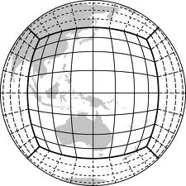
Invert Homme_Mapping.nc to list adjacent nodes.
Store distances between adjacent nodes.
Store directions between adj. nodes (and ‘origin’ node )
Find node closest to the ob
Search could be sped up by using grid knowledge to restrict search.
‘Equatorial’ faces and elements are delimited by lines of longitude.
Latitudes > +L can only be in the north polar face.
Latitudes < -L can only be in the south polar face.
Some latitudes can only be in equatorial faces.

