Slide 1
Introduction to Natural Language Processing
Jie Heng
7/6/2019

Slide 2
Assignments and Resources
https://github.com/jheng18/NLP19
Download resources
Post or view classmates’ questions and answers

Slide 3

NLP
Natural language processing (NLP) is a subfield of computer science, information engineering, and artificial intelligence concerned with the interactions between computers and human (natural) languages, in particular how to program computers to process and analyze large amounts of natural language data.
Linguistics
Google translate, AI Assistance, Communication, ……

Slide 4
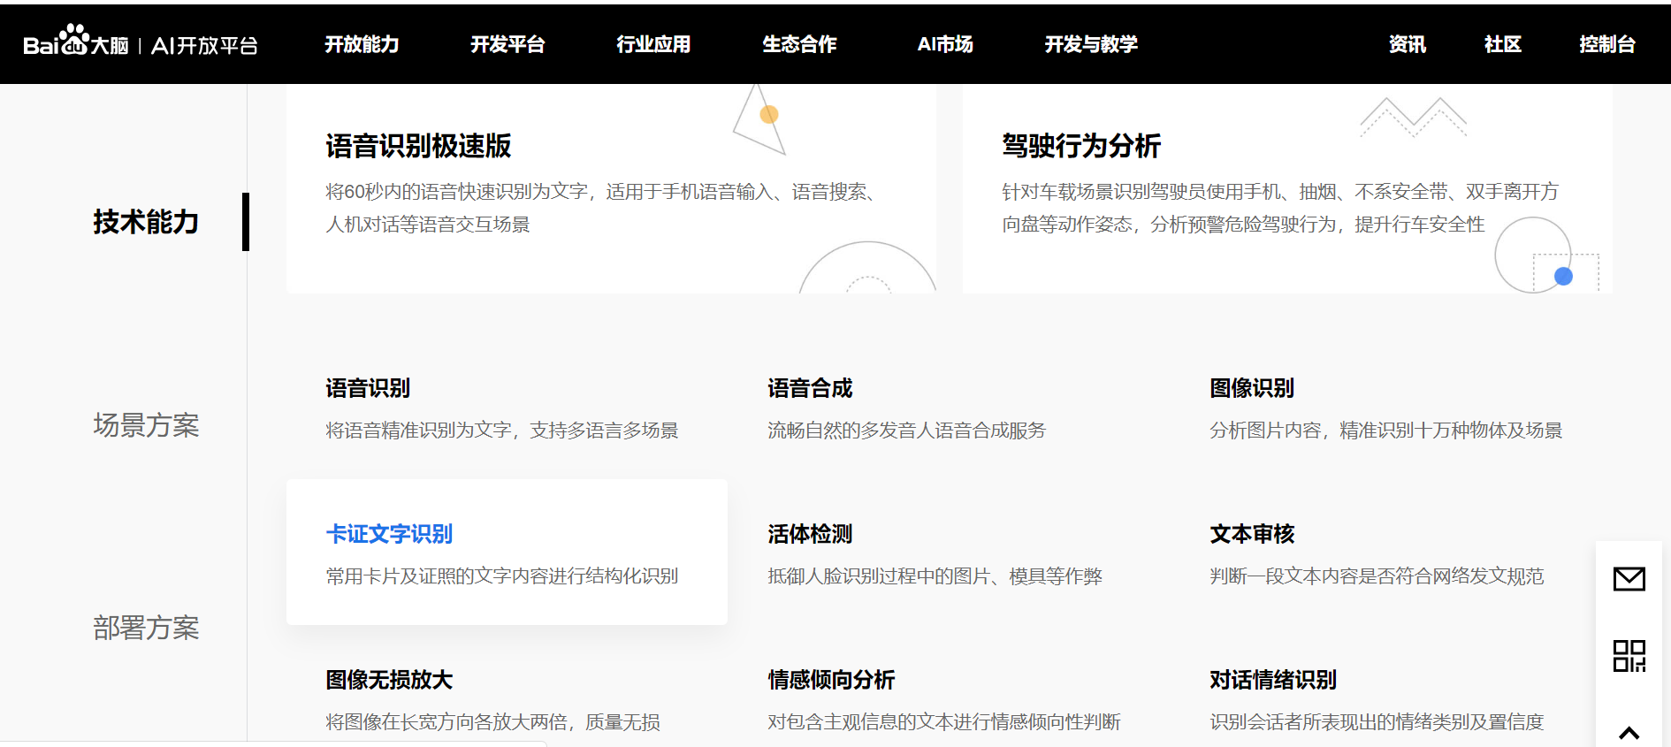

Slide 5
Python Tools
NLTK
NLTK is a leading platform for building Python programs to work with human language data. It provides easy-to-use interfaces to over 50 corpora and lexical resources such as WordNet, along with a suite of text processing libraries for classification, tokenization, stemming, tagging, parsing, and semantic reasoning, wrappers for industrial-strength NLP libraries, and an active discussion forum.
https://www.nltk.org/

Slide 6
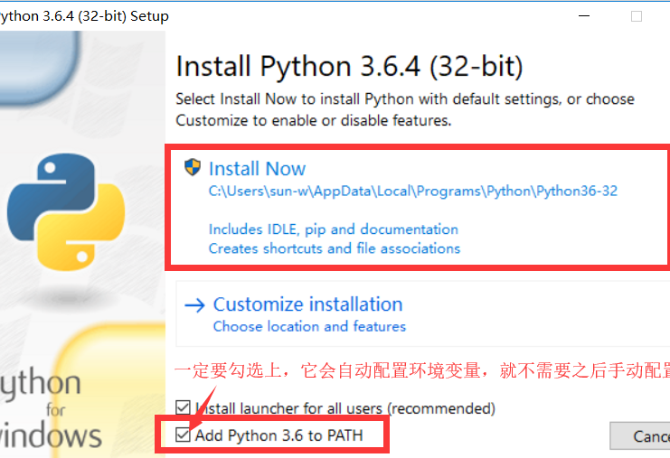
Install Python, Anaconda, Jupyter Notebook
https://www.python.org/downloads/ Windows/IOS
https://www.anaconda.com/distribution/#download-section
https://jupyter.readthedocs.io/en/latest/install.html

Slide 7
Install pip, numpy, pandas, and NLTK
conda install pip
pip install numpy
How to install other packages?

Slide 8
Running Jupyter Notebook
Windows
The Jupyter Notebook App can be launched by clicking on the Jupyter Notebook icon installed by Anaconda in the start menu
IOS
Click on spotlight, type terminal to open a terminal window.
Enter the startup folder by typing cd /some_folder_name.
Type jupyter notebook to launch the Jupyter Notebook App The notebook interface will appear in a new browser window or tab.

Slide 9
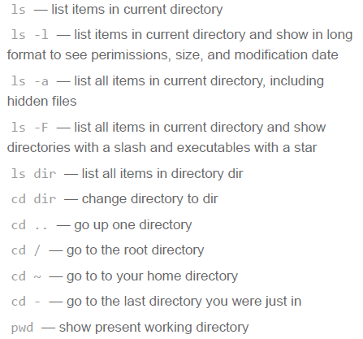
Hold on… something we need to know
Type ipython/ ipython3
what happens?
Type a long string
Hit ctrl+A, ctrl+E, ctrl+U

Slide 10
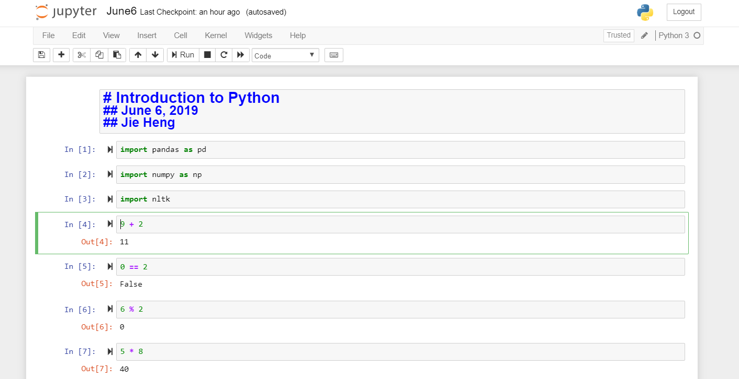
June6.ipynb

