Slide 1
SIP矽智產
HW1
Parameterized fixed-point adder
(參數化小數定點加法器)
學號：M11212091
姓名：張富彥
指導教授：蕭宇宏教授

Slide 2
Summery
Circuit Design
How to design
Data Flow graph
Testbench Algorithm
Data Flow graph
Generate test pattern by Matlab
Performance
Testbench vs inside code
Conclusion

Slide 3
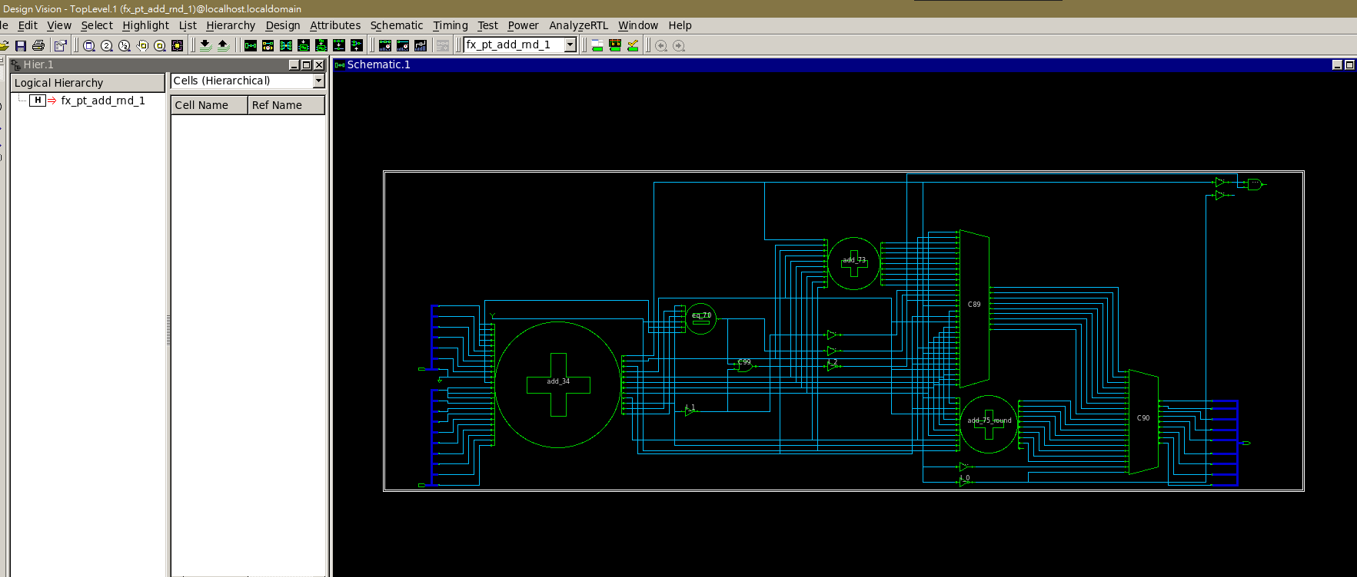
Circuit Design

Slide 4
How to design
Parameter：
SN = Control mode
AIW = A integer width
AFW = A float width
BIW = B integer width
BFW = B float width
SIW = Sum integer width
SFW = Sum float width
A_ext= Aligned with B bit
B_ext = Aligned with A bit
EXT_F1 = the bigger FW between AFW and BFW.
EXT_F2 = the bigger FW between SFW and EXT_F2.
SC = Each SN is distinguished normal case and special case.

Slide 5
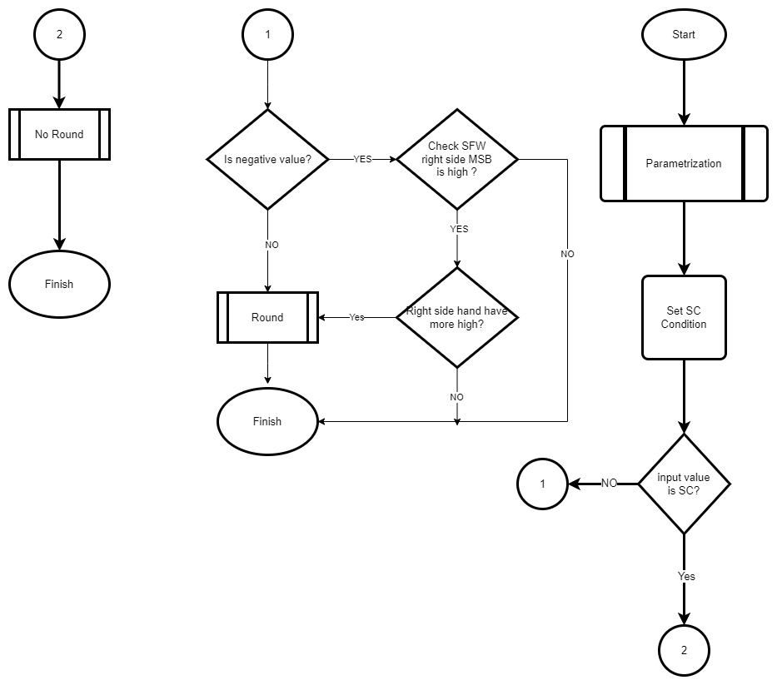
Data Flow Graph

Slide 6
Testbench Algorithm

Slide 7
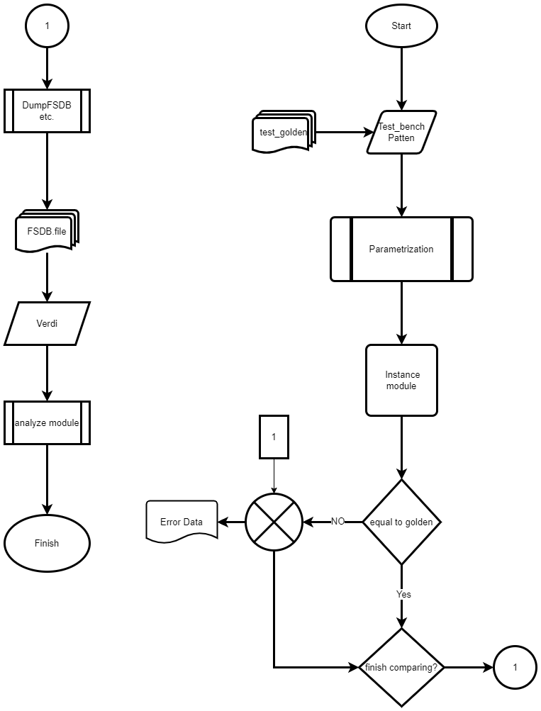
Data Flow Graph
3
1
Loading golden_pattenand define parameter.
Inst module ports by name is compared one by one, and the summed result is then compared to the golden result.
Finally, check the code coverage is work well or not.
2

Slide 8
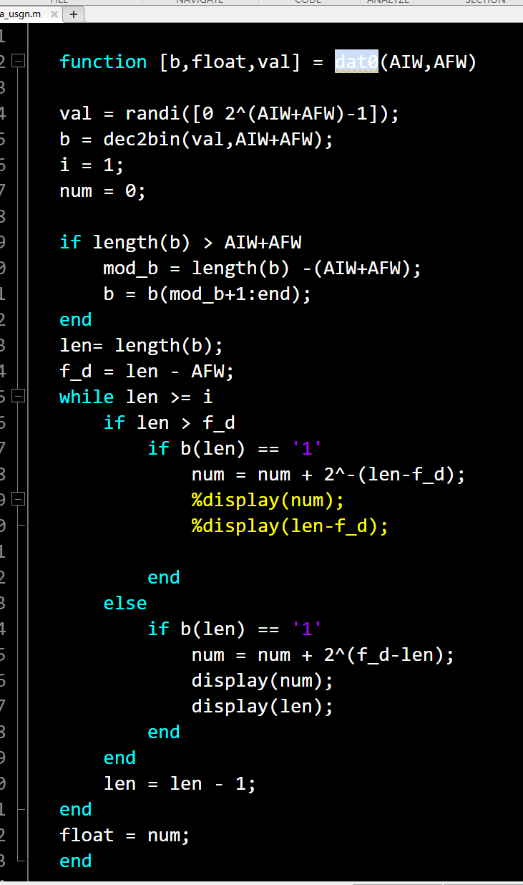
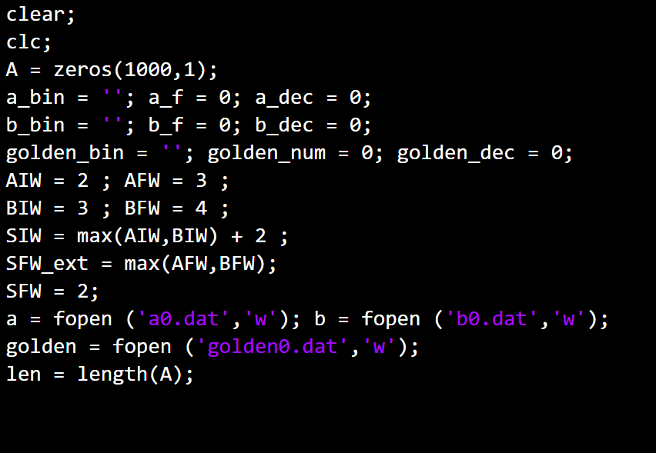
Generate test pattern by Matlab
Generate unsigned number and sign magnitude 10,000 data.
Programing function code provide random value and transfer to binary.
Using 2’s weight code times bits to calculate float number result.

Slide 9
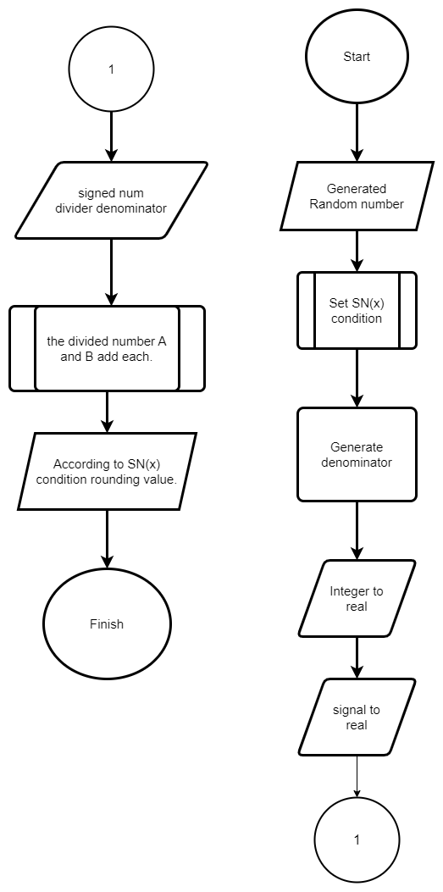
Testbench Algorithm

Slide 10
Performance

Slide 11
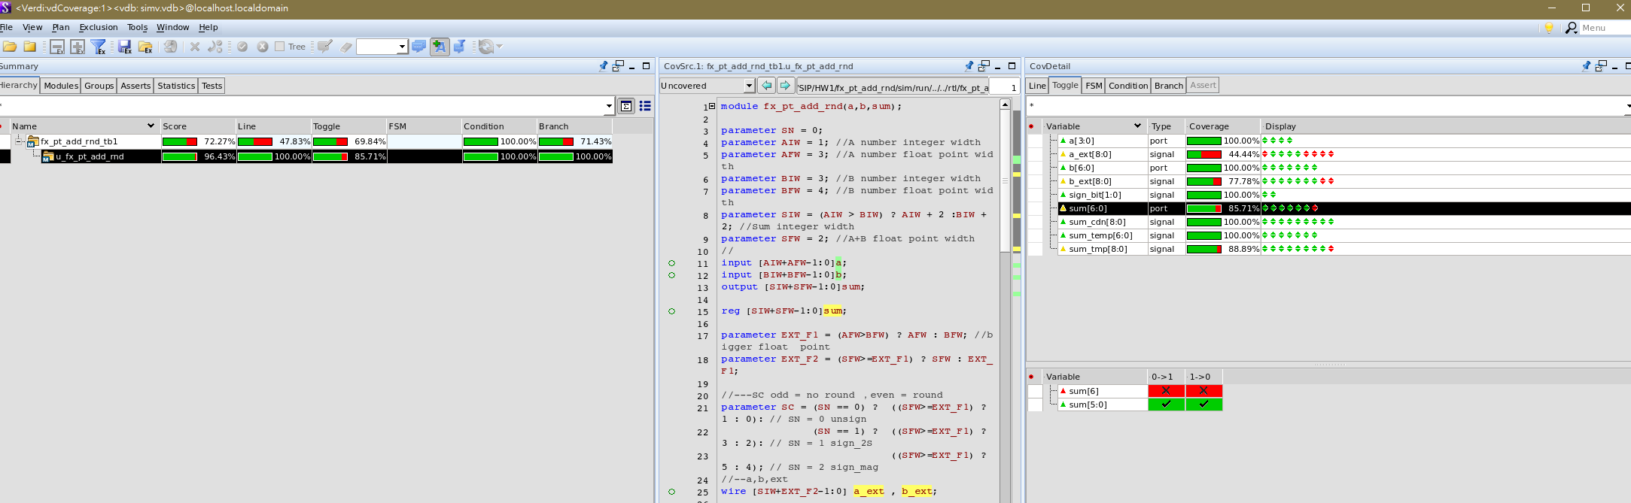
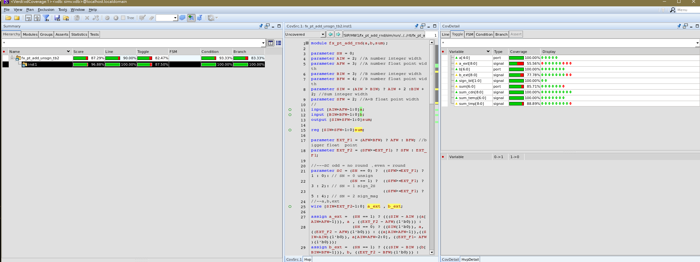
SN0 tb1 & tb2
Verilog code
Matlab Patten

Slide 12
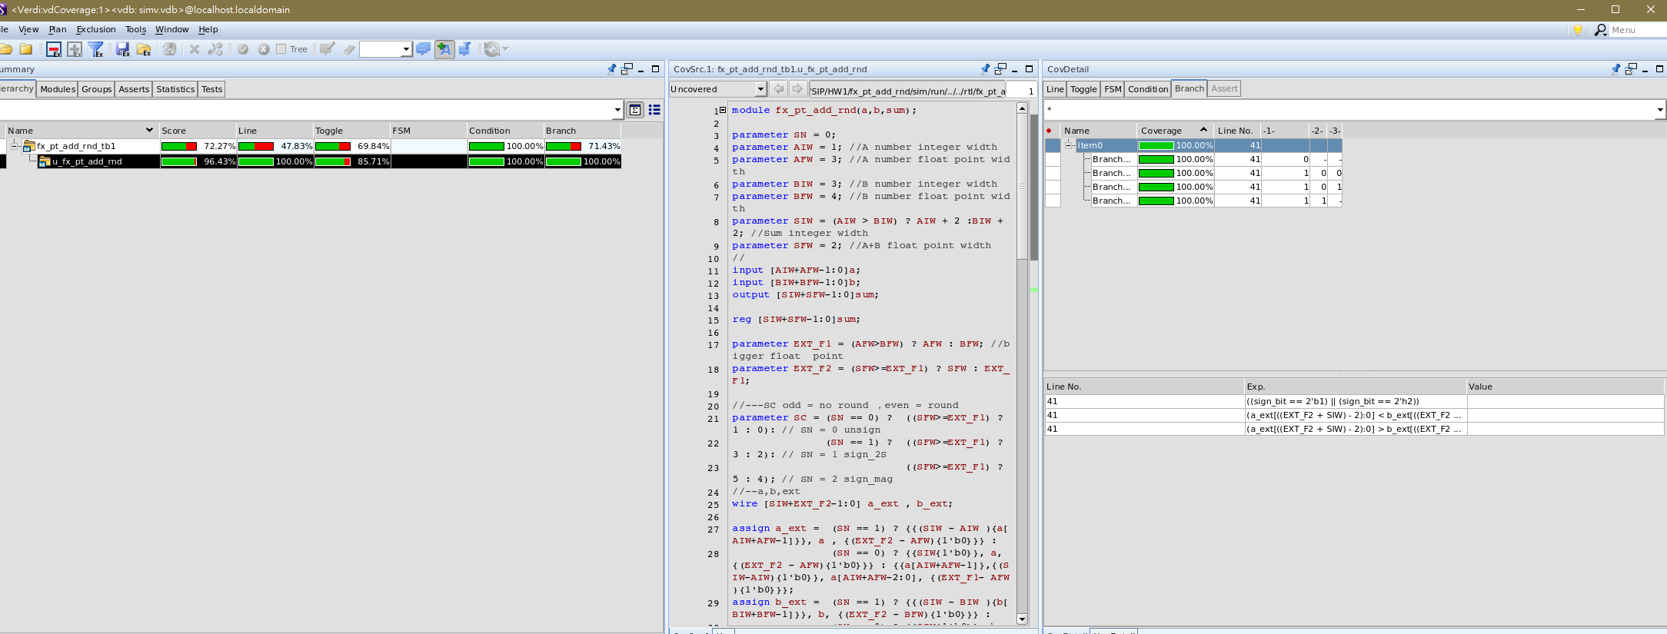
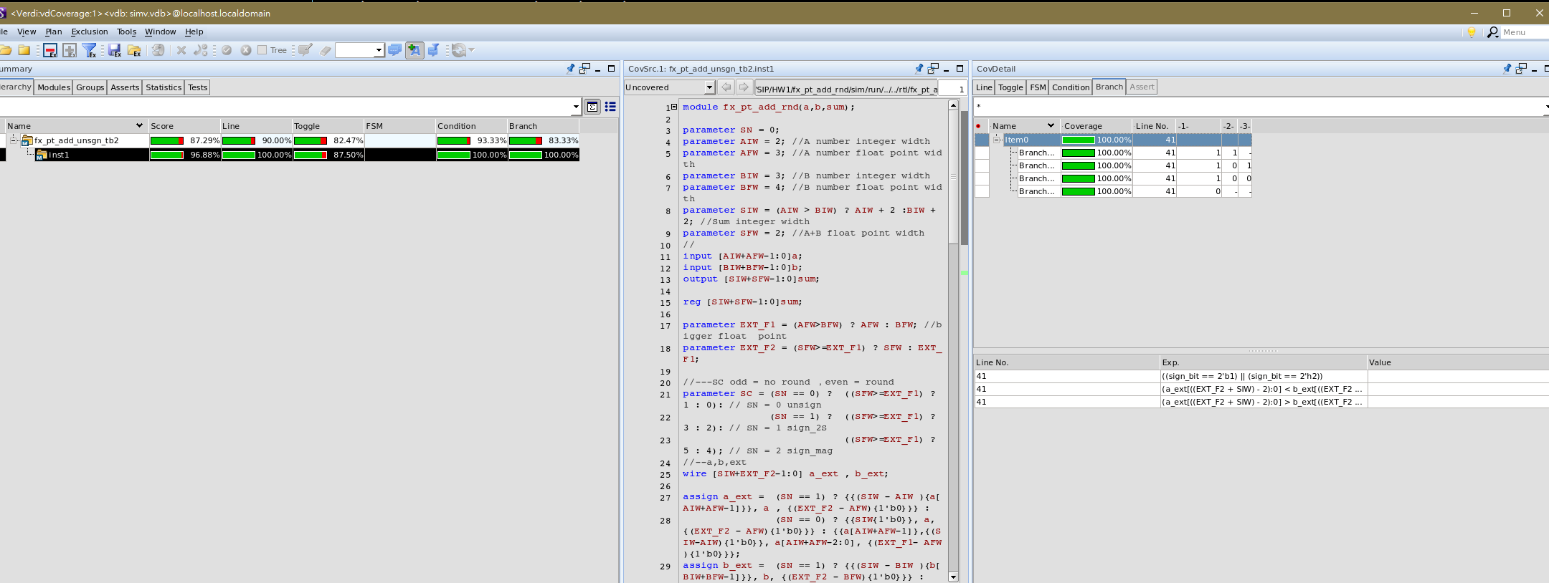
SN0 tb1 & tb2 con’t
Verilog code
Matlab Patten

Slide 13
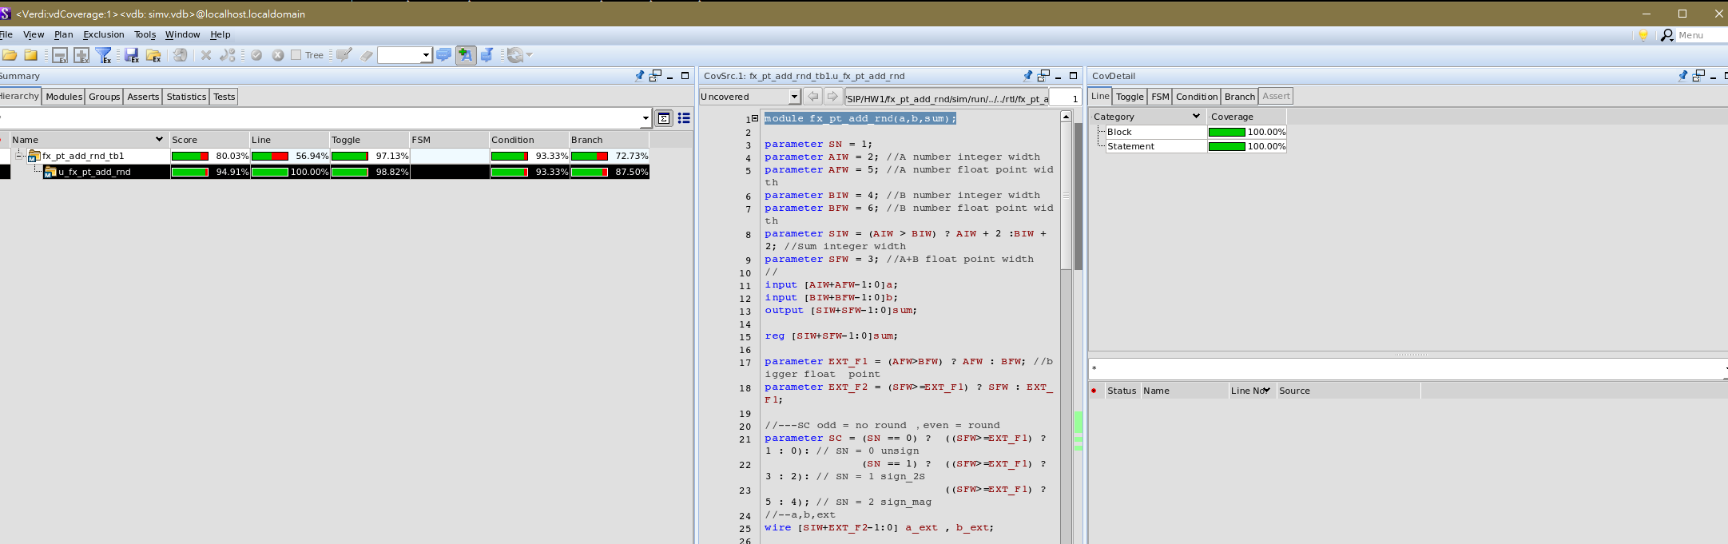
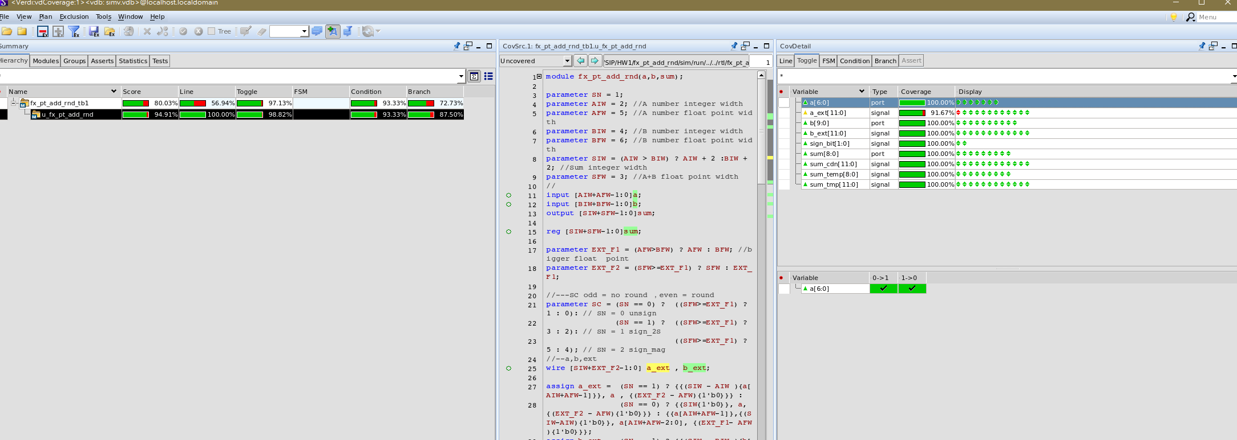
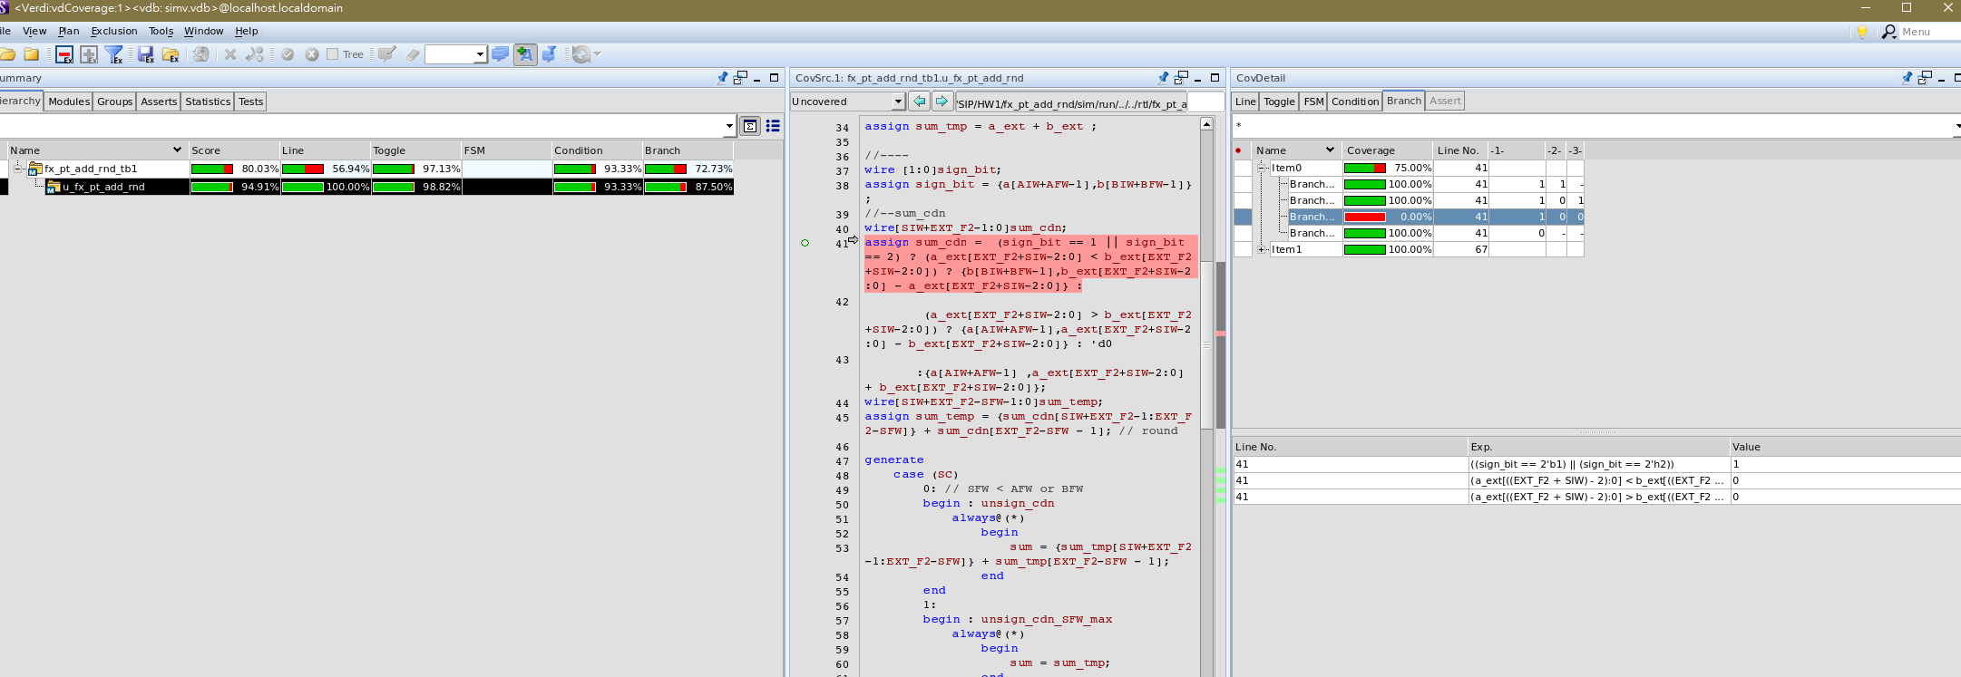
SN1 tb1
Verilog code

Slide 14
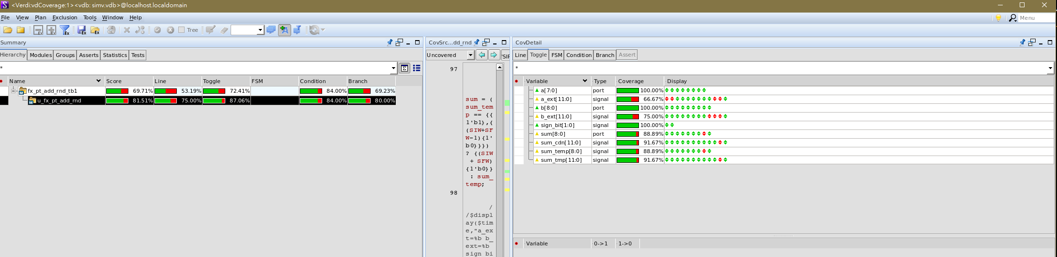
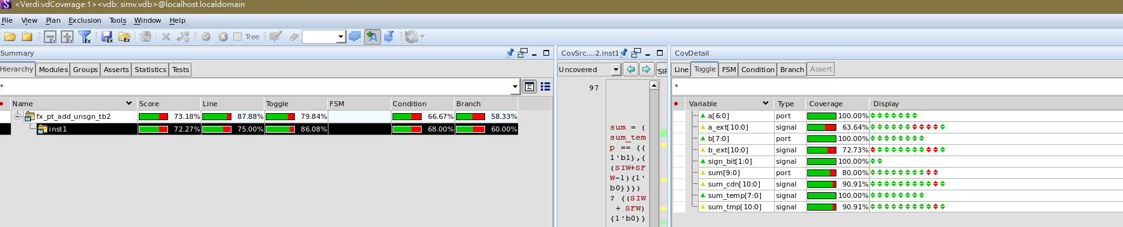
SN2 tb1 & tb2
Verilog code
Matlab Patten

Slide 15
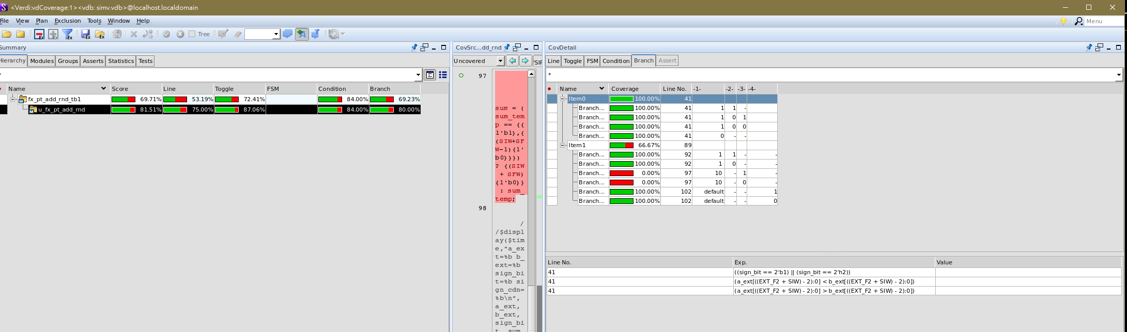
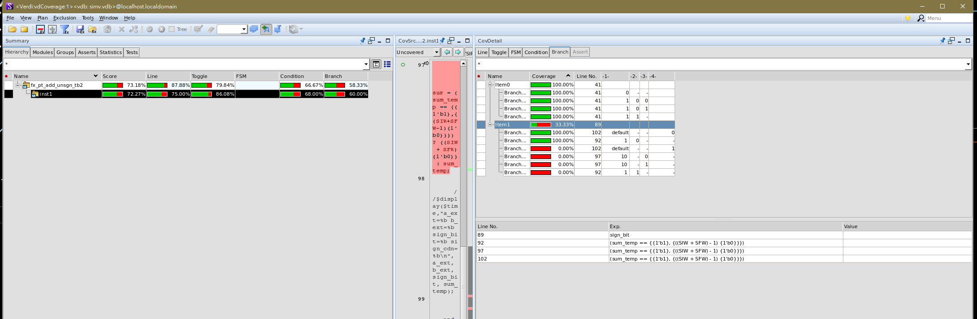
SN2 tb1 & tb2 con’t
Verilog code
Matlab Patten

Slide 16
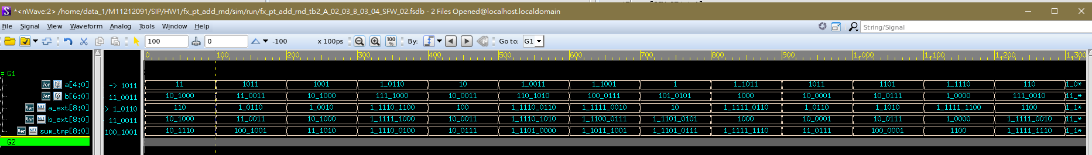
Wave SN0
a_ext 1.0110 = 1.375
+ b_ext 11.0011 = 3.1875
Sum_tmp 100.1001 = 4.5625
Pattern Parameter
AIW = 2,AFW = 3
BIW = 3,BFW = 4
SFW = 2

Slide 17
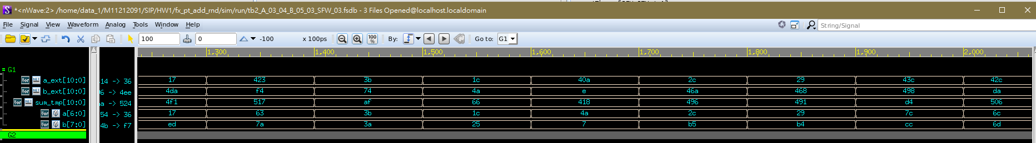
Wave SN2
Pattern Parameter
AIW = 3,AFW = 4
BIW = 5,BFW = 3
SFW = 3
a_ext 0011.1011= 3.6925
+ b_ext 0111.0100= 7.25
Sum_tmp 1010.1111= 10.9425

Slide 18
Experience
在設計參數化的小數定點加法器(fx_pt_add_rnd)的過程中，我深入理解了不同數值表示法對計算的影響，這次實作中，我成功整合了有號數表示法、整數位元和小數位元的彈性參數，使得加法器能夠應對各種場景。特別是四捨五入的實現，讓輸出訊號在特定小數位數下具有更高的準確性。這次作業提供了一個實用的工具，使我更熟悉了小數定點運算的設計和實現，另外這次使用matlab產生pattern也是一個很好的經驗，能夠在這次練習中學習到業界常用的測試方式令我感到相當的值得。

