Slide 1
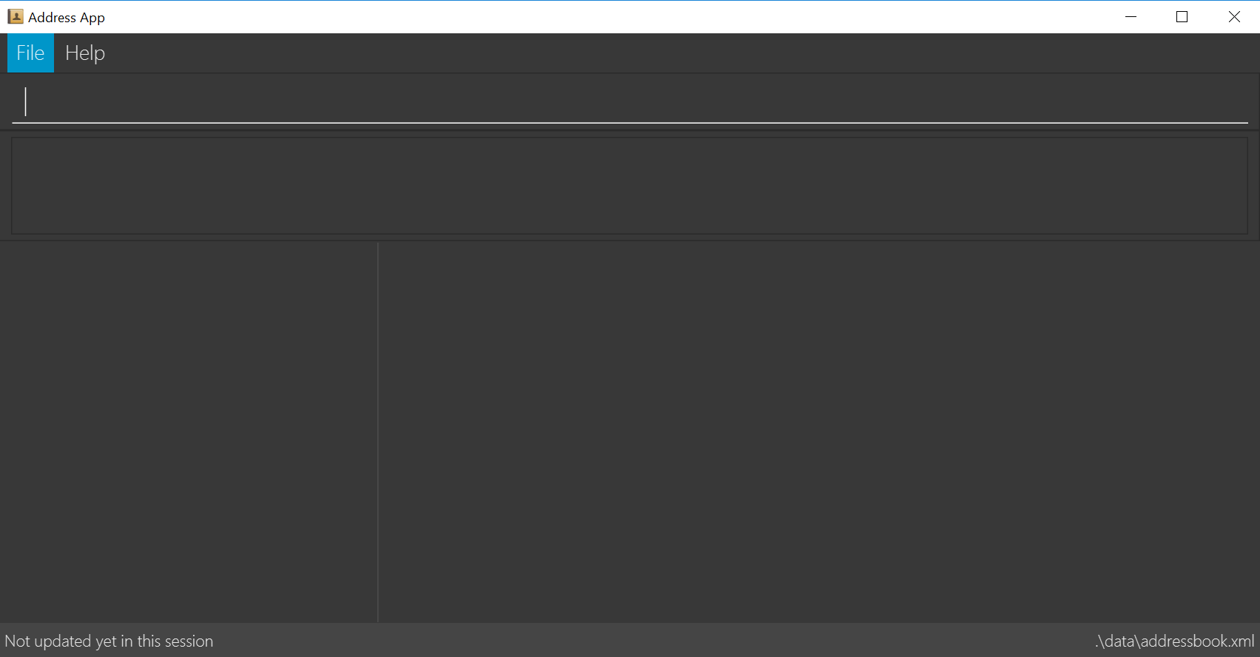
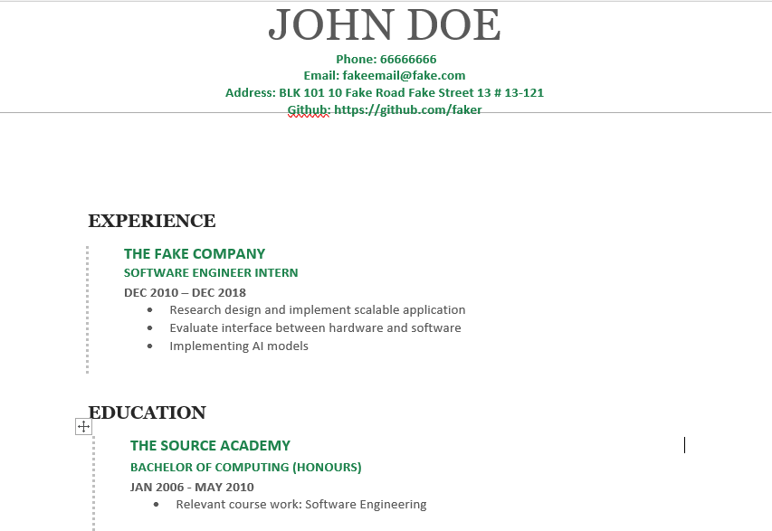
ResuMaker
Enter command here…
THE FAKE COMPANY
Work AI SE
SOFTWARE ENGINEER INTERN
DEC 2010 – DEC 2018
Research design and implement scalable application
Evaluate interface between hardware and software
Implementing AI models
2. THE SOURCE ACADEMY
Education Uni
BACHELOR OF COMPUTING (HONOURS)
JAN 2006– MAY2010
Research design and implement scalable application
Evaluate interface between hardware and software
Implementing AI models
.\data\entrybook.xml

Slide 2
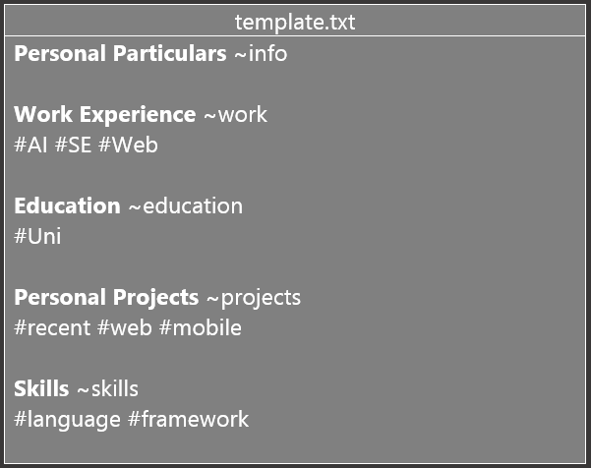
ResuMaker
Enter command here…
XYZ COMPANY
Work AI SE
SOFTWARE ENGINEER INTERN
DEC 2010 – DEC 2018
Research design and implement scalable application
Evaluate interface between hardware and software
Implementing AI models
2. THE SOURCE ACADEMY
Education Uni
BACHELOR OF COMPUTING (HONOURS)
JAN 2006 – MAY 2010
Graduated with First Class Honours
Dean’s List for AY07/08 Semester 1
3. ABC Studios
.\data\entrybook.xml

Slide 3
template.txt
Personal Particulars ~info Work Experience ~work #AI #SE #Web Education ~education #Uni Personal Projects ~projects #recent #web #mobile Skills ~skills #language #framework

