Slide 1
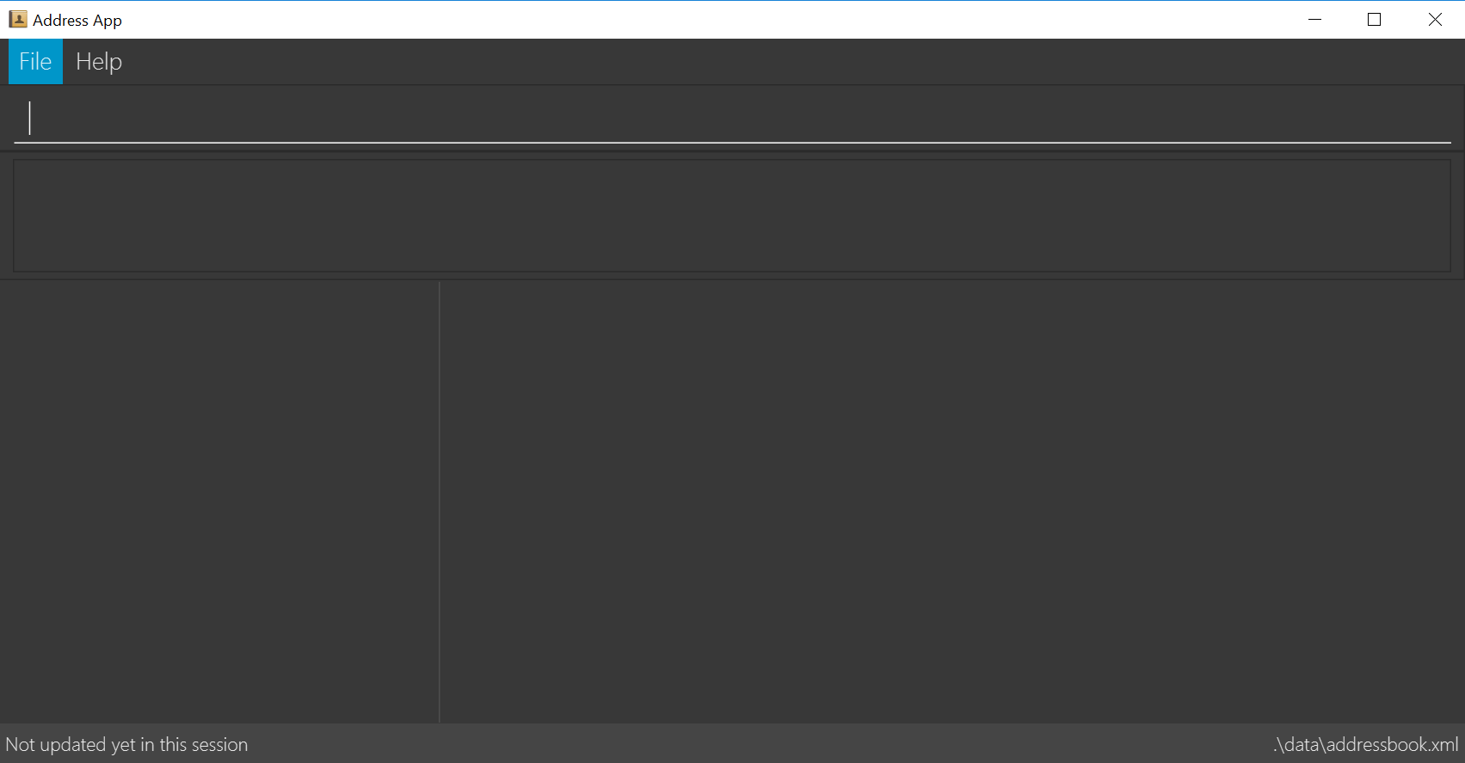
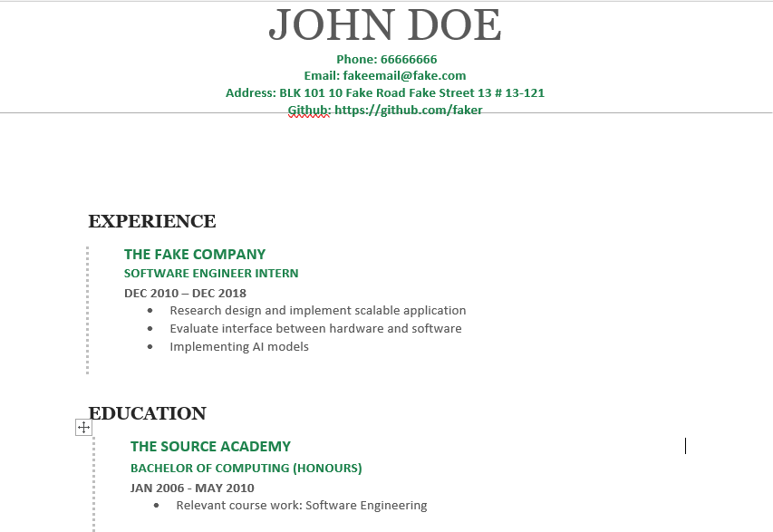
THE FAKE COMPANY
Experience AI SE
SOFTWARE ENGINEER INTERN
DEC 2010 – DEC 2018
Research design and implement scalable application
Evaluate interface between hardware and software
Implementing AI models
2. THE SOURCE ACADEMY
EDUCATION
BACHELOR OF COMPUTING (HONOURS)
JAN 2006– MAY2010
Research design and implement scalable application
Evaluate interface between hardware and software
Implementing AI models

