Slide 1
Ray-Triangle Intersection
Reference:
Möller and Trumbore (1997, paper and code)

Slide 2



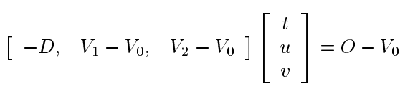

Equations
V₂
V₀
D
Ray
O
V₁
Triangle
Intersection

Slide 3
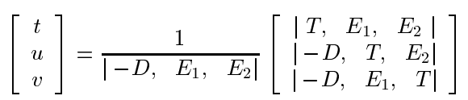
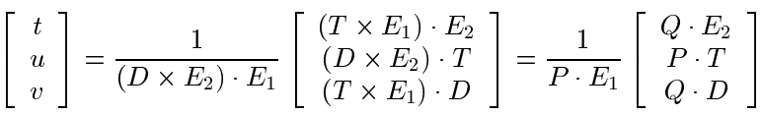
Cramer’s Rule

