Slide 1
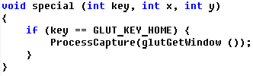
How to Use
Delaytime (cs)
In your OpenGL program, add a special function callback.
When first called, ProcessCapture starts the screen capture every 100 msec. TGA files are generated.
A second call of ProcessCapture stops the screen capture; TGA files are converted to GIF files, and an animated GIF file generated. All temporary files are then deleted.
Window reshape is handled by passing the window’s id to the capturer. [glutGet to get width and height]
Delaytime (in centi-second): determines the playback speed (10 is the default speed). The larger delaytime, the slower it plays back.

Slide 2
Clipboard
#pragma comment(lib, "gifcapture.lib")
extern void ProcessCapture(int,int=10);
void special (int key, int x, int y)
{
if (key == GLUT_KEY_HOME) {
ProcessCapture(glutGetWindow ());
}
}
glutSpecialFunc(special);

Slide 3
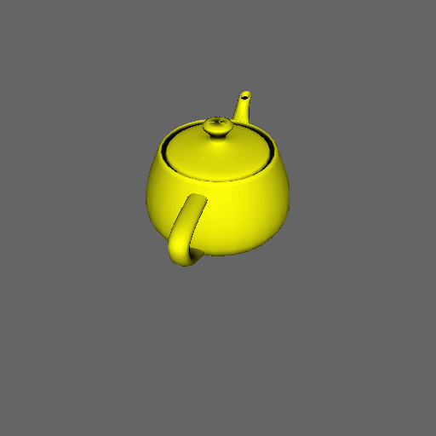
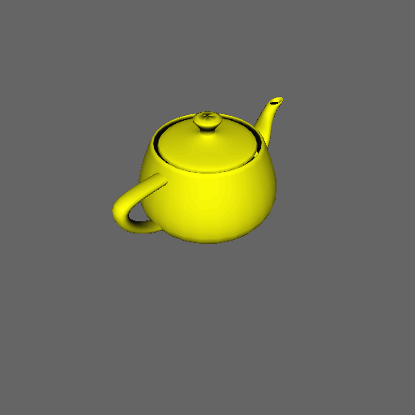
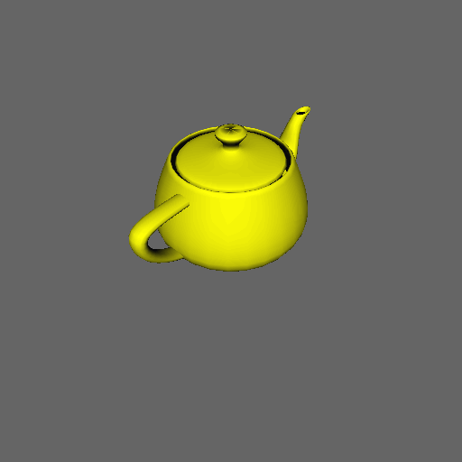
Delaytime 1 cs
Delaytime 20 cs
Delaytime 10 cs

Slide 4
Visual Studio Versions
VC6, VC9 (2008)
  Use gifcapture.lib
VC10 (2010)
  Use gifcapture_MD.lib

