Slide 1
Using SVL

Slide 2
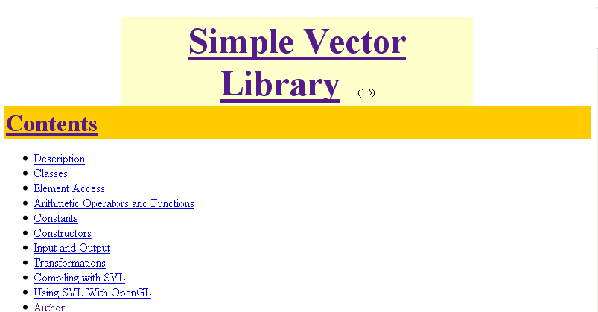
Introduction
(url)
C++ class library, contributed by Andrew Willmott (CMU graphics group)
I added quaternion in 2009
Fall 2013

Slide 3
Introduction (cont)
Online documentation available (here)
Source available; built for:
  Vc6 (two versions: single/multi-threaded debug)
  Vc9, vc10
For basic usage, require inline header files only (lib not needed)
Fall 2013

Slide 4
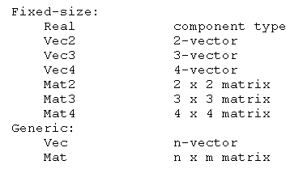
Class Overview
Classes
Pointer access
  X.Ref()
Fall 2013

Slide 5
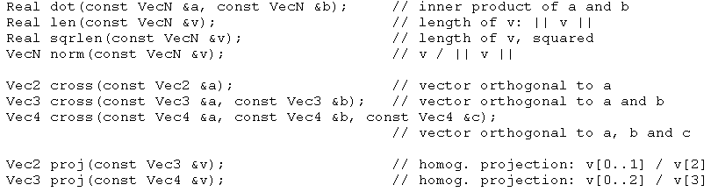
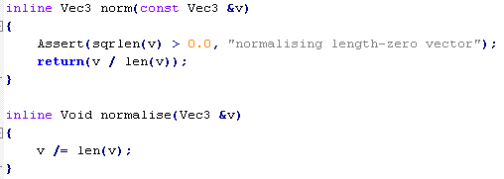
Basic Vector Functions
Use VL_DEBUG in preprocessor to activate Assertions
norm(v) will not change v;
v = norm(v) does the job
normalise(v) also changes v
Fall 2013

Slide 6
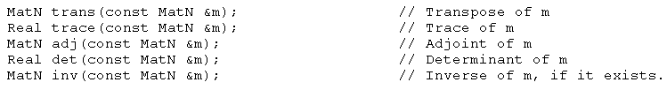
Basic Matrix Functions
About “inv” (finding inverse)
Mat2, Mat3, Mat4: use adj(m) /det(m).
  In linear algebra, adjoint (A) should be the transpose of the cofactor matrix.
  But in SVL, adj(m) is mistakenly used for cofactor matrix
Mat: use Gauss pivoting
Fall 2013

Slide 7
Generic Vector & Matrix
When initialising a generic vector or matrix with a list of elements, you must always ensure there is no possibility of the element being mistaken for an integer. (This is due to limitations of the stdarg package.) Make sure that each element value has either an exponent or a decimal point, i.e., use '2.0' rather than just '2'.
Mat only operate with Vec, not with Vec2, Vec3, Vec4
Fall 2013

Slide 8

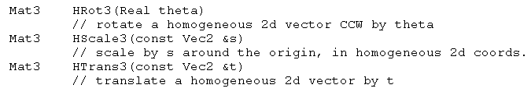
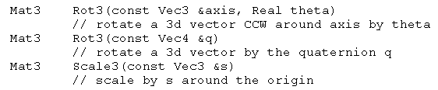
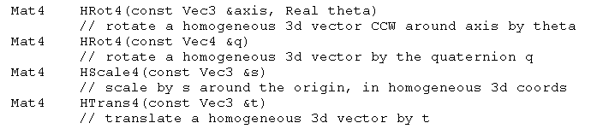
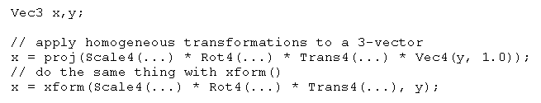
Transformations**
axis: must be a unit vector!
Fall 2013

Slide 9
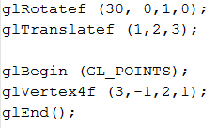
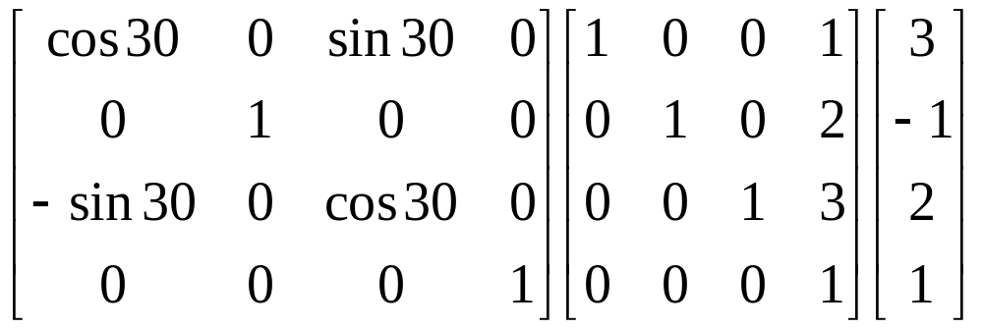
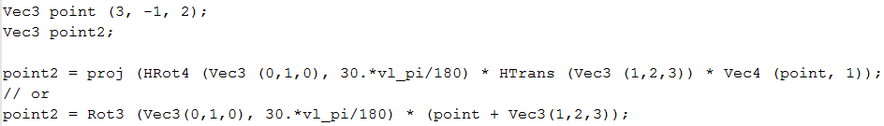
OpenGL, Math, & SVL
Translate first, then Rotate
Fall 2013

Slide 10
Writing your own functions…
Make good use of call-by-reference
(to avoid calling copy constructor)
Reference:
void Sum (const Vec3 &a, const Vec3 &b, Vec3 &sum);
Fall 2013

Slide 11
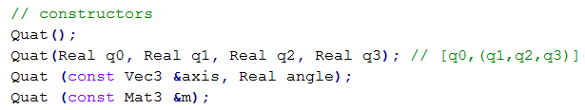
Quat
q = q0 + q1i + q2j + q3k
Quat ←→Axis-angle, Rot3, HRot4
Quat utilities
  Slerp, norm, len, conjugate, +-*, …
Fall 2013

