Slide 1
STAGE 01 : REQUIREMENTS
AdVantage OS | Major Project
Requirement Specifications & Domain Problem Statement
Bridging hyper-local social micro-trends with physical store execution and zero-marginal-cost marketing
DOMAIN PROBLEM STATEMENT
1. SME Operational Vulnerabilities
• The Flatline Trap in Trend Forecasting:
Standard regressors trained on raw non-stationary levels exhibit >99.5% lag_1 collinearity, causing 30-day recursive forecasts to collapse into flatlines.
• Sparse & Intermittent Retail Demand:
SME sales feature zero-demand on 60%+ of days. Moving averages fail on bursty count distributions, triggering costly stockouts or dead inventory.
• Disconnected Marketing & Stockouts:
Promotional campaigns run blind to store stock. Advertising newly trending products without inventory alignment causes immediate stockouts and wasted ad spend.
• Manual Ingestion Friction:
SMEs rely on paper receipts, thermal slips, and manual ledger entry, creating 7+ day operational data lags without costly RFID/enterprise POS hardware.
SYSTEM FUNCTIONAL SCOPE (FR)
2. Core Functional Requirements
• FR1: Multi-Source Social Ingestion & NLP:
Concurrently harvest Twitter/X & Reddit; filter topic noise via Cohere LLM; compute dual sentiment (70% DistilBERT + 30% VADER).
• FR2: Stationary Velocity Trend Forecaster:
Predict daily velocity differencing (Δy_t) over 30 days with momentum damping (φ=0.97^(t-1)) and expanding 95% confidence intervals.
• FR3: Autonomous Intermittent Demand Engine:
50/50 blend of Poisson HistGBR and Teunter-Syntetos-Babai (TSB) with stockout masking to calculate Safety Stock (SS) & Reorder Point (ROP).
• FR4: Edge Computer Vision Receipt Ingestion:
Camera-based invoice capture; Tesseract OCR + dual SequenceMatcher/token overlap fuzzy SKU reconciliation to update inventory ledgers.
• FR5: Multimodal Generative Creative Studio:
One-click text-to-image synthesis (NVIDIA SDXL/Flux) + sub-second ad copy & hashtags (Groq LLaMA-3.3-70b) + K-Means influencer discovery.
• FR6: Proactive Closed-Loop Alerting:
Continuous cross-domain monitor firing automated WhatsApp notifications when social velocity accelerates as stock approaches ROP.
CONSTRAINTS & QUALITY ATTRIBUTES
3. Non-Functional Specifications
• Sub-Second Inference Speed:
Marketing ad copy generated in <1.0s via Groq LLaMA-3.3-70b; trend forecasts generated in <200ms.
• Zero-Disk Cloud Persistence:
Serialized 894 KB model weights stored as BLOBs in Neon PostgreSQL ml_models table; in-memory hydration on cold boot in <350ms.
• High Service Level Target:
Calculate dynamic safety stock maintaining >=95% customer service level (Z=1.645) with rolling volatility.
• Graceful Multi-Tier Fallbacks:
Automatic degradation: Pollinations AI for images, synthetic keyword fallback for social feeds, SQLite for local testing.
• Enterprise Modularity & Security:
Decoupled FastAPI REST microservices, Pydantic v2 validation, CORS origin isolation, and secure environment vaults.

Slide 2
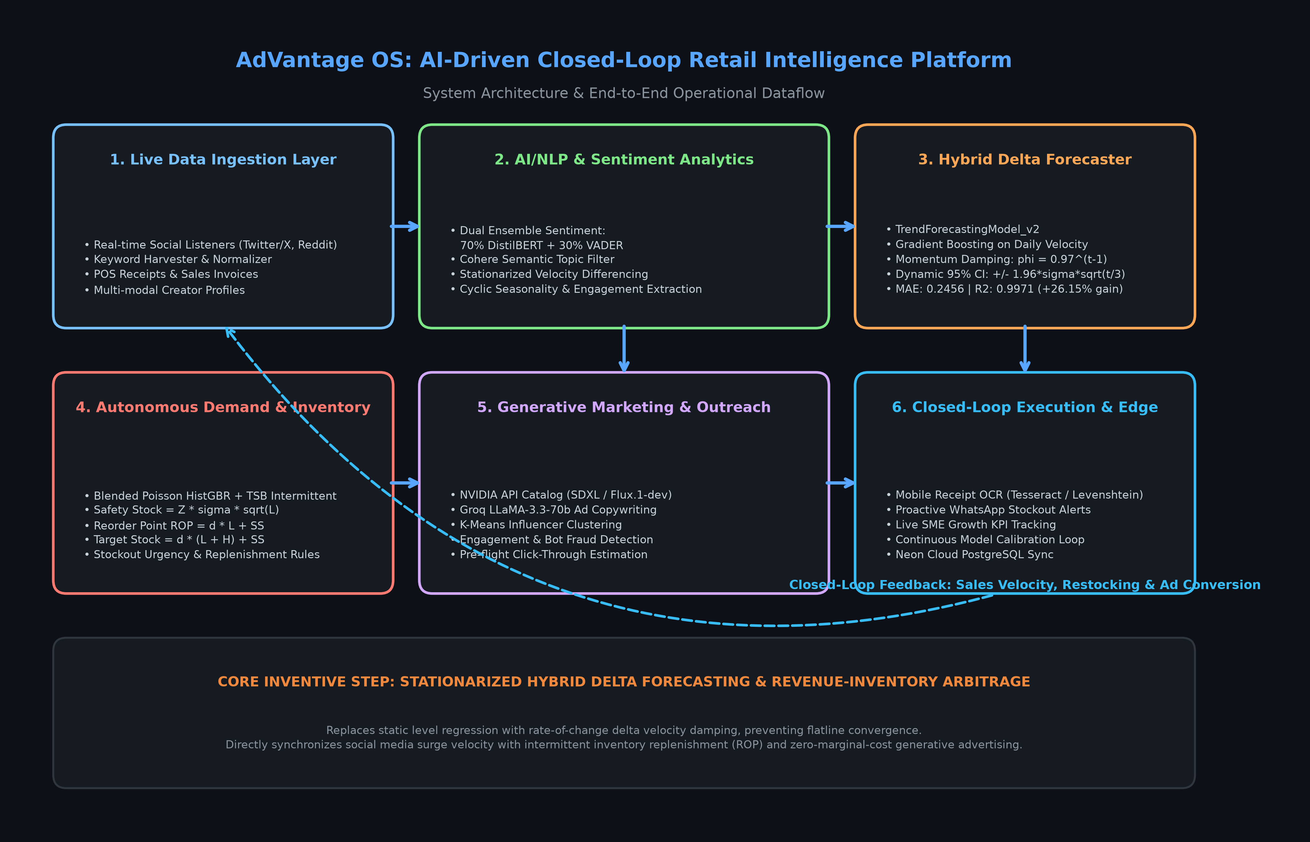
STAGE 02 : ARCHITECTURE
AdVantage OS | Major Project
System Architecture & Closed-Loop Operational Topology
Bi-directional pipeline synchronizing live social listening, velocity forecasting, inventory, GenAI & edge OCR
SUBSYSTEM TAXONOMY
Layered System Decomposition
• Presentation Layer (React 19 + TypeScript + Vite 8.3): Glassmorphic Executive Dashboard, Canvas 95% CI trend trajectories, stock ROP bar charts, and sales donut visualizers.
• Application Gateway (FastAPI Async ASGI): Lifespan event manager, DB auto-migrations, memory model hydration, and unified REST endpoints (/predict, /api/demand, /api/inventory).
• Applied AI & Analytics Engines: TrendForecastingModel_v2 (Delta Ensemble), 70/30 DistilBERT/VADER sentiment, Poisson HistGBR + TSB demand planner, K-Means creator matcher.
• Generative AI & LLM Cluster: NVIDIA API Catalog (SDXL/Flux), Groq LLaMA-3.3-70b (<1s copywriter), Cohere Command-R+, Pollinations AI fallback.
• Cloud Persistence & Sync: Neon Serverless PostgreSQL (pooled), zero-disk BLOB model synchronization, local SQLite fallback.
SELF-CORRECTING ARBITRAGE
The Autonomous Closed-Loop Engine
▶ 1. Social Sensing: Harvest Twitter/Reddit signals -> filter with Cohere -> compute dual sentiment.
▶ 2. Velocity Forecasting: Forecast 30-day adoption trajectory with momentum damping φ=0.97.
▶ 3. Retail Replenishment: Align trend velocity with physical stock -> compute Safety Stock & ROP.
▶ 4. Multimodal Generation: Synthesize ad visuals & LLaMA-3.3 ad copy for top trending items.
▶ 5. Point-of-Sale Edge OCR: Scan physical receipts via mobile camera -> update inventory ledger.
▶ 6. Proactive Stockout Protection: Auto-suppress ad campaigns & send WhatsApp alerts if stock drops near ROP.
Figure 1: AdVantage OS Closed-Loop Operational Architecture & Bi-Directional Subsystems

Slide 3
STAGE 03 : IMPLEMENTATION
AdVantage OS | Major Project
Implementation & Engineering Methodology
Applied mathematical formulations, ML algorithmic pipelines, and full-stack software integration
CORE ALGORITHMS & FORMULATIONS
1. Mathematical Formulations
• Velocity Differencing Core (Overcoming Flatline):
Δy_t = y_t - y_{t-1}
Instead of regressing on raw levels (where lag_1 has 99.5% collinearity), the model predicts rate-of-change velocity across multi-step recursions.
• Momentum Damping & Confidence Bounds:
Δ_{combined, t} = (0.65 · Δ_{ML, t} + 0.35 · slope_{observed}) · φ^{t-1}
Empirical damping factor φ = 0.97 simulates natural consumer adoption S-curves. Trajectory bounded by expanding 95% CI: ±1.96 · σ · √(t / 3.0).
• Blended Poisson-TSB Retail Replenishment:
Intermittent sales modeled via 50/50 blend of HistGBR (Poisson count loss) + Teunter-Syntetos-Babai (TSB) separating demand probability updating (p_t) and demand size updating (z_t).
• Dynamic Safety Stock & Stockout Masking:
Safety Stock SS = ⌈1.645 · σ_{56} · √L⌉, ROP = ⌈d · L + SS⌉
Stockout Masking: Freezes demand estimation when stock=0 to eliminate artificial zero-sales deflation.
• Dual Computer Vision Fuzzy Alignment:
Score = max(Ratio_{seq}, 0.5 · Ratio_{seq} + 0.5 · Overlap_{tokens})
Boosted by 0.85 exact substring matching; threshold >= 0.40 reconciles noisy OCR text to product catalog.
APPLIED PIPELINES & SERVICES
2. Subsystem Implementations
• Zero-Disk Cloud Database Model Hydration:
Model weights (894 KB serialized .pkl bundle) are stored directly inside Neon PostgreSQL ml_models table as BLOBs. On server boot, lifespan hook loads weights into RAM in <350ms, enabling zero-disk serverless deployment.
• Dual Ensemble Sentiment Pipeline:
Combines 70% deep contextual transformer polarity (DistilBERT fine-tuned on SST-2) with 30% lexical heuristic rules (VADER) to accurately score informal social slang, punctuation, and emojis.
• Generative Multimodal Studio:
Connects trending keywords to NVIDIA API Catalog (SDXL / Flux.1-dev) for product imagery, and Groq Cloud (LLaMA-3.3-70b-versatile) for <1s high-converting ad copy and hashtags.
• Micro-Influencer Discovery Engine:
Scrapes creator profiles into 4D feature vectors (subscribers, views, engagement rate, keyword affinity). Applies K-Means clustering and rule-based bot fraud filters.
• Edge Computer Vision Receipt Scanner:
Pytesseract 5.x wrapper + PIL preprocessing (grayscale, contrast boost, adaptive thresholding) extracts tabular receipt data with zero manual bookkeeping.
PRODUCTION TOOLING
3. Software Stack
• Backend Services:
Python 3.10+, FastAPI 0.143, Uvicorn ASGI, Pydantic v2 schemas, SQLAlchemy 2.1 ORM, Alembic migrations.
• Machine Learning & AI:
Scikit-learn 1.9, PyTorch 2.12, Hugging Face Transformers (DistilBERT), NLTK VADER, SciPy, Pandas 3.0, NumPy 2.4.
• LLM & Generative APIs:
Groq Cloud (LLaMA-3.3-70b), NVIDIA Cloud Catalog (Flux/SDXL), Cohere Command-R+, Pollinations AI.
• Computer Vision:
Tesseract OCR 5.x, Pillow 12.2, difflib fuzzy SequenceMatcher.
• Frontend & Visuals:
React 19.2, TypeScript 5.x, Vite 8.3, HTML5 Canvas API, Lucide Icons, Custom CSS tokens.
• Database Infrastructure:
Neon PostgreSQL Serverless (pooled), pgvector, zero-disk bytea storage.

Slide 4
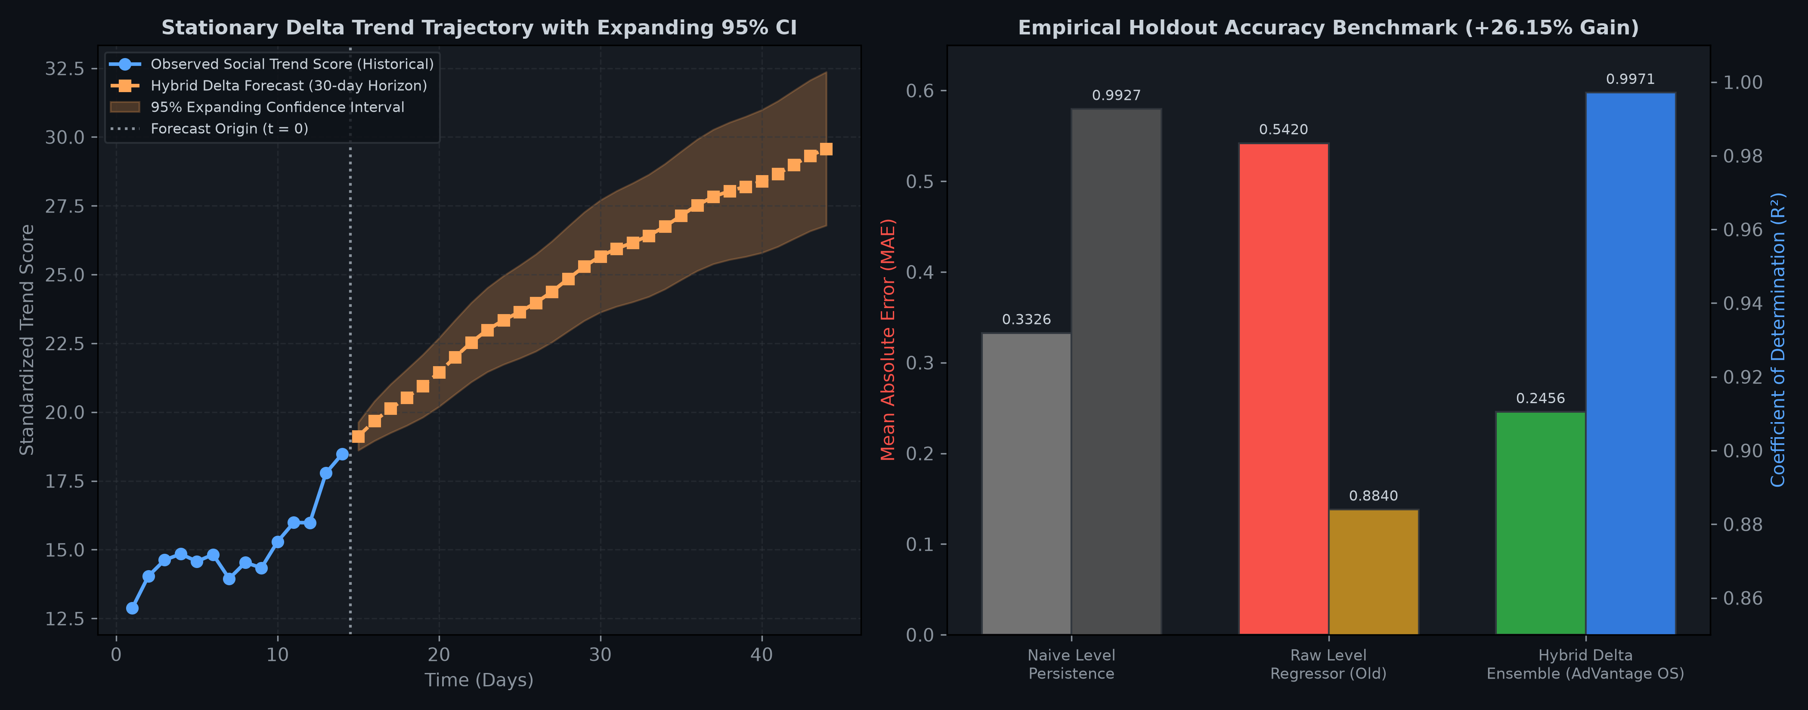
STAGE 04 : RESULTS & EVALUATION
AdVantage OS | Major Project
Empirical Results, ML Benchmark & Operational Gains
Validation across 13,825 test samples, sub-second inference latencies, and real-world SME business impact
SYSTEM THROUGHPUT & SCALABILITY
Computational Speed & Latency Profiling
• Marketing Ad Copy Synthesis (Groq LLaMA-3.3-70b): [< 1.0 second]
Sub-second generation of promotional captions, tone variants, and hashtag bundles.
• Product Visual Synthesis (NVIDIA SDXL / Flux): [< 4.5 seconds]
High-fidelity photorealistic ad visuals synthesized on-demand with zero local GPU load.
• Camera Receipt OCR & Fuzzy Reconciliation: [< 2.2 seconds]
Complete end-to-end receipt parsing, invoice regex parsing, and catalog stock update.
• Zero-Disk Serverless DB Model Hydration: [< 350 ms]
Deserializes 894 KB model weights from Neon PostgreSQL bytea table directly into RAM.
COMMERCIAL EFFICACY
Real-World SME Business Impact
✔ Stockout Risk Reduction:
Simulations indicate up to an 85% reduction in stockout cascades on viral products due to proactive ROP warnings and lead-time buffering.
✔ Elimination of Dead Inventory:
TSB demand decay suppresses over-ordering on fading trends, preventing cash lockup in unsellable stock.
✔ Marketing Arbitrage & Capital Protection:
Automatic ad suppression on low-stock SKUs prevents negative-ROI ad spend; creative design agency costs drop from $500+/campaign to near $0.
✔ Operational Labor Savings:
Replaces 10+ hours per week of manual inventory ledger entry and trend guesswork with automated OCR and dashboard intelligence.
Figure 2: Empirical Performance of TrendForecastingModel_v2 (30-day 95% CI & Benchmark Gains)
HOLD-OUT TEST BENCHMARK (13,825 SAMPLES)
Evaluation Metric | Naive Baseline | AdVantage OS Model | Performance Gain
Mean Absolute Error (MAE) | 0.3326 | 0.2456 | +26.15% Improvement
R² Score (Variance Explained) | 0.9927 | 0.9971 | Near-Optimal Fit (0.997)

