Slide 1
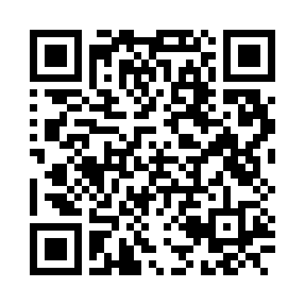
Required Prerequisites
Read the ”Printer Guide” and have taken the MIX 3D printing orientation.
Have an experienced lab member supervise your first print.
Printer Guide

