Slide 1
Multicore CPU simulator
By Jacob Hensley

Slide 2
Simple Multicore CPU Simulator
Goal of the project is to simulate how tasks are distributed across multiple CPU cores
Project demonstrates how multicore processors can improve performance by running tasks in parallel instead of on a single core.
Output is measured in:
Execution Time
Throughput
Core Utilization

Slide 3
Introduction
Modern CPUs use multiple cores to handle complex processes at the same time.
Multicore systems aid in reducing total execution time
The simulator helps visualize scheduling and workload distribution
Goal is to model how tasks arrive, wait, get assigned to cores, and finish. This allows for comparison of multicore performance to single-core performance.

Slide 4
Implemented System
Input file has number of cores, number of tasks, and 3 descriptions for each task:
Task ID
Arrival Time
Execution Duration
Simulator uses a shared ready queue
Tasks are assigned to the next available core using FCFS scheduling
The program will run the same workload twice: once with the number of cores from input, and once with a single core for comparison.

Slide 5
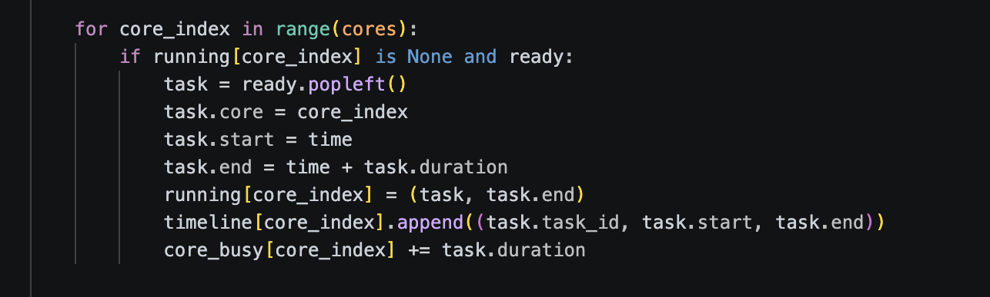
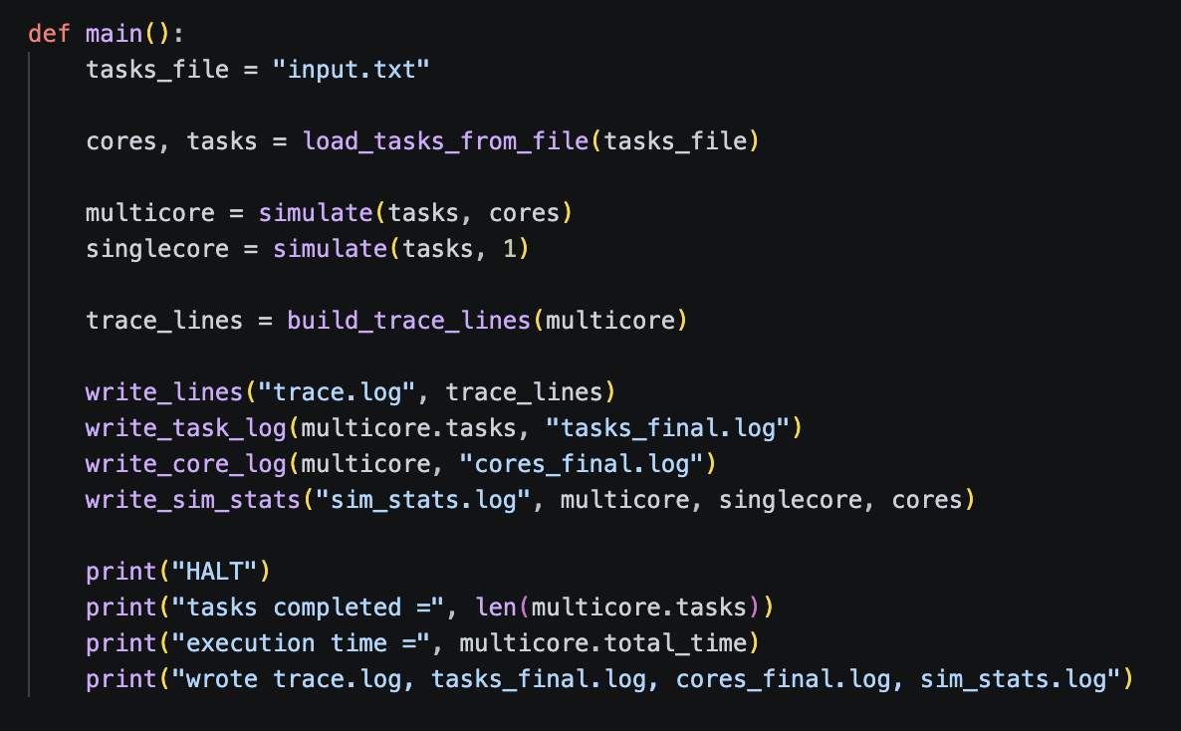
Code Structure
Here the queue holds waiting tasks, then when a core becomes free the next task is assigned to it.
Main function that loads input, runs multicore and single-core simulations, and outputs log files.

Slide 6
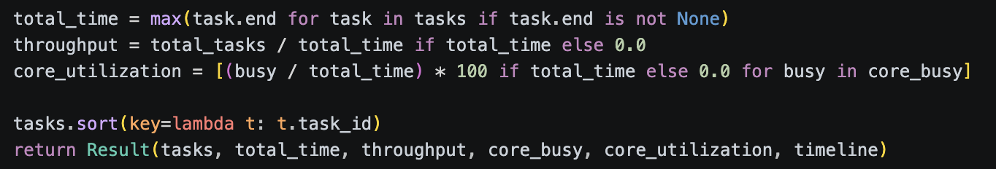
Code Structure
Calculations for total time, throughput, and core utilization.

Slide 7
Observations and Findings
Multicore execution improved total runtime by 1.62x
Workload distribution reduced the task completion time compared to a single core
Core utilization was not perfectly balanced
A simple FCFS scheduler works for demo purposes, however a more developed and smarter scheduler would improve balance
Future improvements could include:
Round-robin scheduling
Task priorities
I/O blocking

