Slide 1
Ubuntu Touch
James Henstridge
james@jamesh.id.au
james.henstridge@canonical.com

Slide 2
How do you start building a phone OS?
Piggy back on Android
Cheap readily available hardware with Linux enabled
Google provides the binary blobs necessary to work with their Nexus devices

Slide 3
Bootstrapping Ubuntu Touch
Kernel built from Android tree
Stripped down Android user space
  adb, OpenGL, codecs, SurfaceFlinger, etc
Ubuntu in an LXC container
Libhybris used to call from Ubuntu to Android
  Allows calls from glibc to bionic

Slide 4
Flipping the Image
Ubuntu as the root file system
Android in an LXC container

Slide 5
Full Image Updates
Prefer full image updates over individual package updates.
Filesystem must be read only to support incremental image updates
Bind mount various locations to a writable partition.
Applications separate from base system image
Can enable write support for development

Slide 6
Developer Mode
Image can be set to read/write
Useful for development
Can install packages with apt-get
Breaks automatic updates

Slide 7
Carrier Customisation
Carrier customisations kept to a separate partition
Base image is identical across devices
Less red tape to push changes out to existing handsets

Slide 8
The Shell
Mir display server
  Server is a shared library embedded in compositor
Unity 8 shell
  A Qt/QML application
  Doesn't share code with Unity 7
  Shares design

Slide 9
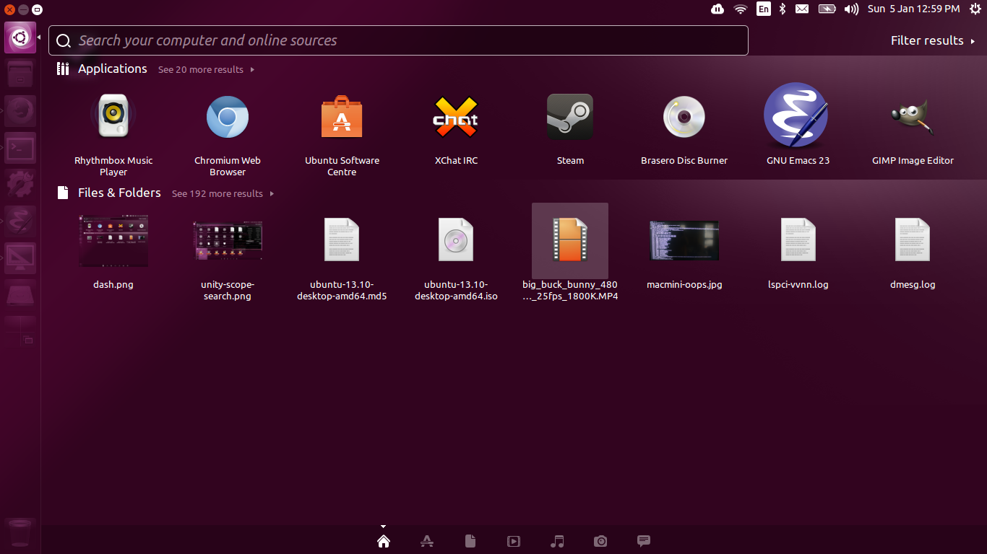
Unity 7 / Unity 8 Comparison (1)

Slide 10
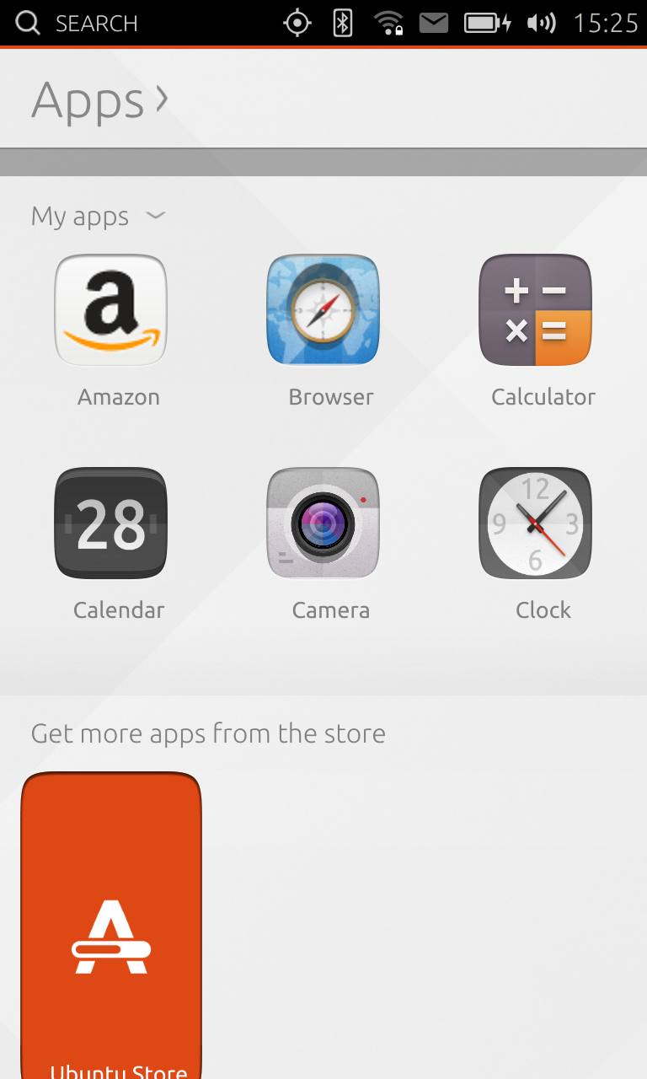
Unity 7 / Unity 8 Comparison (2)

Slide 11
Scopes
Scopes drive the Unity 8 dash
Each scope represents a data source
Handle surfacing and search queries
Can control how search results are presented
Provide previews of results
Currently support C++ and Go

Slide 12
Application Model
Self contained
Not installed into the base image
Use “click packaging” format
Run under confinement

Slide 13
Application Confinement
User installed applications confined via AppArmor
Apps use one of a small number of OS provided policies
Apps use trusted helpers to access OS services
  location, media playback, etc

Slide 14
Application
Two supported APIs:
Qt / QML
HTML5
  Browser based on Chromium
  Supports Apache Cordova APIs (aka PhoneGap)
More details at http://developer.ubuntu.com/apps/

Slide 15
Testing Ubuntu Touch
Supported development devices:
  Nexus 4
  Nexus 7 (2013)
Instructions:
  https://wiki.ubuntu.com/Touch/Install
  Can be used to upgrade the system image without wiping the data partition
Emulator:
  https://wiki.ubuntu.com/Touch/Emulator

Slide 16
Development Process
Most components managed on Launchpad
Use Launchpad merge proposals for code review
Jenkins used to run unit tests pre-review, and on merge
Manual test plans for each component run before adding to the image
Autopilot tool used to test GUI

Slide 17
Ubuntu Phone Hardware
First hardware partners announced at MWC 2014
BQ Aquarius
Meizu MX3
https://insights.ubuntu.com/2014/02/19/canonical-announces-first-partners-to-ship-ubuntu-phones-around-the-globe/

Slide 18
Questions?

