Slide 1
Unity Scopes
On the Desktop and Phone
Presentation by
James Henstridge
james.henstridge@canonical.com
www.canonical.com
linunx.conf.au, January 2014

Slide 2
What are scopes?
Scopes are the back end for the Unity dash (accessed via the Super/Windows key)
Back end feature set follows requirements of UI
Provide results for different types of data (applications, files, videos, music, etc)
Provide results in responses to searches and for “surfacing”
  Determine how to activate or preview results

Slide 3
Dash Overview
Displays a set of “surfacing” results when opened
Results broken down by category labels
Incremental search results are displayed as the user types
Pages for different types of result (apps, files, music, etc) available via tabs at the bottom
Domain specific filters available to limit results
Results can be previewed (click), or activated (double click)

Slide 4
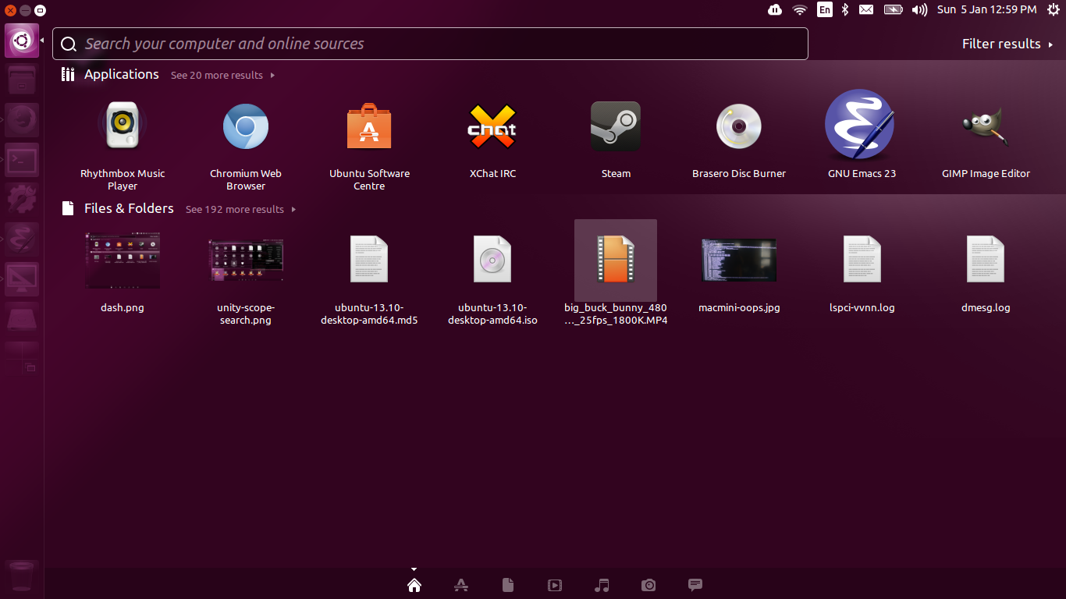
Dash Overview (2)

Slide 5
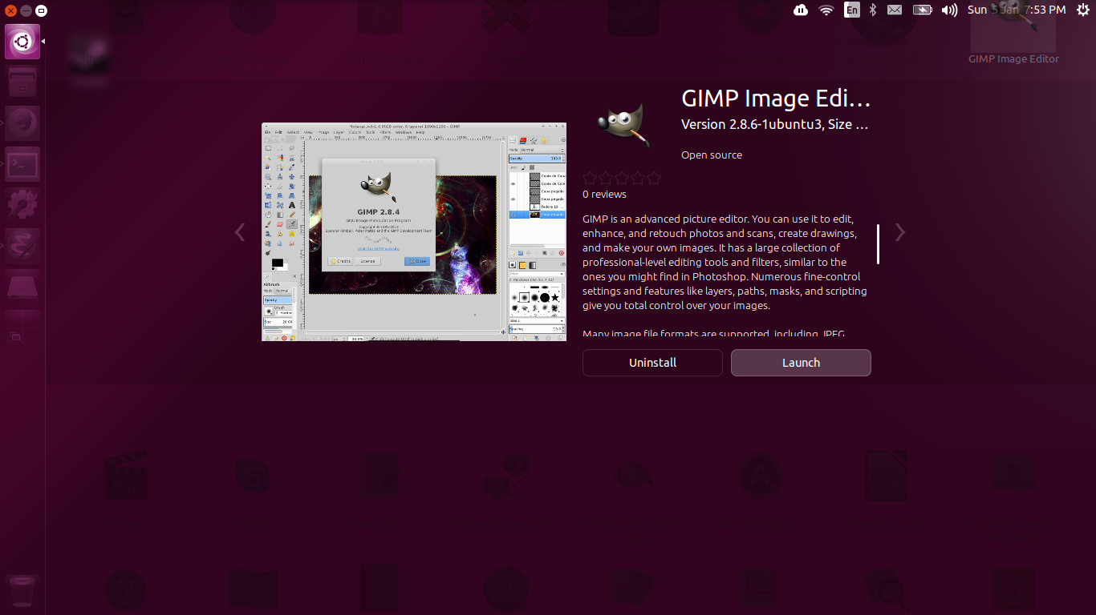
Dash Overview (3)

Slide 6
Results
A scope result is essentially a collection of metadata key/value items.
Some items are predefined such as:
  URI
  Title
  Icon
  Category
Scopes can also store arbitrary metadata in a result

Slide 7
Searching
The primary operation for a scope
  Empty search string used for surfacing
Results are pushed to the client
Search can be cancelled, e.g. for incremental searches
Changes to filters result in new searches

Slide 8
Activating Results
Client requests that the scope
  full result dictionary is passed back to the scope
Scope can reply in a number of ways:
  NOT_HANDLED: tells client to activate result itself
  SHOW_DASH/HIDE_DASH: scope handled activation
  GOTO_PREVIEW: display a preview
  PERFORM_SEARCH: tell client to perform a new search

Slide 9
Previews
Slient can request a preview by passing a result to the scope
Scope can pick one of a small number of templates for the preview (generic, application, music, video, etc)
One or more action buttons can be attached, which are handled via the activation API

Slide 10
Master Scopes
Each page of the dash is handled by a master scope
Master scopes aggregate results from other results
  provide the same API as regular scopes
For best the experience, scopes under the same master scope should use the same categories and filters when appropriate
You probably won't want to write a new master scope: instead, plug in to an existing master scope

Slide 11
Smart Scope Server
Scopes run on a remote server, with results sent to client via HTTP
Access to multiple scopes multiplexed over a single request
Only suitable for anonymous non-personal results
Currently integrated via the “home” master scope

Slide 12
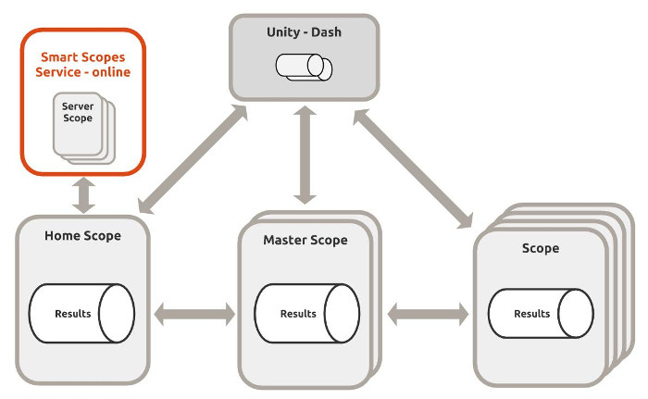
Overview
Ref: http://developer.ubuntu.com/scopes/overview/

Slide 13
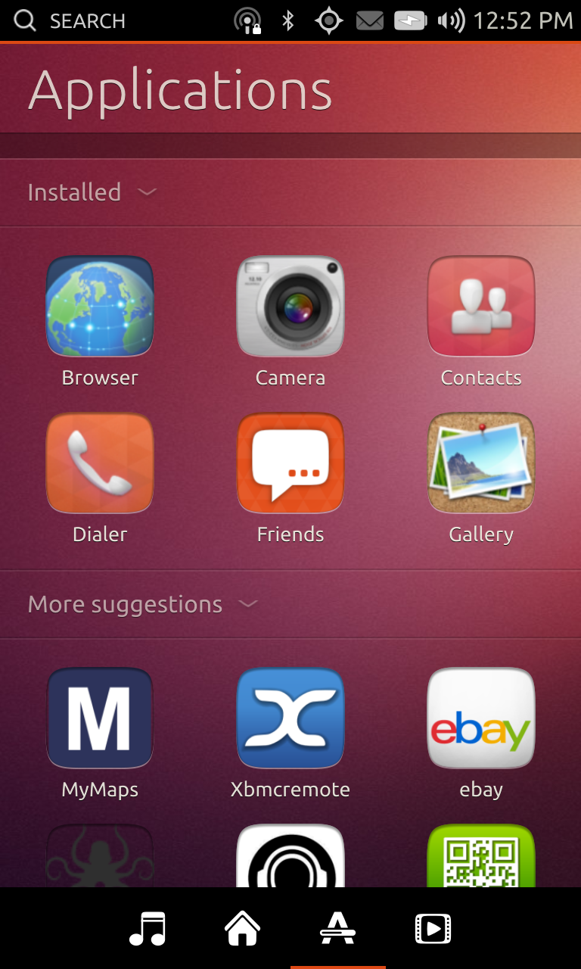
Phone
Unity 8 phone shell modelled on the Dash
Uses the same back end scopes API
Some scopes needed replacement when they depended on functionality not present on the phone
Due to limited resources, a push to run as many scopes remotely as possible
Discourage use of Python for local scopes

Slide 14
Scope Sample
from gi.repository import Unity
class MyScope(Unity.AbstractScope):
def get_categories(self):
cats = Unity.CategorySet.new()
cats.add(Unity.Category.new('name', 'Display name', icon,
Unity.CategoryRenderer.DEFAULT))
return cats
def do_create_search_for_query(self, search_context):
return MySearch(search_context)
def do_create_previewer(self, result, metadata):
return MyPreviewer(result, metadata)
def do_activate(self, result, metadata):
...

Slide 15
Scope Sample (2)
class MySearch(Unity.ScopeSearchBase):
def __init__(self, search_context):
super(MySearch, self).__init__()
self.set_search_context(search_context)
def do_run(self):
query = self.search_context.search_query
result_set = self.search_context.result_set
result = Unity.ScopeResult.create(
uri, icon, category, result_type, mimetype,
title, comment, dnd_uri, metadata)
result_set.add_result(result)
...
if self.search_context.cancellable.is_cancelled():
return
...

Slide 16
Scope Sample (3)
class MyPreviewer(Unity.ResultPreviewer):
def __init__(self, result, metadata):
super(MyPreviewer, self).__init__()
self.set_scope_result(result)
self.set_search_metadata(metadata)
def do_run(self):
preview = Unity.GenericPreview.new(
self.result.title, '', icon)
preview.add_action(Unity.PreviewAction.new(
"open", "Open", None))
return preview

Slide 17
Additional configuration
Scope configuration file
  provides basic metadata and IPC endpoint to talk to scope
  The RemoteContent key used to blanket disable remote access
configuration file location determines which master scope it feeds data to

Slide 18
Future
New version of the scopes API
  C++11 API
  Go and Javascript bindings in development
Ability to confine scopes via AppArmor
  e.g. make “access to network” and “access to personal data” mutually exclusive
  restrict how scopes can talk with each other

Slide 19
Resources
Ubuntu Developer website:
  http://developer.ubuntu.com/scopes/overview/
  http://developer.ubuntu.com/scopes/tutorial/
New scopes API:
  bzr branch lp:unity-scopes-api

Slide 20
Questions please
Thank you
James Henstridge
james.henstridge@canonical.com
www.canonical.com

