Slide 1
MSDS 6373: Time Series Project
Hong Kong Macroeconomics Data
Jason Herbaugh and Alexander Sepenu

Slide 2
Agenda
Data Set Summary
Stationarity
Univariate Analysis
Analysis Plan

Slide 3
Data Set Summary
Data: https://www.kaggle.com/stanley11291985/hk-macroeconomics-data
Economic data for the Hong Kong Private Housing Market
  Collected between 2003 and 2019
  Variables include:
    Hang Seng Index (total volume and close price)
    Index data for Consumer Price and Private Domestic Housing
    Unemployment Rate and Bank Interest Rate
    Inventory (built/sold/vacant)
    Sales Metrics (quantity/amount)
No Missing Data or Outliers
EDA Project: https://github.com/jherbaugh/MSDS6373_TS_Project

Slide 4
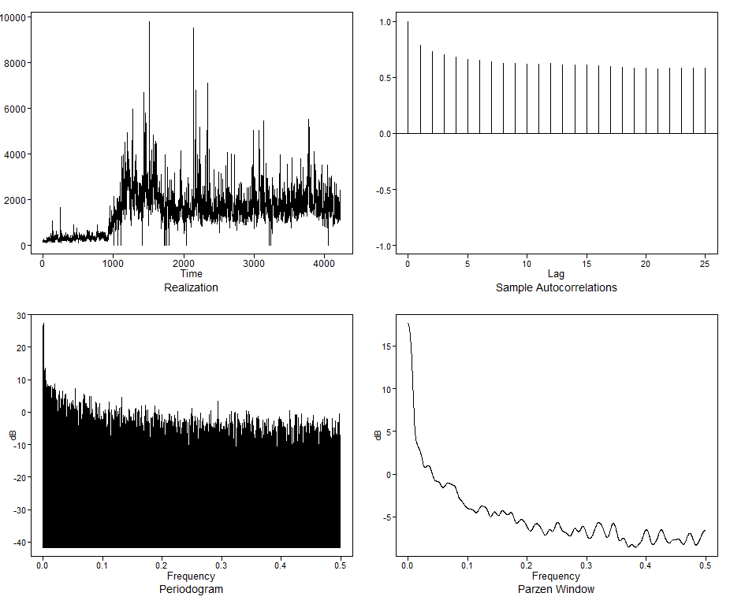
Univariate Analysis – HSI Volume
Transaction volume of Hang Seng Index
Data is scaled in hundreds of millions
  Divide by 1 million to normalize data
True ACF shows slow dampening behavior
Spectral Density
  Non-cyclic, wandering behavior
  Peak at f = 0
Data is not stationary
  Hint of cyclic behavior
    dominant (1-B)
  Difference the data

Slide 5
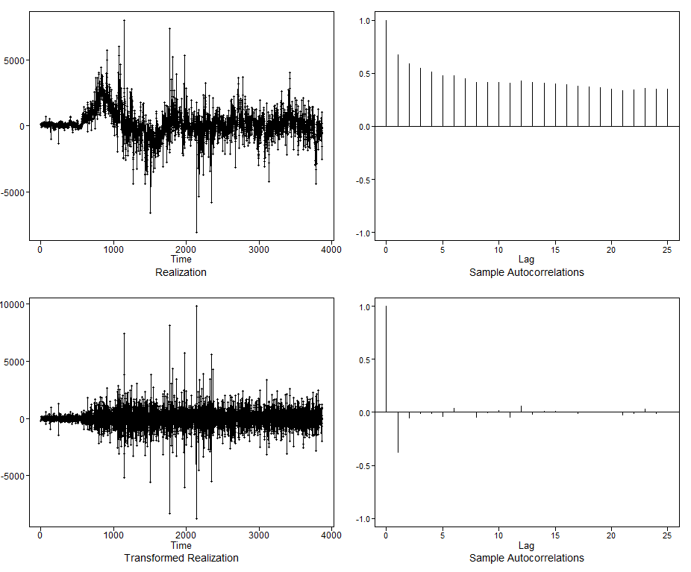
HSI Volume – Differencing
Model Identification
  AIC5.wge chooses AR(2,2)
  Will also model ARIMA(2,1,2)
  BIC favored
  Five Smallest Values of bic
  p q bic
  15 2 2 13.20790
  21 3 2 13.20946
  16 2 3 13.20999
  26 4 1 13.21050
  22 3 3 13.21167
1st difference
  Remove seasonality and make data more stationary
2nd difference show significance at lag 1
  Remove (1-B) factor
  ACF looks not white and shows cyclic behavior

Slide 6
HIS Volume– Final Model
Estimate coefficients
Coefficients of Original polynomial: 1.7383 -0.7394
Mean : 1492.191 | Variance : 538864.1
Final Model
  # (1-B¹²)(1 - 1.7383B + 0.7394B²)(X_{t} + 1492.191) = (1 - 1.3420B + 0.3625B²)a_{t}

Slide 7
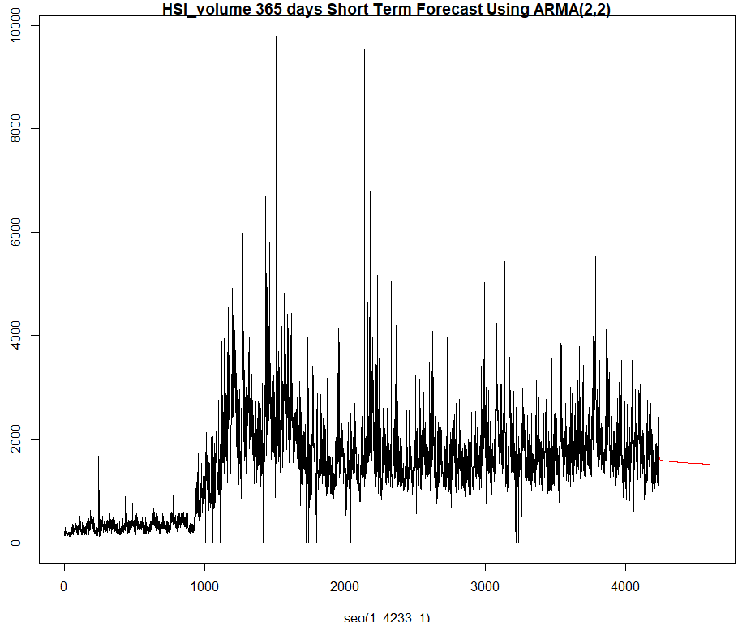
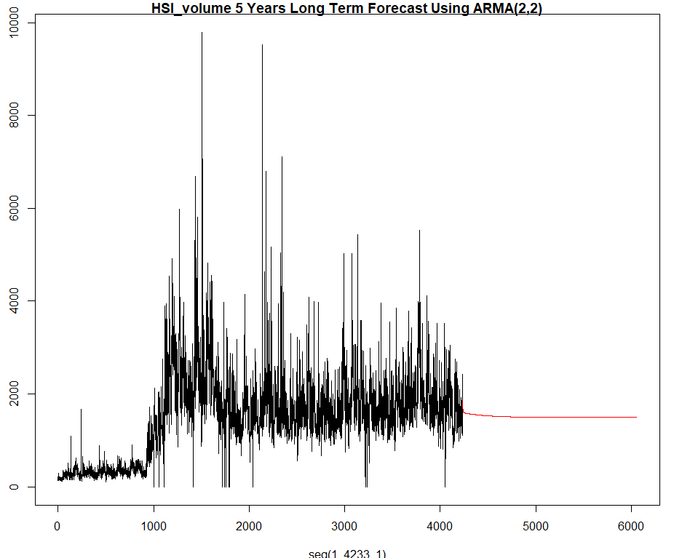
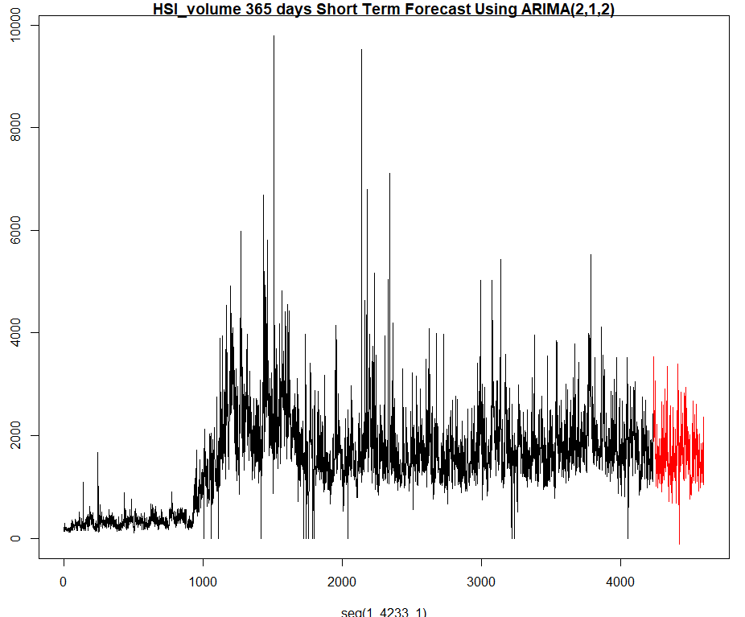
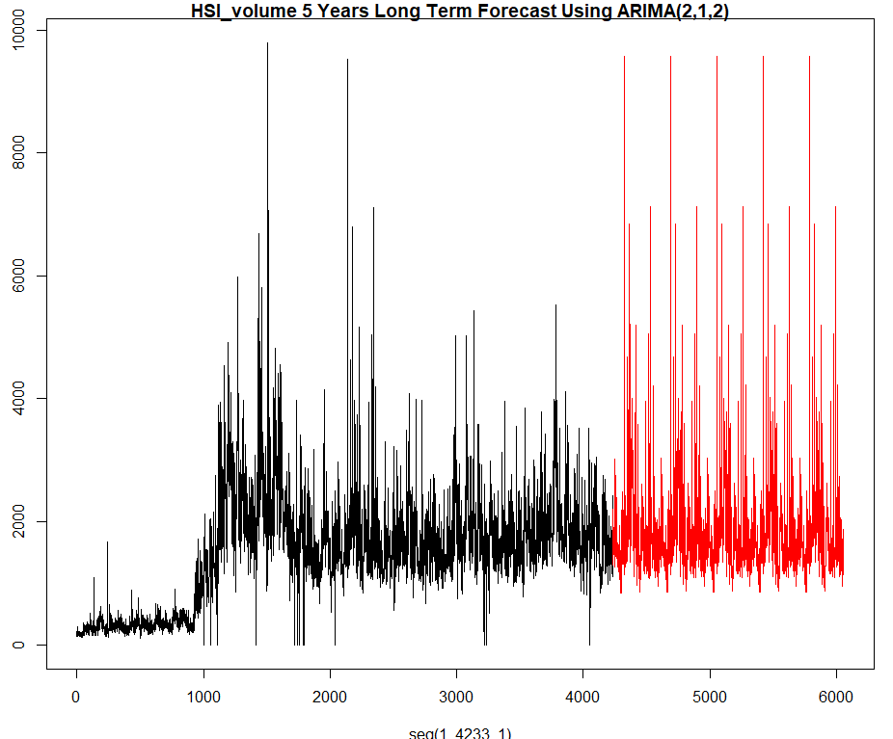
HSI Volume – Forecasting
ARMA(2,2)
  Short Term Forecast – 365 Days
  Long Term Forecast – 5 years
ARIMA(2,1,2)
  Short Term Forecast – 365 Days
  Long Term Forecast – 5 years

Slide 8
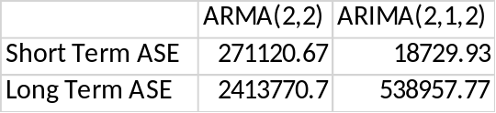
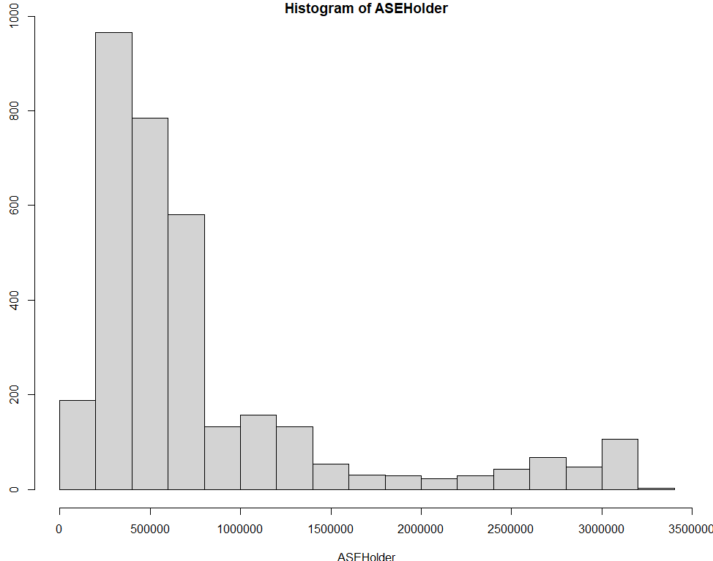
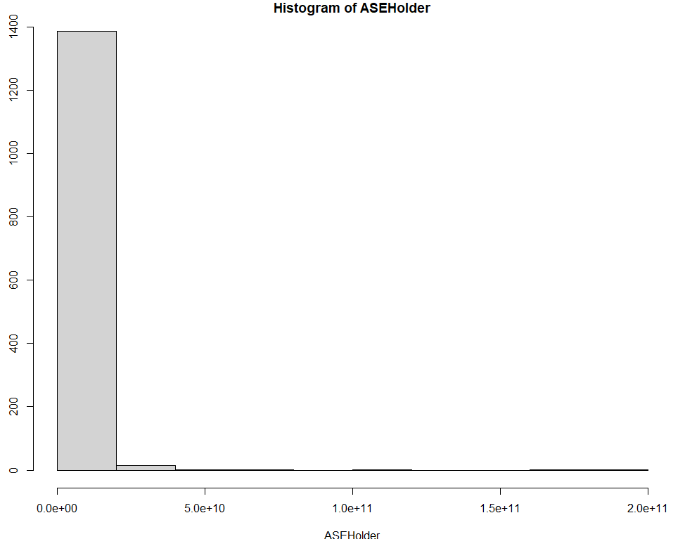
HSI Volume – Model Evaluation
Short and Long Term ASE
Rolling Window ASE
  Training size 500 for short term
    1000 for long term
  Short Term ASE: 645583.3
  Long Term ASE: 1558748
Best Model
  Short Term : ARIMA(2,1,2)
  Long Term : ARIMA(2,1,2)

Slide 9
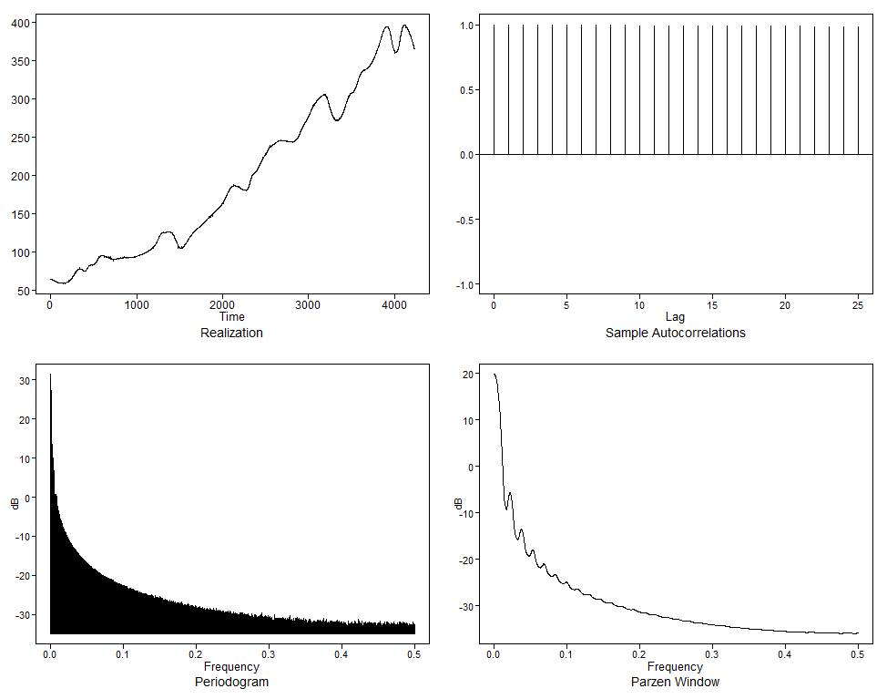
Univariate Analysis –Price Index
Price index of private housing in HK
Acf shows evidence of wandering behavior
  Identical rho_k =1
Spectral Density
  Non-cyclic, wandering behavior
  Spectral dominant (1-B)
    Peak f = 0
Data is not stationary
  Difference data to stationarize

Slide 10
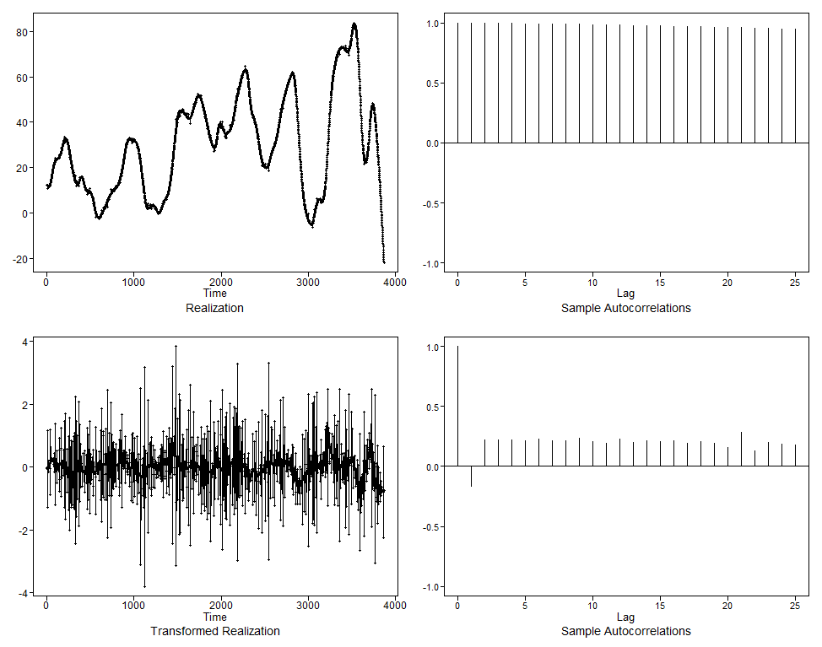
Price Index– Differencing
Model Identification
  AIC5.wge chooses AR(11,4)
  Will also model ARIMA(11,2,4)
  AIC & BIC favored
  Five Smallest Values of bic
  p q bic
  71 11 4 -2.001226
  70 11 3 -1.995635
  72 11 5 -1.995036
  66 10 5 -1.994473
  60 9 5 -1.993425
1st difference
  Remove seasonality and make data more stationary
2nd difference show
  ACF shows cyclic behavior at lag 1 and slight sinusoidal
  Spectral Density with high peak at f = 0 and ripples

Slide 11
Price Index– Final Model
Estimate coefficients
Coefficients of Original polynomial: 0.0322 0.3918 1.1102 -0.0967 -0.0845 -0.0623 -0.0676 -0.0547 -0.0711 -0.0540 -0.0511
Mean : 197.065 | Variance : 0.1306
Final Model
  (1+1.1624B+0.9835B² (1 + 0.0322B - 0.3918B² - 1.1102B³ + 0.0967B⁴ + 0.0845B⁵ + 0.0623B⁶ + 0.0676B⁷ + 0.0547B⁸ + 0.0711B9 + 0.0540B¹⁰ + 0.0511B¹¹)(_{Xt} + 197.065) = (1 - 0.7450B - 0.3282B² - 0.7976B³ + 0.9230B⁴)a_{t}

Slide 12
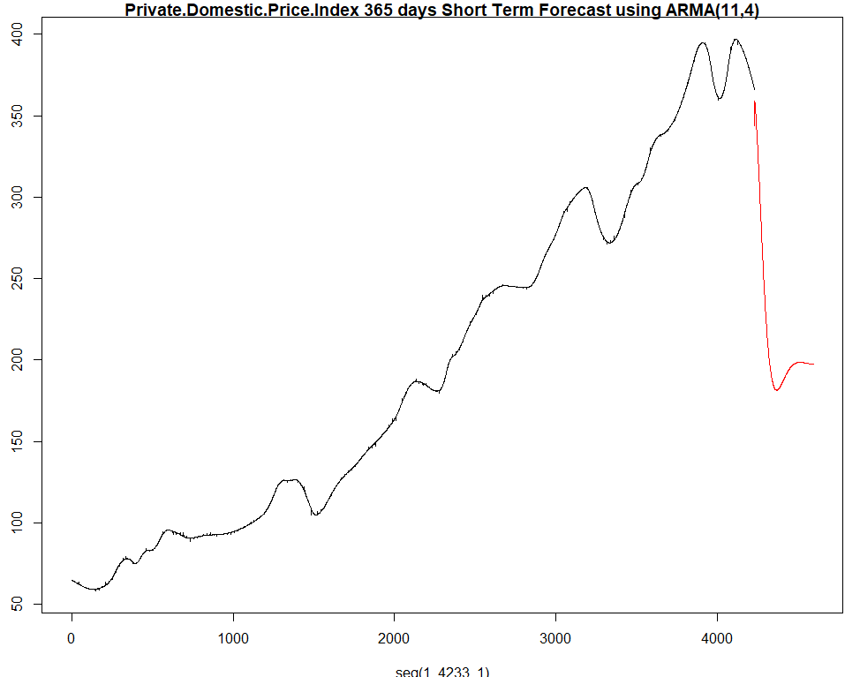
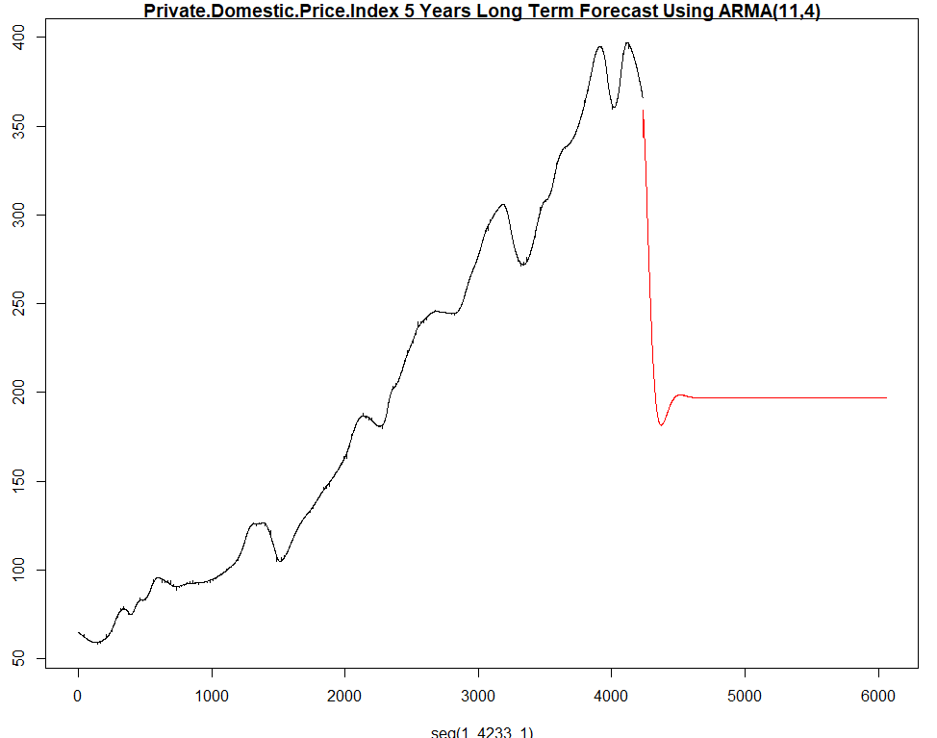
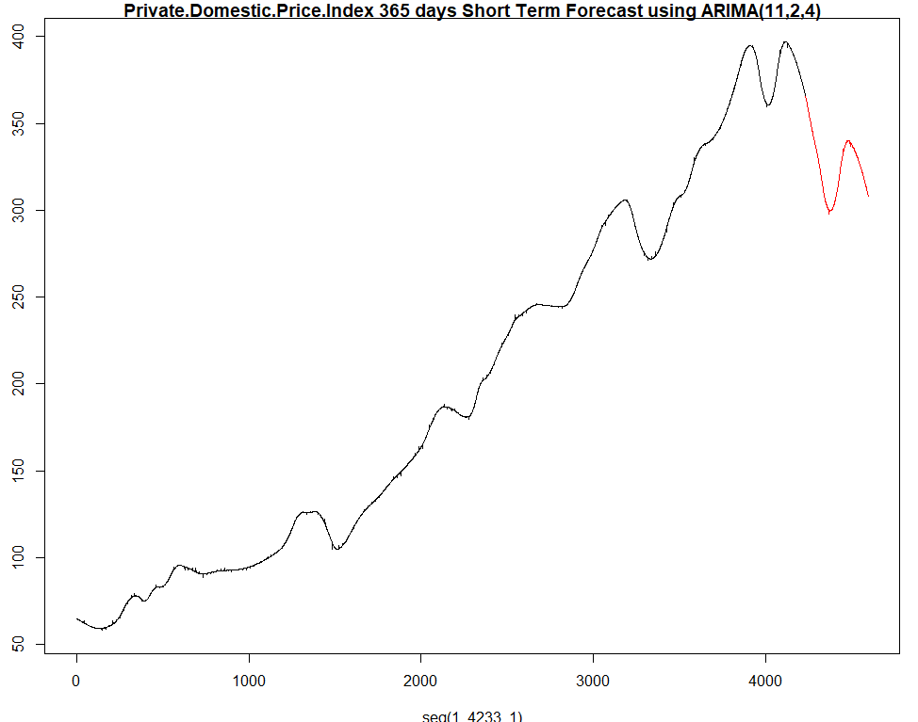
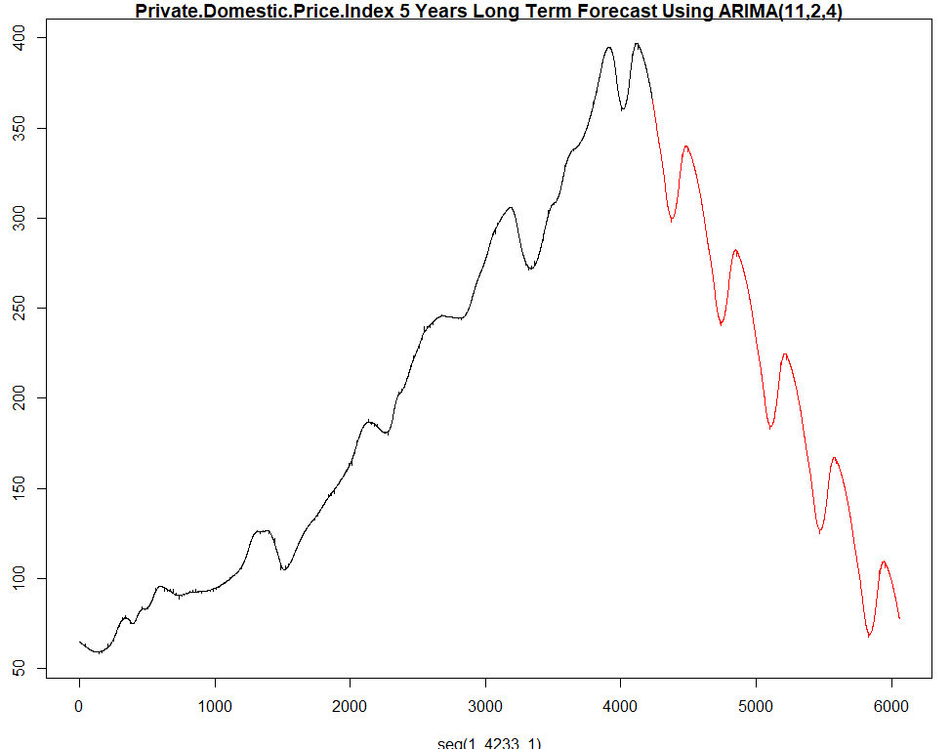
Price Index– Forecasting
ARMA(11,4)
  Short Term Forecast – 365 Days
  Long Term Forecast – 5 years
ARIMA(11,2,4)
  Short Term Forecast – 365 Days
  Long Term Forecast – 5 years

Slide 13
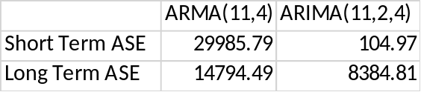
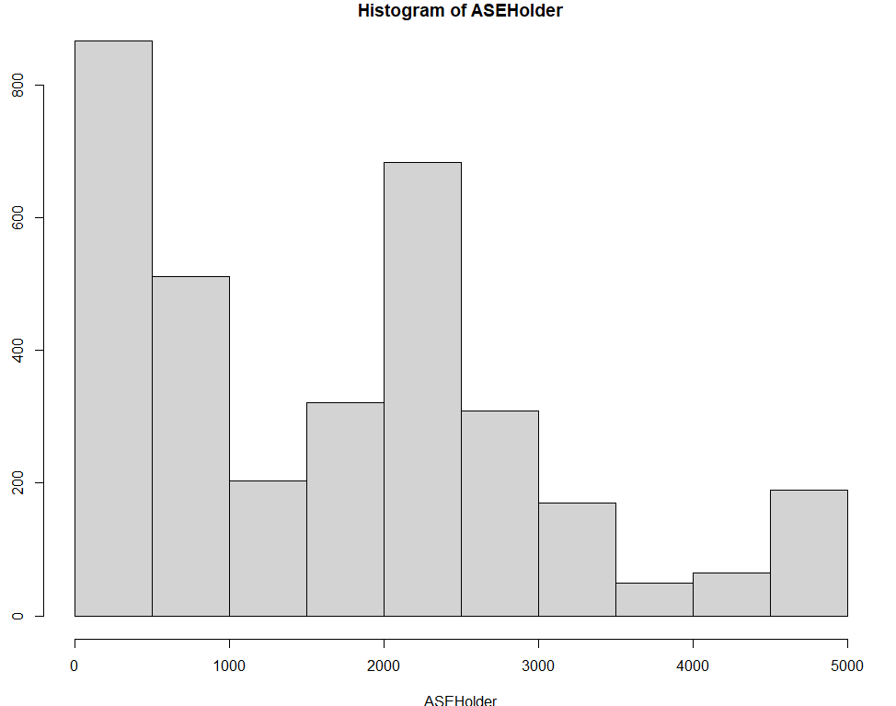
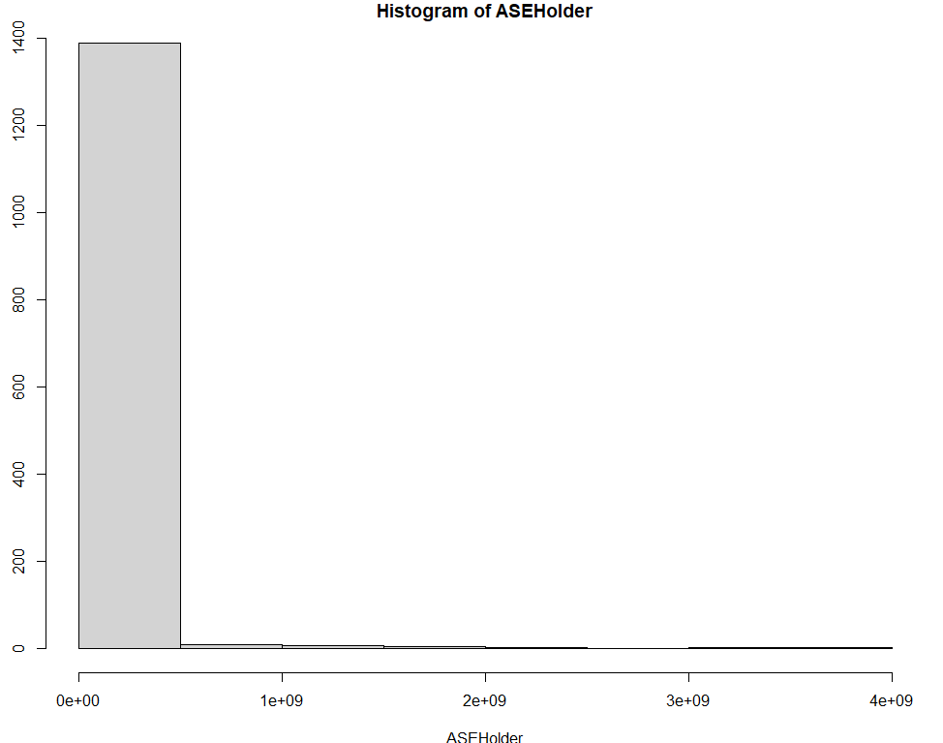
Price Index– Model Evaluation
Short and Long Term ASE
Rolling Window ASE
  Training size 500 for short term and 1000 for long term
  Short Term ASE: 1677.426
  Long Term ASE: 38524175
Best Model
  Short Term : ARIMA(11,2,4)
  Long Term : ARIMA(11,2,4)

Slide 14
Analysis Plan
Look at Pre and Post financial crisis of 2008
  Do the data differ greatly
  Ability to forecast if the same event occurs again
Combination of variables to produce best forecast of Housing Prices
  What economic data forecasts best
  Trends

