Slide 1
Bootcamp
Python for Data Science

Slide 2

Linear Regression
Uses line of best fit to predict
“Best fit” minimizes squared error

Slide 3
single-variable
y = 2x + 1
1 —> 3
2 —> 5
3 —> 7

Slide 4
single-variable
y = model.predict(x)
1 —> 3
2 —> 5
3 —> 7

Slide 5
Training a Model
model = LinearRegression()
columns = [‘crime_rate’]
model.fit(df[columns],df[‘median_price])

Slide 6
Using a Model
model.predict(df[columns])

Slide 7
Multi-variable
y = 2x0 + 3x1 + 1

Slide 8
Multi-variable
y = 2x0 + 3x1 + 1
1,4 —> 15
2,3 —> 14

Slide 9
Training a Model
model = LinearRegression()
columns = [‘crime_rate’, ‘tax_rate’]
model.fit(df[columns],df[‘median_price])

Slide 10
Using a Model
model.predict(df[columns])

Slide 11
Exercises

Slide 12
Problem #1: Shape of Data
Not centered on zero
Columns have different magnitudes

Slide 13
Interpreting Linear models
model.coef_
[-1.840,4.24, …, -9.96])

Slide 14
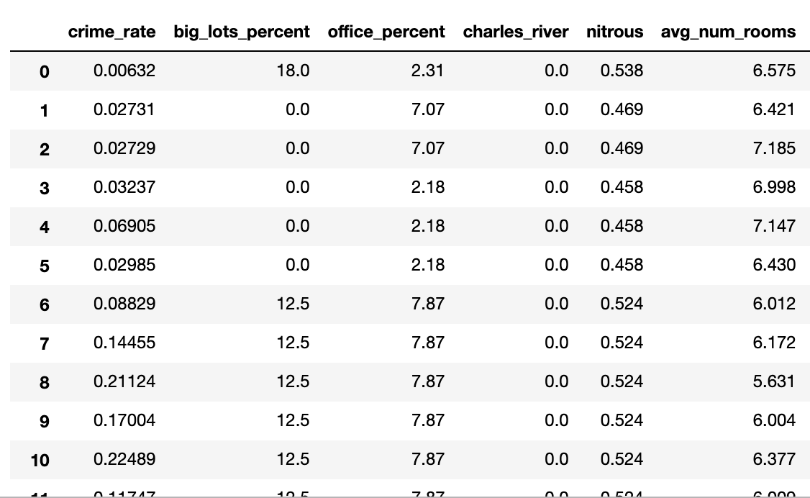
Interpreting Linear models
model.coef_
[-1.840,4.24, …, -9.96])

Slide 15
Solution: Standardize Data!
Centered data around zero
Scale all columns to have variance = 1

Slide 16
Standardizing your data
from sklearn.preprocessing import scale
X = scale(df[columns])

Slide 17
Interpreting Linear models
model.coef_

Slide 18
Problem #2: Sum of Squares
Changes with the magnitude of the data
Cannot compare across two datasets

Slide 19
Solution: R2 score!
Compares model’s error to error against average
Goes from 1 (perfect) to negative infinity

Slide 21
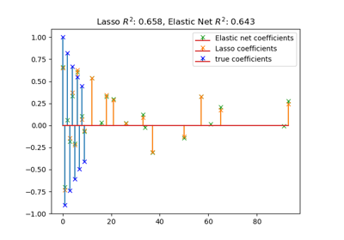
Text

Slide 22
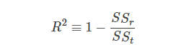
R2 score
<- Error of model
<- Error of mean

Slide 23
R2 Score
Much smaller squared error? R2 close to 1
Same squared error as always guessing mean? R2 close to 0

Slide 24
Exercises

Slide 25
Linear model assumptions
Linear relationship
Independence
Normality
Equal Variance

Slide 26
Testing methods
Quick and qualitative
Protects against major errors

Slide 27
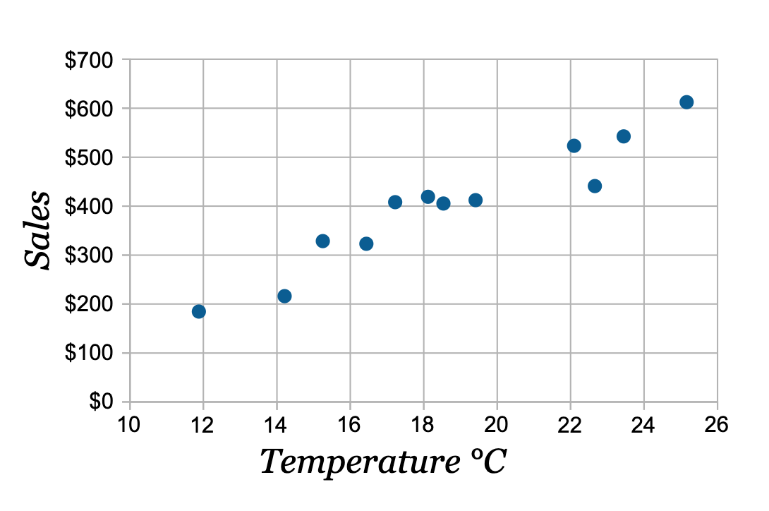
Linear relationship
Can check with a scatter plot

Slide 28
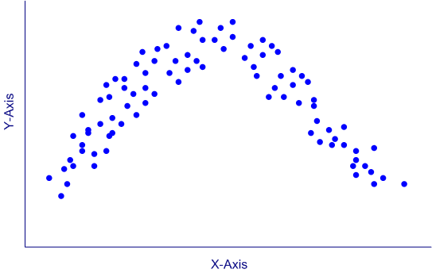
Linear relationship
Can check with a scatter plot

Slide 29
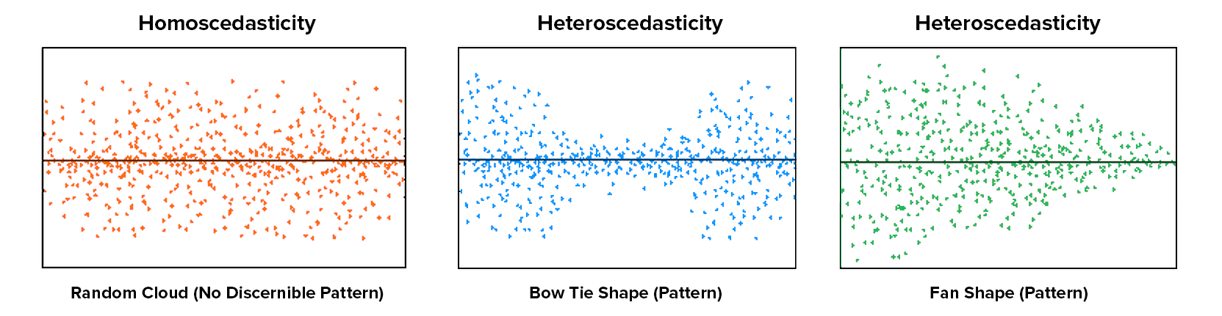
Equal Variance
Can check with a scatter plot

Slide 30
equal Variance
Can check with a scatter plot

Slide 31
equal Variance
Can check with a scatter plot

Slide 33
Linear model assumptions
Linear relationship
Independence
Normality
Equal Variance

Slide 34
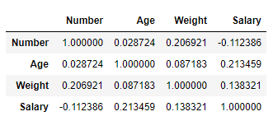
Independence
Check the correlation matrix df.corr()

Slide 35
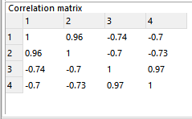
Independence
Check the correlation matrix df.corr()

Slide 36
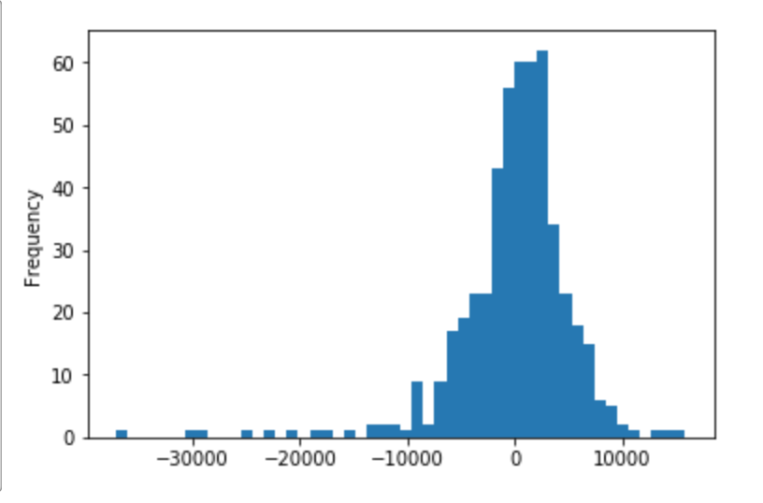
Normality of errors
Can check with a histogram

Slide 37
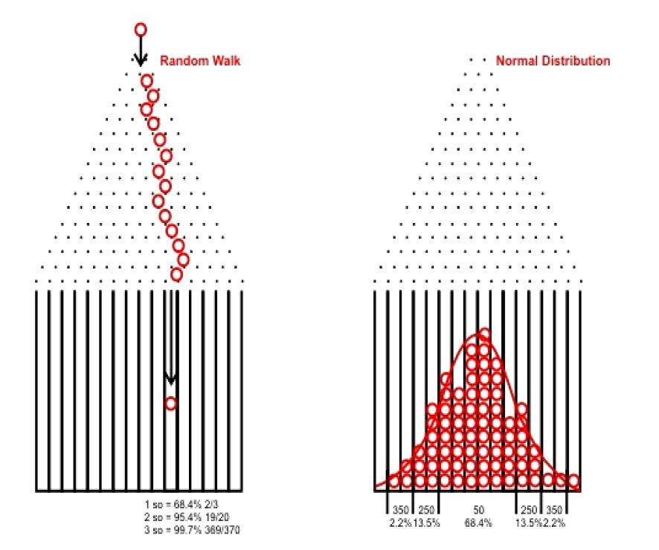

Slide 38
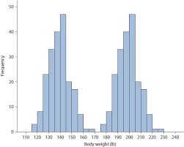
Normality of errors
Can check with a histogram

Slide 39
Exercises

