Slide 1
Bootcamp
Python for Data Science

Slide 2
Foundational Math

Slide 3

Linear Relationship
X has a consistent effect on Y
Eg. Sq footage -> house price

Slide 4
Linear RelationshipS
hours worked —> paycheck
milage -> price of car
close to stage —> ticket price

Slide 5
NonLinear RelationshipS
time in oven —> quality of cake
height of car —> price

Slide 6
Linear Models
Outputs line of best fit
“Best fit” is a function of error

Slide 7
single-variable Linear models
No magic!
2 dials: coefficient and intercept

Slide 8
single-variable
y = 2x + 1

Slide 9
single-variable
y = 2x + 1
coefficient AKA slope

Slide 10
single-variable
y = 2x + 1
intercept

Slide 11
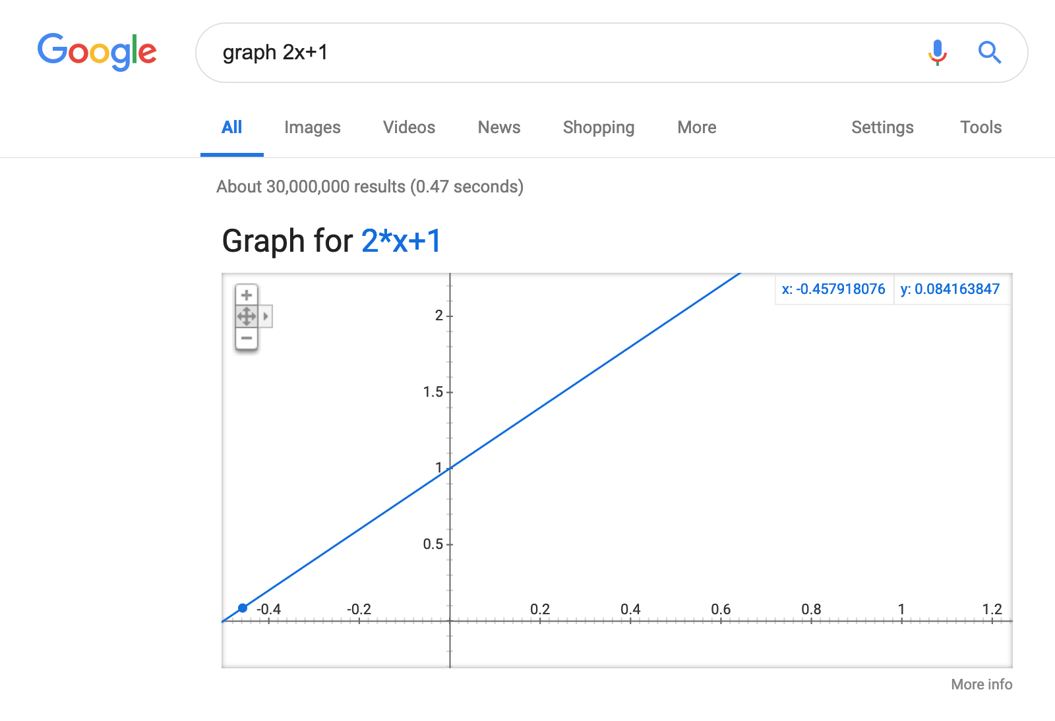
Text

Slide 12
single-variable
y = 2x + 1
1 —> 3
2 —> 5
3 —> 7

Slide 13
single-variable Model for Housing
y = 2000x + 400,000

Slide 14
single-variable Model for Housing
y = 60,000x + 400,000
Number of rooms

Slide 15
single-variable Model for Housing
y = 60,000x + 400,000
Base cost of house

Slide 16
single-variable
y = 60,000x + 400,000
1 —> 420,000
2 —> 480,000
3 —> 540,000

Slide 17
Exercises

Slide 18
Linear Regression

Slide 19
Sci-Kit Learn
All-in-one machine learning package
Built on Numpy and matplotlib

Slide 20
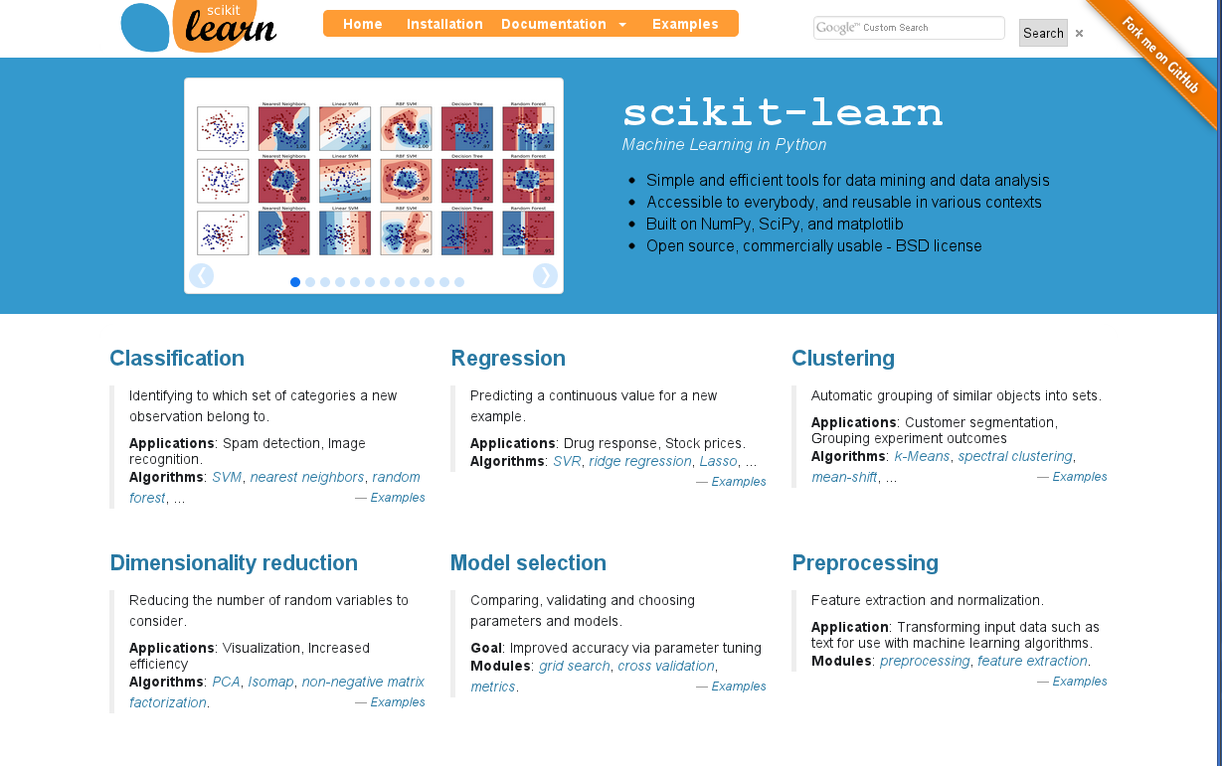
Text

Slide 21
Code is not the hard part
model = LinearRegression()
model.fit(X, y)

Slide 22
Code is not the hard part
model.predict(X)

Slide 23
Code is not the hard part
model.predict(X)
predicted prices

Slide 24
Imported as sklearn
import sklearn

Slide 25
Imported as sklearn
from sklearn.linear_model import LinearRegression

Slide 26
Python Equivalent
model = LinearRegression()
model.coef_ = np.array([2.0])
model.intercept_ = 1.0

Slide 27
single-variable
y = model.predict(x)
1 —> 3
2 —> 5
3 —> 7

Slide 28
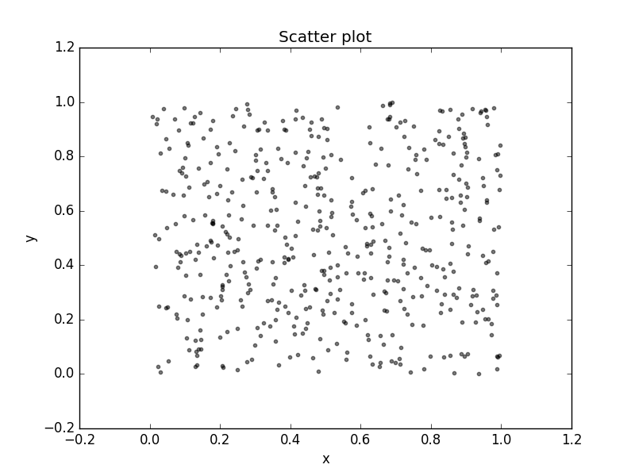
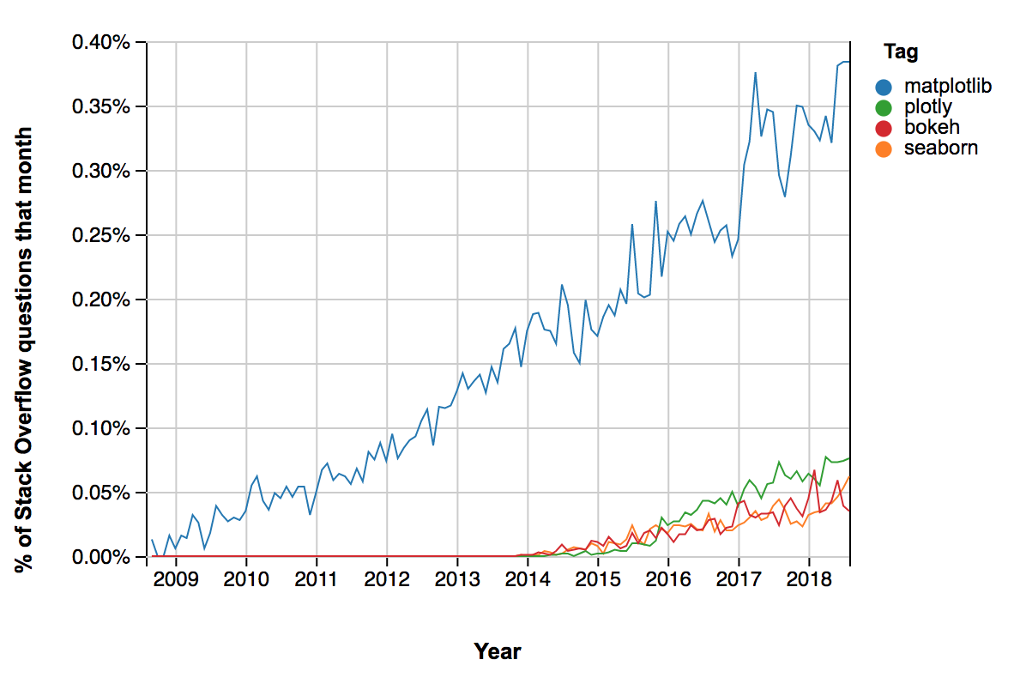
Scatter and Line Plots

Slide 29
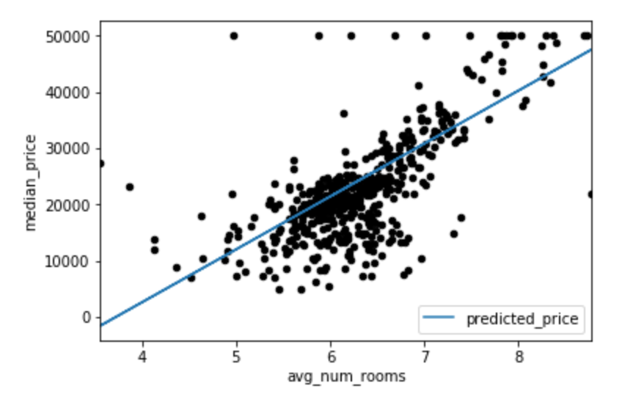

Slide 30
matplotlib.Pyplot
plt.scatter(x_vals, y_vals)

Slide 31
matplotlib.Pyplot
plt.plot(x_vals, y_vals)

Slide 32
Exercises

Slide 34
Why Least squares?
Math is much simpler
Minimal value of a quadratic can be solved analytically

Slide 35
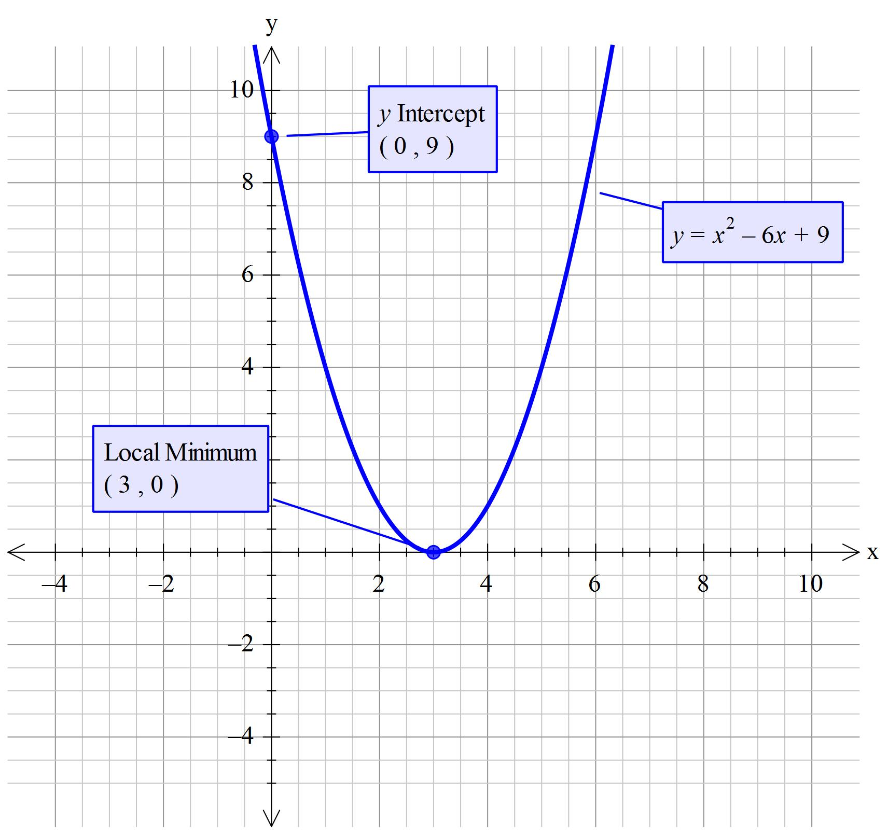
Text

Slide 36
Exercises

