Slide 1
Bootcamp
Python for Data Science

Slide 2
Importing time series data
pd.read_csv(‘path.csv',
parse_dates=[‘Date'],
index_col='Date')

Slide 3
Dataframe from dicts
pd.DataFrame.from_dict(dict_list)
Dicts must all have same keys!

Slide 4

Partial string indexing
Pandas translates string to date
Order is: Year - Month - Day

Slide 5
Partial string indexing
df[‘2017’]

Slide 6
Partial string indexing
df[‘2017-02’]

Slide 7
Partial string indexing
df[‘2017-02-01’]

Slide 8
Resample
Aggregates to a larger unit of time
Single-digit code for each unit

Slide 9
Resample
D —> daily
W —> weekly
M -> monthly
Q -> quarterly
A -> annually

Slide 10
Matplotlib
Intro to Data Visualization with

Slide 11
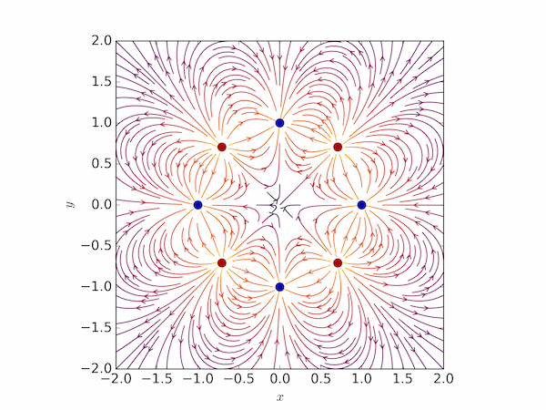

Slide 12
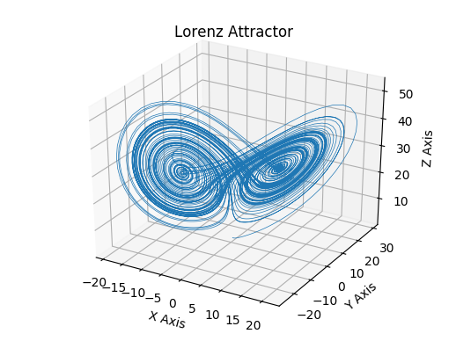

Slide 14
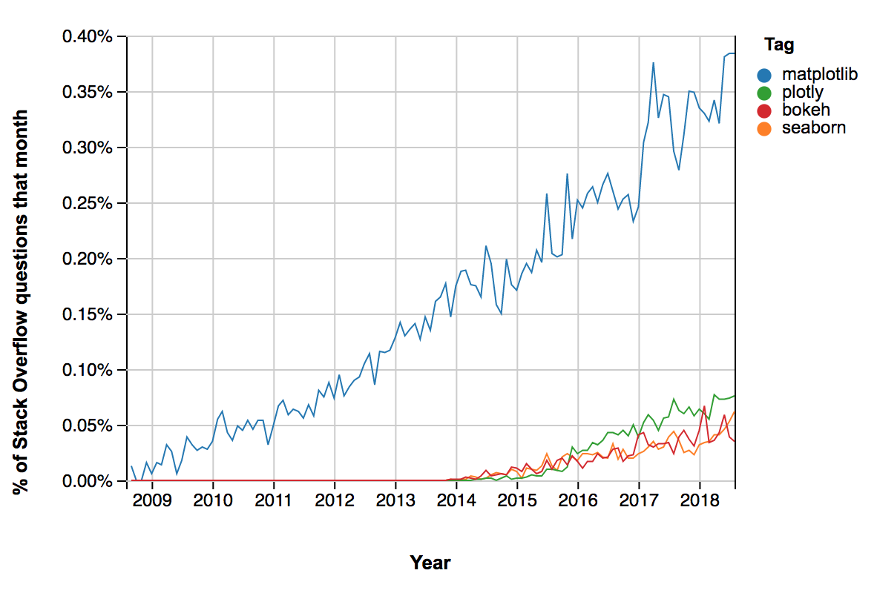

Slide 15
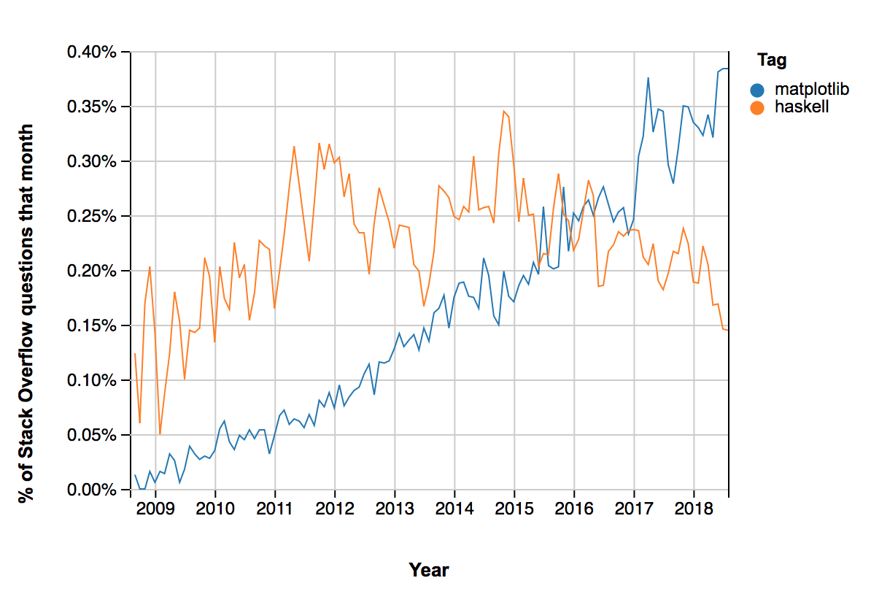

Slide 16
Setup for plotting
%matplotlib inline
from matplotlib import pyplot as plt

Slide 17
Plotting
plt.plot(df[‘Open’])

Slide 18
Plotting
plt.style.use('seaborn')

Slide 19
Basic plotting
Index used as X-values
Column values used as Y-values

Slide 20
Matplotlib.pyplot
High-level interface
Order of execution matters
Don’t mix or confuse with object-oriented interface!

Slide 21
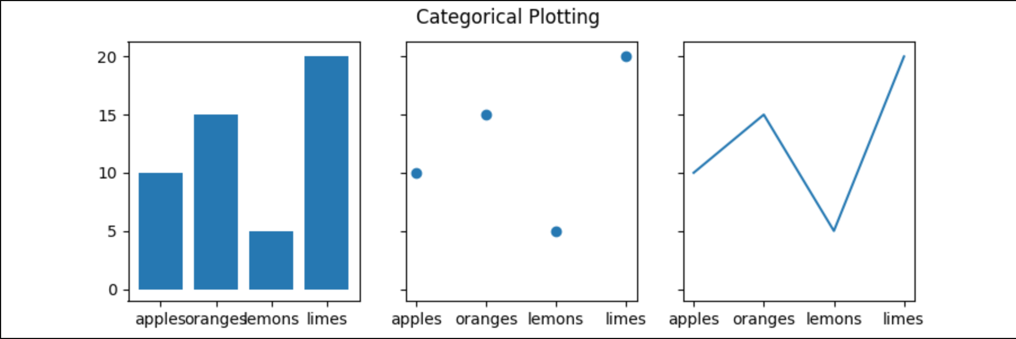
Figure
The entire image output by your code
matplotlib.figure.Figure

Slide 22
Figure
Set overall graph size
Store graph while modifying it
Save graph to disk

Slide 23
Plotting
plt.figure(figsize=(14, 6))

Slide 24
Plotting
plt.savefig(“my_graph.png”)

Slide 25
Exercises

Slide 26
Plotting
plt.bar(x_idx, heights)

Slide 27
Plotting
plt.title('My Name')

Slide 28
Plotting
plt.xlabel(“Hours”)

Slide 29
Plotting
plt.xticks(x_values,labels)

Slide 30
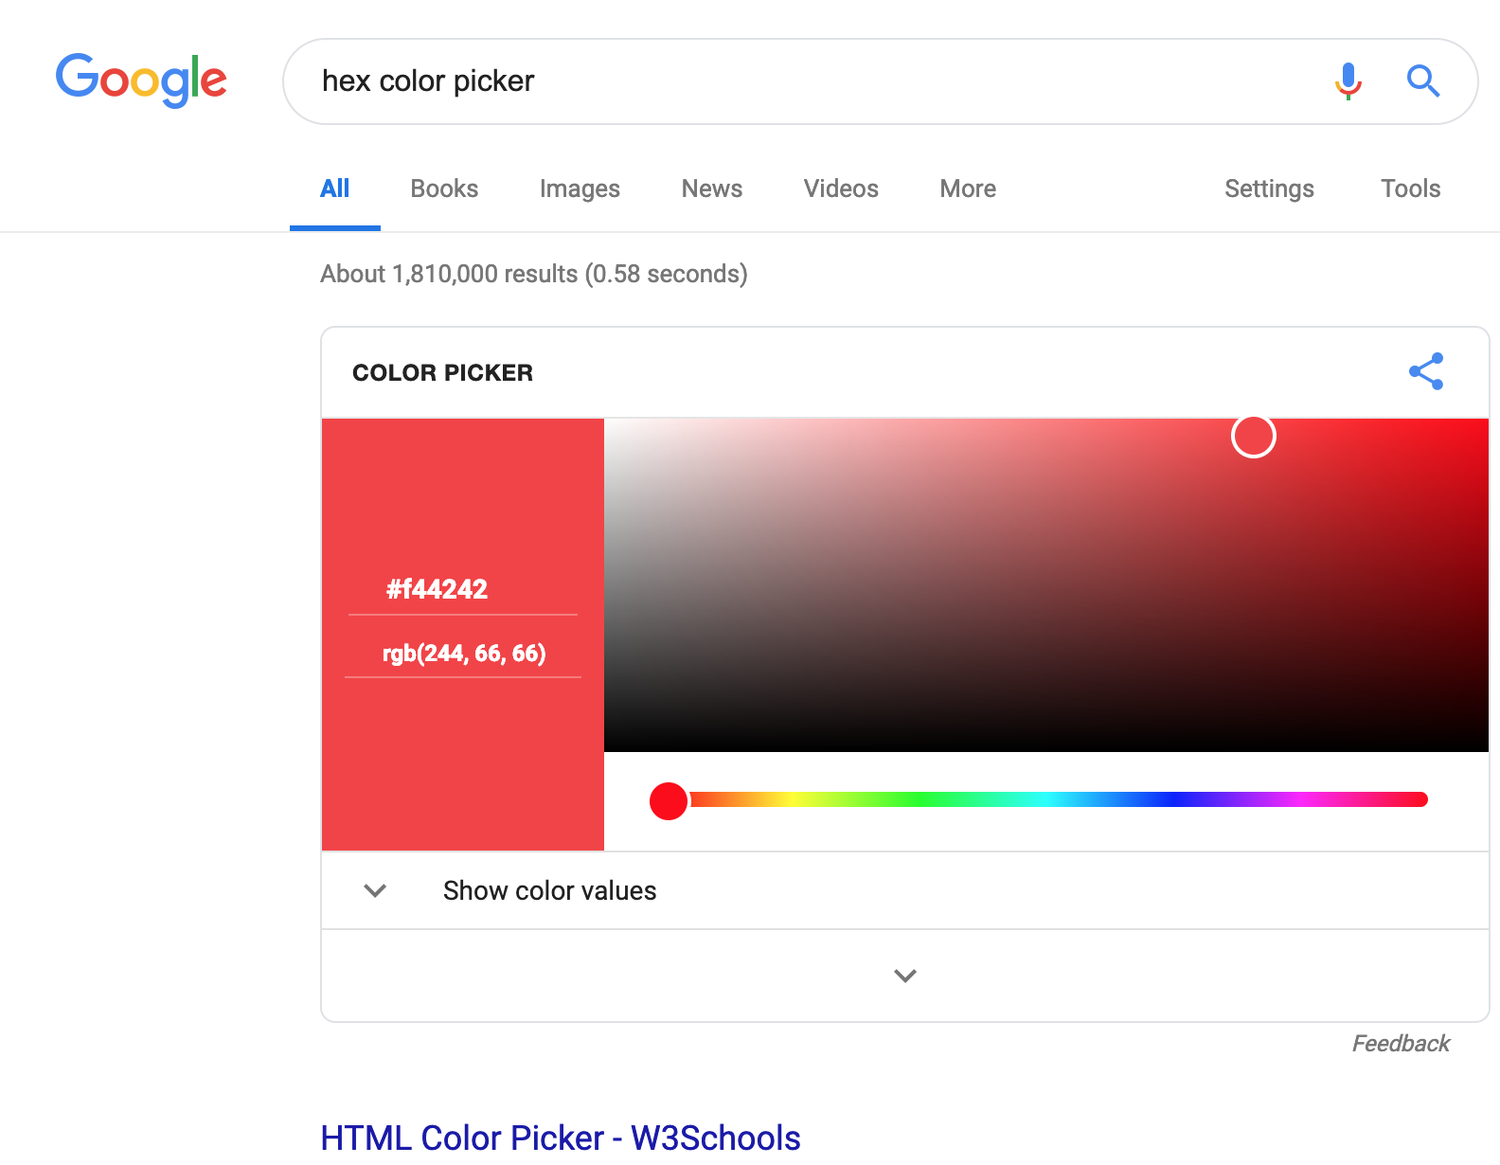
Text

