Slide 1
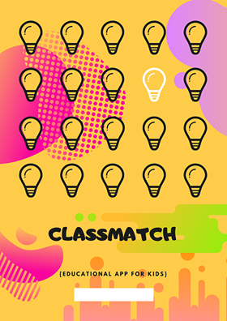

Slide 2
WHO WILL USE?
Children ages 4 to 6 years old.
WHAT ITS ALL ABOUT?
ClassMatch is free learning app for kids that teach children the basics of primary to secondary color, shapes and numbers. This app is suitable to the ages of 4 to 6.The application introduces 3 games that covers pronunciation of different kinds of colors, shapes and number, matching basic shapes, reordering numbers that will be able to help the child on more .
WHY WE CREATED THIS?
To help the children learn and identify basic color, shapes and numbers, explore and figures and develop perceptual skills.

Slide 3
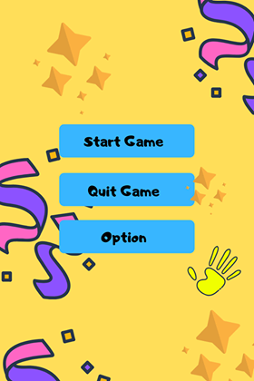

Slide 4
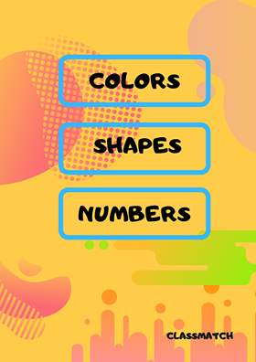

Slide 5

PRIMARY
COLORS
RED
YELLOW
BLUE

Slide 6
PRIMARY
COLORS
RED
YELLOW
BLUE

Slide 7
rectangle
octagon
circle
rhombus
oval
trapezoid
square
triangle
hexagon
pentagon

