Slide 1
Parallel Naive Bayes Classifier
IT 388 Parallel Processing | Spring 2026
Justin Hoffman, Brady Davidson, Daniel Sevik, Nathan Wolniak
8.41x
1M
4
2
Peak
Speedup
Records
Tested
Implementations
Environments

Slide 2
Naive Bayes Classifier
All features are integer-coded categories
Training and classification processed row by row: no dependencies between rows
5-fold cross-validation: split data into 5 parts, train on 4, test on 1, rotate and repeat
ML metrics reported: accuracy and confusion matrix per fold
Log probabilities for numerical stability; Laplace smoothing (alpha=1.0) for unseen values
P(y | x₁...xₙ) =
P(y) ∏ P(xᵢ | y)
P(y) = count(y) / N P(xᵢ | y) = count(xᵢ, y) / count(y) Predict = argmax [ log P(y) + Σ log P(xᵢ|y) ]
Note: Training and test sets are drawn from the same data. Accuracy will be artificially high. This is a parallel computing performance exercise, not a production ML system.

Slide 3
Data & Preprocessing
Diabetes Dataset
Preprocessing Pipeline
Source: UCI ML Repository, CDC BRFSS 2015 Size: 253k rows, 21 binary/categorical features Features: BMI, age, smoking, cholesterol, blood pressure, and more Target: Diabetes positive / negative
1
diabetes_csv.py / heart_csv.py
Two separate Python scripts, one per dataset
2
Integer encoding
All features converted to categorical integer values
Heart Disease Dataset
Source: Kaggle, Alex Teboul, CDC BRFSS 2015 Size: ~3,500 rows, similar feature set to diabetes Purpose: Correctness verification only, not used for scaling tests
3
Scale diabetes data
Resampled to generate 20k, 100k, 500k, and 1m variants
4
Output: three files per dataset
metadata.csv | labeled.csv | unlabeled.csv

Slide 4
Base Algorithm: nb_classifier.c
Design for Parallelism
1
Read inputs
accumulate_counts_range(data, start, end, ...)
Load metadata, labeled, and unlabeled CSVs into memory
P[ offset[j] + class * values[j] + value_idx ]
2
Train
Rows are stored in flat 1D arrays for simple row-based access.
Each row can be trained or classified independently.
Feature counts are flattened into one shared count array.
Offsets map each feature/class/value combination to one index.
Train, classify, and cross-validation can be timed separately.
Accumulate (feature, class) counts, convert to log probabilities
3
Cross-validate
5-fold: train on k-1 folds, score held-out fold
4
Classify
Score unlabeled rows against log probs, return argmax
5
Write output CSV
Append predicted class as final column

Slide 5
Parallelized Functions
6 functions parallelized across 3 phases, file I/O intentionally left serial
Cross-Validate (k = 5 folds)
copy_rows
Builds fold train/test splits
confusion_matrix_binary
TN/FP/FN/TP
Train
Classify
accumulate_counts_range
classify_dataset
Counts (feature, class) occurrences over a row range.
Scores rows against log probs.
build_truth
Extracts true labels from final column.
Counts converted to log probabilities with Laplace smoothing after reduction
compute_accuracy
Counts correct predictions.

Slide 6
OpenMP Approach
Design & Approach
Key Pragmas
accumulate_counts_range array reduction, private copies per thread classify_dataset: parallel for, no contention on predictions[i] build_truth parallel for, each thread writes truth[i] compute_accuracy parallel for with reduction(+:correct) confusion_matrix_binary parallel for with local TN/FP/FN/TP copy_rows parallel for, distinct destination rows Fold loop stays serial parallelism lives inside each fold schedule(static default) uniform work per row.
Count accumulation array reduction
#pragma omp parallel for reduction(+:class_counts[:C]) \ reduction(+:feature_counts[:P])
Classification
#pragma omp parallel for for (i = 0; i < rows; i++) predictions[i] = classify_row(...);
Accuracy reduction
#pragma omp parallel for reduction(+:correct) for (i = 0; i < n; i++) if (truth[i] == pred[i]) correct++;
Serial design enabled this, row ranges, flat arrays, and read-only log_probs required minimal changes.

Slide 7
MPI Approach
Design & Approach
CV Functions
Rank 0 reads all data MPI_Bcast distributes to all ranks
accumulate_counts_range local rows, MPI_Allreduce sums counts
classify_dataset local rows, MPI_Allgatherv collects predictions
build_truth local labels, MPI_Allgatherv collects truth
compute_accuracy local counts, MPI_Allreduce sums total
copy_rows local split, MPI_Allgatherv rebuilds full dataset
confusion_matrix_binary local TN/FP/FN/TP, MPI_Reduce to rank 0
Function: copy_rows
// each rank copies its slice for (i = 0; i < local_rows; i++) memcpy(&local_dest[i*cols], &src[...]); MPI_Allgatherv(local_dest, local_rows*cols,
MPI_INT, dest, counts, displ,
MPI_INT, WORLD);
Function: confusion_matrix_binary
// each rank counts its slice for (i = 0; i < local_n; i++) { if (truth[i]==0 && pred[i]==0) tn++;
else if
(truth[i]==1 && pred[i]==1) tp++;
// ... fp, fn ... } MPI_Reduce(local, global, 4, MPI_INT,
MPI_SUM,
0, MPI_COMM_WORLD);

Slide 8
Hybrid Approach
Design & Approach
accumulate_counts_range: MPI + OMP cooperating
MPI distributes row partitions across nodes OpenMP parallelizes loops within each rank's slice Two levels of parallelism inter-node via MPI, intra-node via OMP Same CV structure as MPI fold loop serial, copy_rows and confusion_matrix_binary use MPI collectives CLI: mpiexec -n <procs> ./nb_hybrid ... <threads> Serial design paid off twice row ranges and flat arrays enabled both MPI and OMP with minimal changes
// MPI: each rank computes its row slice MPI_Comm_rank(MPI_COMM_WORLD, &rank); int local_start = start + rank * (total/size); int local_end = local_start + (total/size); // OMP: threads parallelize within this rank's slice #pragma omp parallel for schedule(static) \ reduction(+:class_counts[:C]) \ reduction(+:feature_counts[:P]) for (i = local_start; i < local_end; i++) { // ... accumulate counts ... } // MPI: sum all rank counts into global totals MPI_Allreduce(local_class, class_counts, C, MPI_LONG_LONG, MPI_SUM, WORLD); MPI_Allreduce(local_feat, feature_counts,
P, MPI_LONG_LONG, MPI_SUM, WORLD);

Slide 9
Experimental Setup
Tested on two systems: ISU Linux Cluster and SDSC Expanse
Performance phase: each configuration run 5 times and averaged
Expanse (SDSC)
Linux Cluster (ISU)
Phase | Details
Correctness | All 4 implementations on heart dataset, 1 run each
Size Scaling | Serial, OMP 8t, MPI 8p, Hybrid 2p×4t — once each at 20k, 100k, 500k, 1m
Performance (1m) | OMP: 1,2,4,8,16 threads MPI: 1,2,4,8,16 procs Hybrid: all proc * thread combos 5 runs each, averaged
Phase | Details
Correctness | All 4 implementations on heart dataset, 1 run each
Size Scaling | Serial, OMP 8t, MPI 8p, Hybrid 2p×4t — once each at 20k, 100k, 500k, 1m
Performance (1m) | OMP: 1,2,4,8 threads MPI: 1,2,4,8 procs Hybrid: all proc * thread combos 5 runs each, averaged

Slide 10
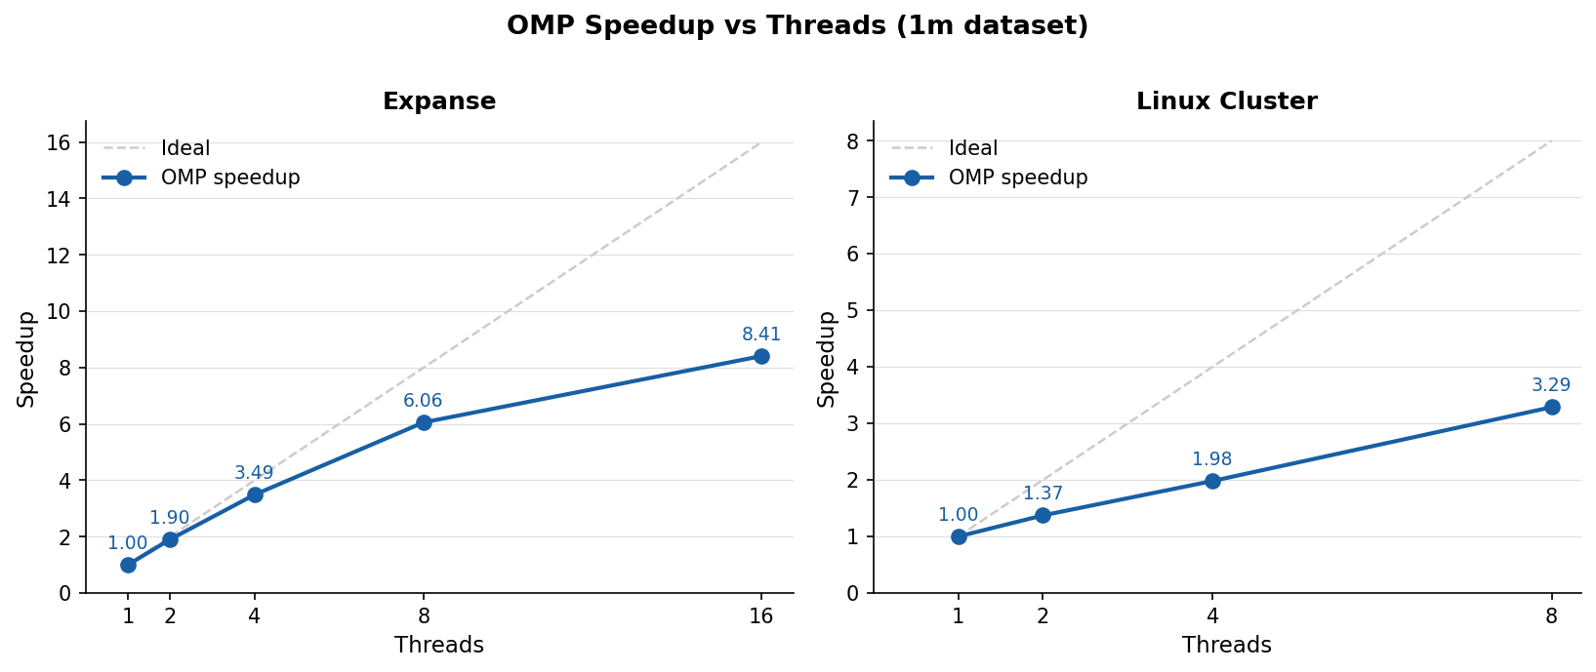
OpenMP Results
Expanse: Scales to 8.41x at 16 threads. Efficiency stays above 0.8 through 4 threads. Linux Cluster: Tops out at 3.62x at 8 threads due to fewer cores and higher thread overhead.

Slide 11
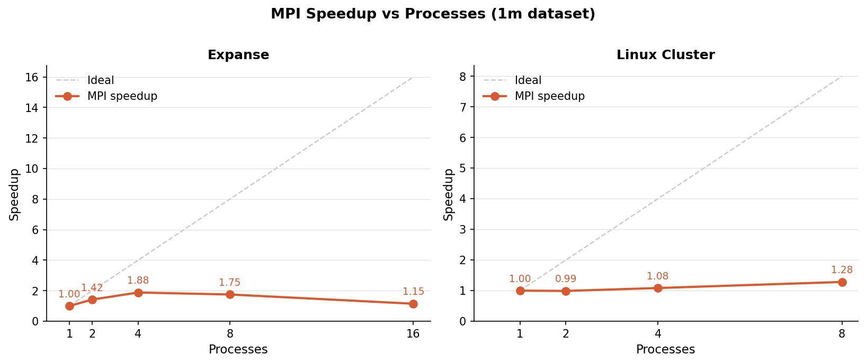
MPI Results (Signs of bottleneck)
Expanse: Speedup peaks at 4 procs (1.88x) then regresses back near serial. Linux Cluster: Barely moves off 1x across all counts. Something is limiting MPI performance.

Slide 12
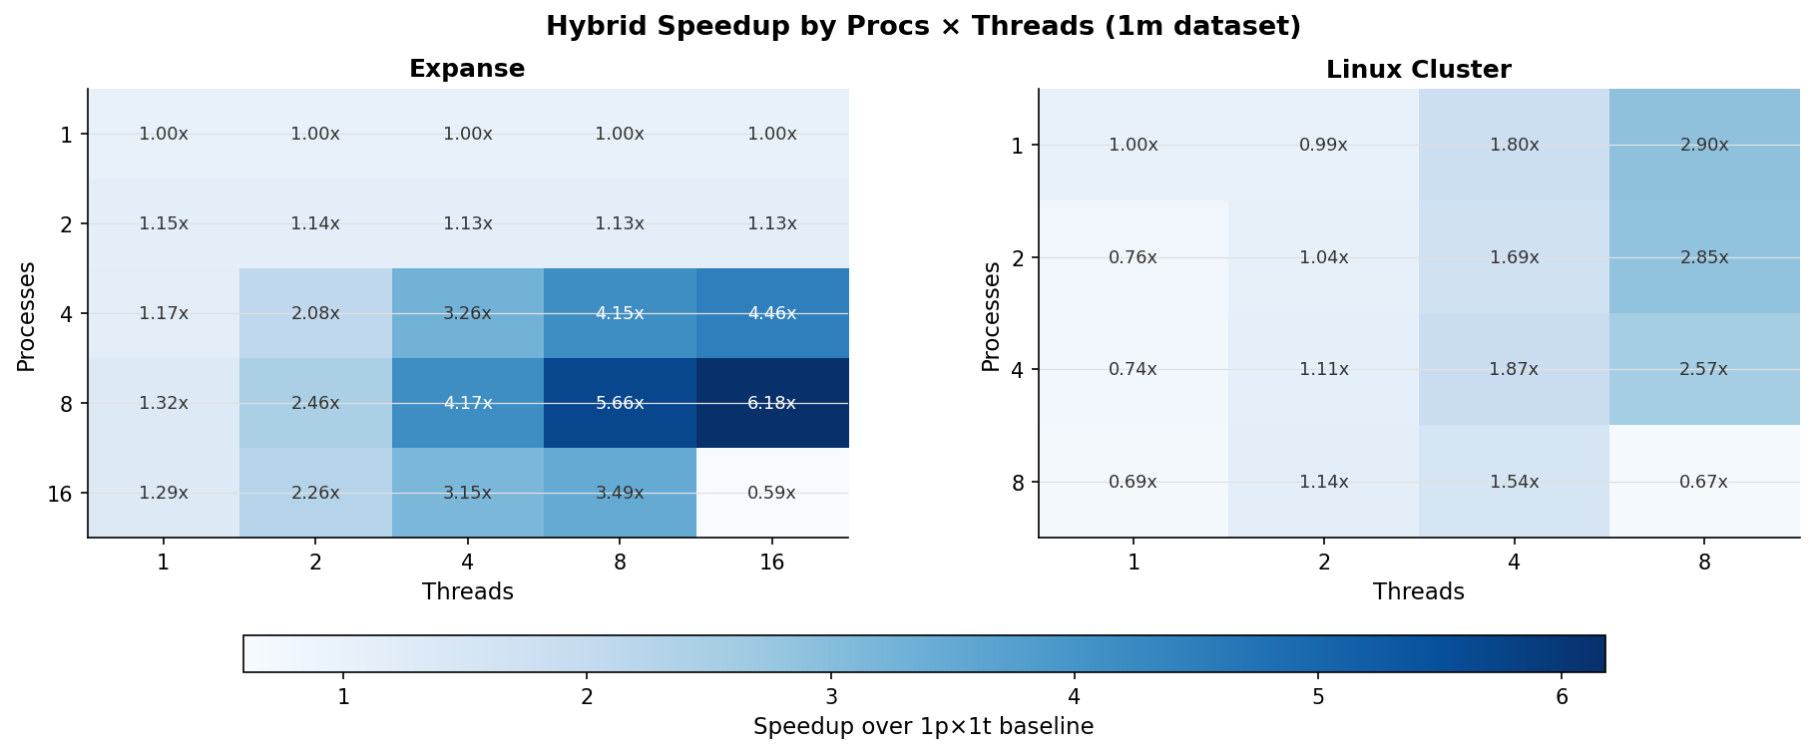
Hybrid Results (Expanse thread bottleneck)
Expanse: Reaches 6.18x at 8p x 16t. Hybrid not scaling by process or threads alone. Linux Cluster: Peaks at 2.9x at 1p x 8t. However, on Linux hybrid is scaling by thread.

Slide 13
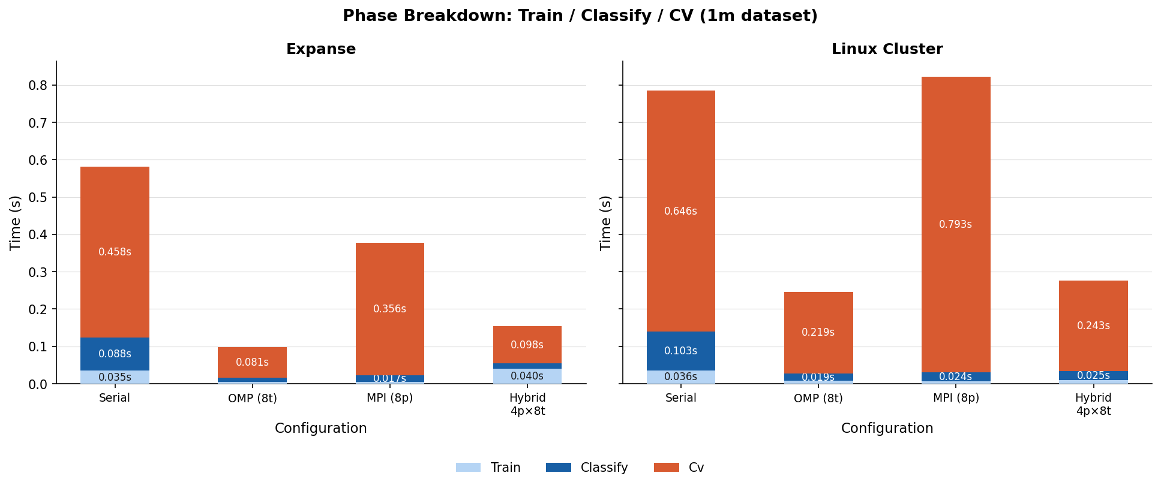
Where the Time Goes
CV dominates: CV accounts for ~79% of serial runtime. Train and classify are fast. OMP reduces CV: threads parallelize inside each fold's train and classify calls.

Slide 14
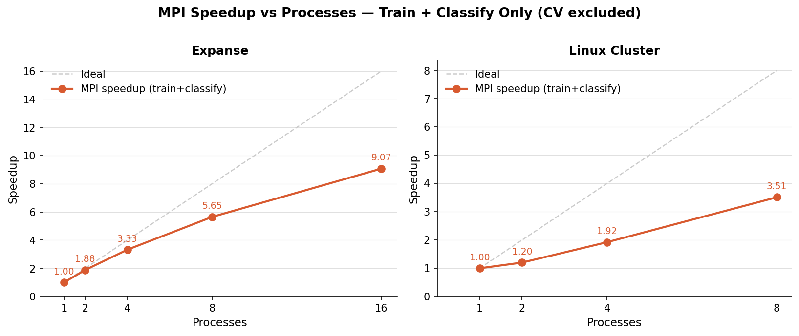
MPI Results: Train + Classify Only
When CV is excluded: MPI train and classify reach 9.07x on Expanse at 16 procs. The bottleneck was never the algorithm. CV broadcasts the full dataset on every fold split.

Slide 15
Identifying the Bottlenecks
Isolating the Problem
copy_rows: the bottleneck
MPI train+classify scales to 9.07x algorithm is not the problem Add CV back and speedup collapses to 1.88x bottleneck lives inside cross_validate copy_rows is only called from cross_validate never during main train or classify Called twice per fold x 5 folds 10 MPI_Allgatherv broadcasts per run Every rank already has the full dataset each rank could build fold splits locally with zero communication Hybrid threads bound on Expanse due to --map-by and --bind-to core flags, this prevented scaling
void copy_rows(src, cols, indices, n_rows, dest) { // each rank copies its slice int local_rows = n_rows / size; for (i = 0; i < local_rows; i++) memcpy(&local[i*cols], &src[idx[i]*cols], ...); // broadcast full result to all ranks MPI_Allgatherv( local, local_rows * cols, MPI_INT, dest, recv_counts, displacements, MPI_INT, MPI_COMM_WORLD ); } // inside cross_validate per fold: copy_rows(..., train_idx, train_size, ...); copy_rows(..., test_idx, test_size, ...);
One function. Each rank can build its own fold split from data it already has no MPI_Allgatherv needed.

Slide 16
Fixing the Bottleneck
The Fix
cross_validate: build indices, pass directly
copy_rows deleted every rank already has the full dataset, no broadcast needed accumulate_counts_range added row_indices parameter classify_dataset same row_indices parameter added build_truth same row_indices parameter added cross_validate removed train_data/test_data malloc and copy_rows calls; passes train_idx/test_idx directly sbash removed map and bind flags and included --bind-to none on every hybrid mpiexec call
for (fold = 0; fold < k; fold++) { // build index arrays locally for (i = 0; i < n; i++) { if (i / fold_size == fold) test_idx[test_size++] = i; else train_idx[train_size++] = i; } // pass indices, no copy, no broadcast accumulate_counts_range(..., train_idx); classify_dataset(..., pred_test, test_idx); build_truth(..., y_test, test_idx);
}
Result: 10 full-dataset broadcasts per CV run eliminated. Hybrid and MPI scale properly.

Slide 17
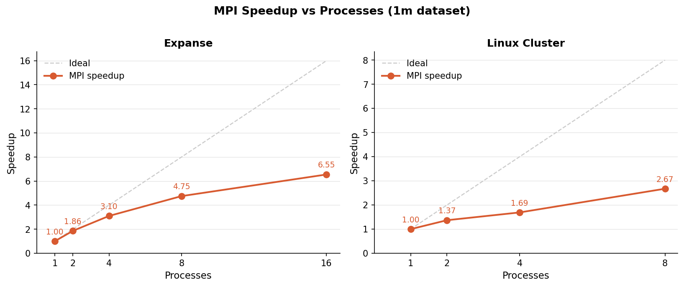
MPI Results: After the Fix
Expanse: Scales cleanly to 6.55x at 16 procs. Up from 1.88x in v1. Linux Cluster: Reaches 2.67x at 8 procs. Up from 1.28x in v1.

Slide 18
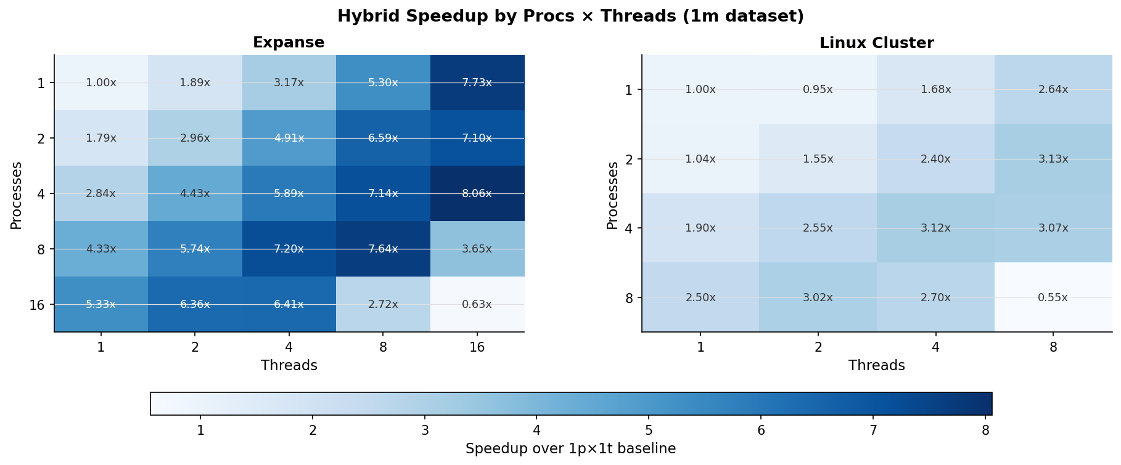
Hybrid Results: After the Fix
Expanse: Peak jumps to 8.06x at 4p x 16t. Up from 6.18x in v1. Heatmap is now much darker. Linux Cluster: Best config hits 3.13x at 2p x 8t. Up from 2.90x in v1.

Slide 19
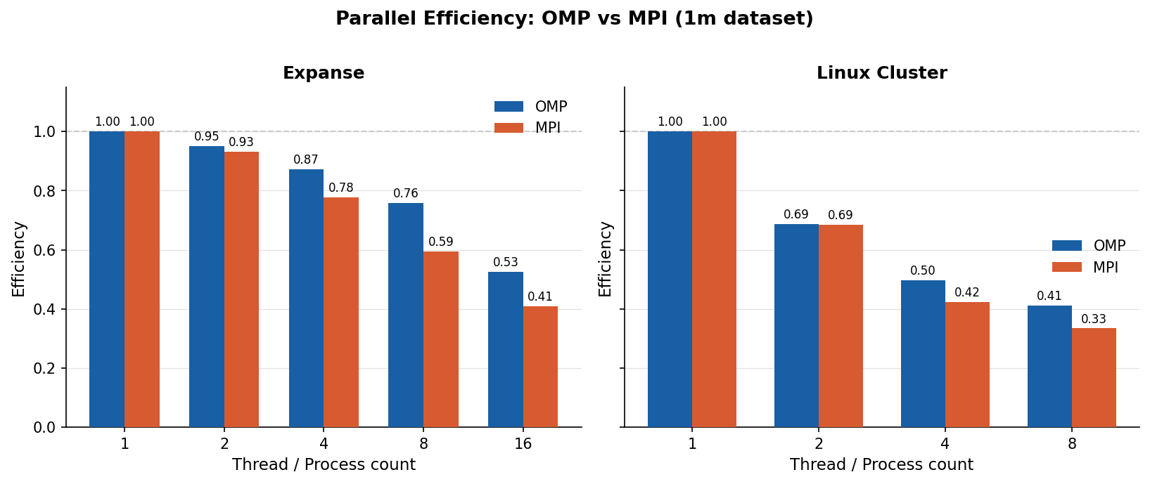
Parallel Efficiency: OMP vs MPI
OMP: Efficiency stays above 0.8 through 4 threads on Expanse. Drops at 16. MPI v2: Efficiency now tracks OMP closely. v1 collapsed due to broadcast overhead.

Slide 20
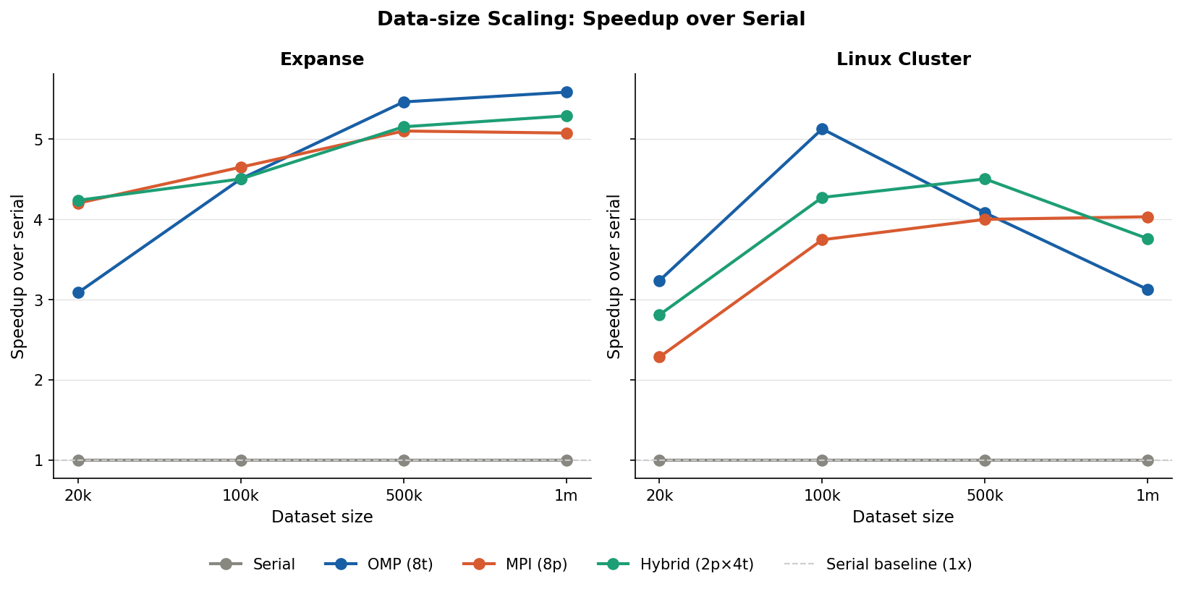
Data-Size Scaling
Expanse: OMP, MPI, and Hybrid improve performance as N increases. Linux Cluster: Performance increases initially then decreases as N increases.

Slide 21
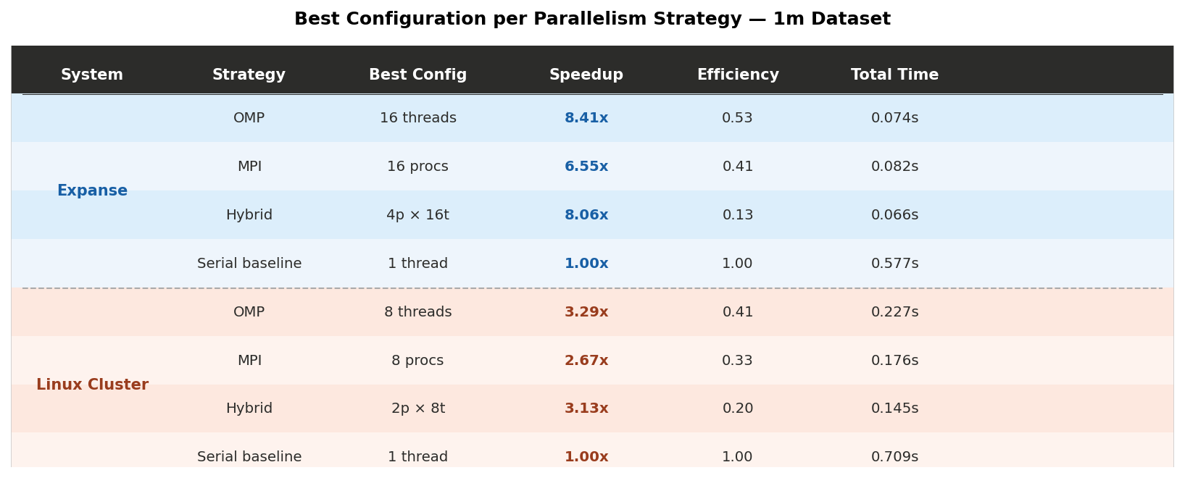
Best Configuration Summary
Expanse: OMP leads at 8.41x. MPI v2 reaches 6.55x. Hybrid peaks at 8.06x. Linux Cluster: OMP leads at 3.29x. MPI v2 reaches 2.67x. Hybrid peaks at 3.13x.

Slide 22
Conclusions
Pipeline & Methodology
Expanse 16p x 16t Collapse
sbash scripts, Python parser, Jupyter notebook created a fast feedback loop Timing each phase independently revealed that CV dominated runtime Data visualization caught the MPI bottleneck and the Hybrid bottleneck driving the v2 fix
Allocated 4 nodes × 16 tasks × 8 CPUs to fully utilize 128 cores per node
--bind-to none untethered threads from specific cores but all 16 threads still run within their rank 16 threads per rank exceeded the 8-CPU ceiling; more nodes cannot fix intra-rank oversubscription
Collapse to 0.628x below serial is the expected result of 2:1 thread oversubscription
Results
OMP scaled well on both systems: design paid off MPI v1 bottlenecked by copy_rows, v2 fixed it and scaled to 6.55x on Expanse Hybrid v2 reached 8.06x combining both levels of parallelism
Both MPI and Hybrid underperformed OMP
Linux Cluster Observations
MPI scaling on the Linux cluster was modest, reaching only 2.67x at 8 procs
Hybrid peaked at 3.13x (2p×8t): oversubscription degraded performance beyond 4 procs
Neither parallelization strategy gains much from larger data, suggesting memory bandwidth limits

Slide 23
References
[1] CDC BRFSS 2015 Diabetes Health Indicators. UCI ML Repository.
https://archive.ics.uci.edu/dataset/891/cdc+diabetes+health+indicators
[2] Teboul, A. Heart Disease Health Indicators Dataset. Kaggle, 2021.
https://www.kaggle.com/datasets/alexteboul/heart-disease-health-indicators-dataset
[3] OpenMP Architecture Review Board. OpenMP API Specification, Version 5.2, 2021.
https://www.openmp.org/specifications/
[4] The Open MPI Project. Open MPI: A High Performance Message Passing Library.
https://www.open-mpi.org/
[5] San Diego Supercomputer Center. SDSC Expanse User Guide.
https://www.sdsc.edu/systems/expanse/user_guide.html
[6] cppreference.com. C Standard Library: fgets, fopen, sscanf, File I/O Reference.
https://en.cppreference.com/w/c/io

