Slide 1

What drives rental prices in Australia?
GAO Innovation Lab Interview Submission Justin Hoffman, March 2026
Ridge and Lasso regression on 6,757 rental listings
github
kaggle

Slide 2
Project Overview
The Analytical Approach Supervised learning was used because the dataset includes observed rent, allowing the model to estimate how listing features are associated with rent.
Modeling Choices Ridge and Lasso regression, both regularized linear models implemented in scikit-learn.
Why both? Ridge shrinks all coefficients but keeps every predictor. Lasso can shrink some coefficients all the way to zero.
Cross-Validated Model Fitting: 5-fold cross-validation was used to tune alpha, the regularization strength. The final model was then refit on the full training set and evaluated once on the held-out test set. Both training, test, and kfold sets were stratified by state.
Metrics: MAE (average absolute prediction error) and R2 (variation explained) were reported on both the log scale and the original rent scale.
Evaluating: Final performance was evaluated on a held-out test set (25% of the data, stratified by state) using both sets of metrics.

Slide 3
Data Quality and Preprocessing
Missing values: Amenities was the only field with nulls (318 rows, 4.7%).
Duplicates: Removed 1 exact duplicate row.
Numeric outliers: A 3-SD screen flagged unusual values; 9 implausible rows were removed after manual review.
Postcode / state consistency: Checked postcodes against official Australia Post ranges; no mismatches were found.
Redundant fields: Suburb and locality were identical in every row, so locality was dropped.
High-cardinality identifiers: Street address, title, description, and agency name were excluded because they were nearly unique to each listing.
Target variable: Weekly rent was strongly right-skewed, so I modeled log(1 + rent) to reduce the influence of extreme listings.
Categorical variables: Postcode, state, and property type were one-hot encoded.

Slide 4
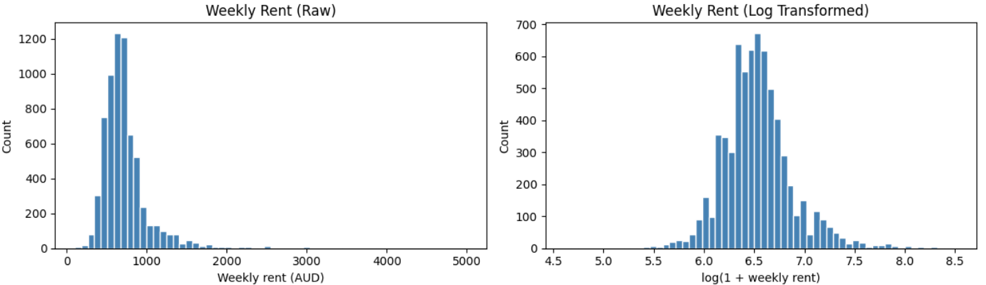
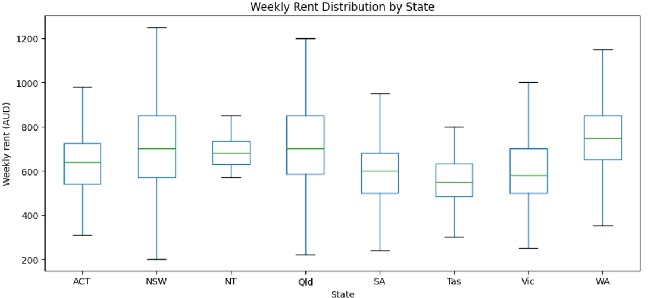
Exploratory Data Analysis
Rent distribution: Right-skew supported modeling log(1 + rent).
Bedrooms and bathrooms: Larger properties generally rented for more.
Rent by state: State-level differences suggested location would likely improve predictions and supported stratifying both the train/test split and cross-validation by state.
Amenities (unadjusted): Some amenities appeared more common in higher-rent listings.
Amenity count: Listings varied in overall amenity richness, making it worth testing separately.

Slide 5
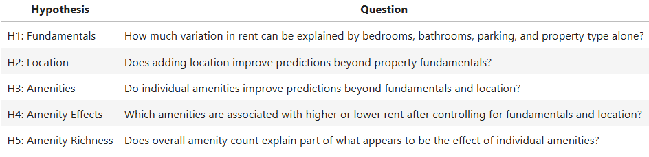
Hypothesis
Each hypothesis adds a new feature group to the model and is evaluated against the previous stage to measure how much predictive performance improves.
Each hypothesis is then trained and tested, building a predictive model that answers the central question: What drives rental prices in Australia.

Slide 6
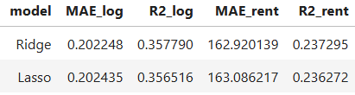
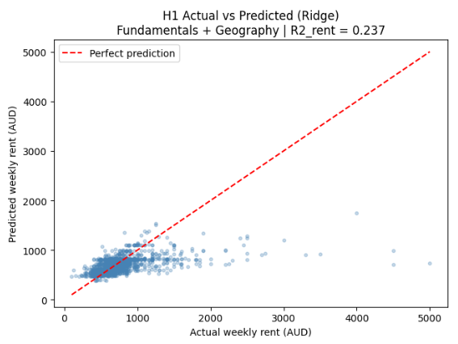
H1 Fundamentals Drive Rent
Features used Bedrooms, bathrooms, parking spaces, and property type only. No location, no amenities.
Purpose H1 establishes a baseline showing how much variation in rent can be captured by structural property characteristics alone.
Findings
Ridge R²_log = 0.358, explaining about 36% of variation in log rent using structural features alone
MAE_rent = 163 AUD/week, a meaningful starting point, but leaves substantial prediction error
Both models perform similarly.
Interpretation Property fundamentals explain roughly a third of rent variation, which confirms they matter but also reveals their ceiling. The model has no way to distinguish a 3-bedroom house in Sydney from one in rural Tasmania, two listings with identical features but very different market prices.
Property fundamentals set the floor, but location is clearly missing.

Slide 7
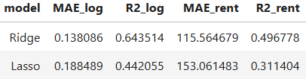
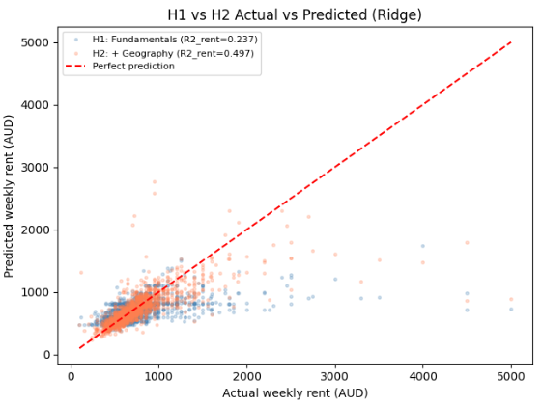
H2 Impact of Geography
Features used H1 features + state and postcode. Suburb was tested but dropped due to sparsity.
Purpose H2 tests whether location explains additional rent variation beyond physical characteristics.
Findings
Ridge R2_log jumps from 0.358 to 0.644 , the largest single gain in the project
MAE_rent drops from 163 to 115.56 AUD/week
Ridge significantly outperforms Lasso (0.442), consistent with geographic signal being spread across postcode indicators
Interpretation Adding 1,000+ postcode indicators produces a dramatic improvement. Ridge handles this well because location signal is distributed across many postcodes rather than concentrated in a few.
Location adds the largest performance gain in the project

Slide 8
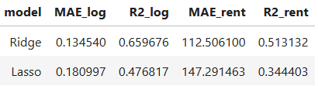
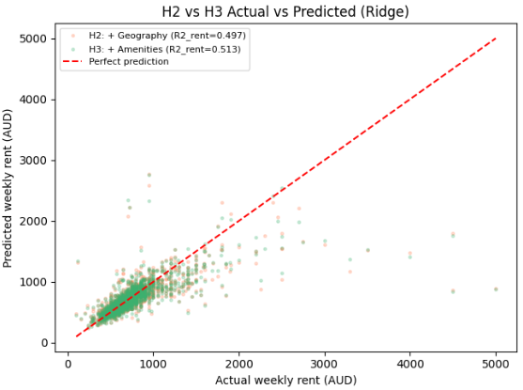
H3 Amenities Add Signal
Features used H2 features + individual amenity dummy variables tokenized from the amenities text field.
Purpose H3 tests whether amenities improve predictions beyond fundamentals and location.
Findings
Ridge R2_log improves from 0.644 to 0.660
MAE_rent drops from 115.56 to 112.51 AUD/week
Ridge continues to outperform Lasso (0.477), suggesting amenity signal is distributed rather than sparse
Interpretation Amenities add real but modest signal. The small improvement over H2 suggests that many amenities primarily reflect properties already located in higher-priced areas rather than adding independent value.
Amenities improve the model, but property fundamentals and location still explain the majority of rent variation.

Slide 9
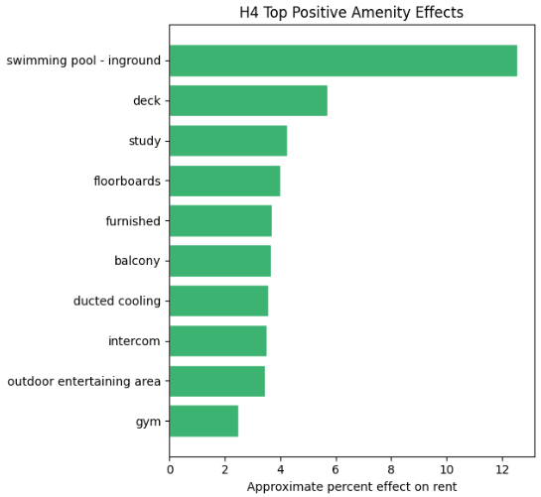
H4 Individual Amenities are Quantifiable
Approach Ridge outperformed Lasso for prediction throughout H1-H3, but Lasso was used here because it can shrink weaker coefficients to zero. The goal is interpretation rather than prediction. Lasso retained 25 amenities and zeroed out 55, producing a more compact set of features.
Findings Largest positive associations: inground pool (+12.5%), deck (+5.7%), study (+4.3%), floorboards (+4.0%) Largest negative associations: fully fenced (-5.0%), air conditioning (-1.6%), split-system air conditioning (-1.3%), evaporative cooling (-1.2%)
Interpretation Positive coefficients indicate amenities associated with higher predicted rent after controlling for fundamentals and location. Negative coefficients are less intuitive and should be interpreted cautiously. One possible explanation is that features like fully fenced and split-system air conditioning are more common in lower-rent properties.
Many amenities add limited incremental signal once location and fundamentals are included, but pools and decks remain among the clearest positive associations.

Slide 10
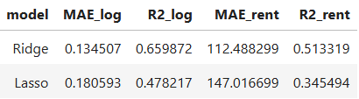
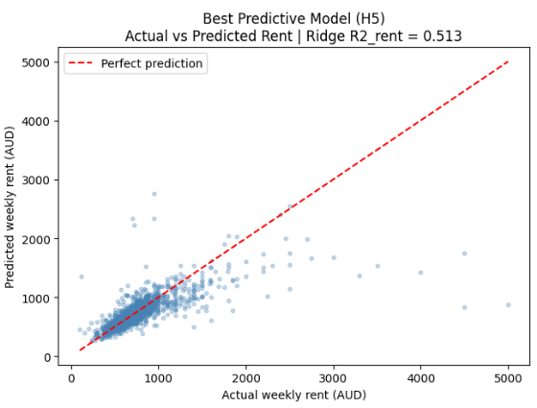
H5 Amenity Richness vs Specific Impact
Features used H3 features + amenity count representing the total number of amenities listed per property.
Purpose H5 tests whether overall amenity richness explains part of the individual amenity associations seen in H4.
Findings
Model performance is essentially unchanged from H3: Ridge R2_log = 0.660, MAE_rent = 112.49 AUD/week
The negligible performance gain suggests amenity_count adds little new predictive value and mainly reallocates existing signal Ridge continues to outperform Lasso (0.478)
Interpretation The flat performance suggests amenity_count mostly redistributes existing signal rather than materially improving prediction. The value of H5 is interpretive, individual amenity coefficients can now be read relative to the overall amenity-richness term.
Predictive improvement is minimal, but H5 helps show which amenity associations remain after accounting for general listing richness.

Slide 11
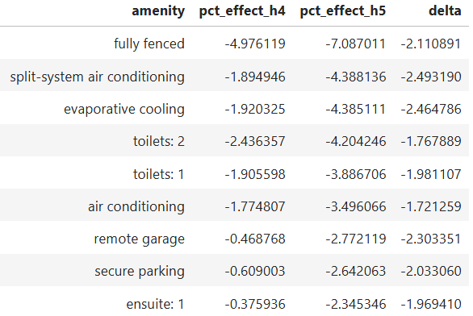
H5 Amenity Richness - (cont..)
Approach Using the H5 Lasso model, amenity coefficients are extracted and compared with H4.
Findings
The amenity_count coefficient implies about +0.87% predicted rent per additional listed amenity in the fitted model
Lasso retained 28 amenities and zeroed out 52
Most positive associations shrink relative to H4, while several negative coefficients become more negative.
Interpretation Feature contributions were grouped into bedrooms, bathrooms, parking, property type, location, and amenities by multiplying each feature value by its coefficient across the test set. In this decomposition, bedrooms receive 38% of the absolute model contribution, bathrooms 23%, location 19%, and amenities 9%.
This decomposition suggests that structural features contribute more modeled signal than location or amenities in the H5 specification.

Slide 12
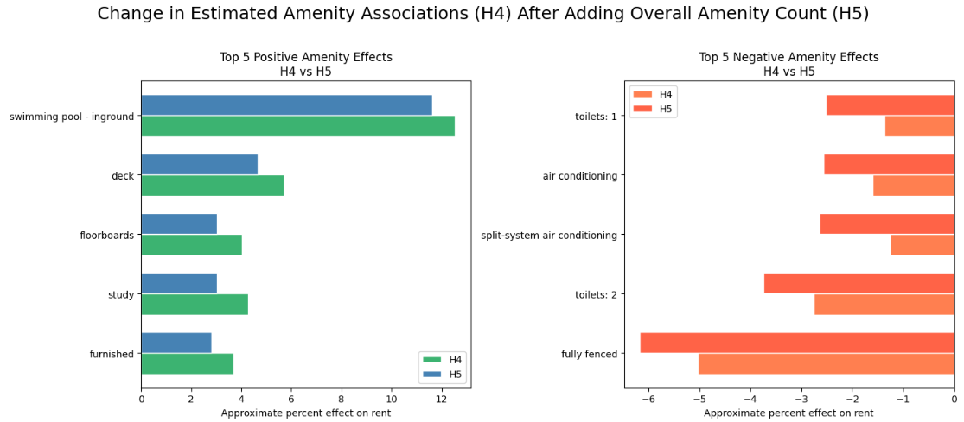
H5 – Model Interpretation

Slide 13
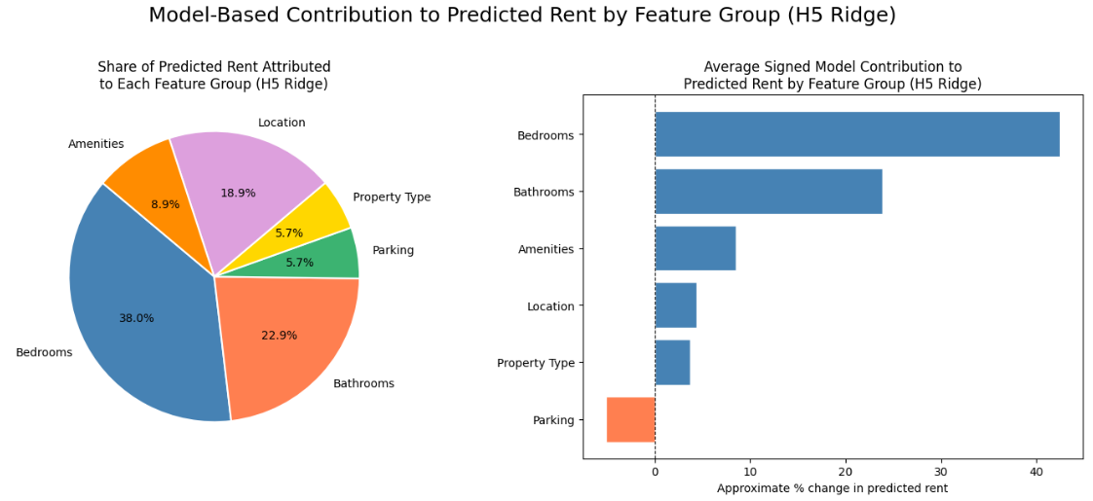
H5 – Model Interpretation

Slide 14
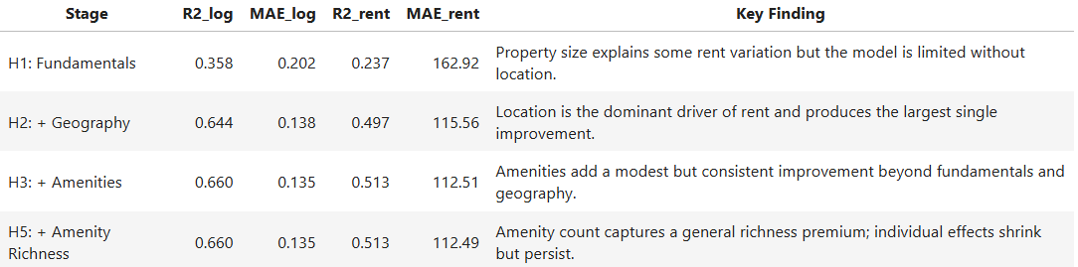
Summary - The Incremental Model Story
Final Model Performance
The final H5 Ridge model includes property fundamentals, geographic indicators, individual amenity dummies, and overall amenity richness. It achieves:
R2_log = 0.660, explaining about 66% of variation in log weekly rent
MAE_rent = 112.49 AUD/week, meaning predictions are off by about 112 AUD/week on average
Because the model is optimized on log-transformed rent, it fits the mid-market well but underpredicts the highest-rent listings. This is a known tradeoff when modeling skewed price data.

Slide 15
Summary - Interpretation
Amenity Contribution Each additional amenity is associated with about +0.87% predicted rent in the fitted model. Beyond that general richness term, some amenities retain positive associations , inground pools (+11.6%), decks (+4.7%), and balconies (+2.6%) after adjusting for overall amenity count. Features like fully fenced and split-system AC become more negative in H5, suggesting they perform worse relative to the general amenity-richness baseline.
Central Finding Three broad patterns emerge:
Property size contributes the largest share in the decomposition. Bedrooms and bathrooms receive 61% of the absolute model contribution in this feature-group breakdown.
Location adds substantial predictive value, but its contribution is spread across 1,000+ postcode indicators rather than concentrated in a small number of areas.
Amenities contribute modestly. Pools and decks remain among the clearest positive associations.
Limitations
Postcode dummies are effective but not easily interpretable; spatial clustering would be cleaner.
Amenity data is self-reported and may be incomplete or inconsistently labeled.
Because the model fits high-rent listings less well, it is reasonable to think additional signal remains uncaptured in the upper end of the market. Amenities may explain part of that gap, which makes them worth exploring further.

Slide 16
Next Steps
Geographic Clustering (Moderate effort, High value) Replace postcode and state dummies with 20–50 geographic clusters built from latitude and longitude using K-means. This would reduce dimensionality, smooth sparse postcode effects, and could improve generalization. The modeling change is straightforward; the main added work is mapping and validating the clusters.
Residual Language Analysis (Low effort, Low value) Apply TF-IDF to listing descriptions and score words by sum(weight^2 * residual) across listings. Positive words would be associated with underpredicted high-rent listings, and negative words with overpredicted ones. A word cloud would be easy to produce, but the result would be less informative and more to simply produce an interesting visual.
Nonlinear Amenity Sensitivity Check (Moderate effort, High value) Fit a nonlinear model better suited to upper-tail rent, then rescore the test set after toggling selected amenities on and off. Comparing the predicted changes would provide a model-based check on whether the amenity signals from the linear models provide signal, especially in higher-rent listings where the current model fits less well.

