Slide 1
Movie Ratings
ServiceNow Problem

Slide 2
Movie Ratings
You are required to make a movie rating page with a star ratings widget
Data for the page will be send through JSON (attached in email)

Slide 3
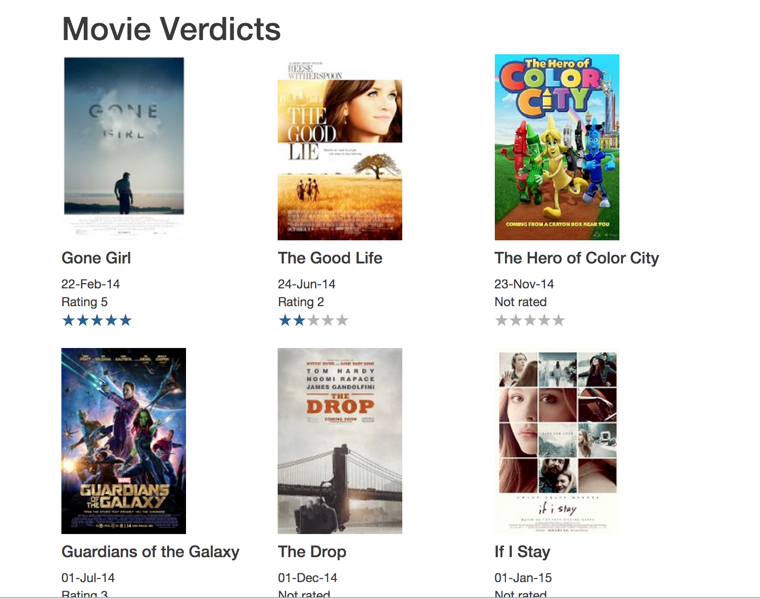

Slide 4


Each Movie has a Star Rating Widget
Clicking on the Stars changes the Ratings of the movie

Slide 5

For movies not yet rated show
“Not Rated”

Slide 6
For movies not yet released star ratings widget should
be read only

Slide 7
Additional Questions
Give options to sort by Name/Release Date
Add a Bar Chart with X-Axis as Stars (1,2,3,4,5) and Y-Axis number of movies
for each rating and the chart should be auto updating based on the rating changes in the page

