Slide 1
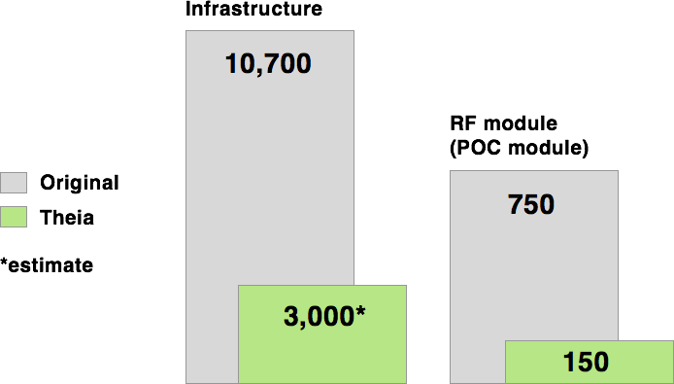
Theia UI Project
Upgrades CSS and JS with Foundation & Angular
Enables faster feature/module development
Reduce lines of maintainable code
Uses modular design for agility/flexibility
Current Progress (Integration Target Date: 10/31)
By the Numbers: Lines of Code
Theia will shrink the codebase, making Athena code easier to debug, revise, and extend.
Readability and reusability are emphasized.

