Slide 1
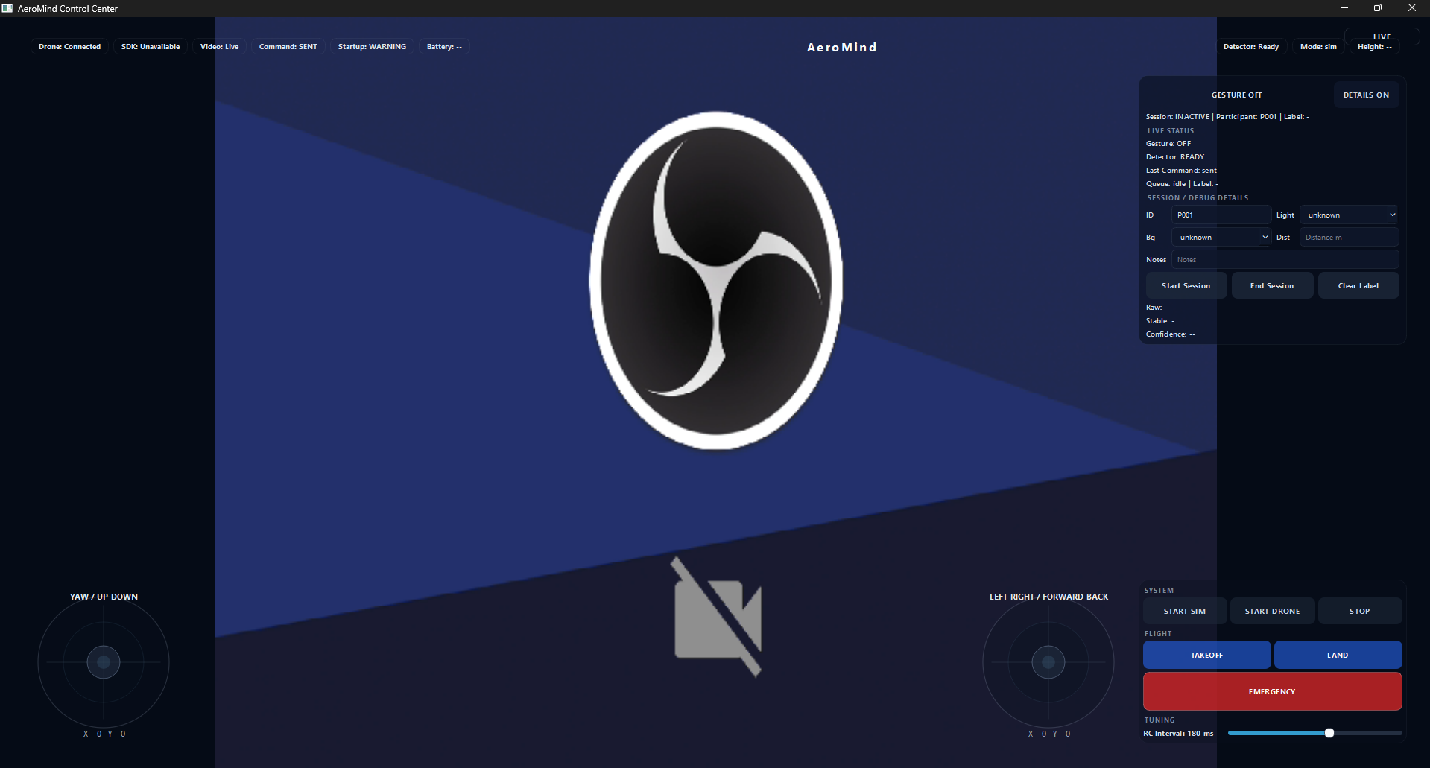
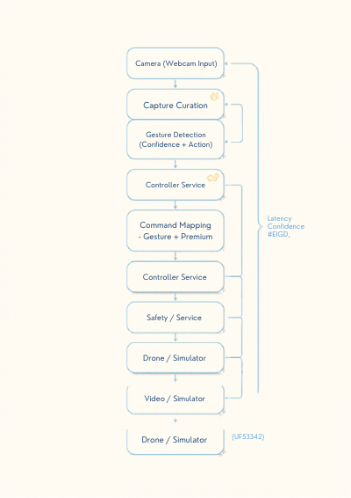
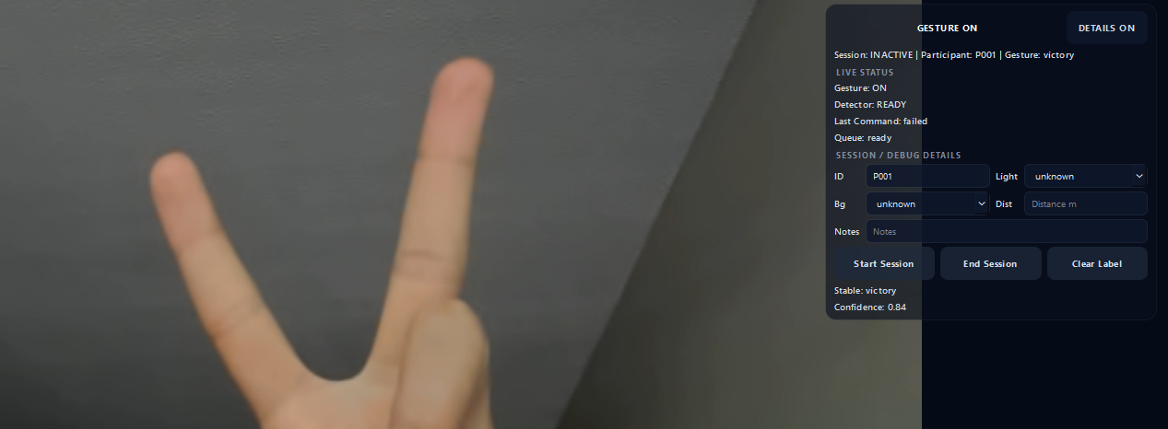
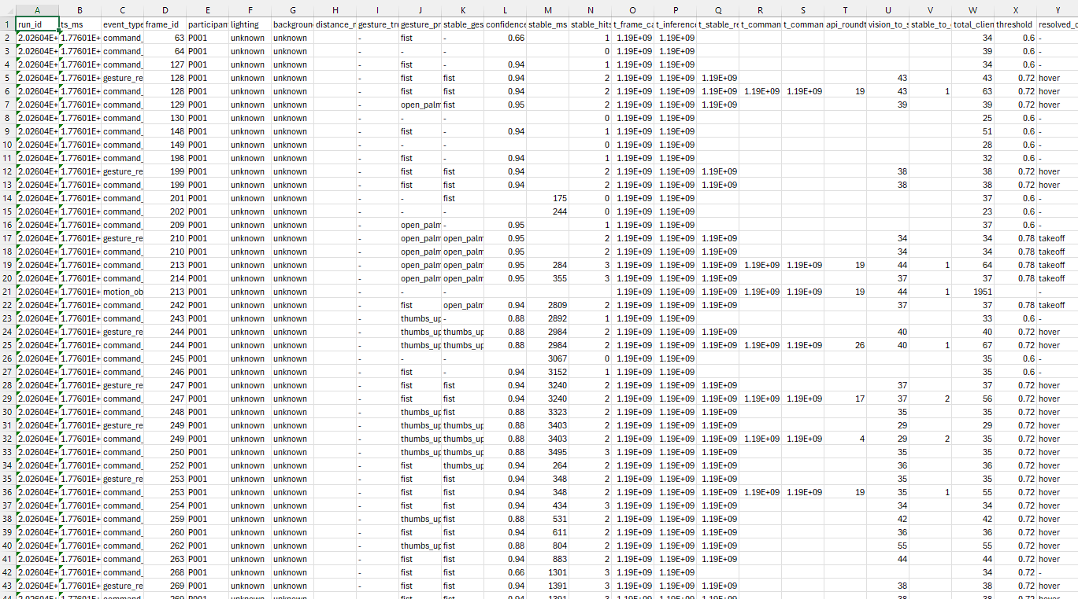
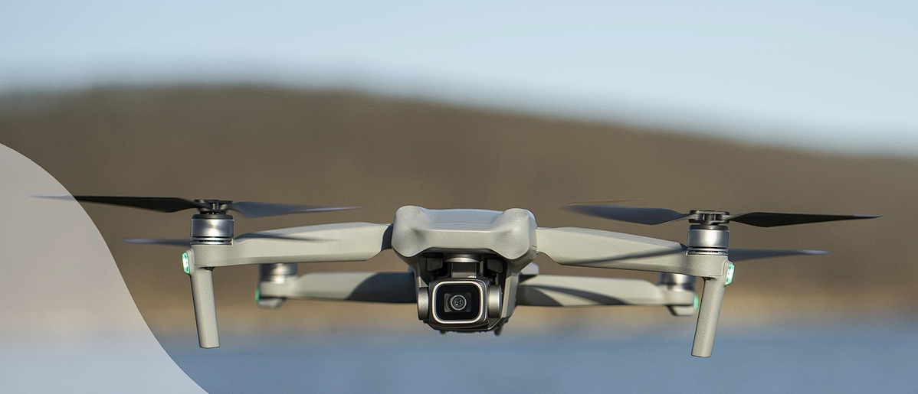
AeroMind: Gesture-Based Drone Control System
Sayed Jihad ElSayed, University of Alabama at Birmingham
Problem
System Architecture
Demo / Visuals
Traditional drone control requires manual controllers
Not intuitive for beginners
High risk of incorrect commands
Camera
Safety Layer
Captures real-time hand gestures
CONTROL FLOW
Filters unstable or unsafe commands
01
Complex Control
High Learning Curve
Detects and classifies gestures
Executes validated commands
Drone controllers require training and are hard to use
02
New users struggle to operate drones safely
Gesture Model
Drone
UI Screenshot
03
Unstable Gestures
04
Safety Risk
Gesture recognition is noisy and inconsistent
Wrong commands can lead to crashes
UI
(PySide6)
Solution
Flask API
Real-time gesture-based drone control using camera input
Uses hand tracking and classification
Includes safety filters and command cooldown system
Gesture Detection Image
Controller
Service
Gesture Control
AI + Safety Layer
Drone /
Simulator
Hand gestures replace traditional controllers
Filters unstable commands before execution
MJPEG Video
Stream
Drone / Simulator Image
Key Features
Hand gesture recognition (MediaPipe)
One-shot and repeatable commands
Safety blocking system
Real-time video feedback
Results
Command dispatch rate and blocked rate
Improved stability with cooldown logic
Reduced false commands
Latency: 0.40s
Avg Confidence: 0.82
Commands Blocked: 60%
Reason: Safety filter
Conclusion
Gesture control is feasible for drone systems
Future improvements needed in accuracy and latency
Metrics to highlight in final print
0.60 Blocked Commands Safety layer filters unstable inputs
Blocked-command percentage
Command latency trend
Stability gain after cooldown tuning
LIVE DEMO
Notes:
[Sources] - Poster content provided directly by user in chat on 2026-04-16. - No external factual claims or external visual assets used. [/Sources]

