Slide 1
Introduction to Shiny Part 2
Jim Hughes

Slide 2

Presentation Resources
This presentation will be recorded
All presentation material located on GitHub
https://github.com/jhhughes256/pfe_shiny_intro
Workspace available on RStudioCloud
https://rstudio.cloud/project/1638785
These are provided for working with the material offline
Includes several additional examples
You are welcome to follow along live

Slide 3
Summary of First Session
Shiny is a tool that allows users to interact with R code through a user interface
Well suited for presenting complex code in a simple form
The user interface runs in a local browser
The R code runs in the background waiting for the user to interact with the UI
The UI is defined with nested UI functions
ui <- fluidPage(
titlePanel("My App"),
sidebarLayout(
sidebarPanel(numericInput(...)),
mainPanel(plotOutput(...))
)
)
The server is defined as a function with arguments input and output
server <- function(input, output) {
}
Inputs and outputs are defined in pairs
*Input("in") -> input$in
output$out -> *Output("out")
Correct render function for each UI output
renderPlot(…) -> plotOutput(…)
Deploying apps to a remote server like RStudio Connect enables sharing of apps

Slide 4
Summary
First Session
Why should I care about Shiny?
Shiny Framework
Inputs and Outputs
Deploying Apps
This Session
UI Layouts
Reactivity
From R Script to App

Slide 5
UI Layouts

Slide 6
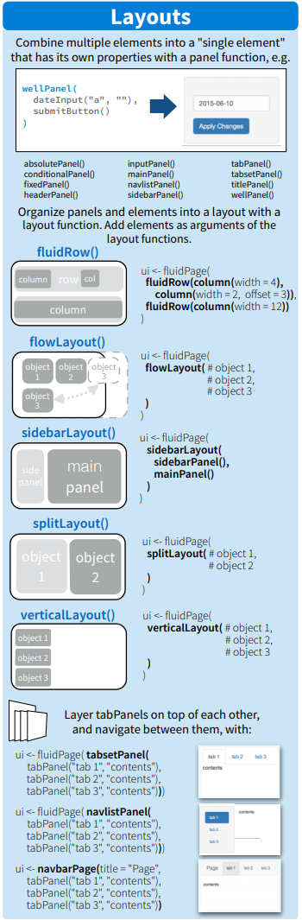
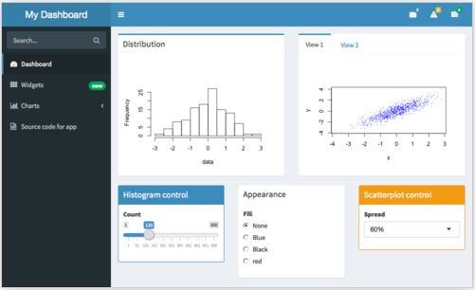
UI Layouts
sidebarLayout is one of several layouts
fluidRow() and column() are particularly flexible
Divide the UI into rows and columns
Can be used inside of other layouts
More information can be found below:
https://shiny.rstudio.com/articles/layout-guide.html
The shinydashboard package is a good option for dashboard-style layouts
https://rstudio.github.io/shinydashboard/ get_started.html

Slide 7
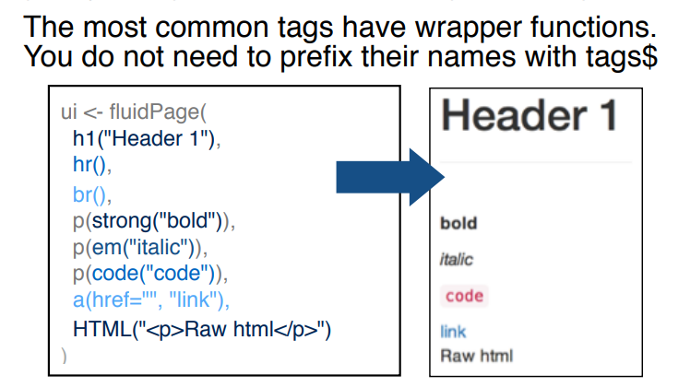
UI Layout
Can use HTML “tags” in Shiny
Similarities with “commands” in LaTeX
Can be added to a layout function as if it was a list
A list of tags can be made without a layout function using tagList()
UI layouts are just R functions that generate multiple HTML “tags”
They can also be added to other functions as if they were lists
Can nest different layouts within each other

Slide 8
Reactivity

Slide 9
Reactivity Revisited
output$plot <- renderPlot({
plot <- plotFunction(raw, input$one)
})
output$plot <- renderPlot({
data <- slowFunction(raw, input$one)
plot <- plotFunction(data, input$two)
})
input
output
input
output
input

Slide 10
Reactivity Revisited
output$plot <- renderPlot({
data <- slowFunction(raw, input$one)
plot <- plotFunction(data, input$two)
})
data <- reactive({
data <- slowFunction(raw, input$one)
})
output$plot <- renderPlot({
plot <- plotFunction(data(), input$two)
})
input
output
input
reactive
input
output
input

Slide 11
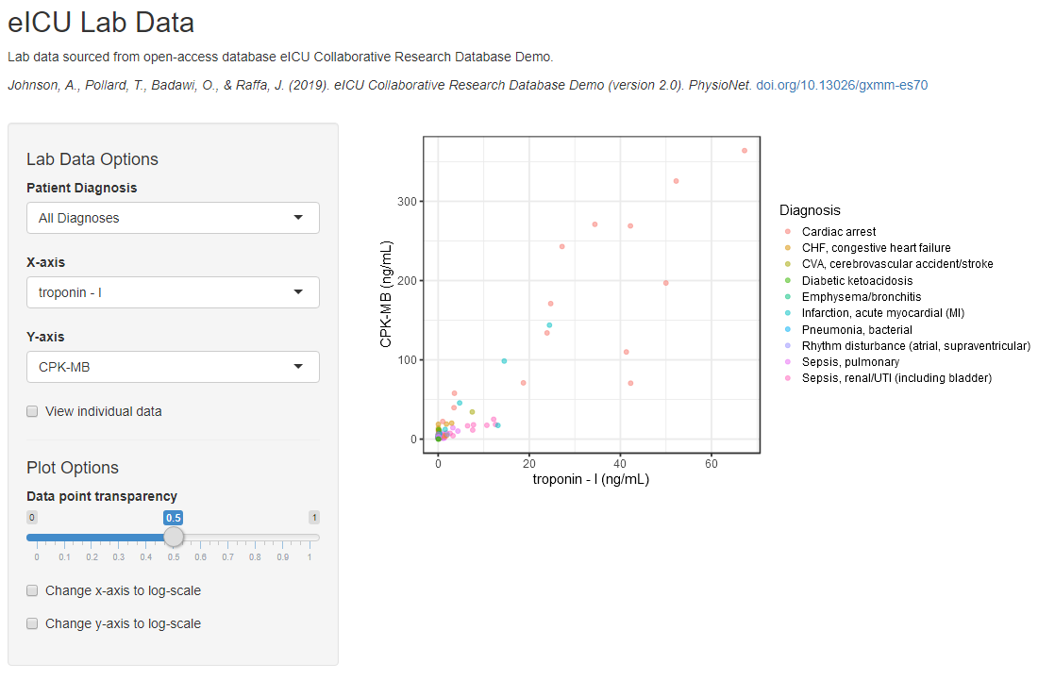
eICU Application – Example 7
The application has had a few UI improvements
It is otherwise the same as last week
Last time we added a table output and copy-pasted the code for filtering the data from the plot
This code runs twice as a result!
input
subsetData
output$plot
input
subsetData
output$table
input
eICU_app_07.R

Slide 12
eICU Application – Example 7
By separating the code for filtering the data it can be used for both the plot and table
This will speed up the app because:
It only runs once
It no longer runs when plot- or table-specific inputs change
eICU_app_08.R shows the solution
input
output$plot
input
subsetData
output$table
input
eICU_app_07.R

Slide 13
From R Script to App

Slide 14
R Script to App
General Workflow
Define application scope
Generate R script that achieves the scope
Add independent code to app
Prototype UI based on input code
Define reactive code in the server
Add reactivity between UI and server
Iteratively add new features

Slide 15
Step 1: Define scope
Plan the scope with your intended users
What is the desired base functionality?
What is the simplest form of the app?
What are the use cases for this application?
What is it going to be used for?
What is actually needed to meet these requirements?
Is daily dosing fine? Or do you need the option of daily, twice daily and every 3 hours?
You don’t have to think about everything, but at least put some thought into it
PKPD Simulation – Example Scope
Scope:
Build app for PKPD model simulation
Inputs:
Number of individuals
Dosing regimens
Model covariates
Outputs:
Plot of the PK & PD predictions
Summary table

Slide 16
Step 2: Write the R code
# Non-reactive code
# Load packages
library(dataManipulationPackage)
library(simulationPackage)
library(summaryPackage)
# Source model
mod <- source(“my_model.R”)
# ------------------------------------------------------------
# Inputs
NID <- 100
DOSEAMT <- 100
DOSEFRQ <- 24
DOSEDUR <- 5
COVBWT <- 70
COVSEX <- 0
# ------------------------------------------------------------
# Reactive code
# Prepare simulation input
inputData <- bunchOfPreparationFunctions(DOSEAMT, DOSEFRQ, DOSEDUR)
# Simulate model predictions
simData <- simulationFunction(mod, inputData, NID, COVBWT, COVSEX)
# Generate outputs
pkPlot <- plotFunction(simData)
pdPlot <- plotFunction(simData)
pkTable <- summaryFunction(simData)
Set up an R script that does what you want the app to do, but structure it like a shiny app
Start with input-independent code
“Non-reactive code” or “global variables”
Define inputs as their own objects
These will have corresponding UI inputs
Write input-dependent code in blocks
Blocks defined by inputs they depend on
“Reactive code”
If you start building an app without knowing the server code, you might have a bad time
Lines of no return

Slide 17
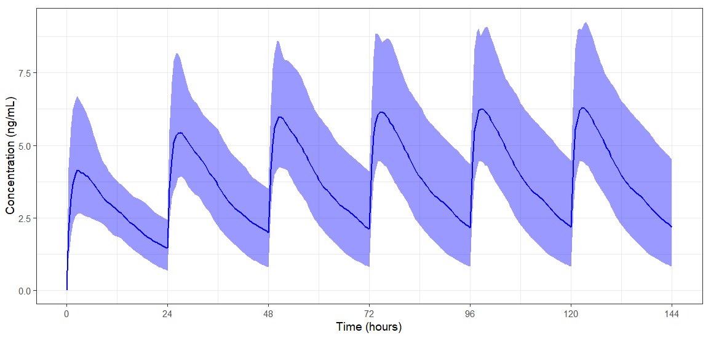
PKPD Simulation – Example R Code
Based on the scope written before an R script was written for simulating a model
pkpd_original_script.R
Reads the built-in model from mrgsolve
Simulates a population
Depends on all inputs in scope
Generates 4 outputs
PK and PD plot
NCA summary tables for single dose and steady-state
> pksum024
# A tibble: 4 x 3
Metric Median PI
<chr> <dbl> <chr>
1 AUCtau 66.3 47 – 89.6
2 Cmax 4.24 2.69 – 6.74
3 Ctrough 1.46 0.693 – 2.44
4 Cave 2.76 1.96 – 3.73

Slide 18
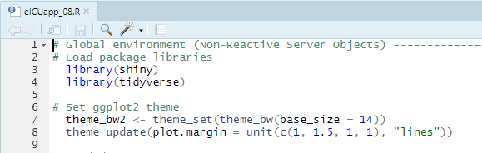
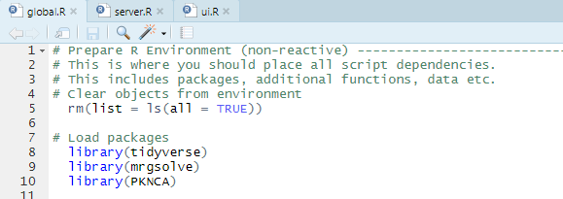
Step 3: Add independent code to the app
Adding the non-reactive code is easy!
This should be pasted at the top of the script if using a single file structure
It should be named app.R if deploying
In the following example we will be using the multiple file structure
There must at least be a server.R and ui.R file in the same directory
Must be named this for deploying
global.R is optional
If present it will always run before the app

Slide 19
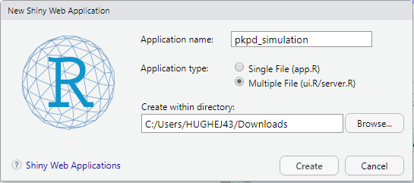

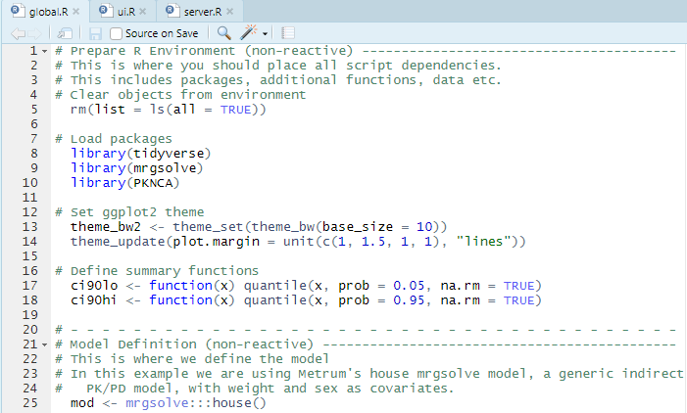
PKPD Simulation – Example 1
Create a new Shiny app with the multiple file structure
Remember to pick an appropriate directory
../Downloads is probably not a good place…
This will create a ui.R and server.R file
Clear out the code inside the shinyServer
Save a global.R file in the same directory
Paste in the non-reactive section of code from pkpd_original_script.R into global.R
The code in the pkpd_app_01 folder shows the solution

Slide 20
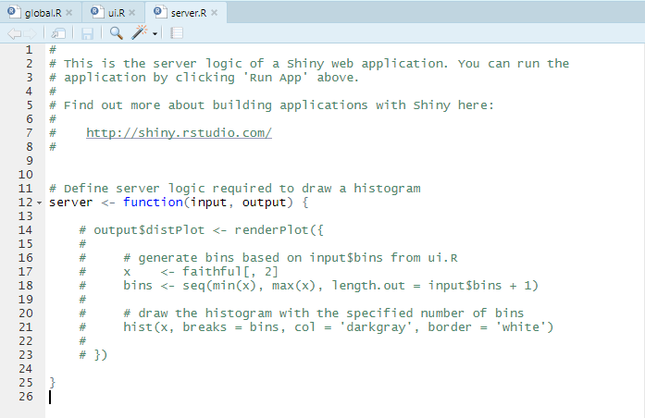
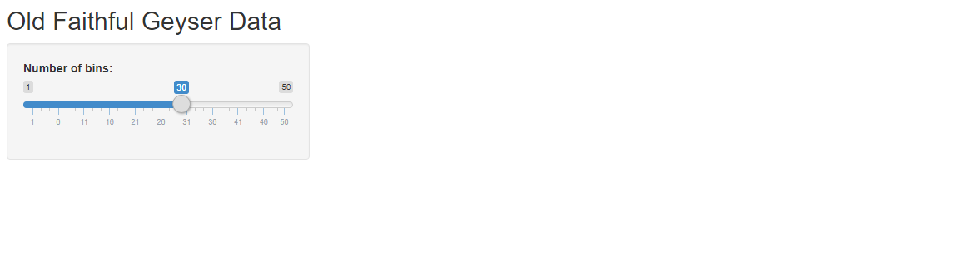
Step 4: Prototype a UI based on the inputs
UI code can be written and run without any server code being present
If you comment-out the code in the server the only side-effect will be a lack of outputs
Can prototype a UI without worrying about any errors due to server code
Can isolate any UI errors
No server code to blame!
*Output() functions will be blank
Missing

Slide 21
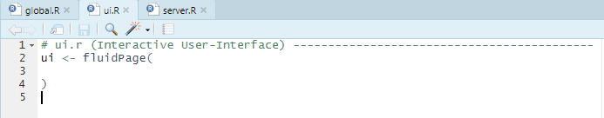
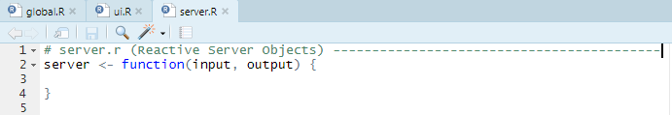
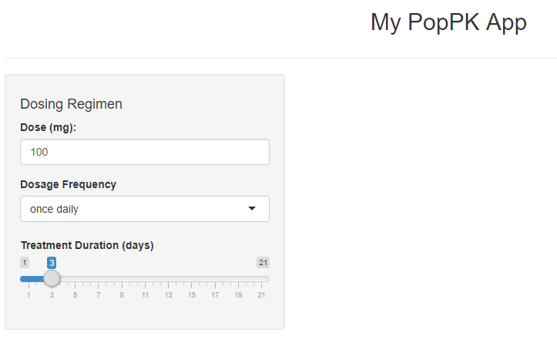
PKPD Simulation – Example 2
Clear out the default UI and server that comes with a new Shiny app
Build a standard sidebarLayout() UI with inputs in the sidebarPanel() and outputs in the mainPanel()
Add the input types you think are appropriate for each input in pkpd_original_script.R
The code in the pkpd_app_02 folder shows one of many solutions

Slide 22
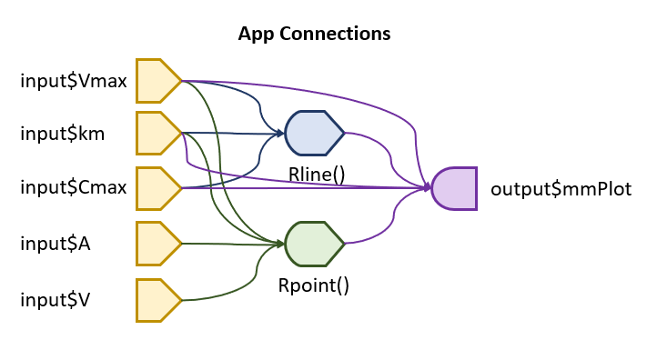
Step 5: Define reactive code in the server
When adding reactive code to the server consider how best to group the code
Only put the code responsible for the output inside the render*() function
Use placeholders for input code
Use reactive() to separate code and prevent it from running when it doesn’t need to
Remember to call reactive code as a function
There is little harm in separating code into more reactive() functions
Though eventually there will be no benefit
Diagram of dependencies for app found in:
additional_apps/michaelis_menten

Slide 23
Step 6: Add reactivity
Add reactivity in pairs starting with output
Render*(…) -> *Output(…)
output$out -> *Output("out")
This will let you find any errors with the server code, ruling out the input as a cause
Remember placeholders are acting as input
Then add reactivity in pairs for the input
*Input("in") -> input$in
Run the app regularly during this process to pick up any errors
Rinput <- reactive({
# Input placeholder
# call using Rinput()$
list(
DOSEAMT = 100, # input$DOSEAMT
DOSEFRQ = 24,
DOSEDUR = 5
)
})
Rsimulation <- reactive({
# Define reactive object
simData <- modelSim(
Rinput()$DOSEAMT, # input$DOSEAMT
Rinput()$DOSEFRQ,
Rinput()$DOSEDUR
)
}

Slide 24
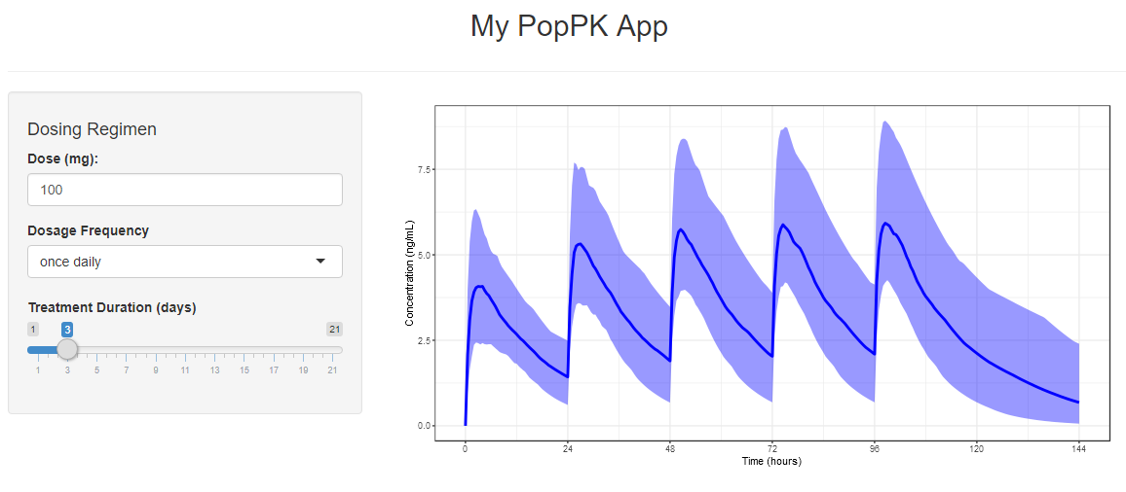
PKPD Simulation – Example 3
As the R script is separated into blocks, it can be copy-pasted in as blocks
Working from top to bottom
Create placeholder for input
Create reactive objects for the model and simulation output
Assign render*() object to the appropriate output
The code in the pkpd_app_03 folder shows the solution
No reactivity added, so treatment duration does not match the plot, but at least the server code is working!

Slide 25
PKPD Simulation – Example 4
The reactivity for the output was set up in the previous step
Now reactivity for the input is added by replacing the placeholder input
Ensure that inputId in *Input() from the UI matches the input in the server
An error with the code to the right
Due to selectInput returning a character type value (i.e. it returns "24" not 24)
The code in the pkpd_app_04 folder shows the solution
Rinput <- reactive({
# Define reactive object
list(
NID = 100,
DOSEAMT = input$DOSEAMT,
DOSEFRQ = input$DOSEFRQ,
DOSEDUR = input$DOSEDUR,
COVBWT = 70,
COVSEX = 0
)
})
By using a placeholder, downstream
code doesn’t need to be changed as they
all reference inputs using Rinput()$*

Slide 26
Step 7: Iteratively add new features
You can waste a lot of time while developing a Shiny app
This is avoided by:
Thinking about what you need to achieve (scope)
Making a proof of concept (R script)
Prototyping a user interface
Designing the server code
Adding reactivity
And repeating this as necessary for new features
Always have a back-up save (git, improve)
💾
Prototype UI
💾
Add reactivity
Define server
💾

Slide 27
Summary

Slide 28
Shiny Summary
The layout of a Shiny app is highly customizable
Many different grid-like structures
Multiple tab-based layouts
Dashboards with shinydashboard
Take control of app reactivity to avoid running code when its not needed
Avoid reactivity issues by visualizing the dependencies of your app
Use reactive to define intermediate objects that other code is dependent on
Learning to build Shiny apps is easier if you follow a process
Define application scope
Generate R script that achieves the scope
Add independent code to app
Prototype UI based on input code
Define reactive code in the server
Add reactivity between UI and server
Iteratively add new features
Prototype UI
reactive
input
output
Add reactivity
Define server
input

Slide 29
Acknowledgements
RStudio Connect/Shiny SME Team
Patanjali Ravva
Satoshi Shoji
Mike K Smith
Jason Williams

Slide 30
Additional Resources
Shiny SME Sharepoint
https://pfizer.sharepoint.com/sites/GPMx/SitePages/R-Shiny.aspx
Shiny Package Cheat Sheet
https://shiny.rstudio.com/images/shiny-cheatsheet.pdf
Basic RStudio Training Resources
Written Shiny tutorial
https://shiny.rstudio.com/tutorial/written-tutorial/lesson1/
Video Shiny tutorial
https://vimeo.com/131218530
PMx-specific Shiny literature
https://ascpt.onlinelibrary.wiley.com/doi/full/10.1002/psp4.21
Basic-Advanced Shiny articles
https://shiny.rstudio.com/articles/
Intermediate-Advanced Shiny books These are both in development planned to be published by the end of 2020
Mastering Shiny by Hadley Wickham
https://mastering-shiny.org/
Engineering Production-Grade Shiny Apps by Colin Fay et al.
https://engineering-shiny.org/

Slide 31
Additional Slides

Slide 32
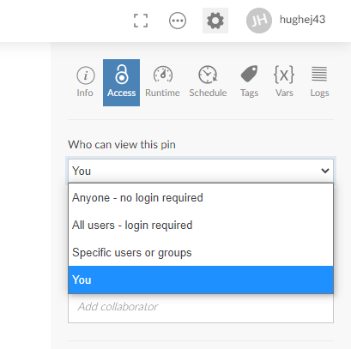
RStudio Connect and Sensitive Data
Standard Pfizer process should be followed when handling sensitive data
Refer to P2L trainings
Best to take the most conservative approach
If you are thinking about uploading clinical data to RStudio Connect within an app, consider:
Will it give access to the data who shouldn’t?
Does its inclusion directly address the scope?
Does it need to be uploaded?
There may be better way! Information on pulling published data out of Improve (and other places) is coming soon
Setting permissions can help restrict access to published apps

Slide 33
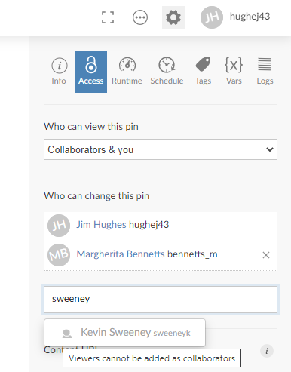
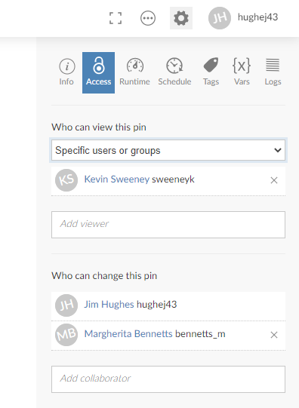
RStudio Connect Access
Set colleagues you would like to have full access as a collaborator
Use the “Collaborators & you” option
Colleagues with “Viewer” access to Rstudio Connect cannot be a collaborator
Set colleagues you would like to see your application as a Viewer
Use the “Specific users or groups” option
Heavily consider application contents before choosing “All users” or “Anyone”
“Anyone” includes all colleagues with an NTID!

Slide 34
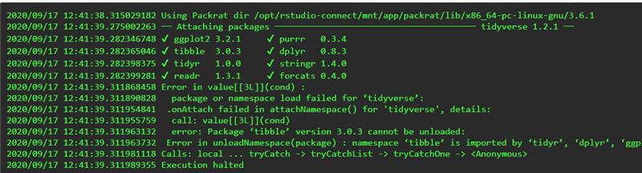
RStudio Connect Troubleshooting
Something may go wrong at some point
First check you have R-3.6.1 and Rstudio v1.2
This will reduce the likelihood of issues
Chances of issues increase if you have installed non-standard packages
Have you installed any additional packages?
If you experience an issue, you should submit a ticket
DL-GPD-RSC-Platform-Engineering-&-Operations@pfizer.com

