Slide 1
Sarah and Duck Fan Club
what a fun show

Slide 2
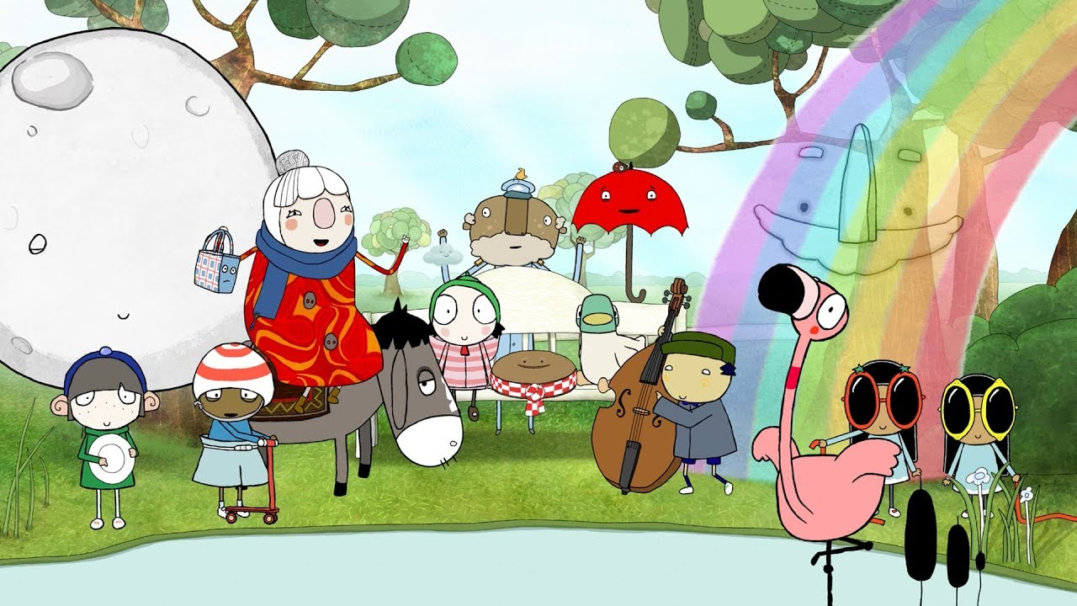
Sarah and Duck Fan Club

