Slide 1
Intro to open source
Jason Hibbets, Red Hat
Opensource.com

Slide 2

What is open source?
http://www.flickr.com/photos/opensourceway/4371000818/in/set-72157623343017387

Slide 3

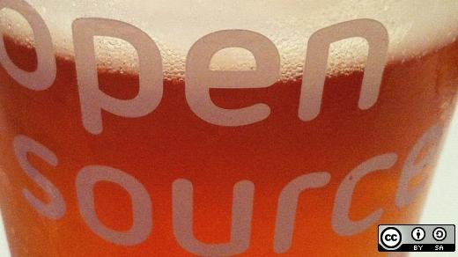
Open source is like a recipe
Credit: http://opensource.com/life/12/12/open-source-pumpkin-spice-latte

Slide 4
Red Hat mission statement
To be the catalyst in communities of customers, contributors, and partners creating better technology
the open source way.

Slide 5
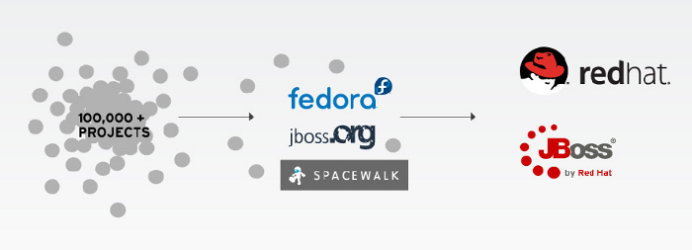
Catalyst in communities

Slide 6

Open source model of participation
Credit: Red Hat
Notes:
In open source, we have a certain set of values and principles that allow us to create better software.

Slide 7

Transparency
Credit: http://www.flickr.com/photos/opensourceway/7496800772/
Notes:
Let’s start with transparency. This is fundamental to many open source projects. You’ll find project roadmaps, bug tracking systems, documentation, and open communications such as mailing lists and IRC channels. Source code is available online for all to use, review, test, and enhance.

Slide 8

Collaboration
Credit: http://www.flickr.com/photos/opensourceway/4404008626/
Notes:
Next there’s collaboration. Many projects will use a combination of websites, wiki’s, email, mailing lists, etherpads, Google Docs, and now we’ve seen the rise of collaborative programming with sites like GitHub.

Slide 9

Participation
Credit: https://wiki.gnome.org/OutreachProgramForWomen#Cartoon
Notes:
The most successful open source projects draw participation from all walks of life. It’s not just about coders and developers. Open source projects need designers, testers, project managers, community organizers, and a lot of them could use better marketing.

Slide 10

Rapid prototyping
Credit: http://www.flickr.com/photos/opensourceway/5041738335/
Notes:
One of the core principles behind open source is rapid prototyping. Another way to think about that is to release early and often. The larger projects can release code on a daily basis, usually referred to as rawhide (the latest source code of a project). But this principle can go much further than code and can be embraced as a way to create better results. At Red Hat, we call this “failing faster.”

Slide 11

Meritocracy
Credit: http://www.flickr.com/photos/opensourceway/4426824995/
Notes:
In the open source world, meritocracy provides a level of governance and is usually defined as “the best code wins.” It doesn’t matter if you’re a senior developer or someone brand new to the project—if your code is superior, it wins out.
Another way to think about this is that the best ideas rise to the top.

Slide 12

Passion
Credit: http://www.flickr.com/photos/opensourceway/5752191750/
Notes:
Last but not least, there’s passion. I think this is the secret ingredient to many successful open source communities. Many projects start with a “scratch your own itch” mentality, but then expand to solve other people’s problems.
People want to work on stuff the matters and open source provides a variety of opportunities for people to work on something they are passionate about.

Slide 13
Open source is a better way
Transparency → accountability
Collaboration → innovative ideas
Participation → more eyes, ideas
Rapid prototyping → failing faster
Meritocracy → best ideas, buy-in
Passion → commitment
Notes:
To summarize, these are some of the core principles that make the open source model superior.
Transparency creates accountability, with more participation, you get bugs fixed faster, you get creative ideas, and more features and enhancements as the project grows.
Rapid prototyping allows you to fail faster and find winning solutions, while passion leads to committed community members participating in open source projects.

Slide 14
How to get started?
http://www.flickr.com/photos/opensourceway/4371000818/in/set-72157623343017387

Slide 15
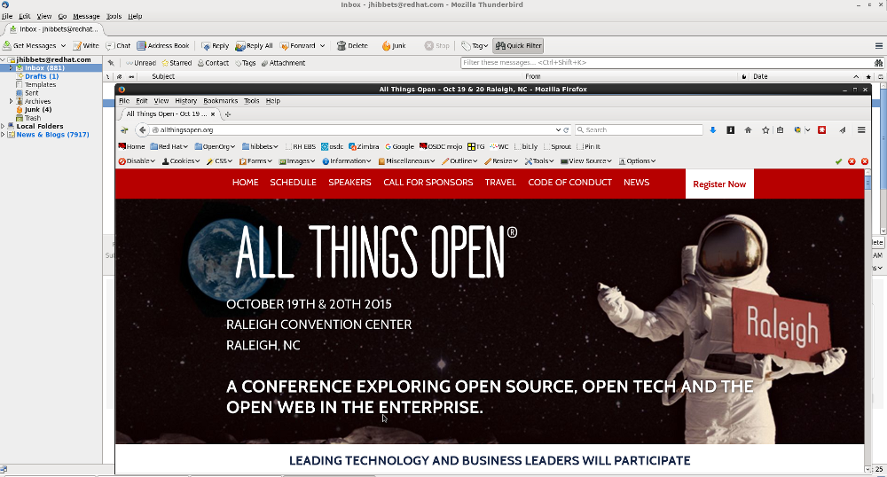
Thunderbird & Firefox from Mozilla
Image credits: Jason Hibbets desktop

Slide 16

Office suite – Libre Office
Image credits: http://www.libreoffice.org/

Slide 17
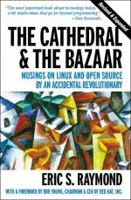
2) Read a book about open source
The Cathedral and the Bazaar, by Eric S. Raymond
Free Software, Free Society, by Richard M. Stallman
Rebel Code, by Glyn Moody
Producing Open Source Software, by Karl Fogel
Image credits: http://www.1000manifestos.com/eric-raymond-the-cathedral-and-the-bazaar/

Slide 18

Image credits: http://theopensourcecity.com

Slide 19
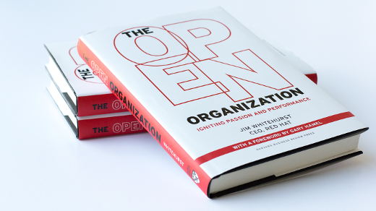
https://opensource.com/open-organization/ | #TheOpenOrg
Image credits: https://opensource.com/open-organization/

Slide 20
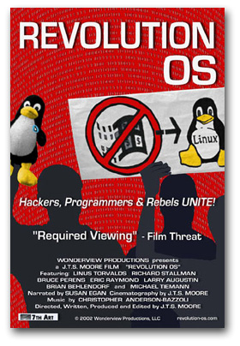
3) Watch a movie
www.revolution-os.com

Slide 21
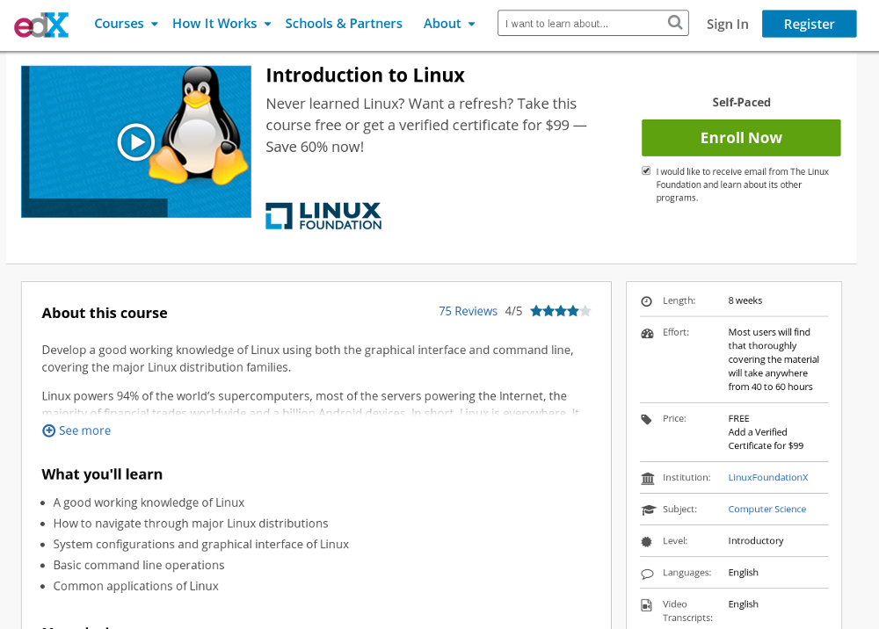

4) Take a class on Linux
Screenshot credits: https://www.edx.org/course/introduction-linux-linuxfoundationx-lfs101x-2#.U_9_rEhy-Cg
Image credits: http://opensource.com/business/14/8/newbie-learns-linux

Slide 22
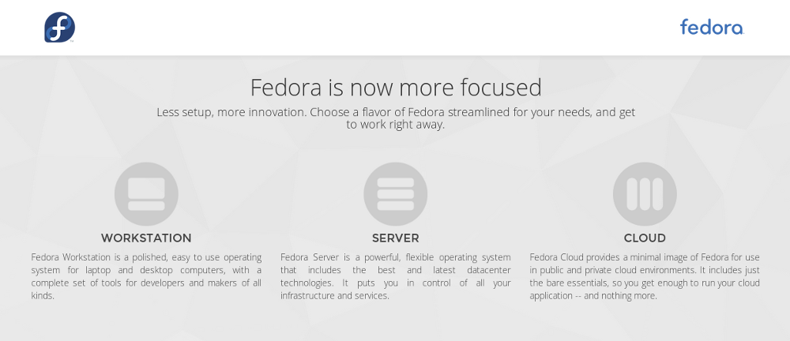
5) Install Linux
https://getfedora.org/en/
Screenshot credits: https://getfedora.org/en/

Slide 23
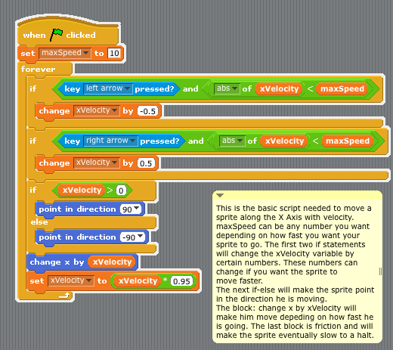
6) Learn to program
Scratch, a programming language for kids
http://opensource.com/education/12/10/scratch-programming-language-kids
Image credits: http://en.wikibooks.org/wiki/Scratch/Lessons/Movement
Notes:
Girl Develop IT
CoderDojos

Slide 24
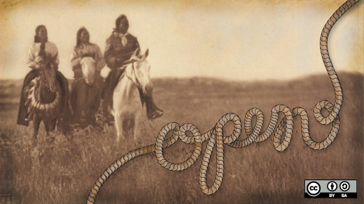
7) Get creative
GNU Image Manipulation Program (GIMP)
Scribus
MyPaint
Inskape
Audacity
Blender
Dream Studio
TuxPaint
KDEnlive
A look back at open source creative tools in 2012
http://opensource.com/life/13/1/open-source-design-tools-review-2012

Slide 25
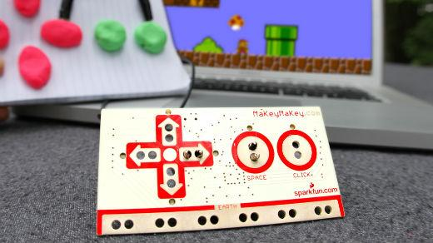
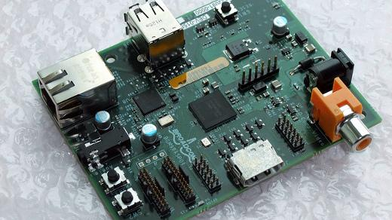
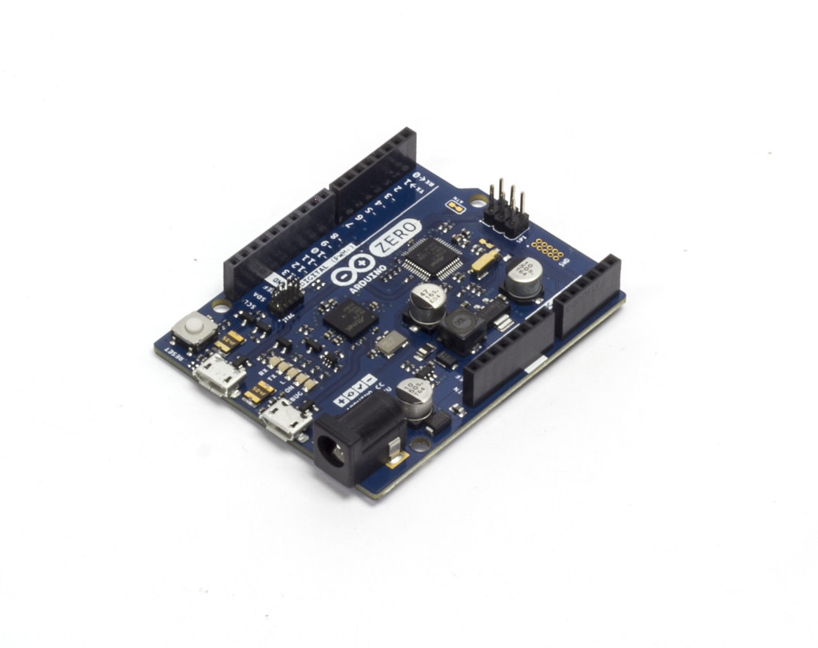
8) DIY & create something
Image credits: MaKey MaKey
Image credits: Raspberry Pi by blogeee.net
http://www.flickr.com/photos/13815526@N02/6055754448/
Image credits: https://www.arduino.cc/
Notes:
Automated lawn watering systems
GPS unit
Home made juke boxes
Musical holiday light shows

Slide 26
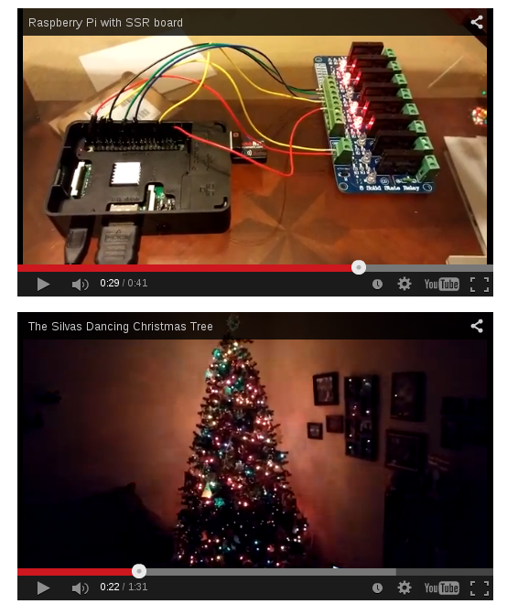
Image credits (and howto) - http://opensource.com/life/15/2/music-light-show-with-raspberry-pi

Slide 27

9) Join an open source project
Repositories: Github, SourceForge
Wanted:
project managers
designers
writers
marketers
other skills
and yes...coders
Image credits: http://opensource.com/life/12/3/its-scary-join-open-source-project

Slide 28
10) Attend a conference (and meet some people)
National Day of Civic Hacking – Durham, NC (June)
CityCamp NC – Raleigh, NC (September)
All Things Open – Raleigh, NC (October)
NC Datapalooza – Raleigh, NC (November)

Slide 29
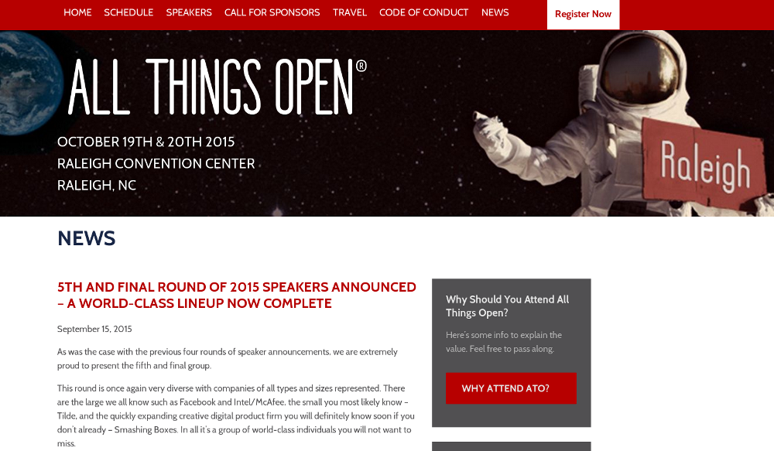
All Things Open
October 26-27 | Raleigh Convention Center | allthingsopen.org
Image credits: http://allthingsopen.org/

Slide 30
Image credits: http://www.flickr.com/photos/opensourceway/5752191750/

Slide 31

Twitter: @jhibbets
Email: jhibbets@redhat.com
or: jhibbets@gmail.com
Slides: https://github.com/jhibbets/presentations
Book: http://theopensourcecity.com
Image credits: http://www.flickr.com/search/?w=47691521@N07&q=lolcat

